Slide 1
2022-2026 Highway Program Development
February 9, 2021

Slide 2
February 9, 2021
Overview
Discuss Highway Program Development Process
Discuss 2022-2026 Highway Program Development Schedule
Discuss Extended Highway Program Analysis
Discuss Statewide Line Items
At what levels should the line item targets be programmed?
Discuss Federal Funding
Discuss Program Objectives/Priorities/Considerations

Slide 3
Highway Program Development Process
February 9, 2021
Public Policy and Input
What direction do we have?
Transportation Plans
What type of system do we need?
Performance Monitoring
Are we successful?
Five-Year Program
What projects will be done and when?

Slide 4
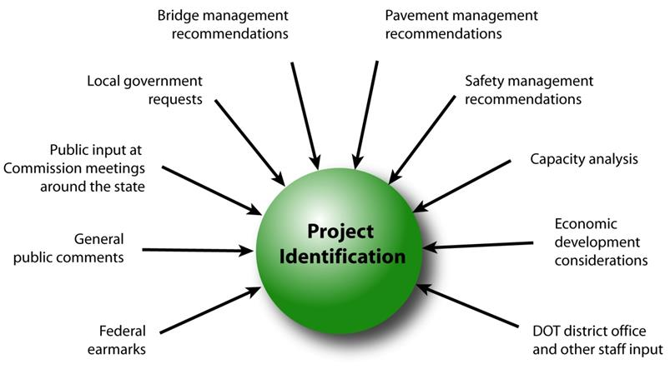
February 9, 2021
Step 1: Project identification

Slide 5
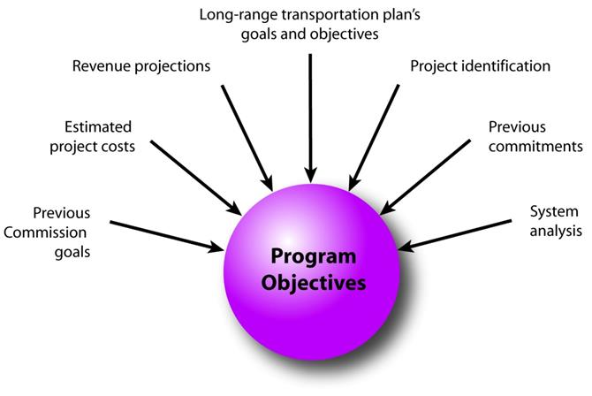
February 9, 2021
Step 2: Establishing the Transportation Commission’s annual programming objectives

Slide 6
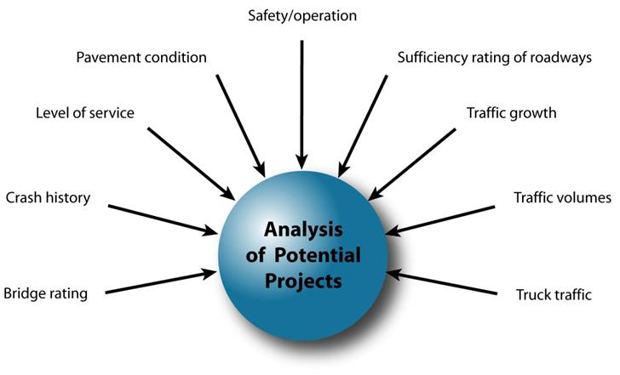
February 9, 2021
Step 3: Evaluating potential project candidates

Slide 7
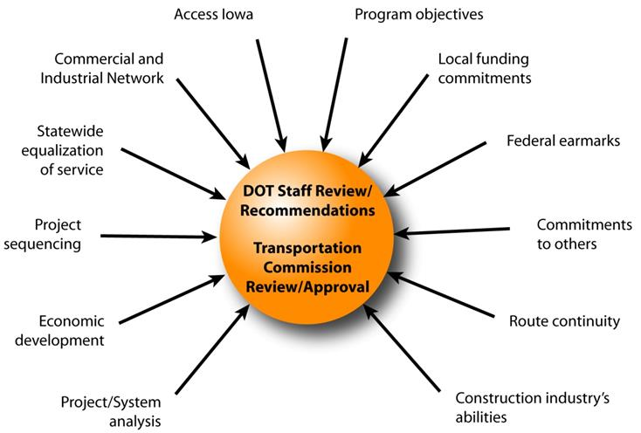
February 9, 2021
Step 4: Developing the final program

Slide 8
February 9, 2021
Commission Program Development Schedule (2022-2026)
February 2021
Discuss Highway Program Development Process
Discuss 2022-2026 Highway Program Development Schedule
Discuss Extended Highway Program Analysis
Discuss Statewide Line Items
At what levels should the line item targets be programmed?
Discuss Federal Funding
Discuss Program Objectives/Priorities/Considerations
March 2021
Discuss 2022-2026 available Highway Program funding
Discuss 2022-2026 Highway Program Options
Determine 2022-2026 Highway Program Objectives
Action Item: Line Item Targets for Programming
April 2021
Develop the Draft 2022-2026 Highway Program
Action Item: 2022-2026 Highway Program Objectives
May 2021
Present the Draft 2022-2026 Iowa Transportation Improvement Program to the public
(including all previous program approvals and draft 2022–2026 Highway Program)
June 2021
Action Item: Approve the 2022–2026 Iowa Transportation Improvement Program

Slide 9
2021-2030 Highway Program Analysis
For Highway Planning Purposes Only (x $1,000,000)
February 9, 2021
as presented May 12, 2020
Proposed Highway Program Extended Highway Program
2021 2022 2023 2024 2025 2026 2027 2028 2029 2030
Projected Funds as of March 2020 826.3 675.2 700.7 693.8 686.2 686.2 686.2 686.2 686.2 686.2
Highway Program Components
Interstate Stewardship 242.1 182.0 146.2 152.8 177.3 170.0 175.0 180.0 185.0 190.0
Non-Interstate Pavement Modernization 105.7 115.0 140.0 145.0 150.0 155.0 165.0 175.0 185.0 190.0
Non-Interstate Bridge Modernization 64.1 65.0 101.3 109.5 125.9 140.0 155.0 170.0 185.0 190.0
Safety Specific 25.6 25.0 25.0 25.0 25.0 25.0 25.0 25.0 25.0 25.0
Non-Interstate Capacity/System Enhancement 125.0 137.8 226.7 217.6 102.1
US 61 Des Moines N of Mediapolis to N of IA 78 24.8 0.1
US 30 Missouri Valley bypass 12.6 27.0
US 61 1 mi N of IA 78 to 2 mi S of IA 92 42.9 51.5
US 63 NW Oskaloosa bypass 12.3 0.3
Major Interstate Capacity/System Enhancement 280.1 200.5 111.8 68.9 125.4
I-35 Polk/Story 2.0 1.0
I-80 Dallas 0.2
I-80 Cedar (scaled back to just include replacement of Sugar Creek bridges)
I-80 Scott Mississippi River Bridge 50.0 50.0
Highway Program Balance (16.3) (50.1) (50.3) (25.0) (19.5) 51.4 87.8 84.7 106.2 91.2
Black: Previous discussion
( ): Indicates Highway Program is over-programmed
Green: Changes since previous discussion

Slide 10
2022-2031 Highway Program Analysis
For Highway Planning Purposes Only (x $1,000,000)
February 9, 2021
Proposed Highway Program Extended Highway Program
2022 2023 2024 2025 2026 2027 2028 2029 2030 2031
Projected Funds as of March 2020 675.2 700.7 693.8 686.2 686.2 686.2 686.2 686.2 686.2 686.2
Highway Program Components
Interstate Stewardship 182.0 146.2 152.8 177.3 170.0 175.0 180.0 185.0 190.0
Non-Interstate Pavement Modernization 115.0 140.0 145.0 150.0 155.0 165.0 175.0 185.0 190.0
Non-Interstate Bridge Modernization 65.0 101.3 109.5 125.9 140.0 155.0 170.0 185.0 190.0
Safety Specific 25.6 25.0 25.0 25.0 25.0 25.0 25.0 25.0 25.0
Non-Interstate Capacity/System Enhancement 137.8 226.7 217.6 102.1
US 61 Des Moines N of Mediapolis to N of IA 78 24.8 0.1
US 30 Missouri Valley bypass 12.6 27.0
US 61 1 mi N of IA 78 to 2 mi S of IA 92 42.9 51.5
US 63 NW Oskaloosa bypass 12.3 0.3
Major Interstate Capacity/System Enhancement 200.5 111.8 68.9 125.4
I-35 Polk/Story 2.0 1.0
I-80 Dallas 0.2
I-80 Cedar (scaled back to just include replacement of Sugar Creek bridges)
I-80 Scott Mississippi River Bridge 50.0 50.0
Highway Program Balance (50.1) (50.3) (25.0) (19.5) 51.4 87.8 84.7 106.2 91.2
Black: Previous discussion
( ): Indicates Highway Program is over-programmed
Green: Changes since previous discussion

Slide 11
February 9, 2021
 | DRAFT 2022 - 2026 IOWA HIGHWAY PROGRAM
 |  |  |  | PROJECT ESTIMATED COSTS X $1000
 | LOCATION | FUNDING | TYPE OF WORK | 2021 | 2022 | 2023 | 2024 | 2025
 | AMERICANS WITH DISABILITIES ACT |  | MISCELLANEOUS | 3000 | 3000 | 3000 | 3000 | 3000
 | CONSTRUCTION INDUSTRY TRAINING PROGRAM |  | MISCELLANEOUS | 1000 | 1000 | 1000 | 1000 | 1000
 | COOPERATIVE CITY/COUNTY/STATE HIGHWAY RESEARCH |  | MISCELLANEOUS | 1500 | 1500 | 1500 | 1500 | 1500
 | COOPERATIVE CITY/COUNTY/STATE HIGHWAY RESEARCH |  | MISCELLANEOUS | 250 | 500 | 750 | 1000 | 1000
 | EMERGENCY & CONTINGENCY - U-STEP/C-STEP |  | MISCELLANEOUS | 6000 | 6000 | 6000 | 6000 | 6000
 | POST LETTING PROJECT COST |  | MISCELLANEOUS | 20000 | 20000 | 20000 | 20000 | 20000
 | PREVOCATIONAL TRAINING AND DBE SUPPORT SERVICES |  | MISCELLANEOUS | 360 | 360 | 360 | 360 | 360
 | SCENIC BYWAY PROGRAM |  | MISCELLANEOUS | 500 | 500 | 500 | 500 | 500
 | STATEWIDE CONSULTANT SERVICES |  | OUTSIDE SERV. ENGINEER | 85000 | 85000 | 85000 | 85000 | 85000
 | STATEWIDE CONTRACT MAINTENANCE |  | MISCELLANEOUS | 35350 | 35350 | 35350 | 35350 | 35350
 | STATEWIDE CONTRACT MAINTENANCE |  | MISCELLANEOUS | 500 | 1000 | 1500 | 2000 | 2500
 | STATEWIDE RAILROAD CROSSINGS |  | MISCELLANEOUS | 500 | 500 | 500 | 500 | 500
 | STATEWIDE ROADSIDE IMPROVEMENT |  | LANDSCAPING | 2500 | 2500 | 2500 | 2500 | 2500
 | STATEWIDE TRAFFIC CONTROL DEVICES |  | TRAFFIC SIGNS | 10000 | 10000 | 10000 | 10000 | 10000
At what levels should the line item targets be programmed?

Slide 12
February 9, 2021
as approved April 14, 2020
FY 2021-2025 Highway Program Objectives
Projects in the 2021-2024 Highway Program will continue to be programmed with cost and schedule updates
Investment Area: Stewardship through maintaining a state of good repair
Maintain increasing Interstate funding levels for pavement reconstruction, modernization, bridges, pavement patching/maintenance, rest areas, and other miscellaneous projects
Maintain increasing funding levels for non-interstate pavement modernization
Maintain increasing funding levels for non-interstate bridge modernization
Maintain funding levels for safety
Invest in additional stewardship projects
Investment Area: Modification through rightsizing the system
Transfer of jurisdiction for portions of primary roadways to cities and counties
Investment Area: Optimization through improving operational efficiency and resiliency
Invest in intelligent transportation systems infrastructure
Invest in Super-2 improvements
Investment Area: Transformation through increasing mobility and travel choices
Invest in corridor improvements

Slide 13
February 9, 2021
Federal Funding Status
The FAST Act authorizes federal funding through September 30, 2021.
FAST Act funding allocations were determined by Commission in 2016.
The next Highway Trust Fund cliff is in 2022, leaving uncertainty in all but one year of this next five-year program.
Contingency plan has been developed should significant reduction in federal funding occur. Continue to identify specific project impacts with this Program.
Recent annual appropriations have included additional funding beyond authorized levels.

Slide 14
February 11, 2020
Program Development Considerations
Long-term COVID-19 impacts on state RUTF
Negative program balances in FY 2022
Continue to increase bridge and pavement stewardship investments on existing highway system
Increase safety target
Balance capacity improvements with stewardship needs
Address increasing safety/operational needs on the Interstate
Address major river crossing needs
Continue to complete existing priority corridors

Slide 15
February 9, 2021
Highway Program Candidates
For Highway Planning Purposes Only (x $1,000,000)
 | 2022 | 2023 | 2024 | 2025 | 2026 | 2027 | 2028 | 2029 | 2030 | Beyond | Total | Score | Rank
Major Interstate Capacity/System Enhancement (MI funds)
I-35 Story: N of IA 210 to E 13th St in Ames |  |  |  |  | 4.9 | 30.7 | 39.3 | 67.6 | 1.2 |  | 143.7
I-80 Scott: Middle Road Interchange (4R or MI)
I-380 Johnson: Segment 1 N of Forevergreen Rd to N of Penn St |  | 8.3 | 10.5 | 11.0 |  |  |  |  |  |  | 29.8
I-380 Johnson: Segment 2 N of Penn St to N of Iowa River |  |  |  |  |  |  |  | 40.0 | 46.1 | 27.0 | 113.1
I-380 Johnson: Segment 3 N of Iowa River to N of 120th St NW |  |  |  |  |  |  | 17.8 | 10.2 |  |  | 28.0
I-380 Linn: Segment 4 N of 120th St NW to US 30 |  |  |  |  |  | 33.5 | 19.2 |  |  |  | 52.7
I-380 Linn: Blairs Ferry Road to County Home Road (add lanes) |  |  |  |  |  |  |  |  | 15.4 | 32.5 | 47.9
Stewardship (Shelf-Ready) Projects | 100.0 | 100.0 | 100.0 | 100.0 | 100.0 |  |  |  |  |  | 500.0
Subject to change as additional information becomes available

Slide 16
Highway Program Candidates
For Highway Planning Purposes Only (x $1,000,000)
February 9, 2021
 |  |  |  |  |  |  |  |  |  | Score
 | 2022 | 2023 | 2024 | 2025 | 2026 | 2027 | Beyond |  | Score | Rank
Non-Interstate Capacity/System Enhancement (NR funds)
Stewardship
IA 2 Fremont: Resiliency improvements (Phase II) IA 12 Woodbury: Gordon Drive bridge in Sioux City |  | 3.5
 |  |  |  |  |  |  | TBD
IA 21 Iowa: South of Belle Plaine |  |  |  | 5.0
US 34 Mills: Resiliency improvements (could be ER) | TBD
US 34 Wapello: Wildwood Dr to US 63 in Ottumwa |  |  |  |  | 30.8
US 67 Scott: Mississippi River Bridge |  |  |  |  |  |  | 110.0
US 75 Sioux: N of Sioux Center to US 18 |  |  |  | 10.0
IA 76 Clayton: McGregor | 4.5
Polk: Traffic Incident Management (TIM) Training Center |  |  | TBD | TBD
ITS (multiple locations statewide) | TBD
Culverts (multiple locations statewide) | TBD
Slide Repairs (multiple locations statewide) | TBD
Subject to change as additional information becomes available

Slide 17
Highway Program Candidates
For Highway Planning Purposes Only (x $1,000,000)
February 9, 2021
 |  |  |  |  |  |  |  |  | Priority |  | Score
 | 2022 | 2023 | 2024 | 2025 | 2026 | 2027 | 2028 | Beyond | Corridor | Score | Rank
Non-Interstate Capacity/System Enhancement (NR funds)
Capacity
US 18 Kossuth/Hancock: East of Algona to Hutchins (Super-2) | 5.5 |  |  |  |  |  |  |  | N
US 30 Cedar/Clinton: ECL Mechanicsville to ECL Clarence (Super-2) |  |  |  |  | TBD | TBD |  |  | Y
US 63 Tama: Toledo to Co Rd E29 (Super-2) |  |  |  | 9.0 |  |  |  |  | N
Potential Transfer of Jurisdictions (NR funds)
US 6 Pottawattamie: 6th St in Council Bluffs east to I-80 |  | 13.0
IA 81 Van Buren: Missouri State Line to IA 2 | TBD
Subject to change as additional information becomes available

Slide 18
Next Steps
February 9, 2021
Discuss 2022-2026 available Highway Program funding
Discuss 2022-2026 Highway Program Options
Determine 2022-2026 Highway Program Objectives
Action Item: Line Item Targets for Programming

