Slide 1
Des Moines Integrated Corridor Management - Update
February 2022
Iowa Transportation Commission

Slide 2
What is Integrated Corridor Management (ICM)?
Framework for multiple modes of transportation
Based on a proactive, integrated management and operation of a regional transportation system
Delivered in a cost-effective manner compared to traditional infrastructure capacity expansion projects
Notes:
Framework for multi-modal, multi-jurisdictional coordination to deliver a safer, more reliable, and more convenient transportation system for all users
Based on proactively managing and operating a regional transportation system as a network instead of individual roadways
Delivered in a more cost-effective manner compared to traditional infrastructure capacity expansion projects

Slide 3
Approach

Slide 4
Why ICM for Des Moines Metropolitan Area?
RECURRING
CONGESTION
28%
RECURRING
CONGESTION
45%
28%
NON-RECURRING
CONGESTION
72%
NON-RECURRING
CONGESTION
55%
Notes:
Traditional widening project focus too narrowly on recurring congestion.
When national research has show that non-recurring congestion makes up more than half of all congestion.
As we can see bad weather and traffic incidents, as part of non-recurring congestion, are larger culprits in Iowa than nationwide.
ICM strategies are more suited for dealing with this non-recurring congestion.
Furthermore:
The Des Moines Metro area is one of the fastest growing metros in the State
We can no longer afford to always build our way out of congestion
We need to find a more sustainable solution to handle the increased traffic demand

Slide 5
ICM Approach
Major Reconstruction Costs: $439M
NEW ICM Costs: $452M
Build as usual with some ICM
TOTAL COSTS: $0.9B by 2050
TOTAL COSTS: $2.3B
$1.4B Cost Savings
Notes:
The preferred approach cost is projected at $900 M by 2050
The comparison approach which is our traditional way of doing business with some ICM strategies added in costs $2.3 B
Therefore, the preferred bundle is a better way forward because our regional analysis shows that we can mitigate 2050 traffic volumes by focusing more heavily on ICM Strategies with a significant reduction in cost.

Slide 6
ICM Goals
Notes:
Some of our goals for the ICM project include improving:
Safety - Reduce fatalities and serious injuries on public roads in the region
Mobility - Provide options to travelers that minimize time spent traveling
Travel Time Reliability - Improve efficiency and predictability of travel in the region
Accessibility - Improve traveler’s overall ability to reach key destinations such as jobs, schools, libraries, health care, shopping, and entertainment
Project delivery time – Be able to deliver identified strategies in a timely manner
Improve public visibility and build support/momentum for the project

Slide 7
Collaboration is key
Notes:
ICM can only be successful when all parties involved work together, that’s why we are taking a collaborative approach to this project with stakeholders from:
Des Moines Area MPO
Federal Highway Administration
DART
Local Jurisdictions – Consisting of 13 cities, 3 counties, first responders, enforcement, and various business groups
Together we are working on solutions that will benefit not just the freeways, but the entire metro area.

Slide 8
ICM Program Elements
Notes:
This slide shows the how ICM is a system composed of 7 different program elements
Each of these program elements host its own list of strategies
When these strategies are coordinated and working together, we see the benefits of Integrated Corridor Management
Note the different colors of the 7 program elements as they correlate with our recommended ICM implementations map on the next slide
Note that each program element adds to key, transportation customer issues?
What choices do I have to travel
How long should I plan for my travel
I’ve run into a delay - How will travel be restored to a functioning condition
Note the colors

Slide 9
Update on status of the Des Moines Metro ICM

Slide 10
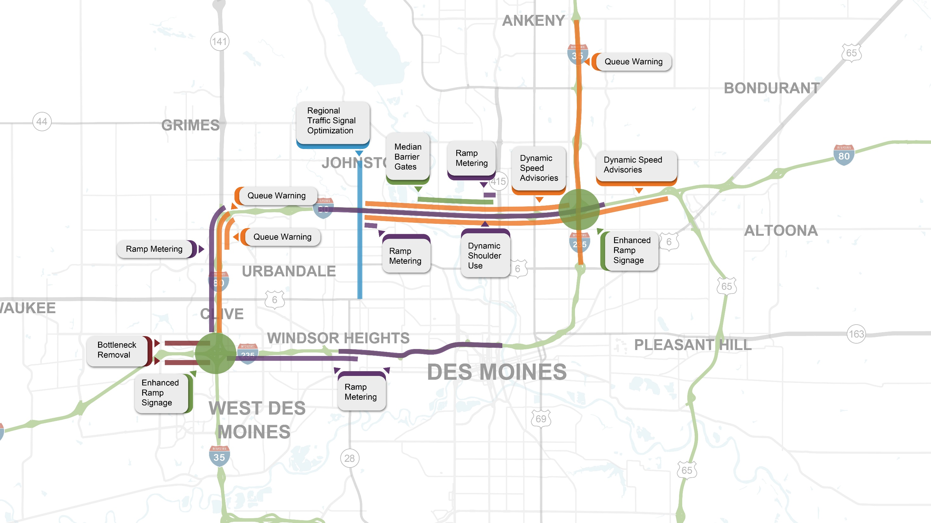
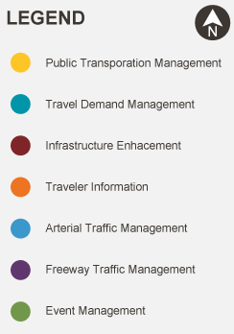
Recommended ICM Implementation
In 2019, ramp metering could have alleviated freeway breakdowns (speeds 15 mph below the speed limit) present on nearly 150 days
Proposed ICM projects have overlapping boundaries and are offset for readability.
Notes:
Installed:
Enhanced Ramp Signage
Design:
Median Barrier Gates
Interstate 35/80 Queue Warning (with Hickman Road)
Interstate 235 Ramp Metering
Interstate 35/80 Dynamic Shoulder Use
Study:
Regional Signal Optimization – Merle Hay
Transit Signal Priority – University Avenue Corridor
To Remove (see comment)
Ramp Queue Mitigation – Oralabor Rd
Interstate 235 and Interstate 35 Queue Warning
First wave of implementation is where the most traffic is – freeways, etc. DOT-led projects. Eventually later waves will include other items.

Slide 11
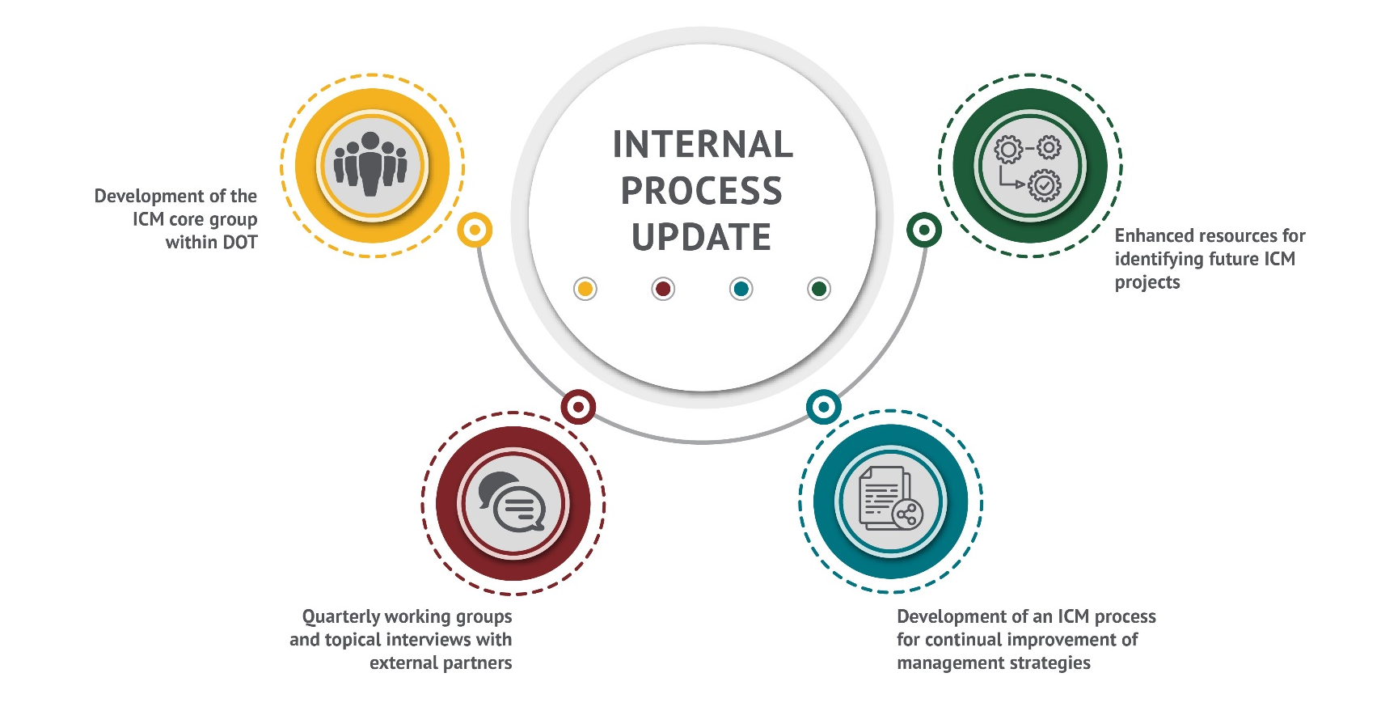
Internal Process Update
Notes:
Yellow – Started an ICM core group with DOT that meets weekly to keep important project issues moving forward
Red – Hold Quarterly working group meetings with our local stakeholders (Freeway Solutions, Green Light, and Personal Mobility)
Blue – Performance Measures collected and reported. TSMO process guide steps/meetings
Green – Enhanced resources like facts sheets/job aids to create awareness in the department for future ICM projects

Slide 12
Future Vision Areas
Notes:
Orange – Development of a funding plan – look at State/local corridor as well as areas that do not fit into a specific corridor
Blue – Development of MPO support tools for targeting corridors with ICM need and a method for scoring projects well that contain an ICM components
Purple – Planning for an ICM performance management system that will measures the system’s performance and share data with our partners

Slide 13
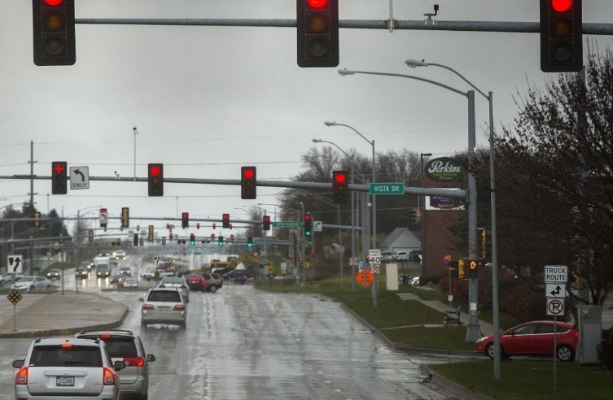
Traffic Signal Control
Funding Optimization Regularly
Plan Adaptive Deployments
Implement targeted Transit Signal Priority
Expand Regional Optimization Process – Iowa DOT ICAAP
Notes:
Along with the freeway strategies we have also been working with our stakeholders to develop some non-freeway/arterials ICM strategies.
The ICM team looked to regional signal optimization as an early win – and programmed improvements for the Merle Hay Rd. corridor to improve traffic flow for City of Johnston, Urbandale, and Des Moines across regional boundaries.
The vision going forward is to make those improvements regularly – reducing delays and number of stops through a combination of review of operations, improvements to equipment, and targeted improvements for transit.
The ICM project will develop a regional process to target priority corridors first and target strategies to operational needs

Slide 14
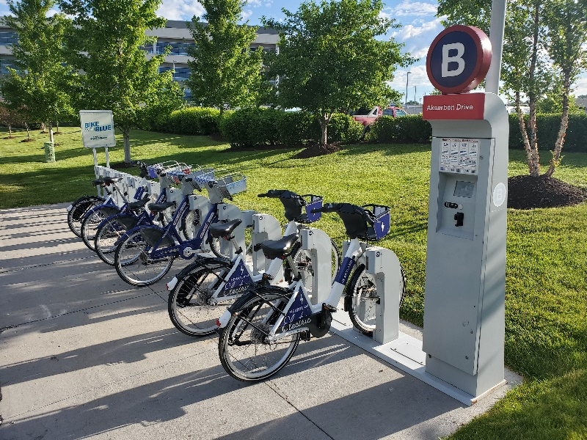
Transportation Demand Management
Reinvest in the past demand management campaigns
Advertised / On-Demand to Employers
Support Vanpool, Transit, Non-Motorized, and Telecommute Options
Notes:
Another major point of emphasis is travel demand management. Long term, the area is growing to a level that congestion on primary roadways and freeways during peak travel times is likely unless the demand for travel can be shifted to other times, other places, or other modes.
ICM in other regions has focused heavily on TDM and providing options to commuters. In Des Moines, the early 2000s included multiple successful demand management campaigns tied to the major Interstate 235 reconstruction project, so we look to build on that past success.
The goal will be to pull multiple agencies together to tackle this issue and provide a resource for the community of employers, particularly those served by major congested roadways. Understanding the needs of that community will make it easier to invest in key supportive infrastructure and policy (like vanpools and bike share or promoting telecommuting)

Slide 15
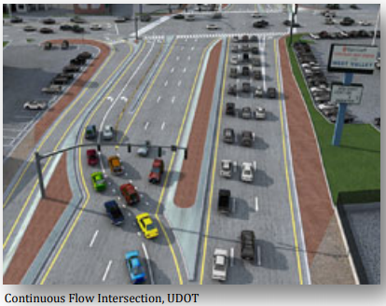
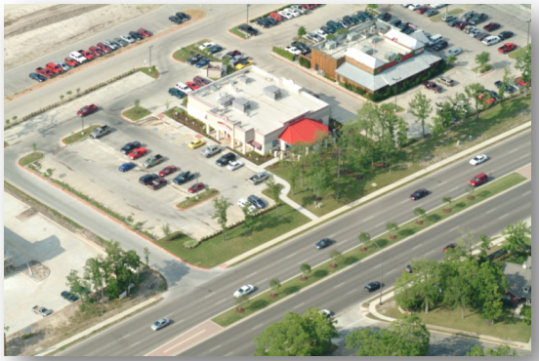
Infrastructure Enhancement - Arterials
Alternative Intersections
Primary Intersections
Access Management
Minor Intersections
Develop new system optimization / ICM prioritization process with DMAMPO
Notes:
Like traffic signal timing, arterial corridor bottlenecks are a major focus of ICM. In some cases those bottlenecks are due to a large number of access points. Other times, the intersection of two major corridors just carries too much traffic for a traditional intersection design.
The ICM will target corridors that can best serve additional auto traffic to offload the freeway during peaks and major events. The process will identify bottleneck issues and categorize them to either primary intersection improvements or access management of minor intersections and driveways. The corridors with the most potential capacity to move regional trips will receive priority.

Slide 16
Next Steps
Design Updates
Add queue warning for I-35 / I-80 near Hickman Road
Implement
Des Moines area DOT fiber optic network infrastructure
Program Design
I-35 / 80 dynamic (inside) shoulder use
Monitor
I-235 traffic volumes until conditions are right for ramp metering
Notes:
Design Updates – Adding queue warning system for I-35/80 from SW MixMaster to the Urban Loop as part of the Hickman Rd. Interchange project
Implement – Des Moines area DOT fiber optic network infrastructure will soon be proposed for inclusion in the program
Program Design – Dynamic Shoulder Use for I-35/80 (inside shoulder) for added capacity during peak periods/events
Monitor – I-235 traffic volumes until conditions warrant ramp metering (use tools created by Iowa State to help)

