Slide 1
2023-2027 Highway Program Development
February 8, 2022

Slide 2
February 8, 2022
Overview
Discuss Highway Program Development Process
Discuss 2023-2027 Highway Program Development Schedule
Discuss Extended Highway Program Analysis
Discuss Statewide Line Items
At what levels should the line item targets be programmed?
Discuss Federal Funding
Discuss Program Objectives/Priorities/Considerations

Slide 3
Highway Program Development Process
February 8, 2022
Public Policy and Input
What direction do we have?
Transportation Plans
What type of system do we need?
Performance Monitoring
Are we successful?
Five-Year Program
What projects will be done and when?

Slide 4
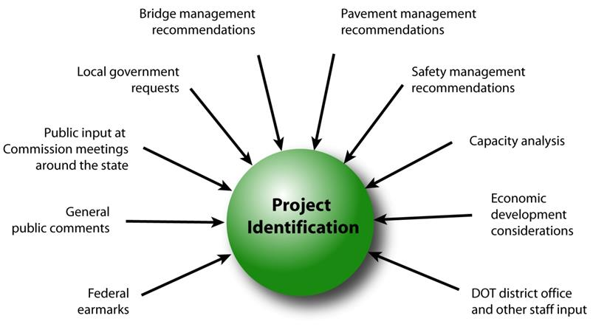
February 8, 2022
Step 1: Project identification

Slide 5
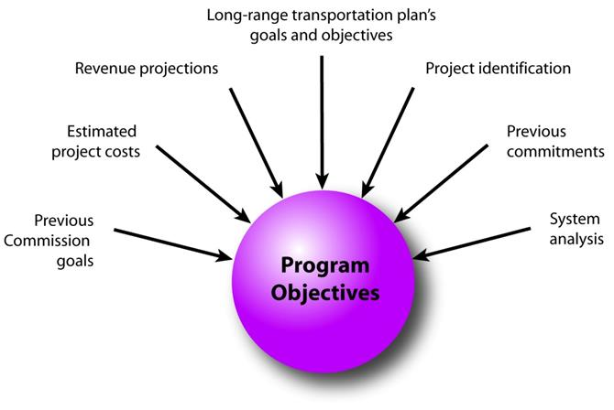
February 8, 2022
Step 2: Establishing the Transportation Commission’s annual programming objectives

Slide 6
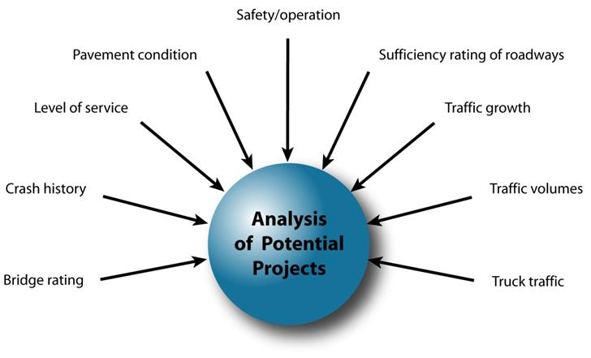
February 8, 2022
Step 3: Evaluating potential project candidates

Slide 7
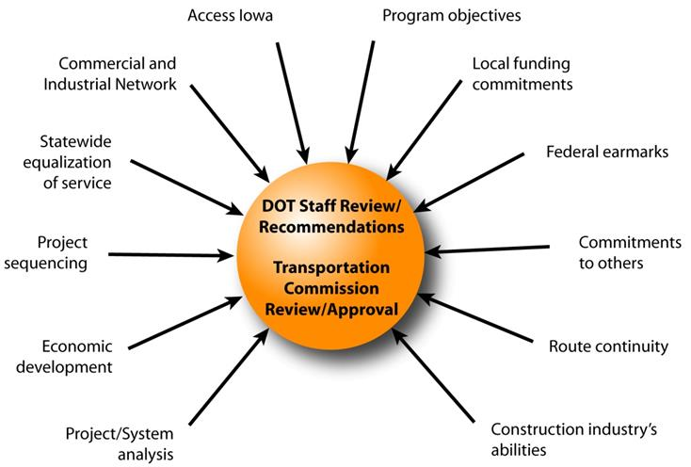
February 8, 2022
Step 4: Developing the final program

Slide 8
February 8, 2022
Commission Program Development Schedule (2023-2027)
February 2022
Discuss Highway Program Development Process
Discuss 2023-2027 Highway Program Development Schedule
Discuss Extended Highway Program Analysis
Discuss Statewide Line Items
At what levels should the line item targets be programmed?
Discuss Federal Funding
Discuss Program Objectives/Priorities/Considerations
March 2022
Discuss 2023-2027 available Highway Program funding
Discuss 2023-2027 Highway Program Options
Determine 2023-2027 Highway Program Objectives
Action Item: Line Item Targets for Programming
April 2022
Develop the Draft 2023-2027 Highway Program
Action Item: 2023-2027 Highway Program Objectives
May 2022
Present the Draft 2023-2027 Iowa Transportation Improvement Program to the public
(including all previous program approvals and draft 2023–2027 Highway Program)
June 2022
Action Item: Approve the 2023–2027 Iowa Transportation Improvement Program

Slide 9
2022-2031 Highway Program Analysis
For Highway Planning Purposes Only (x $1,000,000)
Changes to Projected Funds
FY 2021 Projects Rescheduled
Rescheduling and cost changes of projects programmed in years 2022 to 2025, add 2026
Added highlighted projects
Additional project schedule changes
Adjustment for final non-Interstate pavement modernization costs
February 8, 2022
as presented April 12, 2021
Proposed Highway Program Extended Highway Program
2022 2023 2024 2025 2026 2027 2028 2029 2030 2031
Projected Funds as of March 2021 754.7 687.0 715.5 707.5 701.4 701.4 701.4 701.4 701.4 701.4
Highway Program Components
Interstate Stewardship 199.1 157.9 151.5 149.9 149.0 175.0 180.0 185.0 190.0 195.0
Non-Interstate Pavement Modernization 148.1 140.0 145.0 150.0 155.0 165.0 175.0 185.0 190.0 195.0
Non-Interstate Bridge Modernization 64.5 101.7 110.6 125.8 140.3 155.0 170.0 185.0 190.0 195.0
Safety Specific 31.9 31.0 32.0 33.0 34.0 35.0 36.0 37.0 38.0 39.0
Non-Interstate Capacity/System Enhancement 158.3 178.4 267.4 141.2 156.1
US 61 Des Moines N of Mediapolis to N of IA 78 0.4
US 30 Missouri Valley bypass 21.6 6.7
US 61 1 mi N of IA 78 to 2 mi S of IA 92 49.2
US 63 NW Oskaloosa bypass 0.2
US 75 Plymouth: Hinton 6.1
Major Interstate Capacity/System Enhancement 177.1 90.0 80.2 177.2 117.2
I-35 Polk/Story 1.2
I-80 Scott Mississippi River Bridge 50.0 50.0
I-80 Pottawattamie Madison Avenue 20.7 24.8
Highway Program Balance (24.3) (12.0) (71.2) (69.6) (50.2) 22.0 58.9 109.4 93.4 77.4
Black: Previous discussion
( ): Indicates Highway Program is over-programmed
Green: Changes since previous discussion

Slide 10
2022-2031 Highway Program Analysis
For Highway Planning Purposes Only (x $1,000,000)
Changes to Projected Funds
Project Additions/Deletions
February 8, 2022
Proposed Highway Program Extended Highway Program
2022 2023 2024 2025 2026 2027 2028 2029 2030 2031
Projected Funds as of March 2021 754.7 687.0 715.5 707.5 701.4 701.4 701.4 701.4 701.4 701.4
Infrastructure Bill 50.0
Projected Funds 804.7 687.0 715.5 707.5 701.4 701.4 701.4 701.4 701.4 701.4
Highway Program Components
Interstate Stewardship 199.1 157.9 151.5 149.9 149.0 175.0 180.0 185.0 190.0 195.0
Non-Interstate Pavement Modernization 148.1 140.0 145.0 150.0 155.0 165.0 175.0 185.0 190.0 195.0
Non-Interstate Pavement Modernization 50.4
Non-Interstate Bridge Modernization 64.5 101.7 110.6 125.8 140.3 155.0 170.0 185.0 190.0 195.0
Safety Specific 31.9 31.0 32.0 33.0 34.0 35.0 36.0 37.0 38.0 39.0
Safety Specific 5.0
Non-Interstate Capacity/System Enhancement 158.3 178.4 267.4 141.2 156.1
US 61 Des Moines N of Mediapolis to N of IA 78 0.4
US 30 Missouri Valley bypass 21.6 6.7
US 61 1 mi N of IA 78 to 2 mi S of IA 92 49.2
US 63 NW Oskaloosa bypass 0.2
US 75 Plymouth: Hinton 6.1
Major Interstate Capacity/System Enhancement 177.1 90.0 80.2 177.2 117.2
I-35 Polk/Story 1.2
I-80 Scott Mississippi River Bridge 50.0 50.0
I-80 Pottawattamie Madison Avenue 20.7 24.8
I-80 Pottawattamie Madison Avenue (4.5)
Highway Program Balance (25.2) (12.0) (71.2) (69.6) (50.2) 22.0 58.9 109.4 93.4 77.4
Black: Previous discussion
( ): Indicates Highway Program is over-programmed
Green: Changes since previous discussion

Slide 11
2022-2031 Highway Program Analysis
For Highway Planning Purposes Only (x $1,000,000)
Changes to Projected Funds
Includes Amendment
February 8, 2022
Proposed Highway Program Extended Highway Program
2022 2023 2024 2025 2026 2027 2028 2029 2030 2031
Projected Funds as of March 2021 754.7 687.0 715.5 707.5 701.4 701.4 701.4 701.4 701.4 701.4
Infrastructure Bill 50.0
Projected Funds 804.7 687.0 715.5 707.5 701.4 701.4 701.4 701.4 701.4 701.4
Highway Program Components
Interstate Stewardship 199.1 157.9 151.5 149.9 149.0 175.0 180.0 185.0 190.0 195.0
Non-Interstate Pavement Modernization 198.5 140.0 145.0 150.0 155.0 165.0 175.0 185.0 190.0 195.0
Non-Interstate Bridge Modernization 64.5 101.7 110.6 125.8 140.3 155.0 170.0 185.0 190.0 195.0
Safety Specific 36.9 31.0 32.0 33.0 34.0 35.0 36.0 37.0 38.0 39.0
Non-Interstate Capacity/System Enhancement 158.3 178.4 267.4 141.2 156.1
US 61 Des Moines N of Mediapolis to N of IA 78 0.4
US 30 Missouri Valley bypass 21.6 6.7
US 61 1 mi N of IA 78 to 2 mi S of IA 92 49.2
US 63 NW Oskaloosa bypass 0.2
US 75 Plymouth: Hinton 6.1
Major Interstate Capacity/System Enhancement 172.6 90.0 80.2 177.2 117.2
I-35 Polk/Story 1.2
I-80 Scott Mississippi River Bridge 50.0 50.0
I-80 Pottawattamie Madison Avenue 20.7 24.8
Highway Program Balance (25.2) (12.0) (71.2) (69.6) (50.2) 22.0 58.9 109.4 93.4 77.4
Black: Previous discussion
( ): Indicates Highway Program is over-programmed
Green: Changes since previous discussion

Slide 12
2023-2032 Highway Program Analysis
For Highway Planning Purposes Only (x $1,000,000)
February 8, 2022
Proposed Highway Program Extended Highway Program
2023 2024 2025 2026 2027 2028 2029 2030 2031 2032
Projected Funds as of March 2021 687.0 715.5 707.5 701.4 701.4 701.4 701.4 701.4 701.4
Infrastructure Bill
Projected Funds 687.0 715.5 707.5 701.4 701.4 701.4 701.4 701.4 701.4
Highway Program Components
Interstate Stewardship 157.9 151.5 149.9 149.0 175.0 180.0 185.0 190.0 195.0
Non-Interstate Pavement Modernization 140.0 145.0 150.0 155.0 165.0 175.0 185.0 190.0 195.0
Non-Interstate Bridge Modernization 101.7 110.6 125.8 140.3 155.0 170.0 185.0 190.0 195.0
Safety Specific 31.0 32.0 33.0 34.0 35.0 36.0 37.0 38.0 39.0
Non-Interstate Capacity/System Enhancement 178.4 267.4 141.2 156.1
US 61 Des Moines N of Mediapolis to N of IA 78 0.4
US 30 Missouri Valley bypass 21.6 6.7
US 61 1 mi N of IA 78 to 2 mi S of IA 92 49.2
US 63 NW Oskaloosa bypass 0.2
US 75 Plymouth: Hinton 6.1
Major Interstate Capacity/System Enhancement 90.0 80.2 177.2 117.2
I-35 Polk/Story 1.2
I-80 Scott Mississippi River Bridge 50.0 50.0
I-80 Pottawattamie Madison Avenue 20.7 24.8
Highway Program Balance (12.0) (71.2) (69.6) (50.2) 22.0 58.9 109.4 93.4 77.4
Black: Previous discussion
( ): Indicates Highway Program is over-programmed
Green: Changes since previous discussion

Slide 13
February 8, 2022
 | DRAFT 2023 - 2027 IOWA HIGHWAY PROGRAM
 |  |  |  | PROJECT ESTIMATED COSTS X $1000
 | LOCATION | FUNDING | TYPE OF WORK | 2023 | 2024 | 2025 | 2026 | 2027
 | AMERICANS WITH DISABILITIES ACT |  | MISCELLANEOUS | 3000 | 3000 | 3000 | 3000 | 3000
 | AMERICANS WITH DISABILITIES ACT |  | MISCELLANEOUS | 500 | 1000 | 1500 | 2000 | 2500
 | CONSTRUCTION INDUSTRY TRAINING PROGRAM |  | MISCELLANEOUS | 1000 | 1000 | 1000 | 1000 | 1000
 | COOPERATIVE CITY/COUNTY/STATE HIGHWAY RESEARCH |  | MISCELLANEOUS | 2000 | 2250 | 2500 | 2500 | 2500
 | EMERGENCY & CONTINGENCY - U-STEP/C-STEP |  | MISCELLANEOUS | 6000 | 6000 | 6000 | 6000 | 6000
 | POST LETTING PROJECT COST |  | MISCELLANEOUS | 20000 | 20000 | 20000 | 20000 | 20000
 | PREVOCATIONAL TRAINING AND DBE SUPPORT SERVICES |  | MISCELLANEOUS | 360 | 360 | 360 | 360 | 360
 | BYWAY PROGRAM |  | MISCELLANEOUS | 500 | 500 | 500 | 500 | 500
 | STATEWIDE CONSULTANT SERVICES |  | OUTSIDE SERV. ENGINEER | 85000 | 85000 | 85000 | 85000 | 85000
 | STATEWIDE CONSULTANT SERVICES |  | OUTSIDE SERV. ENGINEER | -9000 | -9000 | -9000 | -9000 | -9000
 | STATEWIDE OPERATIONS |  | OUTSIDE SERV. ENGINEER | 9000 | 9000 | 9000 | 9000 | 9000
 | STATEWIDE CONTRACT MAINTENANCE |  | MISCELLANEOUS | 36350 | 36850 | 37350 | 37850 | 38350
 | STATEWIDE RAILROAD CROSSINGS |  | MISCELLANEOUS | 500 | 500 | 500 | 500 | 500
 | STATEWIDE ROADSIDE IMPROVEMENT |  | LANDSCAPING | 2500 | 2500 | 2500 | 2500 | 2500
 | STATEWIDE TRAFFIC CONTROL DEVICES |  | TRAFFIC SIGNS | 10000 | 10000 | 10000 | 10000 | 10000
At what levels should the line item targets be programmed?
March Action Item: Line Item Targets for Programming

Slide 14
February 8, 2022 as presented
April 12, 2021
FY 2022-2026 Highway Program Objectives
Projects in the 2022-2025 Highway Program will continue to be programmed with cost and schedule updates
Investment Area: Stewardship through maintaining a state of good repair
Maintain increasing funding levels for safety
Maintain increasing Interstate funding levels for pavement reconstruction, modernization, bridges, pavement patching/maintenance, rest areas, and other miscellaneous projects
Maintain increasing funding levels for non-interstate pavement modernization
Maintain increasing funding levels for non-interstate bridge modernization
Invest in additional stewardship projects
Investment Area: Modification through rightsizing the system
Transfer of jurisdiction for portions of primary roadways to cities and counties
Investment Area: Optimization through improving operational efficiency and resiliency
Invest in intelligent transportation systems infrastructure
Invest in Super-2 improvements
Investment Area: Transformation through increasing mobility and travel choices
Invest in corridor improvements

Slide 15
February 8, 2022
Federal Funding Status
Infrastructure Bill authorizes federal funding through September 30, 2026.
Still operating under a continuing resolution for FY 2022 through Feb. 18, 2022
Infrastructure Bill funding allocations are yet to be determined with discussions underway leading to Commission action.
The next Highway Trust Fund cliff is in 2026/2027, leaving uncertainty in the last year of this next five-year program.

Slide 16
February 8, 2022
Program Development Considerations
Increase in funding from the Infrastructure Bill
Increasing construction costs (potential negative balance at the end of FY 2022)
Continue to increase bridge and pavement stewardship investments on existing highway system
Increase safety target
Balance capacity improvements with stewardship needs
Address increasing safety/operational needs on the Interstate
Address major river crossing needs
Continue to complete existing priority corridors

Slide 17
Next Steps
February 8, 2022
Discuss 2023-2027 available Highway Program funding
Discuss 2023-2027 Highway Program Options
Determine 2023-2027 Highway Program Objectives
Action Item: Line Item Targets for Programming

