Slide 1
COVID-19 Transportation Impact
Transportation Commission Workshop
February 8, 2022

Slide 2
Overview
Economic Recovery Index
Travel trends
US total rail carloads
Commercial air service passenger counts
Vehicular traffic

Slide 3
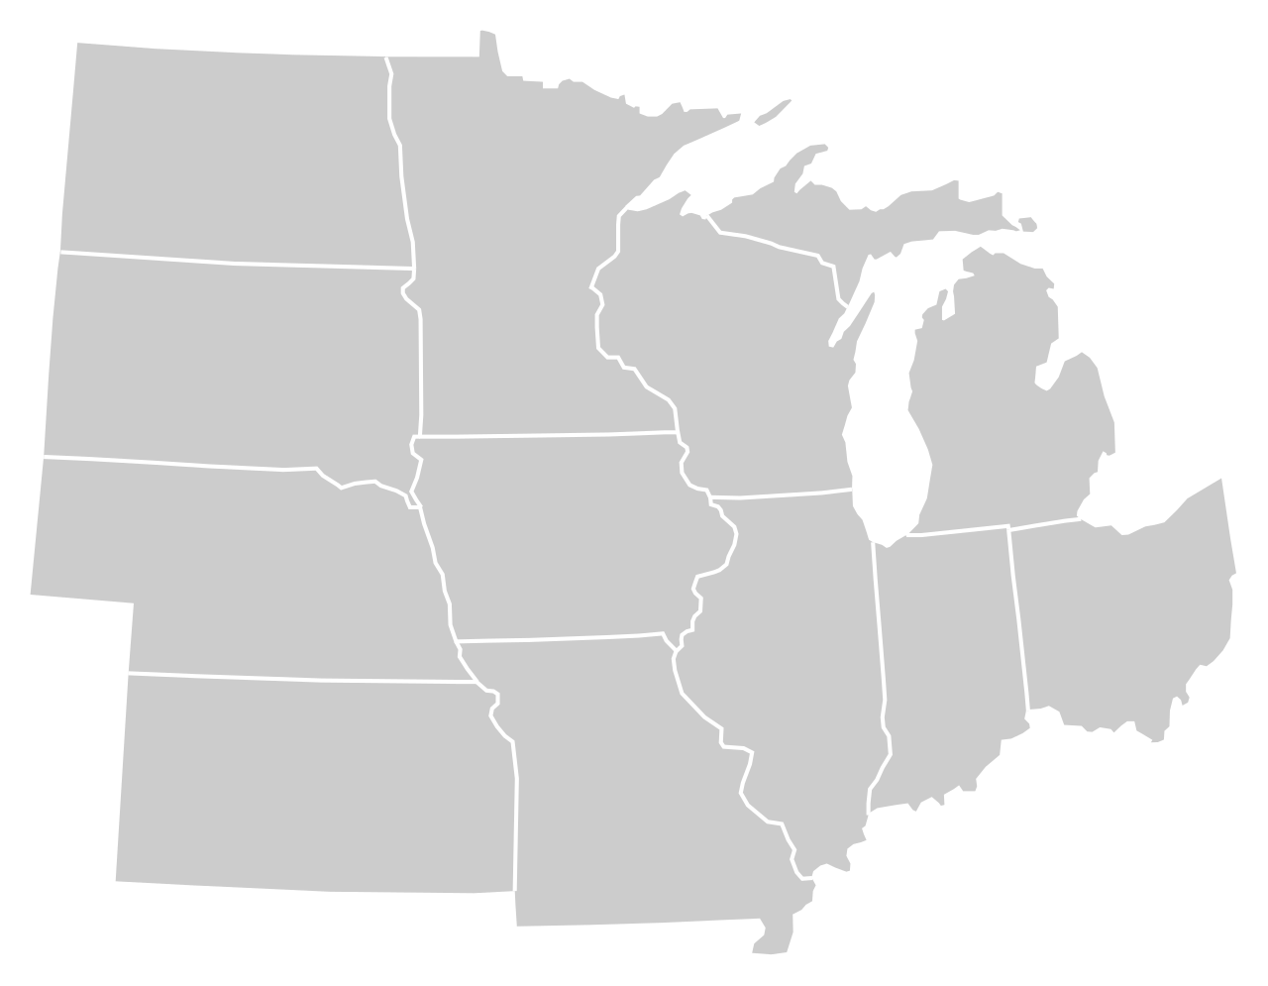
Moody’s/CNN Recovery Index - Midwest (Pre-Pandemic = 100) As of 2/4/2022
92%
89%
100%
93%
92%
94%
(87% last month)
96%
93%
84%
94%
93%
91%
Nation is at 91% (85% last month)

Slide 5
Monthly Passenger Counts at Iowa’s Eight Commercial Service Airports
(through December 2021)

Slide 7
Questions?

