Slide 1
Transportation Trends Update
Transportation Commission Workshop
February 14, 2023

Slide 2
Overview
U.S. total rail carloads
Commercial air service passenger counts
Vehicular traffic

Slide 4
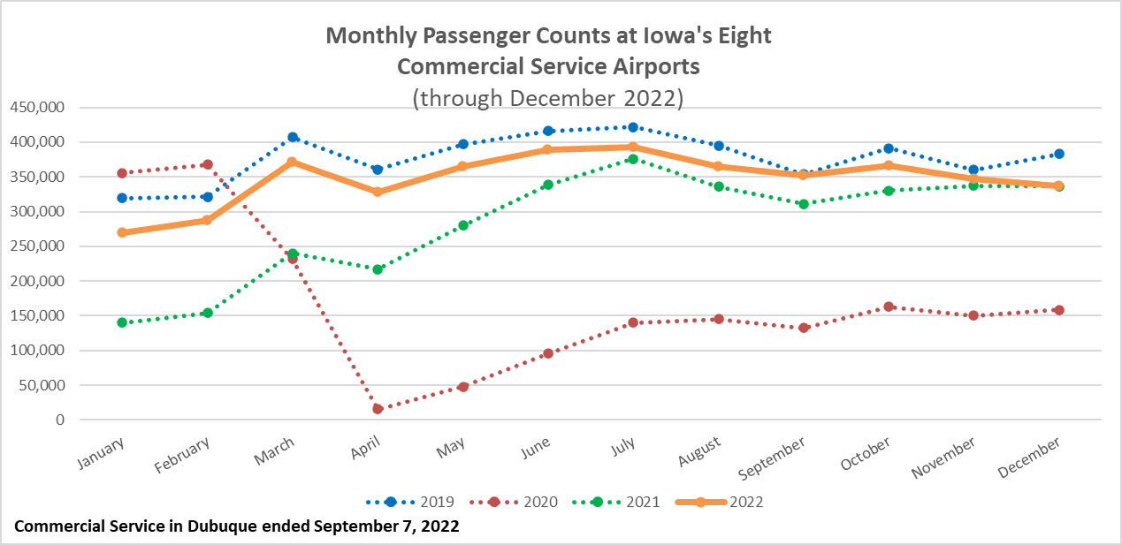

Slide 5
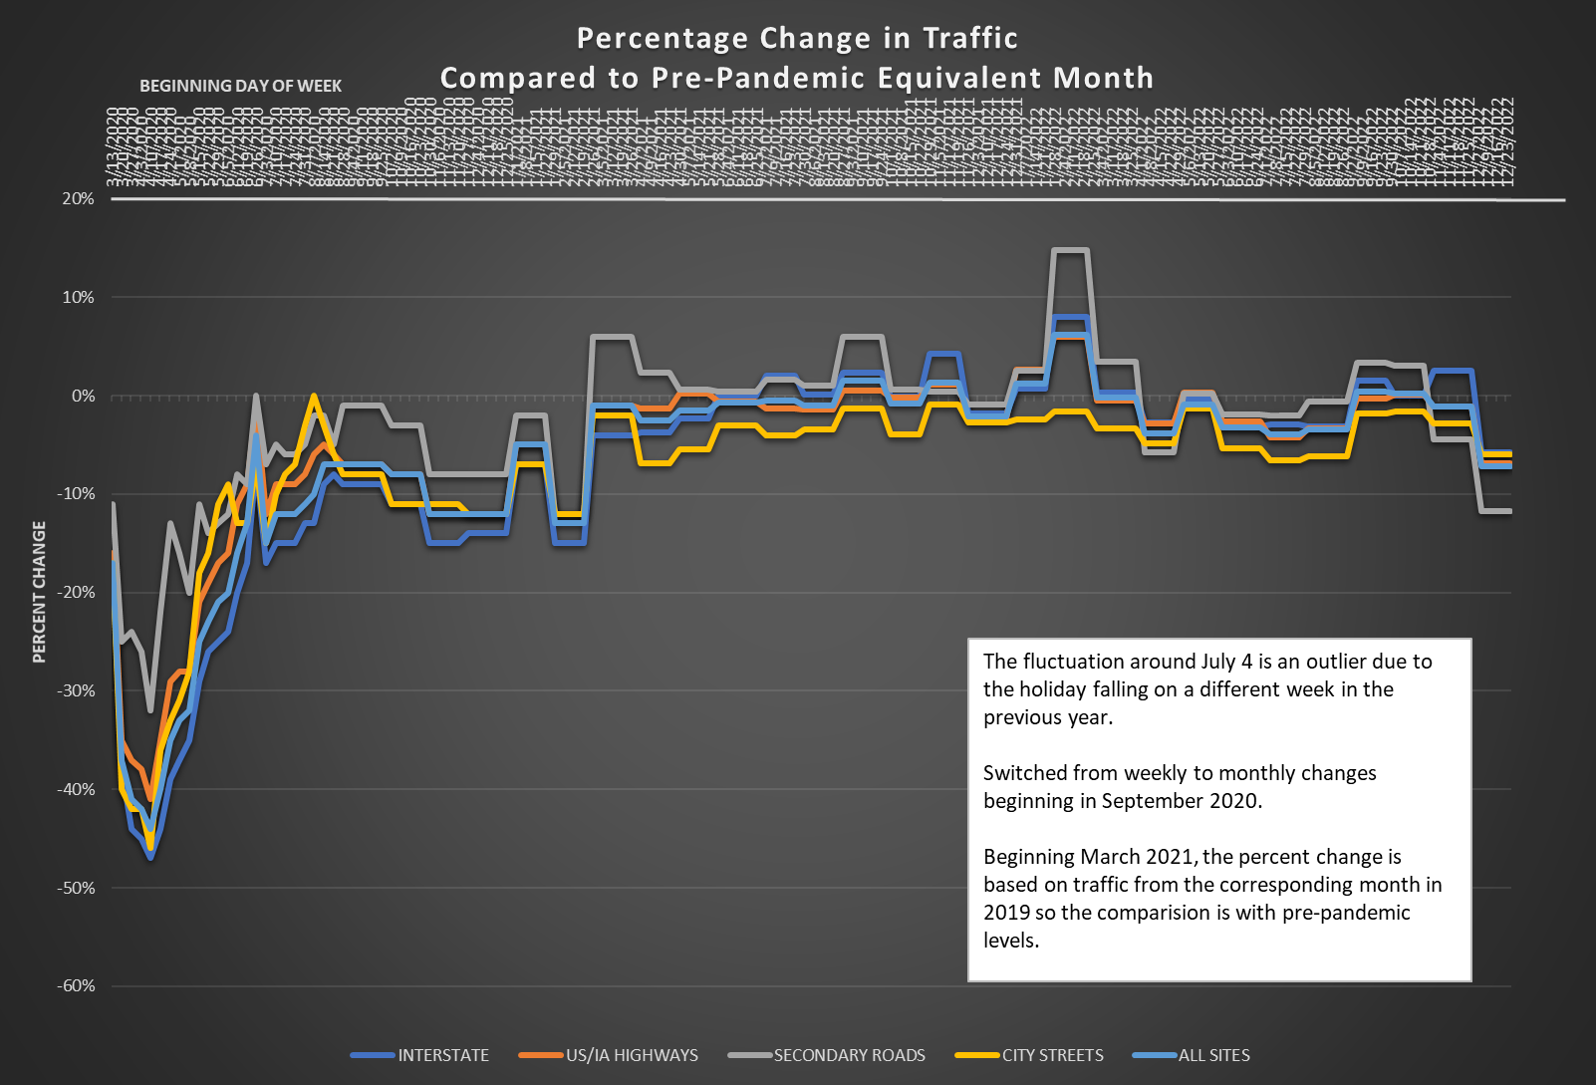

Slide 6
Questions?

