Slide 1
IOWA DOT PROJECT PRIORITIZATION & SCOPING APPLICATION UPDATE 2023
February 14, 2023
Bryan Bradley Location & Environment Bureau
Notes:
Thank you for allowing some time to let me talk about the Project Prioritization and Scoping Application. I am here to give you a quick overview of the application and to let you know of some changes we hope to incorporate in the future.

Slide 2
TAM Principles
Transportation
Asset
Management
Good asset management is:
Policy Driven Funding reflects the vision of the future.
Performance Based Decisions are based on future targets and condition of asset.
Quality Information Based Decisions supported by data and analytical tools.
Transparent and Accountable Decisions are documented, performance is monitored, progress tracked and reported
Trade-offs to Balance Weigh the information for best path.
Asset management is policy driven Funding decisions reflect the vision for
how the transportation system should look in the future.
Asset management is performance based We understand the condition of its assets, define performance targets, and make decisions that support these targets.
Asset management involves making trade-offs We have options for how to allocate transportation funding. We evaluate these options and makes informed decisions regarding the best path forward.
Asset management relies on quality information We use data and analytical tools to support our decisions.
Asset management requires transparency and accountability We document how funding decisions are made, monitor performance, track progress towards performance targets, and report on results.
Notes:
Transportation Asset Management is bigger than the application, but it can be an integral part of the process. If we are able to be Policy Driven, Performance Based using Quality Information and be Transparent and Accountable we get to the point of Trades-Offs where we can weigh all of the information and end up with the best path forward, resulting in the best use of our limited resources. The Prioritization and Scoping Application is part of our system to make sure we follow these principles and practice good Transportation Asset Management.

Slide 3
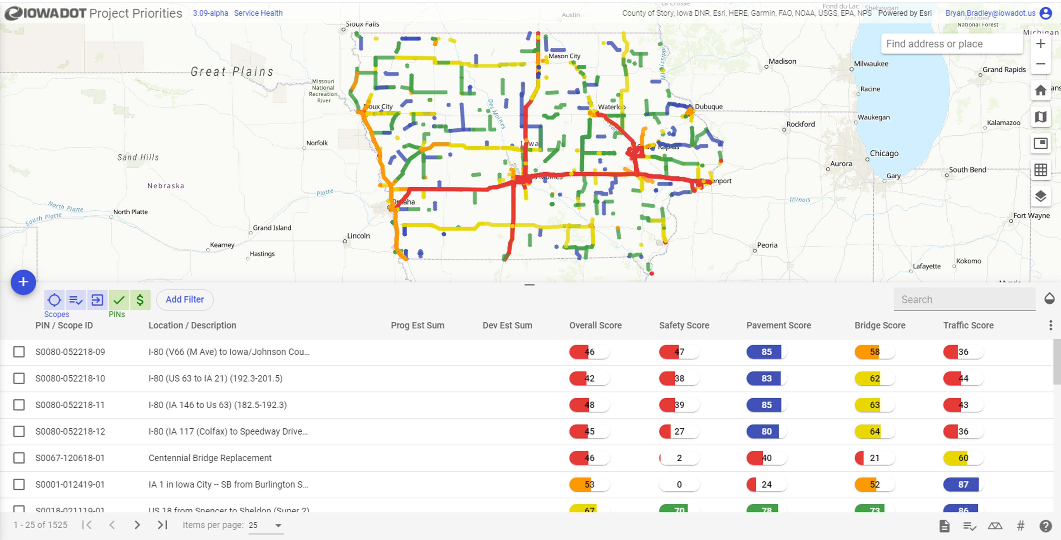
How do we evaluate the universe of possible projects?
Notes:
The application not only allows the users to visualize proposed projects on a map, but it evaluates each proposed project based on a set of established criteria. This score helps the DOT compare and rank each project under consideration.

Slide 4
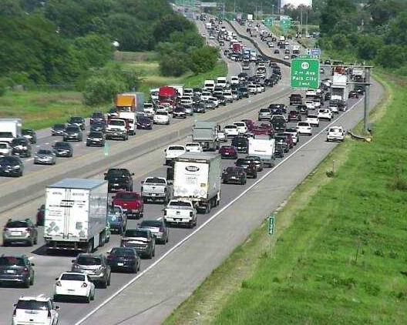
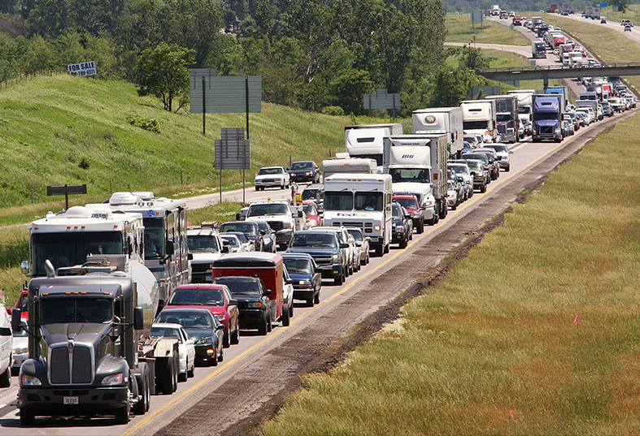
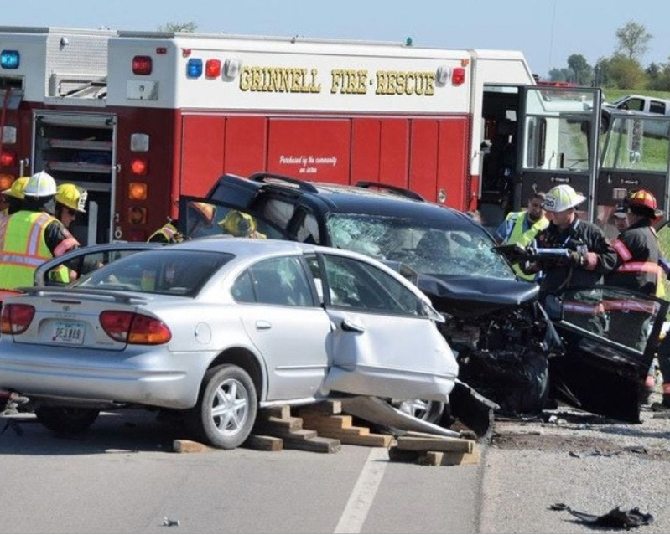
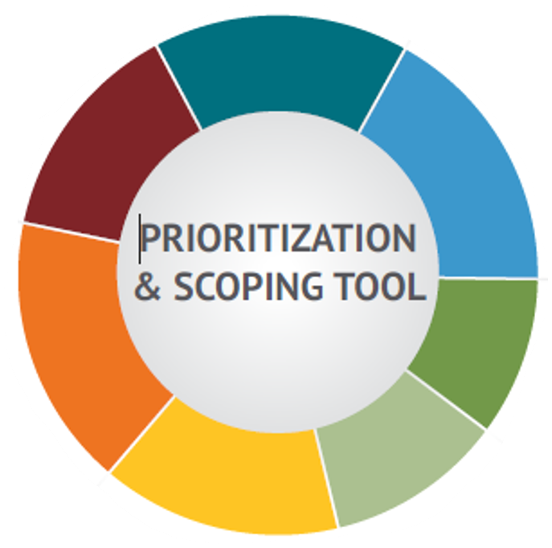
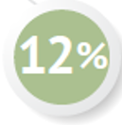
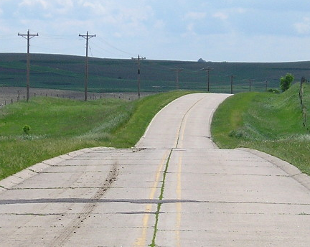
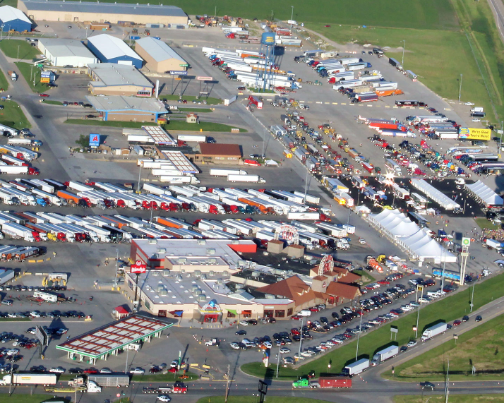
MOBILITY
Based on actual hours of delay when available, or when not available, the relationship between numbers of access points and traffic volumes.
TRAFFIC
A measure of the volume of traffic that each road is carrying in comparison to what it can carry.
14%
SAFETY
Weighted average crash rate from intersection to intersection giving more criticality to fatal and injury crashes.
15%
18%
BRIDGE
ROADWAY CLASS
Bridge condition index, which includes age, load capacity, traffic count, and a few other factors.
15%
10%
Projects inclusion on important Iowa networks like the CIN.
12%
16%
PAVEMENT
FREIGHT
Overall condition of the pavement while also considering it’s smoothness and rideability.
Projects criticality to the statewide freight network. Lower score indicates greater criticality.
Notes:
We have a set of 7 criteria that are used to evaluate projects, these scores are then modified by the weighting factor to come up with a composite score.
As you may remember, the Commission has played a very active role in the past to determine these scoring weights.
The composite scores are used, as well as the scores for individual criteria in the evaluations of future projects. I would like to go into a little explanation of the criteria and the weighting factors that you see here.

Slide 5
Based on actual hours of delay when available, or when not available, the relationship between numbers of access points and traffic volumes.
TRAFFIC
18%
A measure of the volume of traffic that each road is carrying in comparison to what it can carry.
14%
15%
BRIDGE
ROADWAY CLASS
Bridge condition index, which includes age, load capacity, traffic count, and a few other factors.
SAFETY
15%
10%
Projects inclusion on important Iowa networks like the CIN.
Segment Potential Crash Reduction (PCR) factors are used to score the segments of roadway in the Safety criteria and derive a weighted score.
12%
16%
PAVEMENT
FREIGHT
Overall condition of the pavement while also considering it’s smoothness and rideability.
Projects criticality to the statewide freight network. Lower score indicates greater criticality.
Notes:
Safety data is evaluated to determine its score based on the weighted potential crash reduction from treatments for segments of the highway.

Slide 6
MOBILITY
Based on actual hours of delay when available, or when not available, the relationship between numbers of access points and traffic volumes.
16%
TRAFFIC
A measure of the volume of traffic that each road is carrying in comparison to what it can carry.
14%
SAFETY
Weighted average crash rate from intersection to intersection giving more criticality to fatal and injury crashes.
15%
18%
PAVEMENT
BRIDGE
ROADWAY CLASS
Overall condition of the pavement while also considering it’s smoothness and rideability.
Bridge condition index, which includes age, load capacity, traffic count, and a few other factors.
15%
10%
Projects inclusion on important Iowa networks like the CIN.
12%
FREIGHT
Projects criticality to the statewide freight network. Lower score indicates greater criticality.
Notes:
Each section of pavement is evaluated to determine its score based on the pavement condition index, and adjustments based on smoothness and other factors.

Slide 7
MOBILITY
Based on actual hours of delay when available, or when not available, the relationship between numbers of access points and traffic volumes.
15%
14%
SAFETY
Weighted average crash rate from intersection to intersection giving more criticality to fatal and injury crashes.
18%
BRIDGE
ROADWAY CLASS
TRAFFIC
Bridge condition index, which includes age, load capacity, traffic count, and a few other factors.
15%
10%
Projects inclusion on important Iowa networks like the CIN.
A measure of the volume of traffic that each road is carrying in comparison to what it can carry.
12%
16%
PAVEMENT
FREIGHT
Overall condition of the pavement while also considering it’s smoothness and rideability.
Projects criticality to the statewide freight network. Lower score indicates greater criticality.
Notes:
Each Segment of traffic data is evaluated to determine its score based on the desired level of service (LOS) for the road section.

Slide 8
MOBILITY
Based on actual hours of delay when available, or when not available, the relationship between numbers of access points and traffic volumes.
TRAFFIC
A measure of the volume of traffic that each road is carrying in comparison to what it can carry.
14%
SAFETY
Weighted average crash rate from intersection to intersection giving more criticality to fatal and injury crashes.
15%
15%
18%
ROADWAY CLASS
10%
Projects inclusion on important Iowa networks like the CIN.
BRIDGE
Bridge condition index, which includes age, load capacity, traffic count, and a few other factors.
12%
16%
PAVEMENT
FREIGHT
Overall condition of the pavement while also considering it’s smoothness and rideability.
Projects criticality to the statewide freight network. Lower score indicates greater criticality.
Notes:
Each bridge if evaluated to determine its score based on condition, age, and deck area. Thresholds for poor conditions or very old age are also identified.

Slide 9
TRAFFIC
A measure of the volume of traffic that each road is carrying in comparison to what it can carry.
SAFETY
14%
Weighted average crash rate from intersection to intersection giving more criticality to fatal and injury crashes.
15%
18%
BRIDGE
ROADWAY CLASS
Bridge condition index, which includes age, load capacity, traffic count, and a few other factors.
15%
10%
MOBILITY
Projects inclusion on important Iowa networks like the CIN.
Based on actual hours of delay when available, or when not available, the relationship between numbers of access points and traffic volumes.
12%
16%
PAVEMENT
FREIGHT
Overall condition of the pavement while also considering it’s smoothness and rideability.
Projects criticality to the statewide freight network. Lower score indicates greater criticality.
Notes:
The mobility score is a measure of how efficiently traffic moves within the project area. The score is derived by evaluating accessibility, cross road density, real time and historical delays, and traffic incidents within the project area

Slide 10
MOBILITY
Based on actual hours of delay when available, or when not available, the relationship between numbers of access points and traffic volumes.
TRAFFIC
A measure of the volume of traffic that each road is carrying in comparison to what it can carry.
14%
SAFETY
12%
Weighted average crash rate from intersection to intersection giving more criticality to fatal and injury crashes.
15%
18%
BRIDGE
ROADWAY CLASS
Bridge condition index, which includes age, load capacity, traffic count, and a few other factors.
15%
10%
FREIGHT
Projects inclusion on important Iowa networks like the CIN.
Projects criticality to the statewide freight network. Lower score indicates greater criticality.
16%
PAVEMENT
Overall condition of the pavement while also considering it’s smoothness and rideability.
Notes:
Each project is assigned a freight score based on the percentage of freight traffic and proximity to bottlenecks.

Slide 11
MOBILITY
Based on actual hours of delay when available, or when not available, the relationship between numbers of access points and traffic volumes.
TRAFFIC
A measure of the volume of traffic that each road is carrying in comparison to what it can carry.
14%
SAFETY
Weighted average crash rate from intersection to intersection giving more criticality to fatal and injury crashes.
10%
15%
18%
BRIDGE
Bridge condition index, which includes age, load capacity, traffic count, and a few other factors.
15%
ROADWAY CLASS
12%
16%
Projects inclusion on important Iowa networks like the CIN.
PAVEMENT
FREIGHT
Overall condition of the pavement while also considering it’s smoothness and rideability.
Projects criticality to the statewide freight network. Lower score indicates greater criticality.
Notes:
The Road classification score indicates a road’s importance in the overall system. Scoring is based on the commercial/Industrial Network (CIN) and the Federal Functional Class of the roadway

Slide 12
MOBILITY
Based on actual hours of delay when available, or when not available, the relationship between numbers of access points and traffic volumes.
TRAFFIC
A measure of the volume of traffic that each road is carrying in comparison to what it can carry.
14%
SAFETY
Weighted average crash rate from intersection to intersection giving more criticality to fatal and injury crashes.
15%
18%
BRIDGE
ROADWAY CLASS
Bridge condition index, which includes age, load capacity, traffic count, and a few other factors.
15%
10%
Projects inclusion on important Iowa networks like the CIN.
12%
16%
PAVEMENT
FREIGHT
Overall condition of the pavement while also considering it’s smoothness and rideability.
Projects criticality to the statewide freight network. Lower score indicates greater criticality.
Notes:
So we end up back here with the tool criteria and the weights that each one has in the composite score.

Slide 13
State Long Range Transportation Plan
Review of tool against plan system objectives and other priorities confirmed general alignment
All current scoring factors tie to one or more system objectives
Opportunity to integrate accessibility into plan
Notes:
The recent State Long Range Transportation Plan has been discussed in several recent commission meetings and is in many ways aligned with the criteria in this application. I’d like to go into the similarities and discuss how they are closely related and aligned.

Slide 14
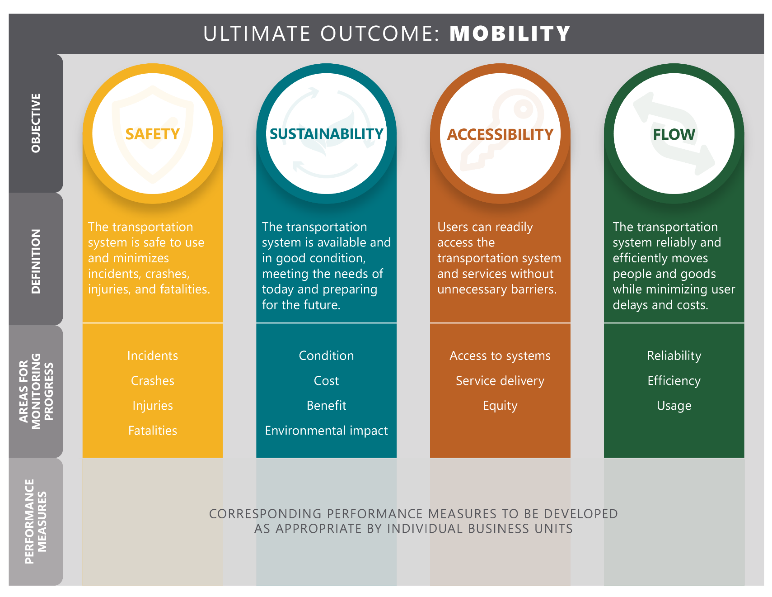
State Long Range Transportation Plan System Objectives
Notes:
Four objectives that the State Long Range Transportation Plan is based upon include Safety, Sustainability, Accessibility and Flow.

Slide 15
Objective: FLOW
Objective: FLOW
Objective: SAFETY
Objective: SUSTAINABILITY
Objectives: SUSTAINABILITY, FLOW
Objective: SUSTAINABILITY
Objective: FLOW
Notes:
Discuss Each SLRTP Objective linkage to the current PP/S categories

Slide 16
Accessibility
Notes:
In the current 7 factors within the application, we are missing the ability to measure Accessibility. We are hoping to add this to the scoping and possibly scoring for comparison across all Iowa Projects

Slide 17
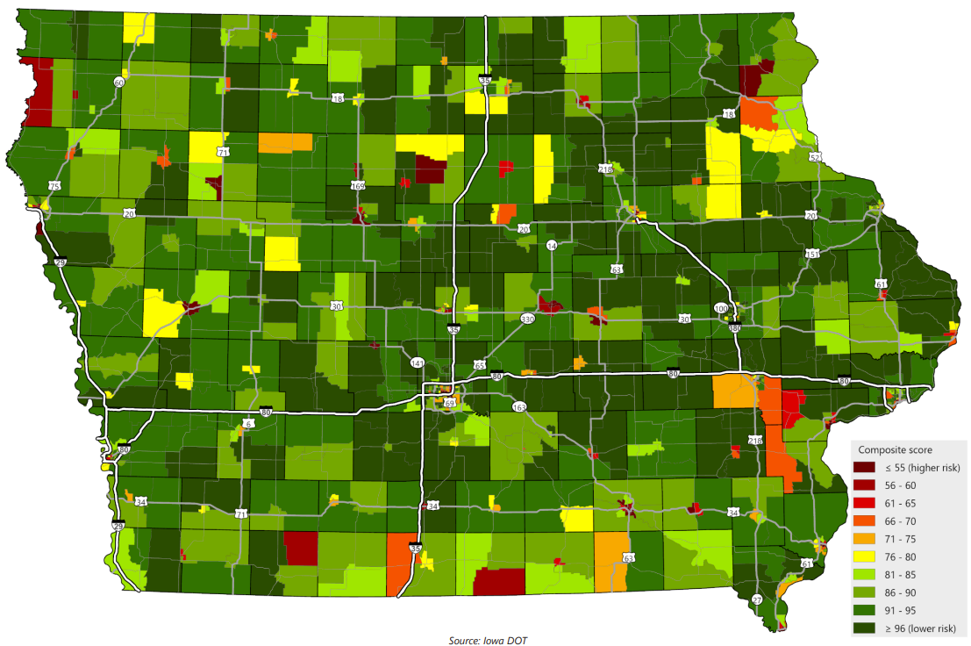
Accessibility/mobility analysis
Analysis identified areas at higher risk of mobility challenges
Will examine how this could be effectively integrated into tool
Attributes considered
Youth – under 18
Older adults – 65 and over
Minority (non-White and/or Hispanic/Latino)
Foreign-born
Limited English proficiency
With a disability
Households below poverty level
Zero vehicle households
College enrolled
Single parent households
Notes:
Accessibility is unique in sense, that we are analyzing the highway system in geographic areas – potential hotspots – based on national research – mostly census data.
We suggest creating a data layer that factors in the 10 attributes, outlined above, during the scoping process to highlight those projects that overlap areas where the analysis has determined to have accessibility challenges/needs.
These data layers are not currently being reviewed in the application and we would like to incorporate them into our analysis during both the scoping and scoring phases. We believe this addition will help align this application more closely with the Long Range Transportation Plan.

Slide 18
Next Steps
Proceed with using tool with existing factors and weightings as they are still consistent with updated plan
Explore methods to consider “accessibility” in the tool for next year

Slide 19
BRYAN BRADLEY
LOCATION ENGINEER / DEPUTY BUREAU DIRECTOR
LOCATION & ENVIRONMENT BUREAU
Bryan.bradley@iowadot.us
Office: 515-239-1787
QUESTIONS ???

