Slide 1
2024-2028
Highway Program
Development
February 14, 2023

Slide 2
February 14, 2023
Overview
  Discuss Highway Program Development Process
  Discuss 2024-2028 Highway Program Development Schedule
  Discuss Extended Highway Program Analysis
  Discuss Statewide Line Items
  At what levels should the line item targets be programmed?
  Discuss Federal Funding
  Discuss Program Objectives/Priorities/Considerations

Slide 3

Highway Program Development Process
February 14, 2023
Public Policy and Input
What direction do we have?
Transportation Plans
What type of system do we need?
Performance Monitoring
Are we successful?
Five-Year Program
What projects will be done and when?

Slide 4
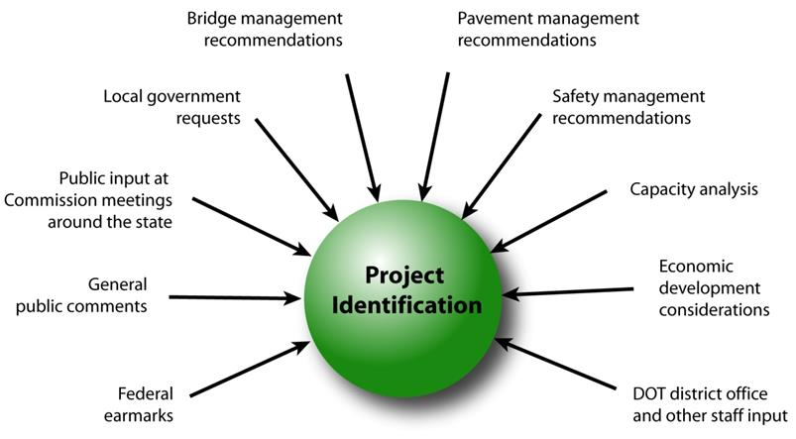
February 14, 2023
Step 1: Project identification

Slide 5
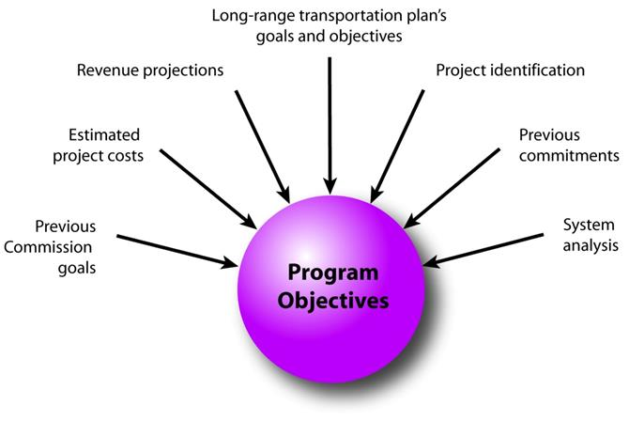
February 14, 2023
Step 2: Establishing the Transportation Commission’s annual programming objectives

Slide 6
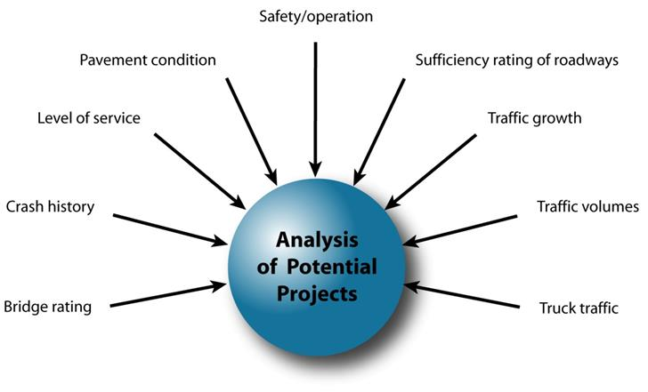
February 14, 2023
Step 3: Evaluating potential project candidates

Slide 7
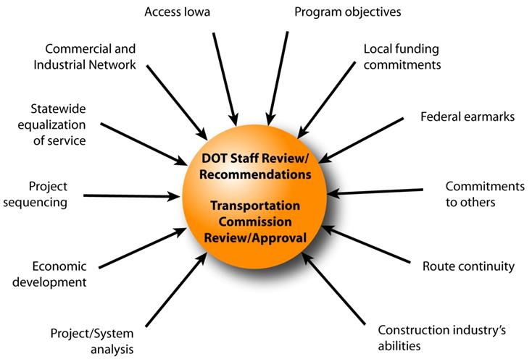
February 14, 2023
Step 4: Developing the final program

Slide 8
February 14, 2023
Commission Program Development Schedule (2024-2028)
  February 2023
  Discuss Highway Program Development Process
  Discuss 2024-2028 Highway Program Development Schedule
  Discuss Extended Highway Program Analysis
  Discuss Statewide Line Items
  At what levels should the line item targets be programmed?
  Discuss Federal Funding
  Discuss Program Objectives/Priorities/Considerations
  March 2023
  Discuss 2024-2028 available Highway Program funding
  Discuss 2024-2028 Highway Program Options
  Determine 2024-2028 Highway Program Objectives
  Action Item: Line Item Targets for Programming
  April 2023
  Develop the Draft 2024-2028 Highway Program
  Action Item: 2024-2028 Highway Program Objectives
  May 2023
  Present the Draft 2024-2028 Iowa Transportation Improvement Program to the public
  (including all previous program approvals and Draft 2024–2028 Highway Program)
  June 2023
  Action Item: Approve the 2024–2028 Iowa Transportation Improvement Program

Slide 9
2023-2032 Highway Program Analysis
For Highway Planning Purposes Only (x $1,000,000)
February 14, 2023 as presented on June 13, 2022
Proposed Highway Program Extended Highway Program
2023 2024 2025 2026 2027 2028 2029 2030 2031 2032
Projected Funds 835.1 855.6 856.1 857.9 850.6 850.6 850.6 850.6 850.6 850.6
Highway Program Components
Interstate Stewardship 169.0 134.5 191.6 203.6 200.9 180.0 185.0 190.0 195.0 200.0
Non-Interstate Pavement Modernization 139.5 145.0 150.0 155.0 200.0 210.0 220.0 225.0 230.0 235.0
Non-Interstate Bridge Modernization 102.1 110.3 144.6 141.0 175.0 190.0 205.0 210.0 215.0 220.0
Safety Specific 31.6 32.0 33.0 34.0 40.0 41.0 42.0 43.0 44.0 45.0
Non-Interstate Capacity/System Enhancement 206.6 315.0 110.8 218.4 24.4
US 30 Missouri Valley bypass 32.9
US 61 1 mi N of IA 78 to 2 mi S of IA 92 45.7
Stewardship Projects 14.9 0.5 0.7 0.5 39.5
Capacity Projects 1.7 86.6 11.1 0.4
Transfer of Jurisdiction 2.0 7.0 5.0 5.0 (2.0)
Major Interstate Capacity/System Enhancement 181.0 148.3 82.3 146.1 51.7
I-80 Scott Mississippi River Bridge 50.0
I-35/80/235 Polk Southwest Mixmaster 36.1 86.4 13.0
I-380 Linn 120th St to NW to US 30 0.3 99.1 0.1
I-35 Story US 30 Interchange Bridges and Mainline 4.9 10.4 29.9 25.6 1.2
I-80 Scott Middle Road Interchange 45.8
Highway Program Balance (11.6) (37.3) (8.5) (45.8) (8.5) (4.9) 155.0 157.0 165.4 150.6
    Black: Previous discussion
    ( ): Indicates Highway Program is over-programmed

Slide 10
2024-2033 Highway Program Analysis
For Highway Planning Purposes Only (x $1,000,000)
February 14, 2023
Proposed Highway Program Extended Highway Program
2024 2025 2026 2027 2028 2029 2030 2031 2032 2033
Projected Funds 855.6 856.1 857.9 857.9 850.6 850.6 850.6 850.6 850.6 850.6
Highway Program Components
Interstate Stewardship 134.5 191.6 203.6 200.9 180.0 185.0 190.0 195.0 200.0 205.0
Non-Interstate Pavement Modernization 145.0 150.0 155.0 200.0 210.0 220.0 225.0 230.0 235.0 240.0
Non-Interstate Bridge Modernization 110.3 144.6 141.0 175.0 190.0 205.0 210.0 215.0 220.0 225.0
Safety Specific 32.0 33.0 34.0 40.0 41.0 42.0 43.0 44.0 45.0 46.0
Non-Interstate Capacity/System Enhancement 315.0 110.8 218.4 24.4
US 30 Missouri Valley bypass 32.9
US 61 1 mi N of IA 78 to 2 mi S of IA 92 45.7
Stewardship Projects 0.5 0.7 0.5 39.5
Capacity Projects 1.7 86.6 11.1 0.4 0.4
Transfer of Jurisdiction 7.0 5.0 5.0 (2.0)
Major Interstate Capacity/System Enhancement 148.3 82.3 146.1 51.7
I-80 Scott Mississippi River Bridge 50.0
I-35/80/235 Polk Southwest Mixmaster 36.1 86.4 13.0
I-380 Linn 120th St to NW to US 30 0.3 99.1 0.1
I-35 Story US 30 Interchange Bridges and Mainline 4.9 10.4 29.9 25.6 1.2
I-80 Scott Middle Road Interchange 45.8
Highway Program Balance (37.3) (8.5) (45.8) (8.5) (4.9) 155.0 157.0 165.4 150.6 134.6
    Black: Previous discussion
    ( ): Indicates Highway Program is over-programmed

Slide 11
February 14, 2023
Draft 2024-2028 Iowa Highway Program Line Items
  At what levels should the line item targets be programmed?
  March Action Item: Line Item Targets for Programming

Slide 12
Draft 2024-2028 Iowa Highway Program Line Items
Rest Area Maintenance
 |  | Project Estimated Costs X $1000
Location | Type Of Work | 2024 | 2025 | 2026 | 2027 | 2028
Statewide Interstate Rest Area Maintenance | Rest Area Improvement | 6,000 | 6,000 | 6,000 | 6,000 | 6,000
 |  | 2,800 | 2,900 | 3,000 | 3,100 | 3,200
  Higher standard of cleaning since the pandemic
  Increase in labor costs
  Addition of adult changing stations

Slide 13
Draft 2024-2028 Iowa Highway Program Line Items
Interstate Pavement Markings
 |  | Project Estimated Costs X $1000
Location | Type Of Work | 2024 | 2025 | 2026 | 2027 | 2028
Statewide Interstate Pavement Maintenance | Pavement Rehab | 9,500 | 9,500 | 9,500 | 9,500 | 9,500
 |  |  |  |  | 5,000 | 5,000
Statewide Safety Specific | Paving |  | 33,000 | 34,000 | 40,000 | 41,000
 |  |  |  |  | -5,000 | -5,000
  Shift the costs of high-performance Interstate pavement markings from the Safety line item to Interstate Pavement Maintenance line item
  Funded out of Safety for the initial placement but shift to Interstate Pavement Maintenance for pavement marking replacement
  No net change in investment level

Slide 14
Draft 2024-2028 Iowa Highway Program Line Items
Post Letting Project Cost
 |  | Project Estimated Costs X $1000
Location | Type Of Work | 2024 | 2025 | 2026 | 2027 | 2028
Post Letting Project Cost | Miscellaneous | 20,000 | 20,000 | 20,000 | 20,000 | 20,000
 |  | 10,000 | 10,000 | 10,000 | 10,000 | 10,000
  Line item covers cost increases that can occur after a project is under construction to cover issues identified during construction
  Historically, amounts to approximately 3-4 percent of construction costs
  Line item has been a fixed amount and should be adjusted to reflect additional funding in the Program

Slide 15
Draft 2024-2028 Iowa Highway Program Line Items
Winter Maintenance Materials Shift
 |  | Project Estimated Costs X $1000
Location | Type Of Work | 2024 | 2025 | 2026 | 2027 | 2028
Winter Maintenance Materials | Miscellaneous | 15,000 | 15,000 | 15,000 | 15,000 | 15,000
Winter operations materials (primarily salt and brine materials) are currently paid with department operational appropriations
Propose funding as a Program line item at the same amount
Will make unused budget for winter materials available at the end of the winter operations season instead of remaining until the close out of the state fiscal year
Provides additional flexibility for the strategic management of the salt inventory and its storage infrastructure without constraints created by the state fiscal year
Allows more rapid response to address a budget shortfalls caused by abnormally severe winter
No net change in investment level

Slide 16
Draft 2024-2028 Iowa Highway Program Line Items
Information Technology Cost Shift
 |  | Project Estimated Costs X $1000
Location | Type Of Work | 2024 | 2025 | 2026 | 2027 | 2028
Statewide Consultant Services | Outside Services Engineering | 76,000 | 76,000 | 76,000 | 76,000 | 76,000
 |  | -15,000 | -15,000 | -15,000 | -15,000 | -15,000
Shift Information Technology costs to support primary system improvement and operations from the Statewide Consultant Services line item to the department’s operational appropriation.
Allows Statewide Consultant Services line item to be more focused on direct consultant support of primary highway system improvement and operation
No net change in investment level

Slide 17
Draft 2024-2028 Iowa Highway Program Line Items
Statewide Operations Adjustment
 |  | Project Estimated Costs X $1000
Location | Type Of Work | 2024 | 2025 | 2026 | 2027 | 2028
Statewide Consultant Services | Outside Services Engineering | 76,000 | 76,000 | 76,000 | 76,000 | 76,000
 |  | -2,000 | -2,000 | -2,000 | -2,000 | -2,000
Statewide Operations | Outside Services Engineering | 9,000 | 9,000 | 9,000 | 9,000 | 9,000
 |  | 2,000 | 2,000 | 2,000 | 2,000 | 2,000
  Last year, Statewide Operations were split out from Statewide Consultant Services
  An adjustment is recommended to more accurately reflect allocation of costs
  No net change in investment level

Slide 18
Draft 2024-2028 Iowa Highway Program Line Items
Bridge Approach Maintenance
 |  | Project Estimated Costs X $1000
Location | Type Of Work | 2024 | 2025 | 2026 | 2027 | 2028
Statewide Contract Maintenance | Miscellaneous | 36,850 | 37,350 | 37,850 | 38,350 | 38,850
 |  |  |  |  |  | 4,650
  Poor bridge approach conditions result in poor ride quality
  Recommend a new targeted contract maintenance initiative beginning in FY 2028 to repair bridge approaches
  New funding allocation

Slide 19
Draft 2024-2028 Iowa Highway Program Line Items
Intelligent Transportation System Costs
 |  | Project Estimated Costs X $1000
Location | Type Of Work | 2024 | 2025 | 2026 | 2027 | 2028
Statewide Traffic Control Devices/Signs | Traffic Signs | 10,000 | 10,000 | 10,000 | 10,000 | 10,000
 |  | -5,000 | -5,000 | -5,000 | -5,000 | -5,000
Statewide ITS | Miscellaneous | 5,750 | 5,750 | 5,750 | 5,750 | 5,750
  Intelligent Transportation Systems (ITS) costs have been previously included in Statewide Traffic Control Devices line item and as individual small projects in the Program
  To simplify line item financial management and project accounting, recommend creating a new Statewide ITS line item
  No net change in investment level (when line items and Program impacts are combined)

Slide 20
February 14, 2023 as presented
April 11, 2022
FY 2023-2027 Highway Program Objectives
  Projects in the 2023-2026 Highway Program will continue to be programmed with cost and schedule updates
  Investment Area: Stewardship through maintaining a state of good repair
    Provide a targeted increase and then maintain increasing funding levels for safety
    Maintain increasing Interstate funding levels for pavement reconstruction, modernization, bridges, pavement patching/maintenance, rest areas, and other miscellaneous projects
    Provide a targeted increase and then maintain increasing funding levels for non-interstate pavement modernization
    Provide a targeted increase and then maintain increasing funding levels for non-interstate bridge modernization
    Invest in additional stewardship projects
  Investment Area: Modification through rightsizing the system
    Transfer of jurisdiction for portions of primary roadways to cities and counties
  Investment Area: Optimization through improving operational efficiency and resiliency
    Invest in intelligent transportation systems infrastructure
    Invest in Super-2 improvements
    Invest in operational and Integrated Corridor Management improvements
    Invest in additional truck parking at Interstate Rest Areas
  Investment Area: Transformation through increasing mobility and travel choices
    Invest in corridor improvements

Slide 21
February 14, 2023
FY 2024-2028 Highway Program Objectives
  Update to shift to the System Objectives of the new State Long Range Transportation Plan
    Safety
    Sustainability
    Accessibility
    Flow

Slide 22
February 14, 2023
Federal Funding Status
Infrastructure Bill authorizes federal funding through September 30, 2026, leaving some funding uncertainty for the last two years of this Program.
Infrastructure Bill funding allocations based on Commission action in June 2022.
The next Highway Trust Fund cliff is in 2026/2027

Slide 23
February 14, 2023
Program Development Considerations
  Increasing construction costs (potential negative balance at the end of FY 2023)
  Continue to increase bridge and pavement stewardship investments on existing highway system
  Balance capacity improvements with stewardship needs
  Address increasing safety/operational needs on the Interstate
  Address major river crossing needs

Slide 24
Next Steps
February 14, 2023
Discuss 2024-2028 available Highway Program funding
Discuss 2024-2028 Highway Program Options
Determine 2024-2028 Highway Program Objectives
Action Item: Line Item Targets for Programming

