Slide 1


Bridge Asset Management
Scott Neubauer, PE
Iowa DOT Bridges and Structures Bureau
Transportation Commission Workshop
February14, 2023

Slide 2


Presentation Overview
Preservation Activities
2. Bridge Inventory
3. Condition Summary
4. Funding Scenarios

Slide 3
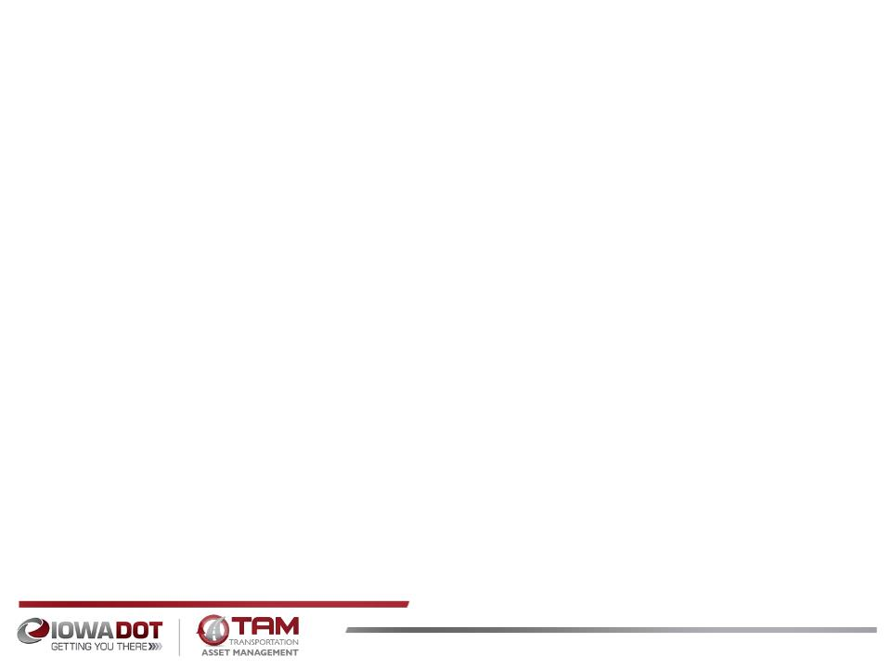
Bridge Preservation and Maintenance
What are some of the things we’re doing to preserve and maintain bridges?
Replace aging deck joints
Overlay decks with new wearing surface
Dense concrete layer
Polyester Polymer layer
Latex modified concrete layer
Epoxy polymer layer
Repair beams ends
Patch deteriorated deck areas
Install berm and bank protection
Use stainless steel reinforcing in areas with high potential for corrosion
Use High Performance Concrete (HPC) in new bridge decks
Use fewer or no deck joints
Use of Non-Destructive Evaluation (NDE) methods to assess condition
Notes:
NDE: Impact Echo, GPR, Infra red thermography, Hammer sounding, Ultrasonic Wave, Sonar, Mag particle, Dye Penetrant, Acoustic imaging, Harmonic vibration,

Slide 4
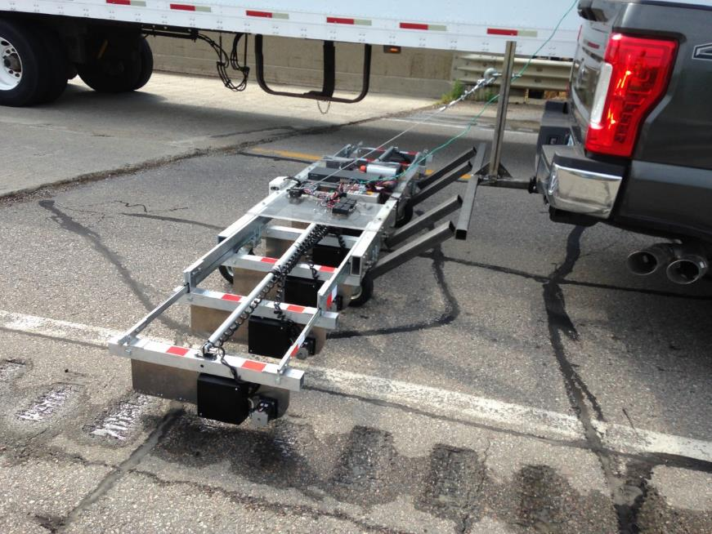

Slide 5
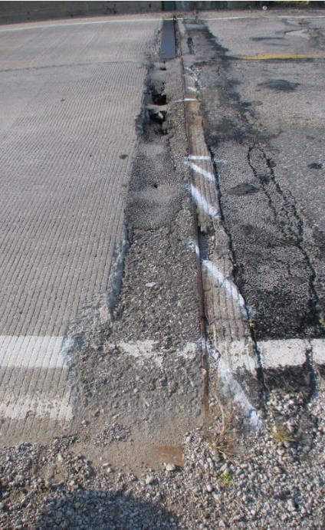
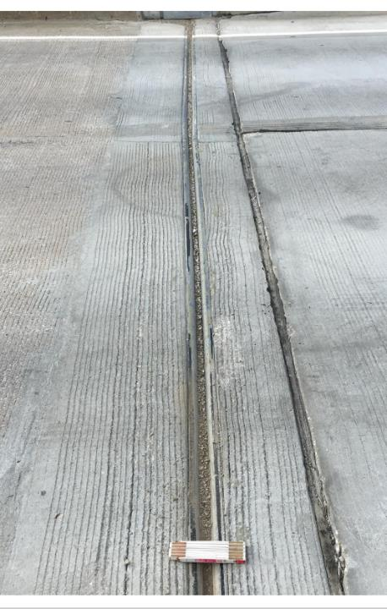
Notes:
Bridge 7834.9S092

Slide 6
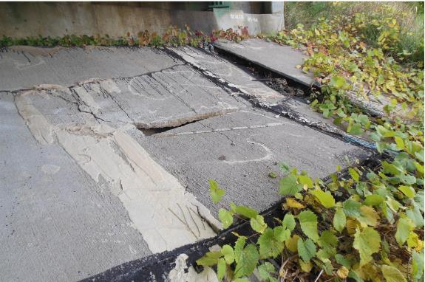
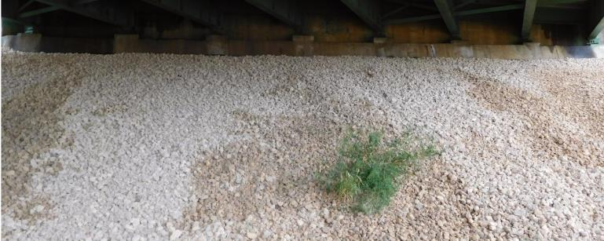
Notes:
Macadam stone – uniform crushed stone.

Slide 7
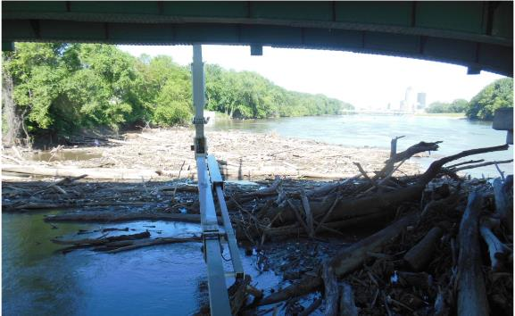
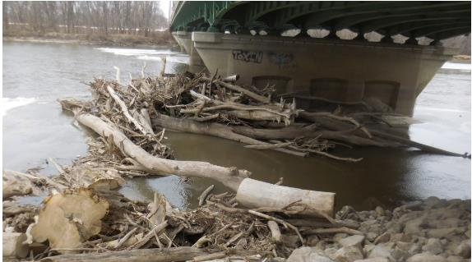
Notes:
Bridge 7784.2S069

Slide 8
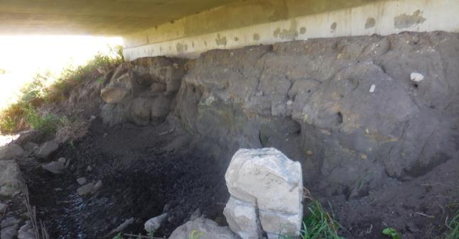
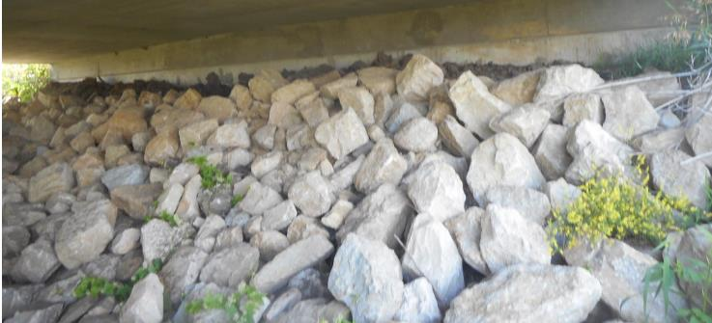
Notes:
Bridge 6669.0S218

Slide 9
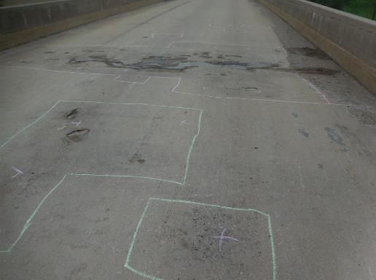
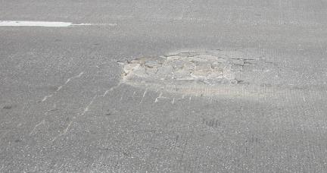
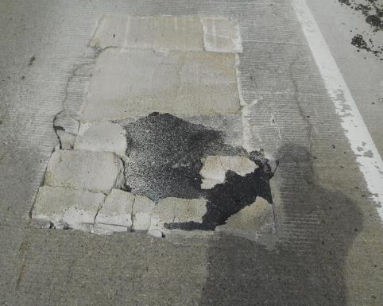
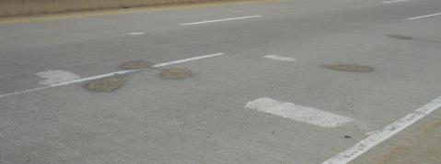
Notes:
5233.0O080
8295.9R080
3190.2S061 Peosta Channel
0625.7S030

Slide 10
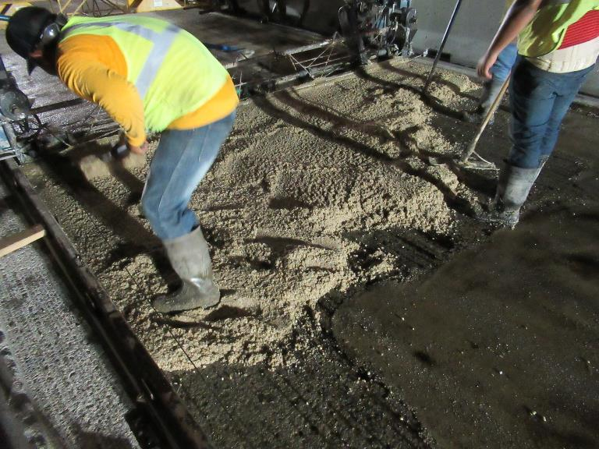
Notes:
Polyester Polymer overlay
Cedar Rapids over I-380 – 5720.8O380 8th st.

Slide 11
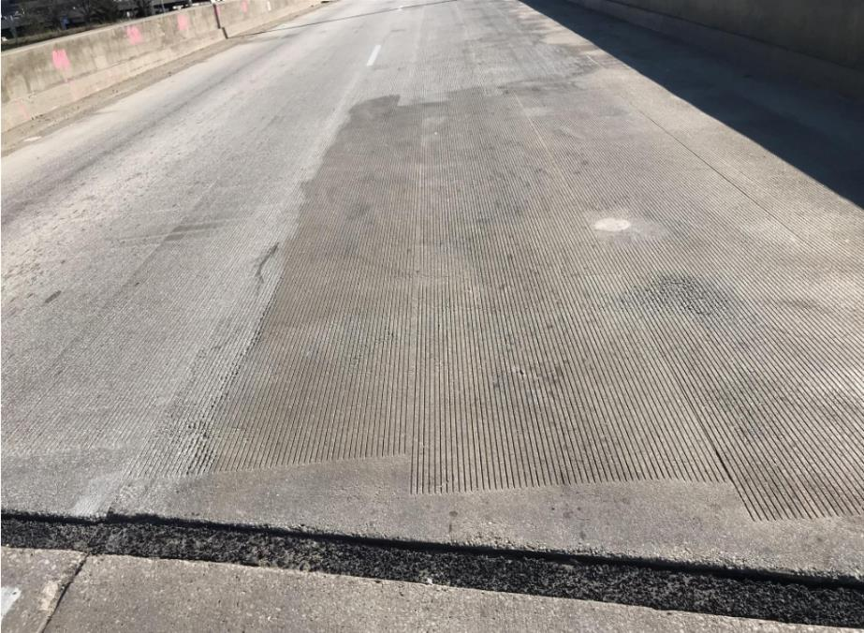
Notes:
Polyester Polymer overlay
Cedar Rapids over I-380 – 5720.8O380 8th st.

Slide 12
Bridge Inventory
The primary system includes 4,195 bridges and large culverts
Added together, the deck area of all primary system bridges is over 47 million square feet – that’s approximately 1.7 square miles. (over 820 football fields)
If we had to replace these bridges today, the cost would exceed $20 billion. (this would be more than 20 years of our entire program)
Average VPD 5,806. Median VPD 3,180.
Notes:
2600 bridges on the NHS. 32 total Poor. 15 Poor on NHS. 725 interstate bridges. 3470 non-interstate bridges. 4195 total bridges.
Make comment that there are 23,800 bridges statewide. Iowa’s status as number one state with the most Poor/SD bridges due to local bridges.
17.0% of bridges are on the interstate. 25.3% of the total deck area in on the interstate.
$9 billion to replace in-kind. $425/ft^2 vs $200/ft^2
The Des Moines River bridge on I-235 has the highest VPD at 78,300.
Football field is 57,600ft^2

Slide 13
Bridge Inspection
Federal Highway Administration requires all bridges to be inspected every 24 months or less. (approximately 23,800 city, county and state bridges)
State bridge condition data is collected by 18 trained bridge inspectors.
It takes up to 5 years of training to be qualified to be a bridge inspector.
Inspection documentation is used to evaluate the need for replacement, rehab, or repair.
Notes:
89 FC bridges. 4195 bridges on state highways. 725 interstate (93 culverts, 22 FC), 3470 non-interstate (729 culverts, 67 FC).
Mention Scour Critical bridge inspection and how we have mitigated the scour critical bridges.

Slide 15
FHWA Terms Describing Bridge Condition:
Good
Fair
Poor
Notes:
Poor is the same as SD. The SD term was misleading to people who don’t know bridges. It does not mean the bridge is near failure.

Slide 16
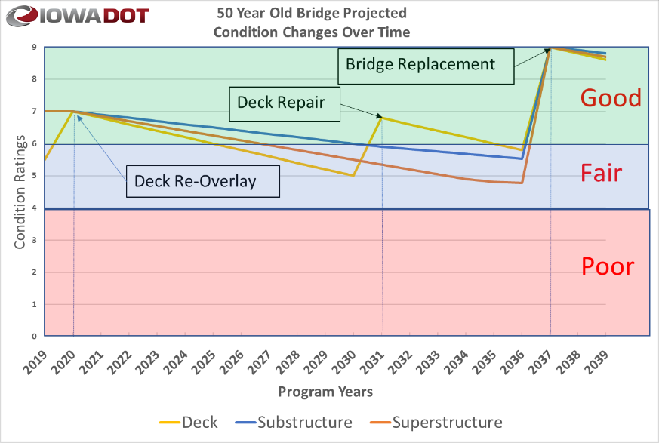
Notes:
This is a scenario recommended by our deterioration modeling system for a given bridge. Bridge 3826, IA-28 over Walnut Creek in Polk Co. Built in 1969. Second overlay in 2020. As bridges age, it is difficult to repair and maintain superstructures and Substructures.
Non-Interstate Unlimited budget CI42 Corrected.xlsx

Slide 17
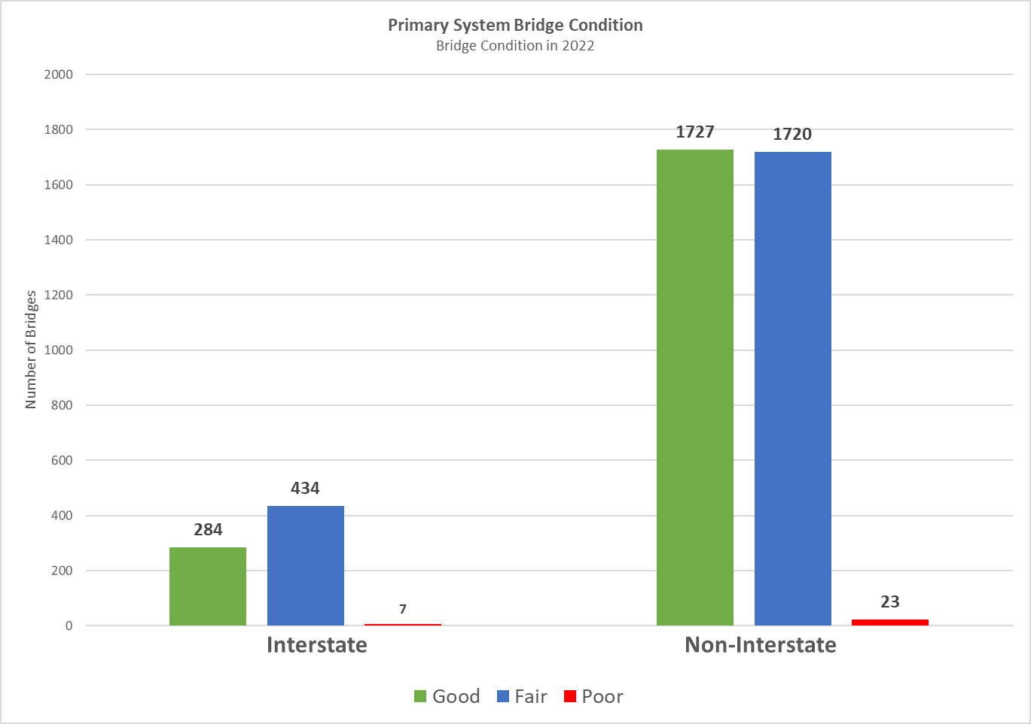
Notes:
NBI_TAPE_OUTPUT_15-03-2021_05-04-28 - Updated

Slide 18
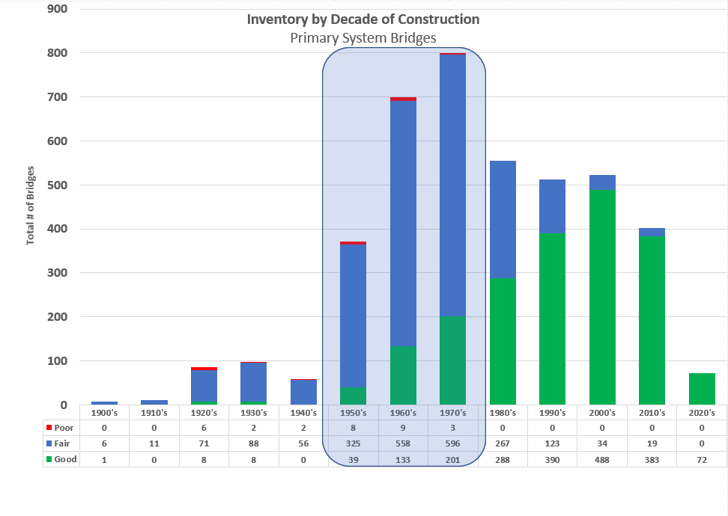
Notes:
OneDrive - Iowa Department of Transportation\Documents\2023 commission meeting\Graphs 4.3 & 5.7 for Non-inter & 4.6 & 5.9 for Non-Inter on NHS and Interstate – copy.xlsx
Bridges in the 1950’s thru 1970’s will cost $5.6 Billion to replace.
We replaced 37bridges in FY2022
1613 bridges are over 50 years old. 38.5% of states bridges and 28.6% of state deck area.
The 16 fair bridges in the 2010’s are from the deck condition. 7 are on the I-29 corridor project. An issue with deck concrete quality. HPC

Slide 19
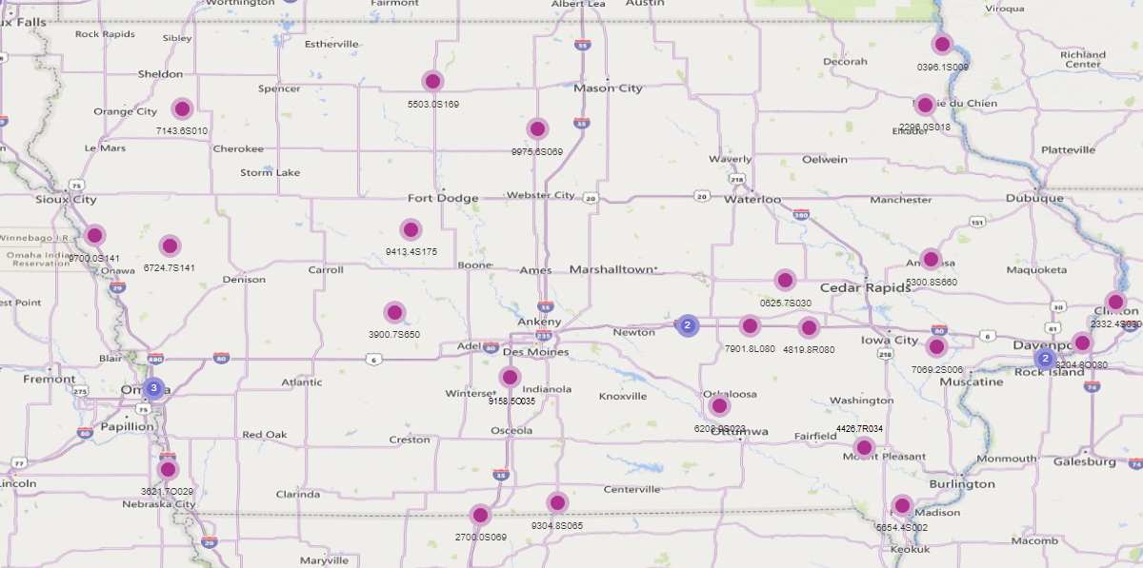
Poor Bridges on Primary Highways
Notes:
OneDrive - Iowa Department of Transportation\Documents\2023 commission meeting\Graphs 4.3 & 5.7 for Non-inter & 4.6 & 5.9 for Non-Inter on NHS and Interstate – copy.xlsx
Only 30 Poor bridges in 2022. 5 border bridges are Poor.
Poor bridges statewide = 4599, up from 4497 in 2021.
3 posted poor bridges (2 border, 1 state park). 1 closed due to collision damage.

Slide 20
Typical Bridge Costs
Replacements cost from:
$2.4M Non-Interstate
$3.0M Interstate (outliers not included)
Rehabilitations cost from:
$0.25M to $1.3M
New Bridges cost from:
$2.7M Non-Interstate
$4.8M Interstate (outliers not included)
Notes:
892 Steel Girder Bridges
1871 PPCB bridges
563 Slab bridges
822 culverts
47 Other types of bridges
60 to 70% of bridges are $3 million or less (average = $1.5 million). Average of the other 30 to 40% is $6.3 million (2021 information)

Slide 21
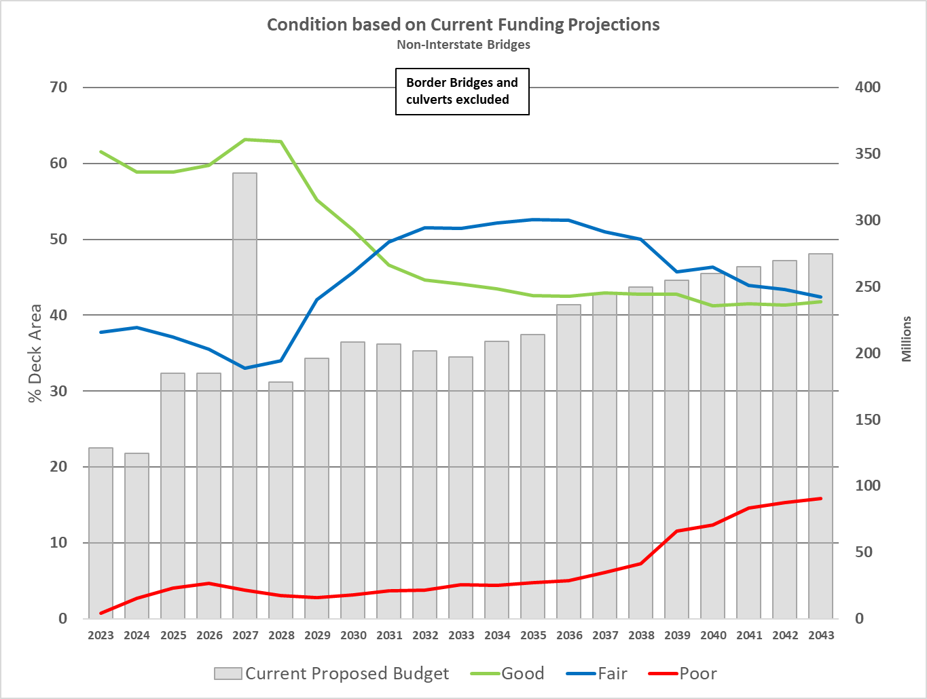
Condition Forecast
Notes:
OneDrive - Iowa Department of Transportation\Documents\2023 commission meeting\Graphs 4.3 & 5.7 for Non-inter & 4.6 & 5.9 for Non-Inter on NHS and Interstate – copy.xlsx
FHWA requirement to keep NHS below 10% of deck area as Poor.

Slide 22
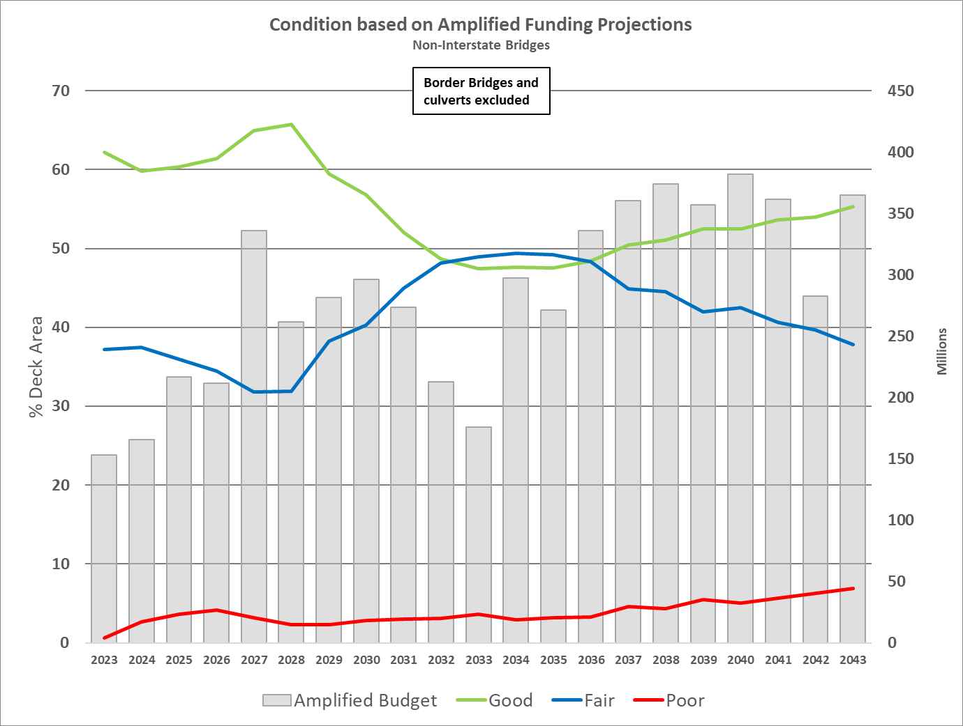
Condition Forecast
Notes:
OneDrive - Iowa Department of Transportation\Documents\2023 commission meeting\Graphs 4.3 & 5.7 for Non-inter & 4.6 & 5.9 for Non-Inter on NHS and Interstate – copy.xlsx
Amplified budget is 150% of proposed budget.

Slide 23
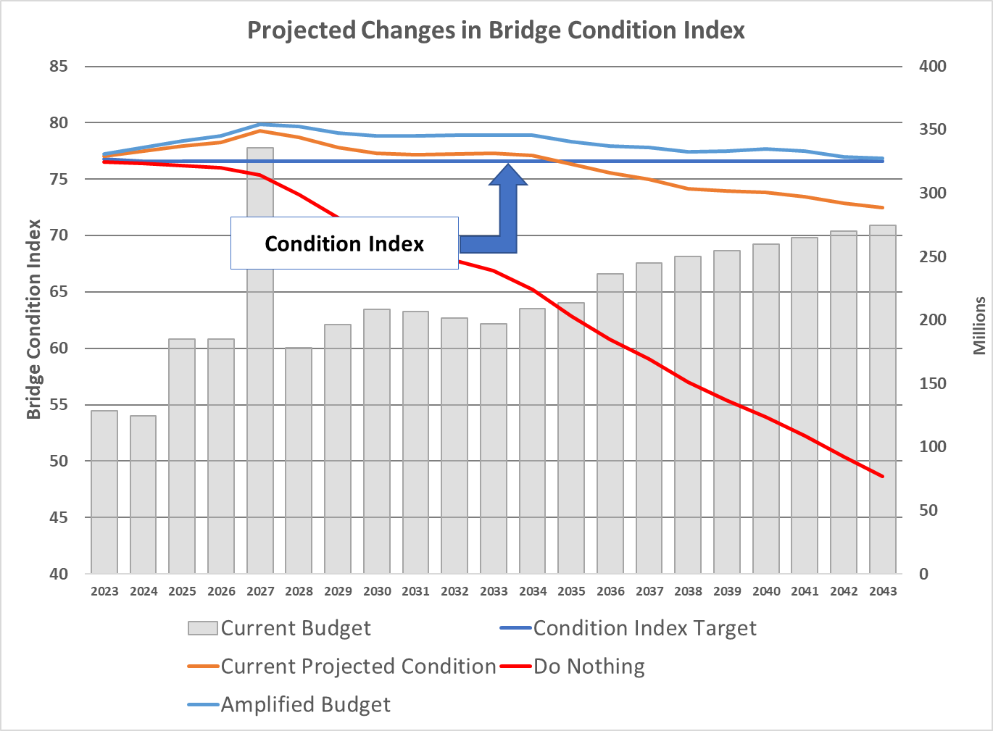
Condition Forecast
Notes:
OneDrive - Iowa Department of Transportation\Documents\2023 commission meeting\Graphs 4.3 & 5.7 for Non-inter & 4.6 & 5.9 for Non-Inter on NHS and Interstate – copy.xlsx

Slide 24



Additional Needs
There is a need to replace or rehabilitate several large bridges over the next 20 years.
US-63: Ottumwa Viaduct over Des Moines River (deck replacement in FY2028- $25 million)
I-129: Sioux City over Missouri River (barrier rail replacement in FY2024 - $3.5 million)
IA-9: Lansing (Black Hawk) over the Mississippi River (replace in FY2024, $64 million)
I-80: Le Claire (Fred Schwengel) over the Mississippi River (replace in FY2026, $150 million)
IA-12: Sioux City (Gordon Drive Viaduct) (replace in FY2027, $109 million)
US-67: Davenport (Centennial) over the Mississippi River (replace beyond 2028, $110 million)
IA-175: Decatur over the Missouri River (replace - $60 million )
US-20: Dubuque (Julien-Dubuque) over the Mississippi River (replace - $175 million )
US-30: Clinton (Gateway) over the Mississippi River (replace - $125 million )
IA-926: Fort Dodge (Karl King Viaduct) over Des Moines River (replace - $30 million)
Note: the costs shown above represent Iowa’s estimated share for border bridges.
In 5 Years
In 10 Years
In 20 Years
24
Notes:
15 bridges over Mississippi River, 12 bridges over Missouri River, 1 owned by the city of Akron and South Dakota, and 11 bridges over other waterways

Slide 25
Key Take-Aways
There is a large inventory of bridges built in the 1950’s, 1960’s and 1970’s.
Good progress has been made reducing the number of bridges classified as poor. This trend is likely to reverse due to the large number of aging bridges.
Border bridges represent large capital improvement projects that need to be planned for far in advance.
A sustained focus on stewardship is critical.

