Slide 1
Transportation Trends Update
Transportation Commission Workshop
February 13, 2024

Slide 2
Overview
US total rail carloads
Commercial air service passenger counts
Vehicular traffic
Mississippi River and Panama Canal

Slide 4
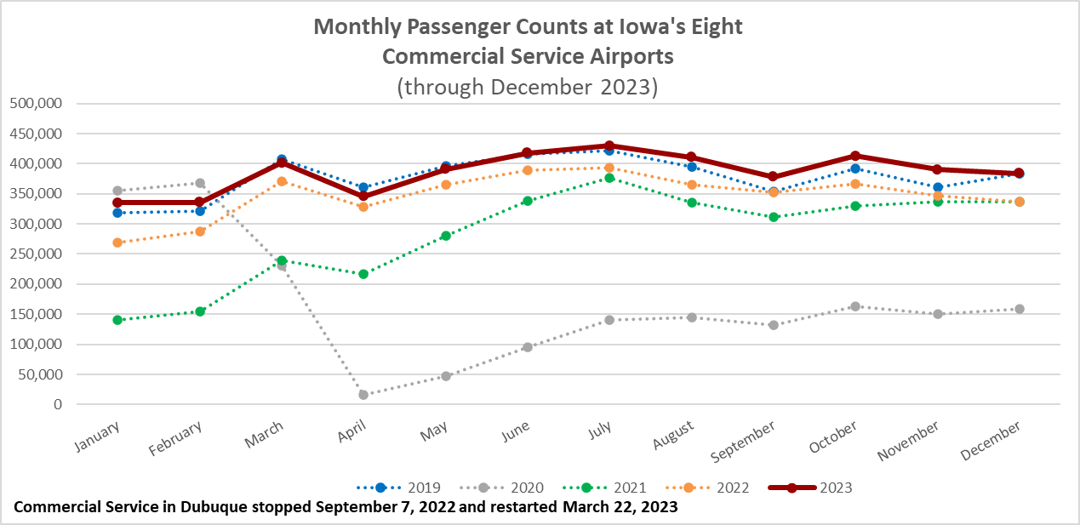

Slide 5
Monthly State Vehicle Miles of Travel
(through December 2023)

Slide 6
Mississippi River
Water levels have been falling since June
Drought expected to continue into winter
Result is barges are not fully loaded with grain causing reduced barge supply
Impacts partially mitigated by lower demand for shipping by barge
Panama Canal
Drought has reduced the amount of freshwater available to use for the lock system
Maximum ships per day is 24. Normal is 36 to 38
Forty percent of all US container traffic travels through the Panama Canal
“The passage of one ship is estimated to consume as much water as half a million Panamanians use in one day.” New York Times, Nov. 1, 2023

Slide 7
Questions?

