Slide 1


Bridge Asset Management
Scott Neubauer, PE
Iowa DOT Bridges and Structures Bureau
Transportation Commission Workshop
February 13, 2024

Slide 2


Presentation Overview
Preservation Activities
2. Bridge Inventory
3. Condition Summary
4. Funding Scenarios

Slide 3
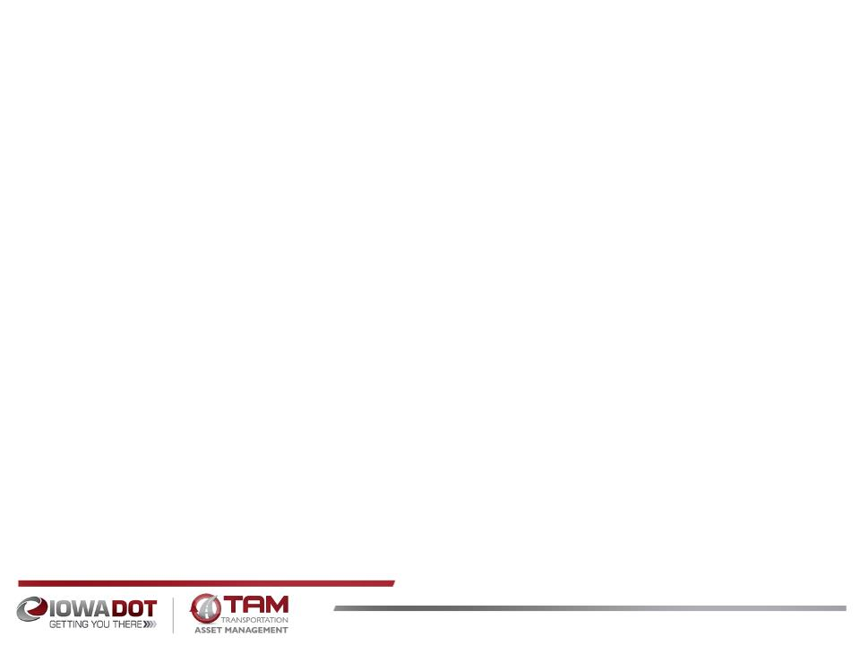
Bridge Preservation and Maintenance
What are some of the things we’re doing to preserve and maintain bridges?
Replace aging deck joints
Overlay decks with new wearing surface
  Dense concrete layer
  Polyester Polymer layer
  Latex modified concrete layer
  Epoxy polymer layer
  Repair beams ends
  Epoxy Inject or Patch deteriorated deck areas
  Install berm and bank protection
  Use stainless steel reinforcing in areas with high potential for corrosion
  Use High Performance Concrete (HPC) in new bridge decks
  Use fewer or no deck joints
  Use of Non-Destructive Evaluation (NDE) methods to assess condition
Notes:
NDE: Impact Echo, GPR, Infra red thermography, Hammer sounding, Ultrasonic Wave, Sonar, Mag particle, Dye Penetrant, Acoustic imaging, Harmonic vibration,

Slide 4
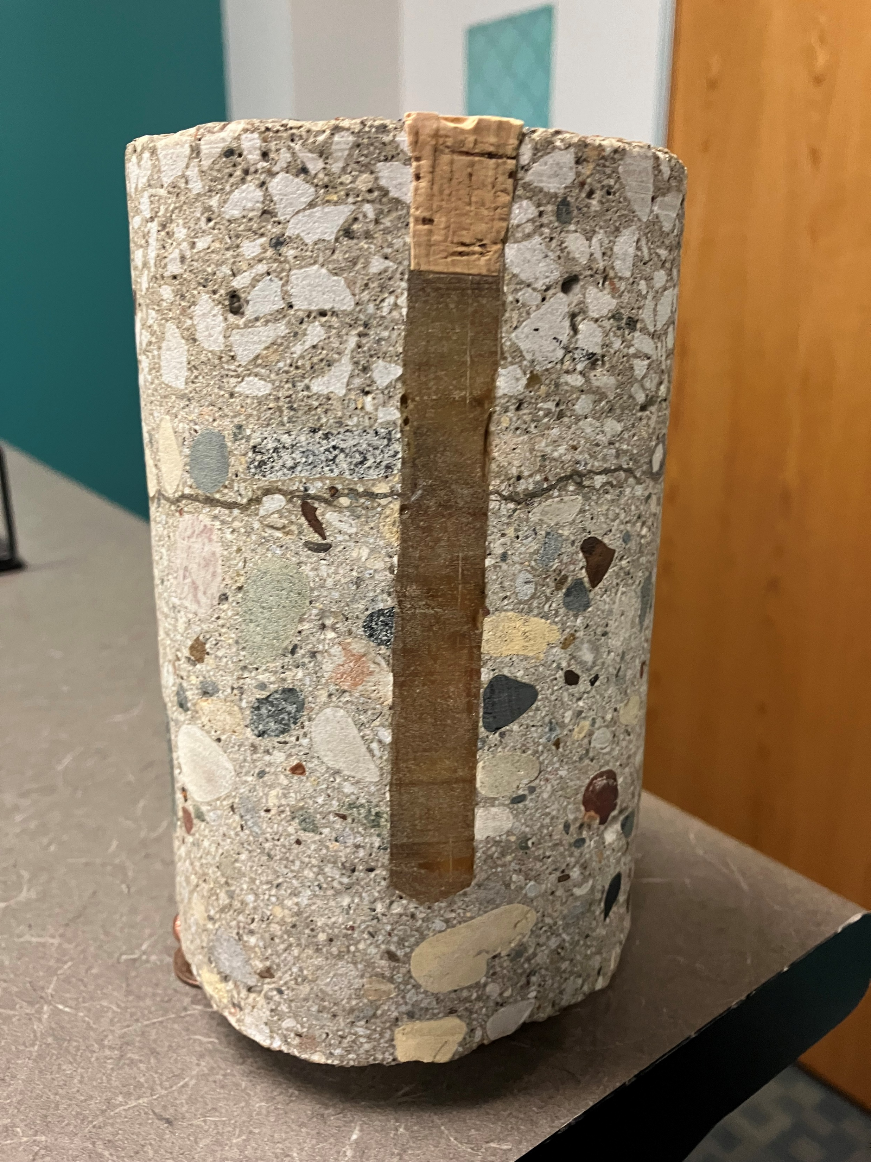
Bridge Preservation and Maintenance with Epoxy Injection
Overlay
Delamination
Notes:
Epoxy injection

Slide 5
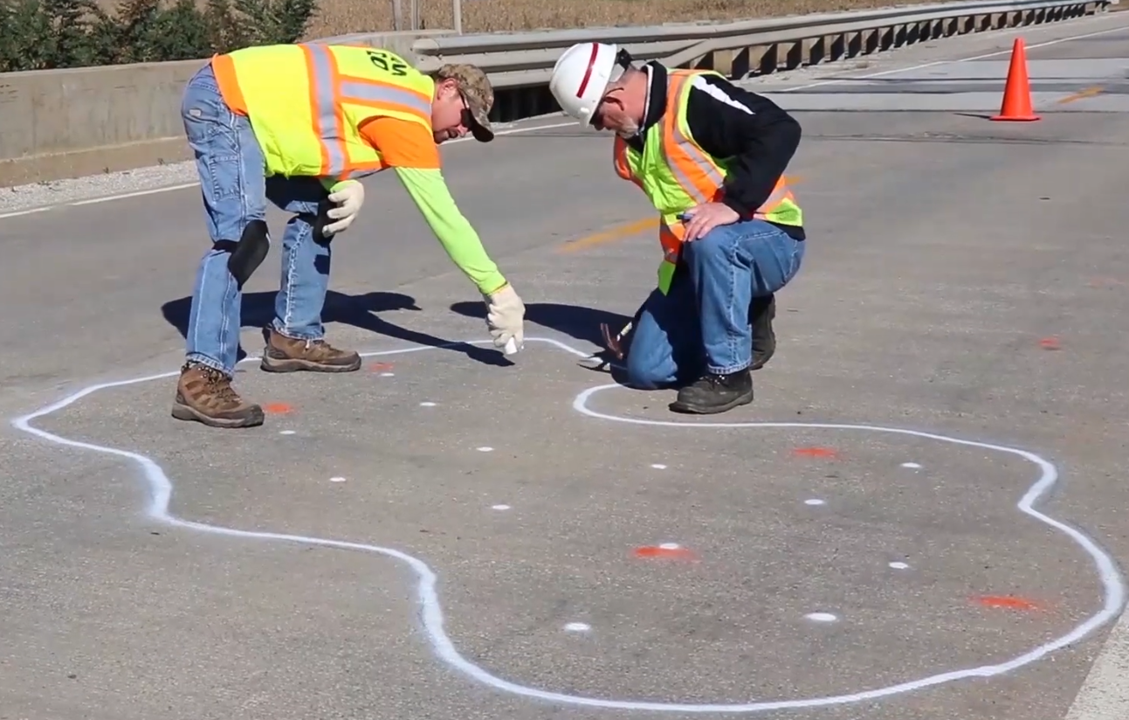
Bridge Preservation and Maintenance with Epoxy Injection
Notes:
“Epoxy injection demonstration” on Youtube

Slide 6
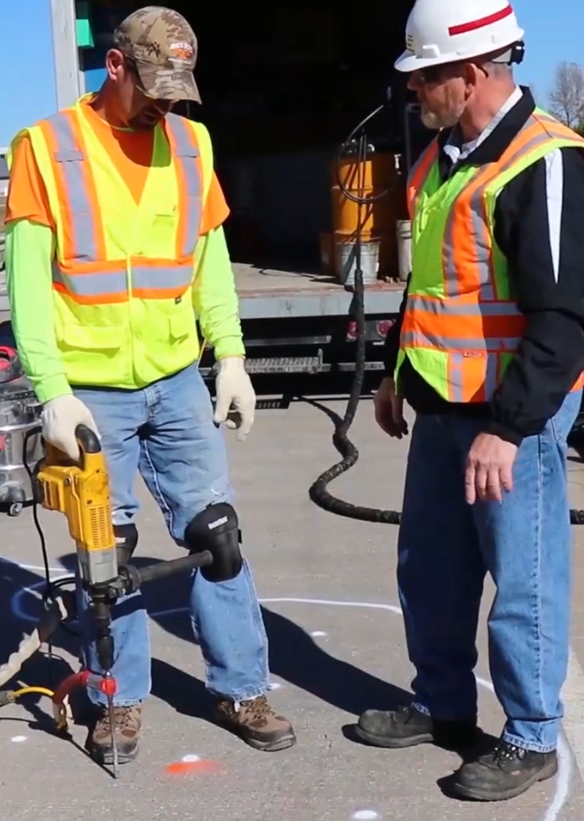
Bridge Preservation and Maintenance with Epoxy Injection
Notes:
Epoxy injection

Slide 7
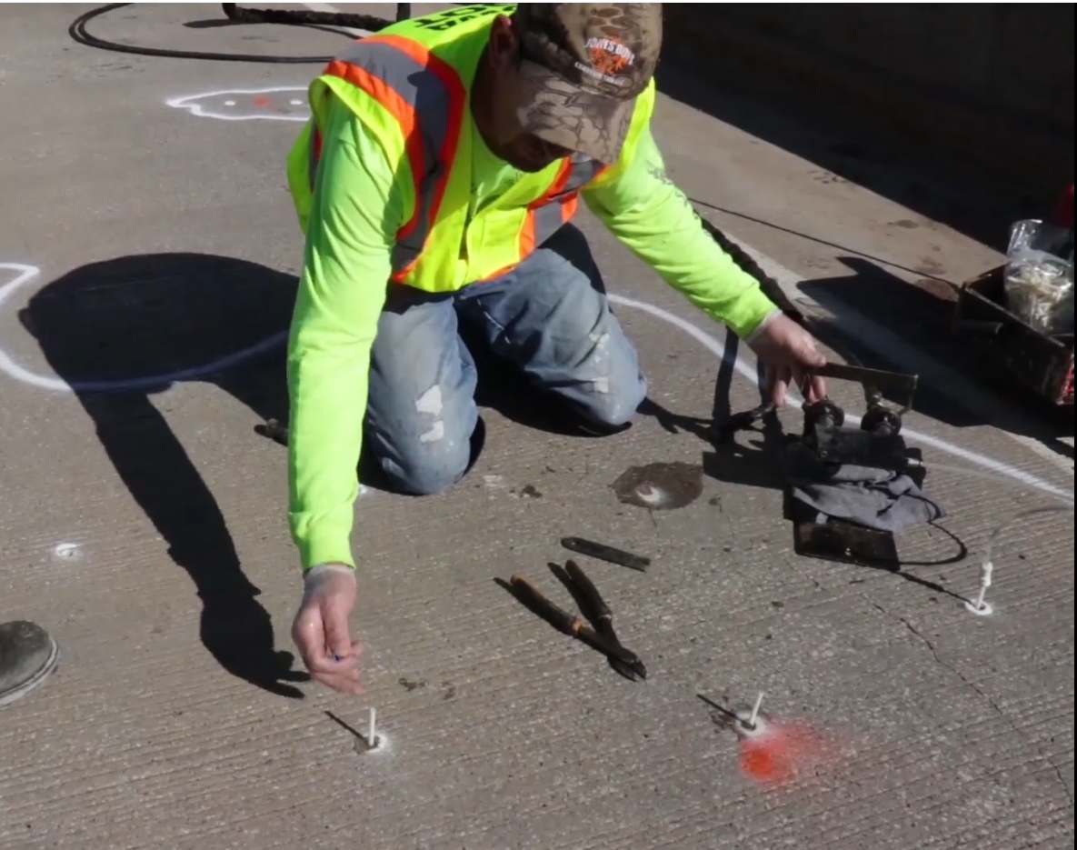
Bridge Preservation and Maintenance with Epoxy Injection
Notes:
Epoxy injection

Slide 8
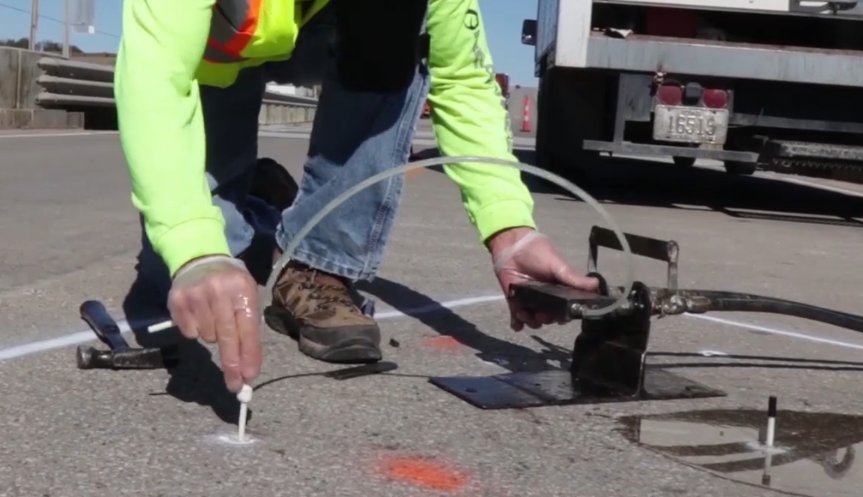
Bridge Preservation and Maintenance with Epoxy Injection
Notes:
Epoxy injection

Slide 9
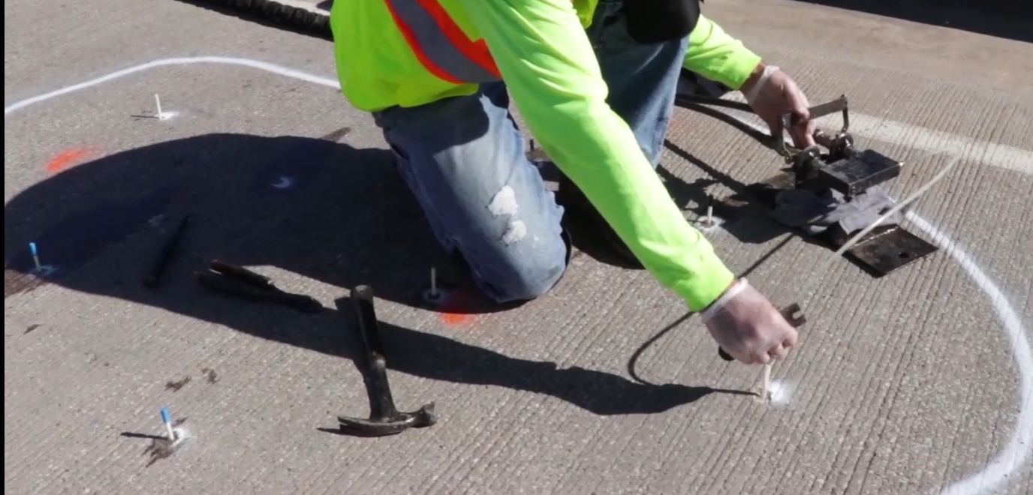
Bridge Preservation and Maintenance with Epoxy Injection
Notes:
Epoxy injection

Slide 10
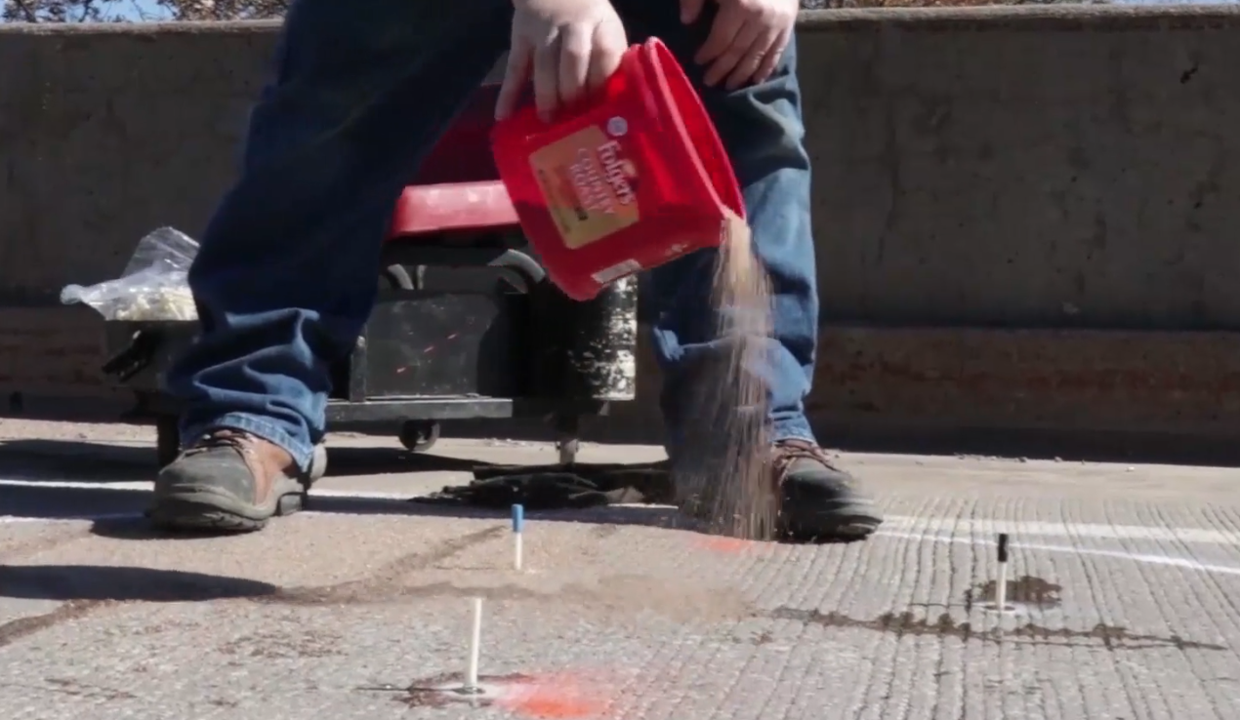
Bridge Preservation and Maintenance with Epoxy Injection
Notes:
Epoxy injection

Slide 11
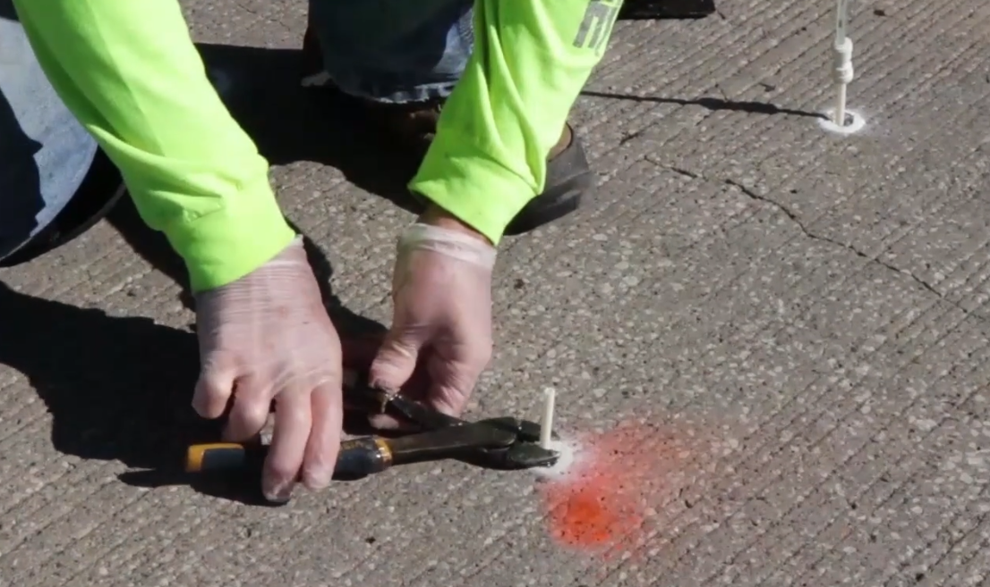
Bridge Preservation and Maintenance with Epoxy Injection
Notes:
Epoxy injection

Slide 12
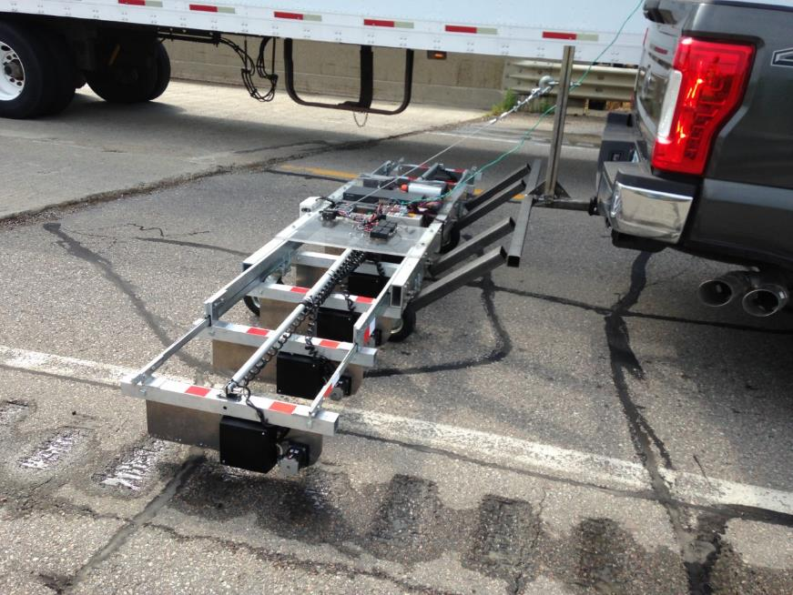

Slide 13
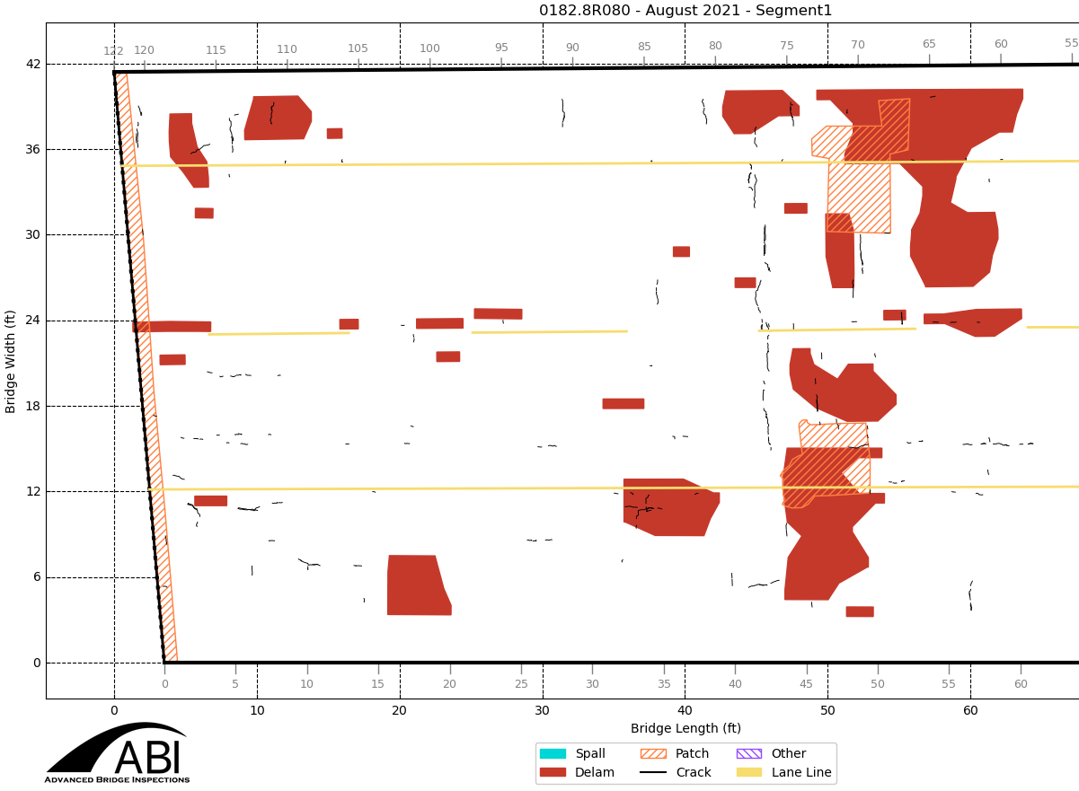

Slide 14
Bridge Inventory
State Owned Inventory
  The primary system includes 4,174 bridges and large culverts
  The deck area of all primary system bridges is over 46.5 million square feet – that’s approximately 1.7 square miles. (over 820 football fields)
  If we had to replace these bridges today, the cost would exceed $20 billion. (this would be more than 20 years of our entire program)
  Average VPD 6515. Median VPD 3500.
  Local Agency Owned Inventory
    The secondary system includes 19,514 bridges and large culverts
      County owned = 18,268
      City owned = 1,240
      Other owners = 6
    The deck area of all secondary system bridges is over 50.0 million square feet – That is approximately 1.8 square miles.
    Average county VPD 202. Median VPD 46
    Average city VPD 3089. Median VPD 1515
Notes:
2588 bridges on the NHS. 26 total Poor. 12 Poor on NHS. 716 interstate bridges. 3458 non-interstate bridges. 4174 total bridges.
Make comment that there are 23,862 bridges statewide. Iowa’s status as number one state with the most Poor/SD bridges (4551) due to local bridges.
17.0% of bridges are on the interstate. 25.3% of the total deck area in on the interstate.
$9 billion to replace in-kind. $425/ft^2 vs $200/ft^2
The Des Moines River bridge on I-235 has the highest VPD at 89,000.
Football field is 57,600ft^2

Slide 15
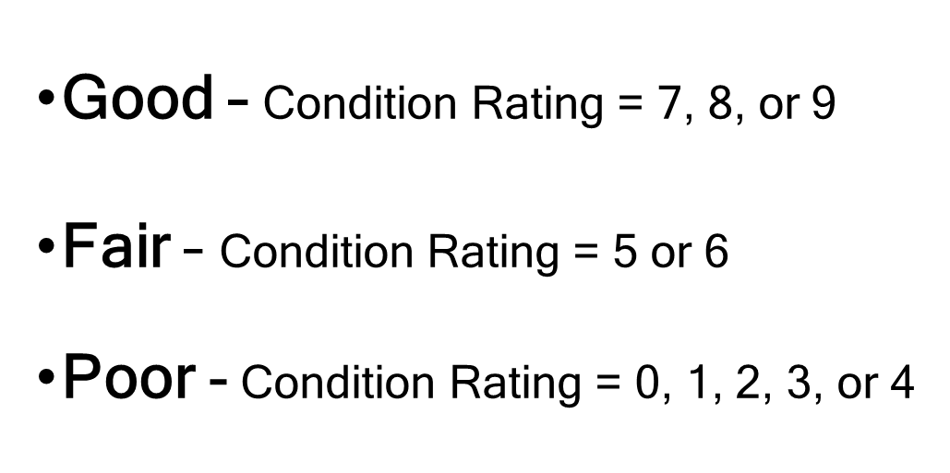
Notes:
Discuss inspection and how we arrive at Good, Fair, and Poor.

Slide 16
Iowa’s Comparison to Other States
Highest Bridge Counts per State
Highest Count of Poor Bridges per State
Notes:
Updated from 2023 submittal
Rhode Island only has 780 bridges and 120 are Poor

Slide 17
Iowa’s Primary Highway Bridges Compared to Other States
Notes:
Updated from 2023 submittal.

Slide 18
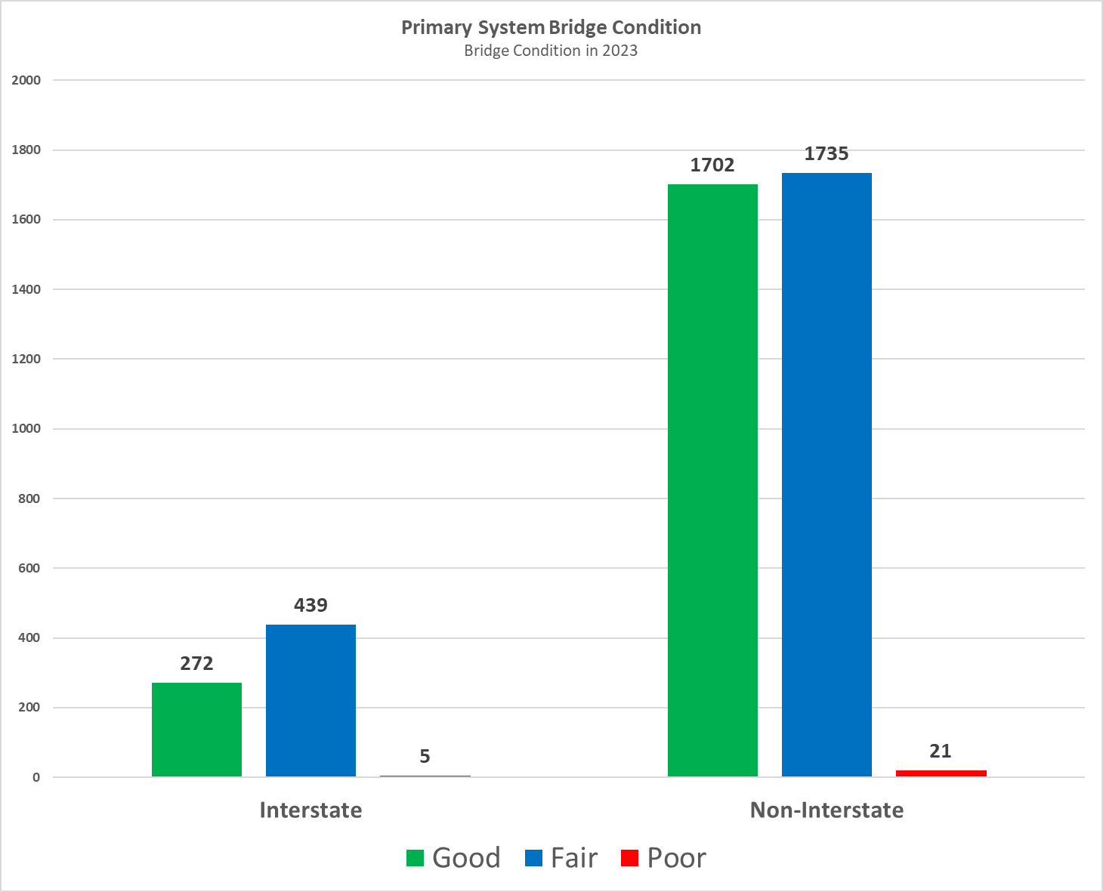
Notes:
Updated from 2023 submittal. 4 Poor interstate bridges have been repaired or replaced. 1 Poor interstate bridge is programmed for replacement in 2028.

Slide 19
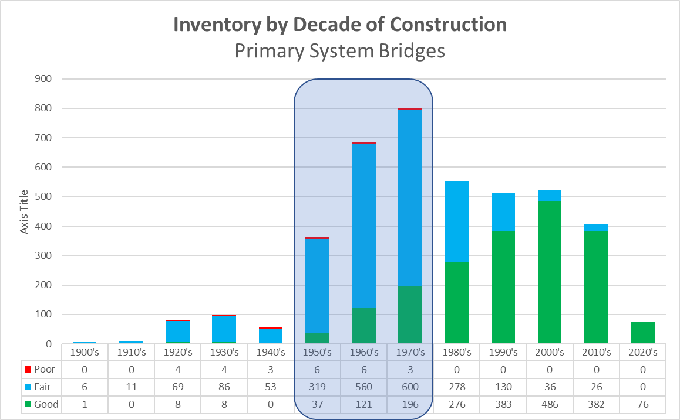
Notes:
Updated from 2023 submittal

Slide 20
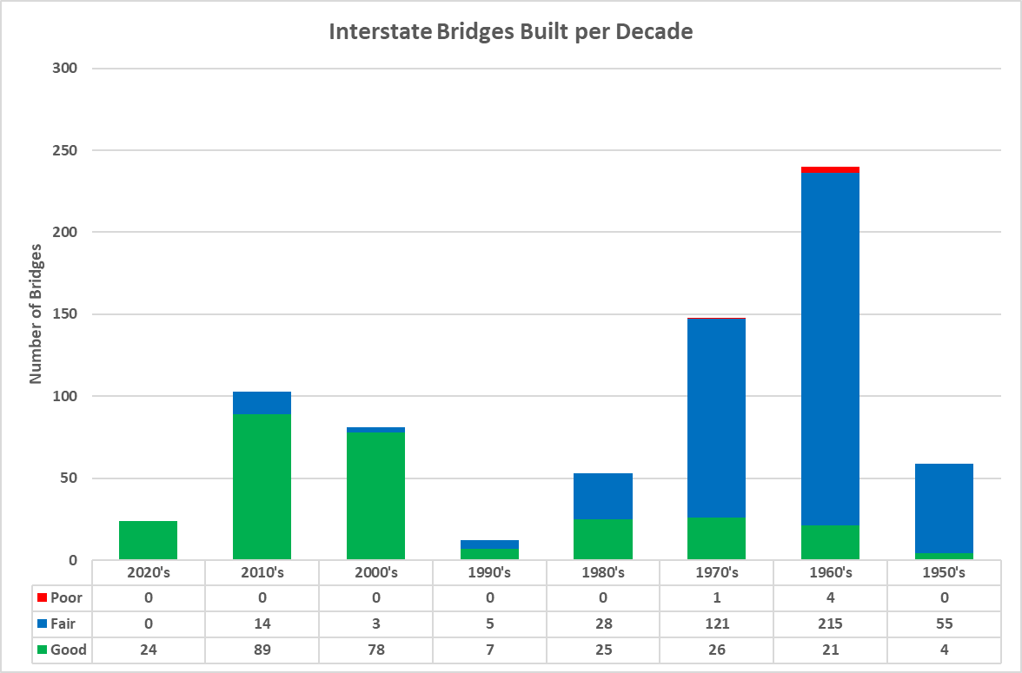
Notes:
From 2023 submittal. Average age of the 18 bridges replaced in the 2020’s was 55 years. The remaining 6 bridges built in the 2020’s were not replacements.

Slide 21
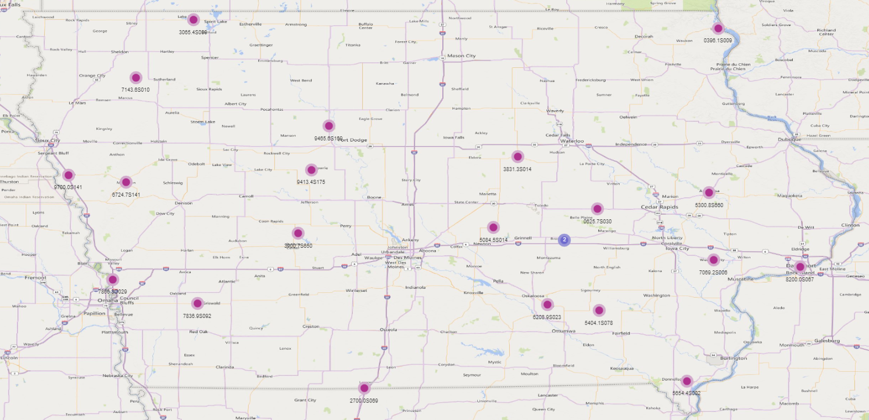
Poor Bridges on Primary Highways
Notes:
Only 26 Poor bridges in 2023. 4 border bridges are Poor. Only 22 shown on map due to 4 being replaced or repaired, 19 are programmed. All but 3 are programmed for replacement or repair.
Poor bridges statewide = 4551, down from 4599 in 2022.
3 posted poor bridges (2 border, 1 state park). 1 closed has been opened after repairs.

Slide 22
Typical Bridge Costs
Replacements cost from:
  $2.6M Non-Interstate
  $3.1M Interstate (outliers not included)
Rehabilitations cost from:
  $0.25M to $1.3M
New Bridges cost from:
  $2.9M Non-Interstate
  $4.8M Interstate (outliers not included)
Notes:
898 Steel Girder Bridges
1868 PPCB bridges
562 Slab bridges
825 culverts
21 Other types of bridges
60 to 70% of bridges are $3 million or less (average = $1.5 million). Average of the other 30 to 40% is $6.3 million (2021 information)

Slide 23
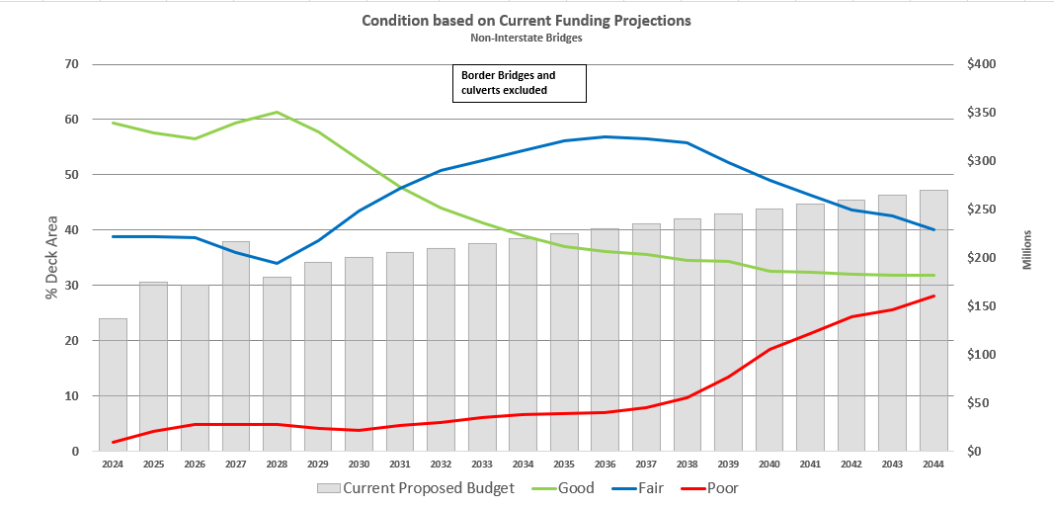
Condition Forecast
Notes:
OneDrive - Iowa Department of Transportation\Documents\2024 commission meeting\
FHWA requirement to keep NHS below 10% of deck area as Poor.

Slide 24
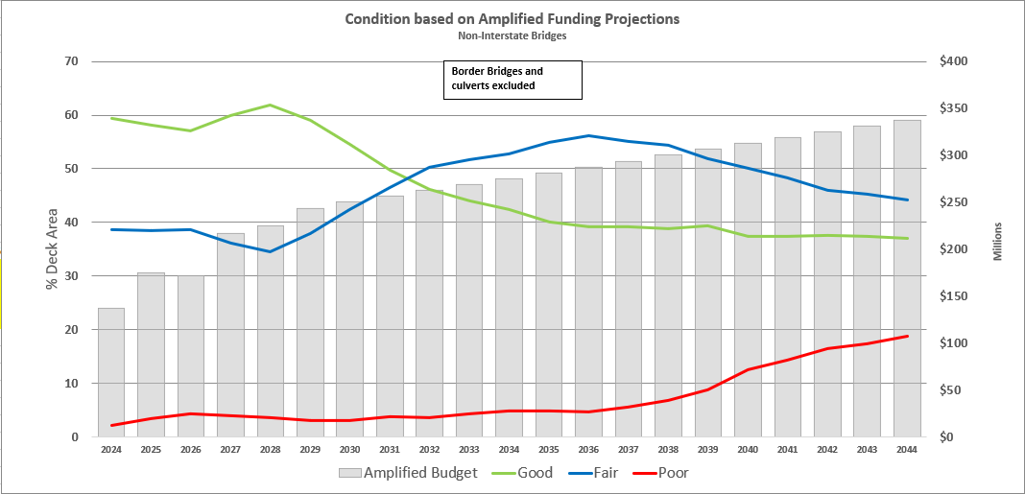
Condition Forecast
Notes:
OneDrive - Iowa Department of Transportation\Documents\2024 commission meeting
Amplified budget is 125% of proposed budget.

Slide 25
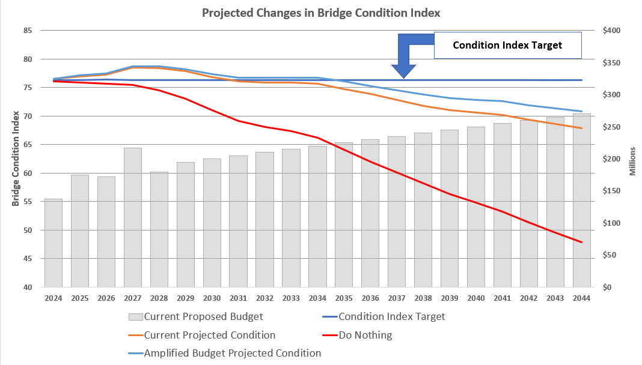
Condition Forecast
Notes:
OneDrive - Iowa Department of Transportation\Documents\2024 commission meeting

Slide 26



Additional Needs
There is a need to replace or rehabilitate several large bridges over the next 20 years.
  IA-9: Lansing (Black Hawk) over the Mississippi River (replace in FY2024, $62.5 million)
  I-129: Sioux City over Missouri River (barrier rail replacement in FY2025 - $9.5 million)
  IA-149: Ottumwa Viaduct over Des Moines River (deck replacement in FY2028- $25 million)
  I-80: Le Claire (Fred Schwengel) over the Mississippi River (replace in FY2028, $150 million)
  IA-12: Sioux City (Gordon Drive Viaduct) (replace in FY2029, $200 million)
  US-67: Davenport (Centennial) over the Mississippi River (replace beyond 2030, $110 million)
  IA-175: Decatur over the Missouri River (replace - $60 million )
  US-20: Dubuque (Julien-Dubuque) over the Mississippi River (replace - $175 million )
  US-30: Clinton (Gateway) over the Mississippi River (replace - $125 million )
  IA-926: Fort Dodge (Karl King Viaduct) over Des Moines River (replace - $30 million)
Note: the costs shown above represent Iowa’s estimated share for border bridges.
In 5 Years
In 10 Years
In 20 Years
26
Notes:
15 bridges over Mississippi River, 12 bridges over Missouri River, 1 owned by the city of Akron and South Dakota, and 11 bridges over other waterways
Nebraska is applying for a grant to replace IA-175.

Slide 27
Key Take-Aways
There is a large inventory of bridges built in the 1950’s, 1960’s and 1970’s.
Good progress has been made reducing the number of bridges classified as poor. This trend is likely to reverse due to the large number of aging bridges.
Border bridges represent large capital improvement projects that need to be planned for far in advance.
A sustained focus on stewardship is critical.

