Slide 1
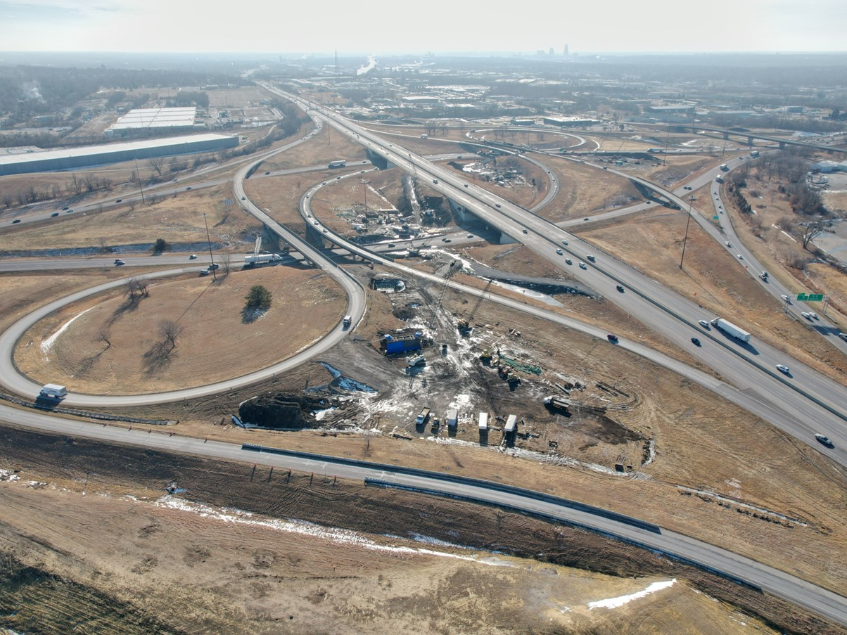


2025-2029 Highway Program Development
February 13, 2024
3/2/2023

Slide 2
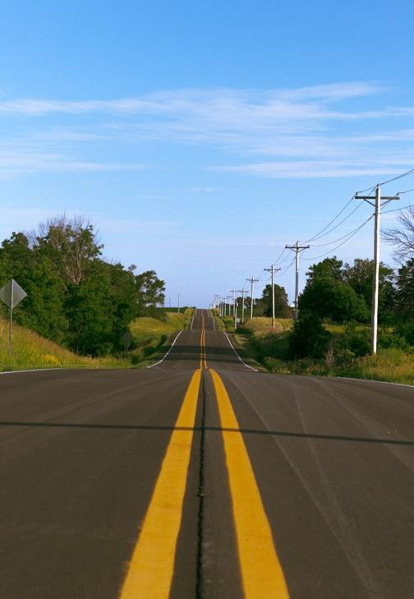

Agenda
TOPIC 1
2025-2029 Highway Program Development Schedule
TOPIC 2
Extended Highway Program Analysis
TOPIC 3
Statewide Line Items
At what levels should the line item targets be programmed?
TOPIC 4
Federal Funding Status
Program Development Considerations
Next Steps

Slide 3
Topic 1
2025-2029 Highway Program Development Schedule

Slide 4
February 13, 2024
Highway Program Development Schedule (2025-2029)
February 2024
Discuss Extended Highway Program Analysis
Discuss Statewide Line Items
At what levels should the line item targets be programmed?
March 2024
Discuss 2025-2029 available Highway Program funding
Discuss 2025-2029 Highway Program options
Determine 2025-2029 available Highway Program Objectives
Action Item: Line Item Targets for Programming
April 2024
Develop the Draft 2025-2029 Highway Program
Action Item: 2025-2029 Highway Program Objectives
May 2024
Present the Draft 2025-2029 Iowa Transportation Improvement Program to the public (including all previous program approvals and Draft 2025-2029 Highway Program)
April 2024
Action Item: Approve the 2025-2029 Iowa Transportation improvement Program

Slide 5
Topic 2
Extended Highway Program Analysis

Slide 6
February 13, 2024 as presented on January 9, 2024
2024-2033 Highway Program Analysis
For Highway Planning Purposes Only (x $1,000,000)

Slide 7
February 13, 2024
2025-2034 Highway Program Analysis
For Highway Planning Purposes Only (x $1,000,000)
 |  |  |  |  |  |  |  |  |  |  | Extended Highway Program
 |  | 2025 |  | 2026 |  | 2027 |  | 2028 | 2029 |  | 2030 |  | 2031 |  | 2032 |  | 2033 |  | 2034
Projected Funds |  | 863.4 |  | 867.0 |  | 857.3 |  | 846.1 | 846.1 |  | 846.1 |  | 846.1 |  | 846.1 |  | 846.1 |  | 846.1
Highway Program Components
Interstate Stewardship |  | 218.7 |  | 220.5 |  | 236.1 |  | 185.0 | 190.0 |  | 195.0 |  | 200.0 |  | 205.0 |  | 210.0 |  | 215.0
Non-Interstate Pavement Modernization |  | 150.0 |  | 155.0 |  | 200.0 |  | 210.0 | 220.0 |  | 225.0 |  | 230.0 |  | 235.0 |  | 240.0 |  | 245.0
Non-Interstate Bridge Modernization |  | 155.2 |  | 143.3 |  | 177.8 |  | 190.0 | 205.0 |  | 210.0 |  | 215.0 |  | 220.0 |  | 225.0 |  | 230.0
Safety Specific |  | 33.0 |  | 34.0 |  | 35.0 |  | 36.0 | 37.0 |  | 38.0 |  | 39.0 |  | 40.0 |  | 41.0 |  | 42.0
Non-Interstate Capacity/System Enhancement |  | 201.5 |  | 210.9 |  | 195.2 |  | 235.3 | 170.8 |  | 6.6 |  | 0.0 |  | 0.0 |  | 0.0 |  | 0.0
Major Interstate Capacity/System Enhancement |  | 182.1 |  | 175.4 |  | 69.2 |  | 78.2 | 81.3 |  | 76.6 |  | 1.2 |  | 0.0 |  | 0.0 |  | 0.0
Highway Program Balance |  | (77.0) |  | (72.1) |  | (56.0) |  | (88.4) | (58.0) |  | 94.9 |  | 160.9 |  | 146.1 |  | 130.1 |  | 114.1
Underfunded Projects |  | 50.0 |  | 25.0 |  | 35.0 |  | 60.0
Highway Program Balance |  | (27.0) |  | (47.1) |  | (21.0) |  | (28.4) | (58.0) |  | 94.9 |  | 160.9 |  | 146.1 |  | 130.1 |  | 114.1
Black: Previous discussion
( ): Indicates Highway Program is over-programmed
Green: Changes since previous discussion

Slide 8
Topic 3
Statewide Line Items

Slide 9
February 13, 2024
Draft 2025-2029 Iowa Highway Program Line Items
At what levels should the line item targets be programmed?
March Action Item:
Line Item Targets for Programming

Slide 10
February 13, 2024
Draft 2025-2029 Iowa Highway Program Line Items
Interstate Lighting
 |  | Project Estimated Costs X $1000
Location | Type Of Work | 2025 | 2026 | 2027 | 2028 | 2029
Statewide Interstate Lighting | Lighting | 500 | 500 | 500 | 500 | 500
 |  | 1,300 | 1,300 | 1,300 | 1,300 | 1,300
Interstate Stewardship Line Item
Some Interstate light towers need to be replaced due to age and condition.
Need to convert bulbs to LED.
Recommend additional annual funding for updates/replacement.

Slide 11
February 13, 2024
Draft 2025-2029 Iowa Highway Program Line Items
Rest Area Maintenance
 |  | Project Estimated Costs X $1000
Location | Type Of Work | 2025 | 2026 | 2027 | 2028 | 2029
Statewide Interstate Rest Area and Scale Maintenance | Rest Area Improvement | 8,900 | 9,000 | 9,100 | 9,200 | 9,300
 |  | 900 | 900 | 900 | 900 | 900
Interstate Stewardship Line Item
Shift rest area and scale building maintenance costs from operations budget to Program line item
Small additional increase for installation of vault toilets at truck parking locations without permanent rest room facilities.

Slide 12
February 13, 2024
Draft 2025-2029 Iowa Highway Program Line Items
Statewide Interstate Pavement Rehabilitation
 |  | Project Estimated Costs X $1000
Location | Type Of Work | 2025 | 2026 | 2027 | 2028 | 2029
Statewide Interstate Pavement Rehabilitation | Pavement Rehab |  | 15,000 | 15,000 | 15,000 | 15,000
Interstate Stewardship Line Item
Recommend setting aside $15 million of Interstate Stewardship for each of the last four-years of every Program instead of fully programming all available Interstate Stewardship funding all five years.
Provides for flexibility to identify Interstate pavement rehab needs that arise unexpectedly each year

Slide 13
February 13, 2024
Draft 2025-2029 Iowa Highway Program Line Items
Construction Industry Training Program
 |  | Project Estimated Costs X $1000
Location | Type Of Work | 2025 | 2026 | 2027 | 2028 | 2029
Construction Industry Training Program | Miscellaneous | 1,000 | 1,000 | 1,000 | 1,000 | 1,000
 |  | 300 | 300 | 300 | 300 | 300
Increase to support expanded training for construction industry

Slide 14
February 13, 2024
Draft 2025-2029 Iowa Highway Program Line Items
Consultant Services
 |  | Project Estimated Costs X $1000
Location | Type Of Work | 2025 | 2026 | 2027 | 2028 | 2029
Statewide Consultant Services | Outside Services Engineering | 59,000 | 59,000 | 59,000 | 59,000 | 59,000
 |  | 5,000 | 5,000 | 5,000 | 5,000 | 5,000
Increase to cover additional use and cost of consultant services for project development and inspection.

Slide 15
February 13, 2024
Draft 2025-2029 Iowa Highway Program Line Items
Statewide Operations
 |  | Project Estimated Costs X $1000
Location | Type Of Work | 2025 | 2026 | 2027 | 2028 | 2029
Statewide Operations | Outside Services Engineering | 11,000 | 11,000 | 11,000 | 11,000 | 11,000
 |  | 1,450 | 1,450 | 1,450 | 1,450 | 1,450
Statewide operations line item previously included some costs for Highway Helper while some Highway Helper costs were paid with project construction funding.
This change shifts all Highway Helper costs to the Statewide Operations line item.

Slide 16
February 13, 2024
Draft 2025-2029 Iowa Highway Program Line Items
Summer Maintenance Materials
 |  | Project Estimated Costs X $1000
Location | Type Of Work | 2025 | 2026 | 2027 | 2028 | 2029
Summer Maintenance Materials | Miscellaneous | 1,500 | 1,500 | 1,500 | 1,500 | 1,500
New Line Item
There is a need for dedicated funding to cover materials used by DOT staff for small repairs on pavements and bridges.
Split amongst District Offices

Slide 17
February 13, 2024
Draft 2025-2029 Iowa Highway Program Line Items
Pavement Marking Materials
 |  | Project Estimated Costs X $1000
Location | Type Of Work | 2025 | 2026 | 2027 | 2028 | 2029
Pavement Marking Materials | Miscellaneous | 5,700 | 7,700 | 7,700 | 7,700 | 7,700
New Line Item
Shifts funding from operations budget to Program funds ($3.8 million per year)
Provides for funding increase to implement enhanced pavement markings

Slide 18
Topic 4
Federal Funding Status
Program Development Considerations
Next Steps

Slide 19
February 13, 2024
Federal Funding Status
FFY 2024 Appropriation: Third continuing resolution expires March 1
Infrastructure Bill authorizes federal funding through September 30, 2026, leaving some funding uncertainty for the last three years of this Program.
Infrastructure Bill funding allocations based on Commission action in June 2022.
The next Highway Trust Fund cliff is in 2028.

Slide 20
February 13, 2024
Program Development Considerations
Construction cost inflation is moderating.
State road funding continues to come in higher than forecast.
The last three years of federal funding in this Program are not part of an authorization.
Continue to prioritize bridge and pavement stewardship investments on existing highway system.
Pursue grant funding opportunities.
Assess balance of pavement and bridge stewardship investments.
Balance capacity improvements with stewardship needs.
Address major river crossing needs.

Slide 21
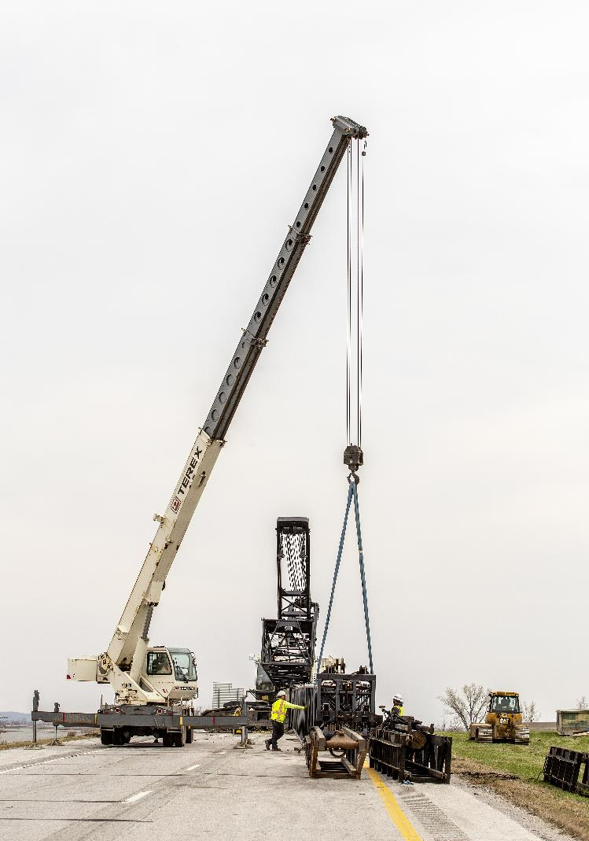
Next Steps
Discuss 2025-2029 available Highway Program funding
Discuss 2025-2029 Highway Program Options
Determine 2025-2029 Highway Program Objectives
Action Item: Line Item Targets for Programming

Slide 22
Questions?

