Slide 1
Primary Road Fund Experience July 2018 to November 2018
Jan 8, 2019
Forecast PRF receipts $335.5 million
Actual PRF receipts $365.1 million
Difference +$29.6 million
previous difference reported +$18.2 million

Slide 2
Project Costs vs. Programmed Amounts July 2018 to December 2018
Jan 8, 2019
Programmed Amounts $325.7 million
Project Costs $324.7 million
Difference +$1.0 million
previous difference reported +$6.2 million

Slide 3
Program Balance (19.3) (June 2018) PRF Forecast Experience 29.6 (Nov 2018) Project Costs vs. Programmed Amounts 1.0 (Dec 2018) Program Balance 11.3 (Dec 2018) previous difference reported +$5.1 million
Jan 8, 2019
FY 2019 Highway Program Balance
(For Highway Planning Purposes) (x $1,000,000)
2019

Slide 4
Jan 8, 2019
Note:
June 2019 letting includes $88 million for cash flow portion of programmed amount for I-74 Mississippi River Bridge

Slide 5
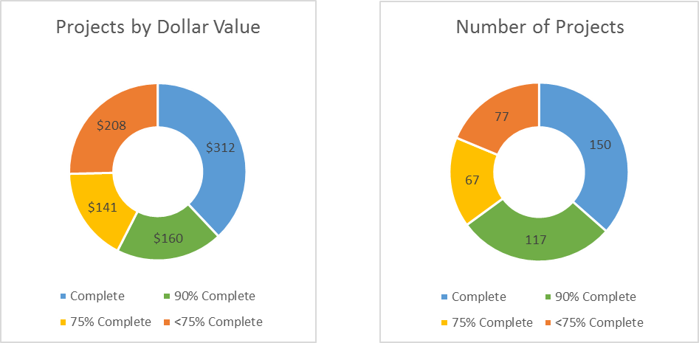
Construction Status
(mock-up for comment)

Slide 6
Jan 8, 2019
Fiscal Year Overview
Revenue: Continues to fluctuate from month-to-month but overall higher than forecast and expect that to continue.
Lettings:
46 percent of the Program has been let
Approximately $383 m of work remains to be let
Construction has been slowed by winter weather until spring

Slide 7
Jan 8, 2019
Primary Road Fund Balance
Primary Road Fund balance (Nov. 1): $252.5 million
Previous month: $253.7 million
Lowest projected balance in FY 2019: $133.4 million in May 2019
Previous month: $111.7 million in May 2019
Lowest projected balance in FY 2020: -$25.0 million in Nov. 2019
Previous month: -$37.8 million in Nov. 2019
Current RISE Fund Balance: $55.4 million
Previous month: $55.4 million

