Slide 1

State Transportation Plan
Implementation Update
Iowa Transportation Commission
January 8, 2019

Slide 2
Discussion overview
Brief background
Plan strategies and recent implementation activities
Performance measurement
Critical implementation next steps

Slide 3
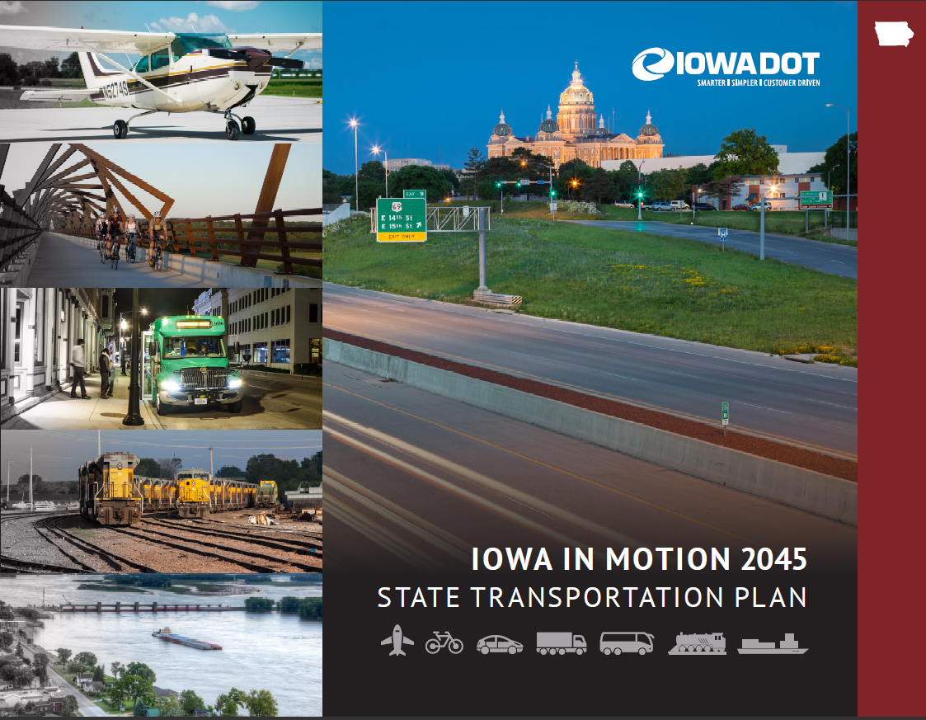
Background
State Transportation Plan adopted by Iowa Transportation Commission May 2017
Significant Plan implementation activity has taken place

Slide 4
Strategies
Plan included 80 strategies for Iowa DOT and Commission to work toward implementing across 12 modal/subject areas
  Asset management
  Aviation
  Bicycle/pedestrian
  Bridge
  Energy
  Freight
  Highway
  Public transit
  Rail
  Safety
  Technology
  Transportation system management and operation (TSMO)

Slide 5
Strategy implementation
Aviation
  Starting development of an aviation system plan update
  Outreach and training on unmanned aircraft systems
Bicycle/pedestrian
  Completed Bicycle and Pedestrian Long-Range Plan
  Complete Streets policy adopted; implementation beginning
  Updating design guidelines
Public transit
  Applying for discretionary grants for bus replacement – three grant awards totaling $14.9 million to replace 167 vehicles
  Starting development of a public transit system plan
  Park and ride plan implementation – three new park and ride locations created; counting users and collecting condition data at all lots
Rail
  Rail system plan completed

Slide 6
Strategy implementation
Bridge
  Transitioning to new Bridge Management program for use in creating deterioration and funding models and developing condition forecasts
  Applying for discretionary grants from FHWA’s Competitive Highway Bridge Program
Energy
  IEDA/Iowa DOT joint Iowa Energy Plan completed
  Propane study completed
  Joint response planning in support of Iowa’s Energy Assurance Plan
Freight
  Freight Plan updated to be FAST Act compliant
  Linking Iowa’s Freight Transportation System (LIFTS) program created to support freight intermodal and freight rail projects
  Integrating considerations for the Iowa Multimodal Freight Network into the design process
  Advancing efforts on Upper Mississippi River/M-35 Corridor

Slide 7
Strategy implementation
Safety
  Completed 2019-2023 Strategic Highway Safety Plan update
  Implementation of road diets on state and local projects
  Integrating methodologies identified in AASHTO’s Highway Safety Manual into the project development process to improve safety performance of the roadway
Technology
  New position created for Automated Transportation and ITS Program Manager
  Incorporation of “pause points” to consider impacts of disruptive technology
TSMO
  Implementation of traffic incident management (TIM) to provide a systematic approach to managing highway incidents through coordination of emergency response and quick clearance
  Integrated corridor management (ICM) studies of I-380 and the Des Moines area to analyze operational alternatives to improve system performance

Slide 8
Strategy implementation
Asset management
  Integration of asset management into department functions
  Establishing the Transportation Asset Management (TAM) Implementation Team, TAM Technical Committee, and subcommittees for pavements, bridges, safety, and operations
  Regular Commission presentations on asset management as part of program development
  TAM Plan development/update
  Development of the project prioritization and scoping tool

Slide 9
Strategy implementation
Highway
  Review of highway program candidates for Plan consistency
  Additional funding for pavement/bridge stewardship needs
  Targeting Interstate investments to capacity needs, including I-35 and I-80
  Planning workshop to support development of Iowa Interstate Investment Plan
  Studies related to right-sizing the system (e.g., overhead bridges, rest areas)
  Super-2 implementation
    Design guidance being developed
    Passing “window” analysis of targeted corridors
    Examination of 3R projects on targeted corridors
    Significant interest on US 18
      Local jurisdictions
      Highway 18 Super-2 Coalition
      $700,000 committed by RPA 2

Slide 10
Performance measures
Evolving area
  Plan included a mix of performance measures and tracking measures, some of which may not be directly influenced by programming decisions
  Federally required measures were being finalized when plan was adopted; statewide targets have now been set for all measures
  Department performance management efforts are ongoing:
    Defining around primary mission of mobility (i.e., “getting you there”)
    Breaking mobility into safety, flow, sustainability, accessibility
    Developing measures to monitor progress towards these outcomes

Slide 11
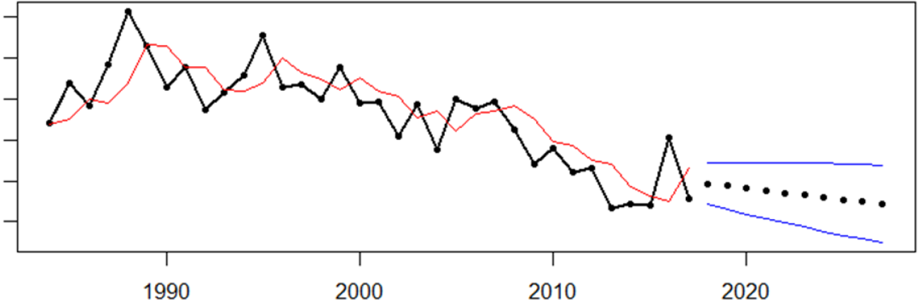
Federal performance measures
Targets set based on data-driven, risk-based approach
  Trend models developed when historical data is available
  Variability within existing data is evaluated when historical data is not available
  Targets set based on prediction intervals and the probability of achieving targets; used 75% probability for targets
Anticipated trends emphasize importance of stewardship; the majority of performance areas are expected to trend opposite of the desired direction
Example:
actual values and 75% prediction intervals

Slide 12
Federal performance measures

Slide 13
Implementation next steps
  Complete aviation system plan update (2020/2021)
  Integrate Complete Streets Policy into project development process
  Complete public transit system plan (2020)
  Complete FAST Act compliant Transportation Asset Management Plan update and continue to enhance pavement and bridge management systems
  Complete ongoing Planning and Environmental Linkages (PEL) and ICM studies; utilize these types of studies on appropriate corridors
  Super-2 implementation – finalize design guidelines; incorporate elements into planned projects
  Refine project prioritization tool and utilize in program development
  Continue to emphasize stewardship of the transportation system and maintaining a state of good repair

Slide 14
Questions?
Garrett Pedersen, Planning Team Leader
Office of Systems Planning
garrett.pedersen@iowadot.us
515-239-1520

