Slide 1
Project Prioritization Weighting
Iowa Transportation Commission
January 8, 2019
Matt Haubrich
Transportation Asset Management Administrator
Iowa DOT

Slide 2
December 2018 Weighting Workshop
Reviewed the Project Prioritization Tool
Learned about how the 7 criticality criteria are calculated
Discussed the process of Swing Weighting
Each Commissioner used the Swing Weighting process to provide initial weights
We discussed the results
Used average to arrive at consensus weighting

Slide 3
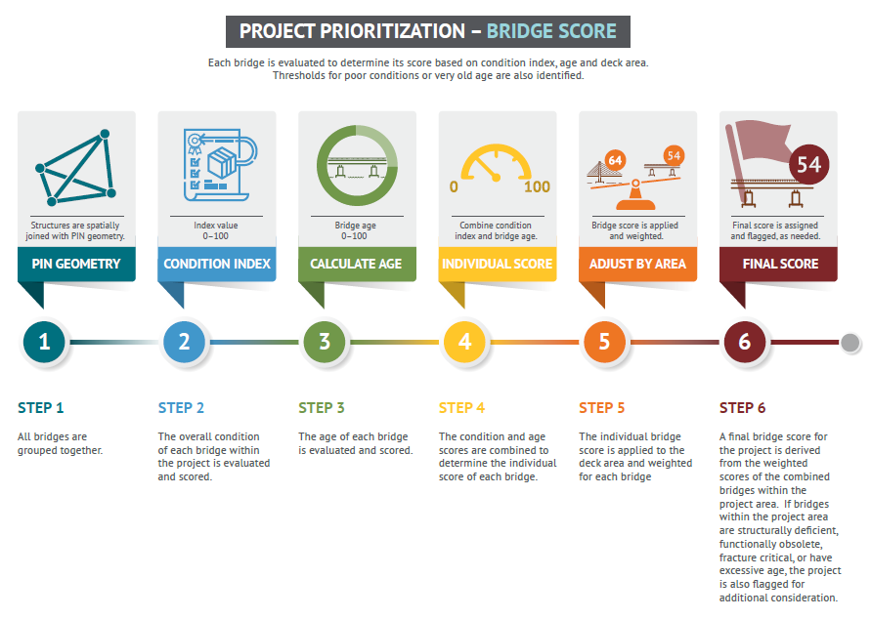

Slide 4
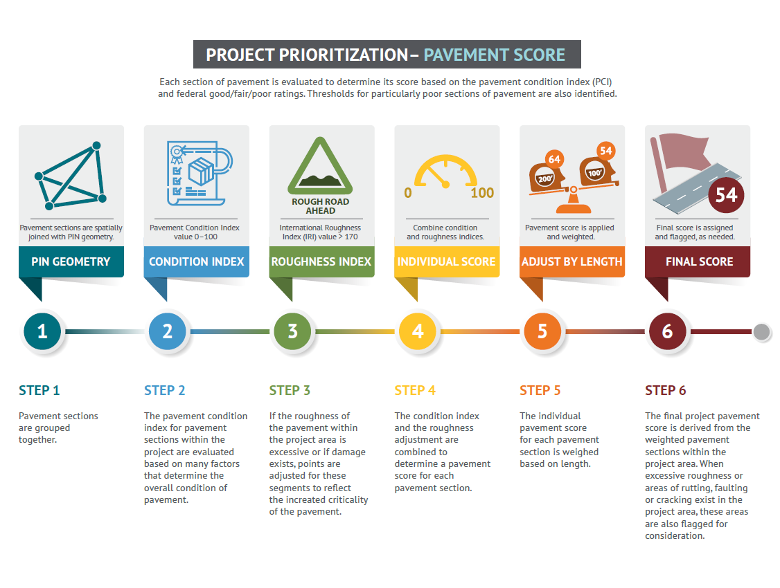

Slide 5
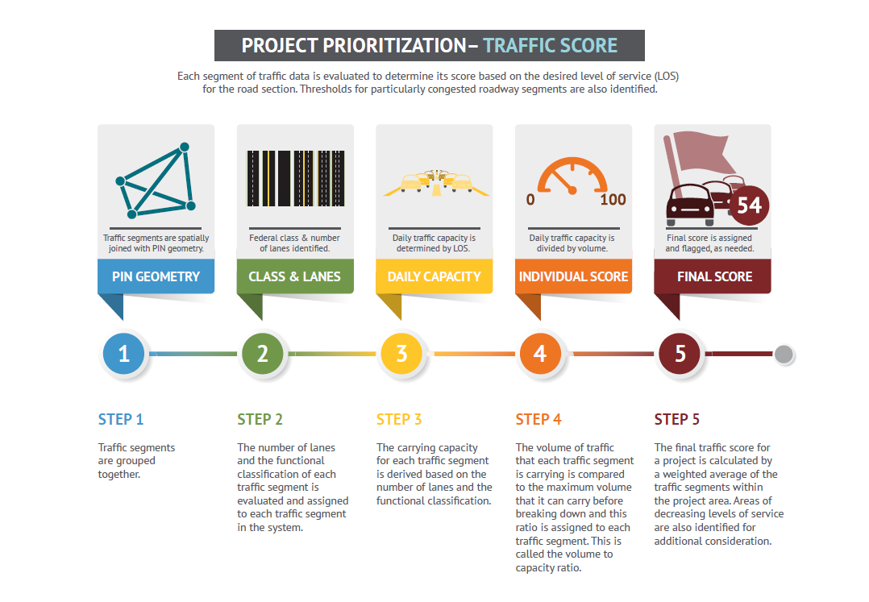

Slide 6
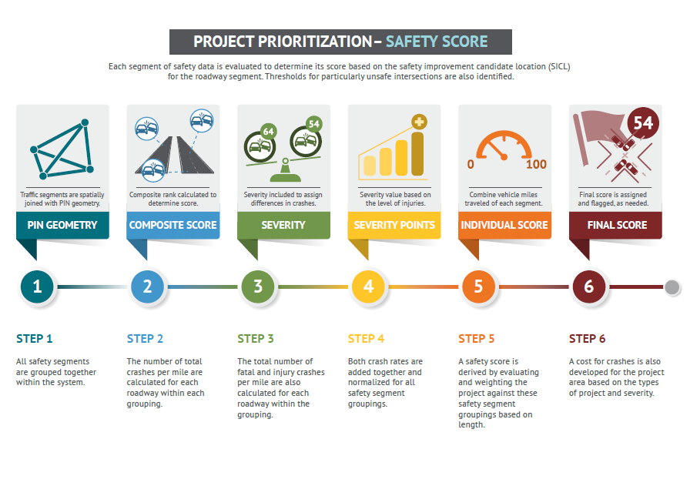

Slide 7
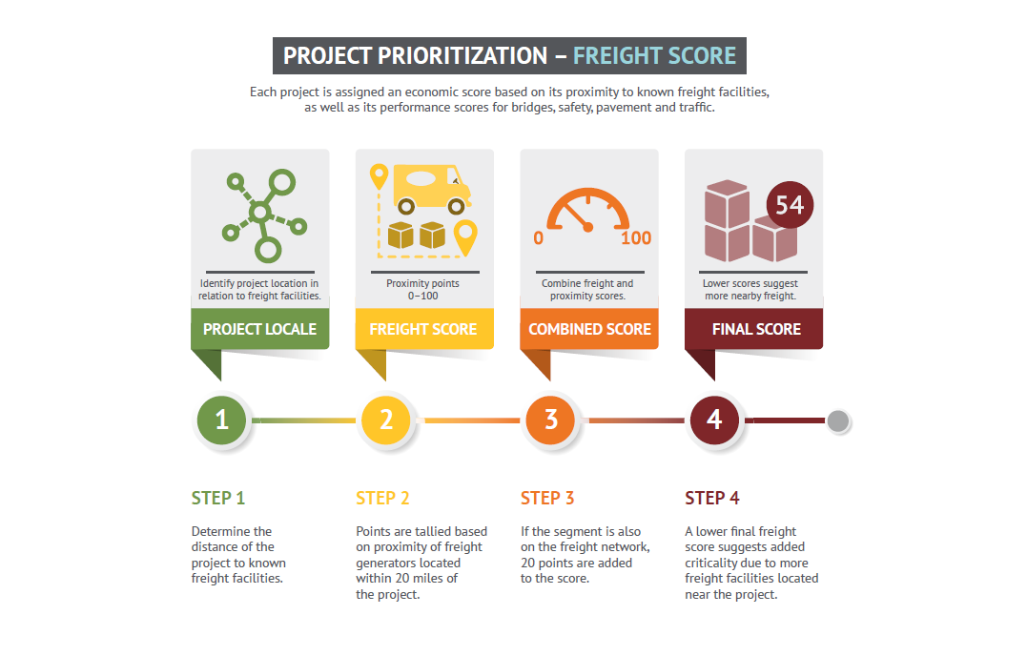

Slide 8
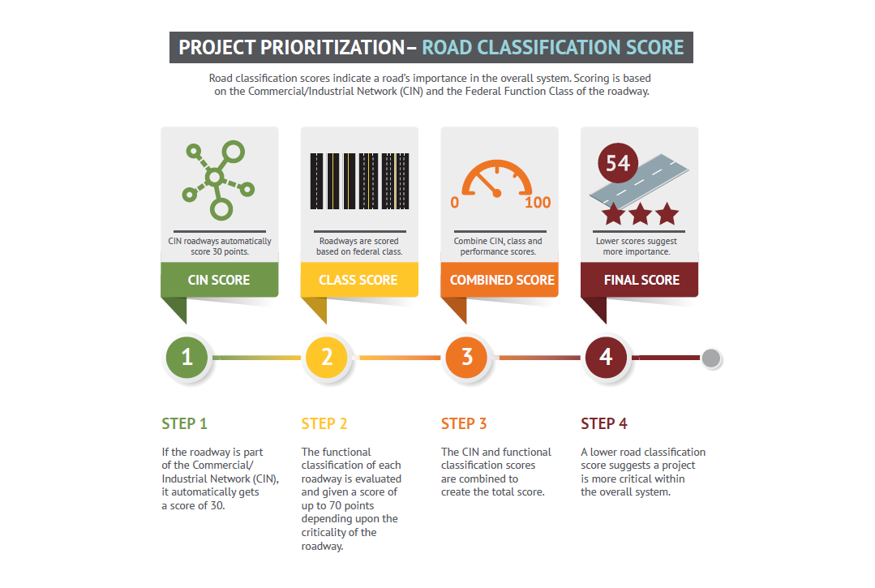

Slide 9
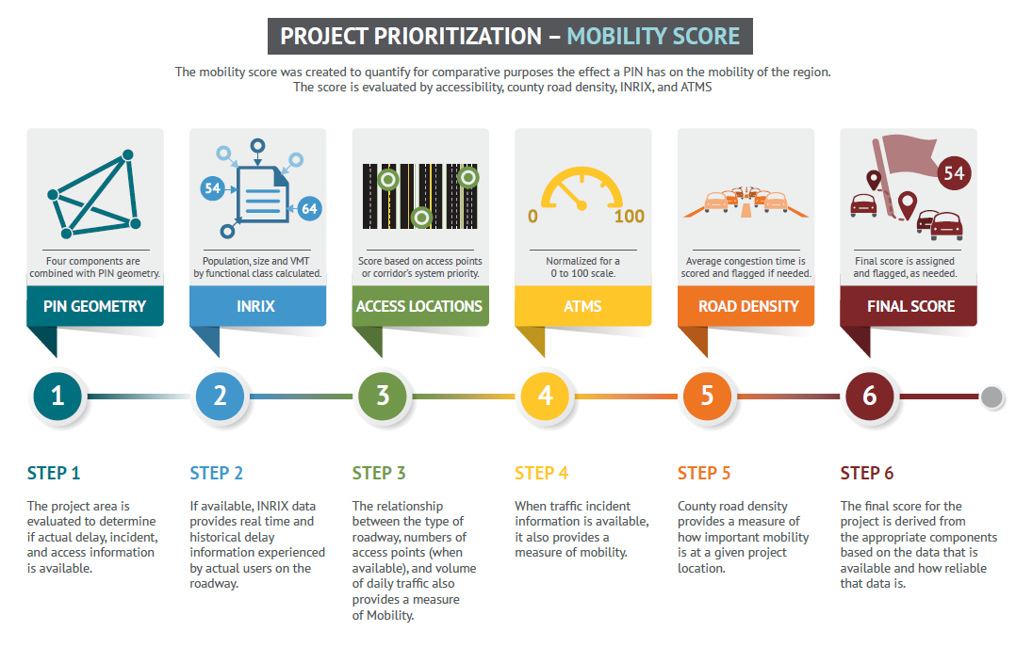

Slide 10
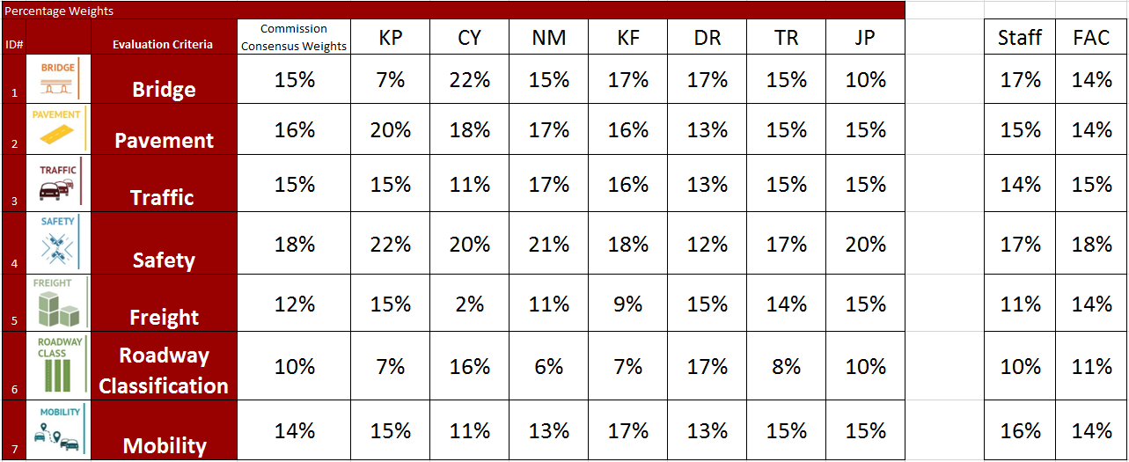
Criticality Criteria Weights
Average from December Workshop

Slide 11
Discussion
Results of Freight Advisory Council
Working to refine the Freight measure (next year)
Incorporate bottleneck analysis from Freight Plan
Additional discussion of initial weights?
Finalize consensus weights

