Slide 1
Revitalize Iowa’s Sound Economy Program

Slide 2
Revitalize Iowa’s Sound Economy Program
Created in 1985
Purpose: To promote economic development through roadway improvements.
Eligible development shall have value-adding activities that feed new dollars into the economy
Available to cities and counties through an application program

Slide 3
Available Funding and Application Summary
Available Funding
Funded annually with dedicated state motor fuel and special fuel tax revenues
Application Summary for SFY2019
Total number of projects awarded: 3
Total project costs: $1,679,302
Total amount awarded: $1,092,256
 | CITY | COUNTY
Average funding generated monthly | $997,556 | $498,778
SFY 2019 current Road Use Tax Revenue (as of 11/26/2018) | $5,071,670.73 | $2,535,835.37
Current Unobligated Balance (as of 11/26/2018) | $14,476,177.80 | $2,732,676.29

Slide 4
Local Development Project Evaluation Criteria
Development Potential (35 points)
Economic impact and Cost Effectiveness (20 points)
Local Commitment and Initiative (33 points)
Transportation Need and Justification (4 points)
Local Economic Need (6 points)

Slide 5
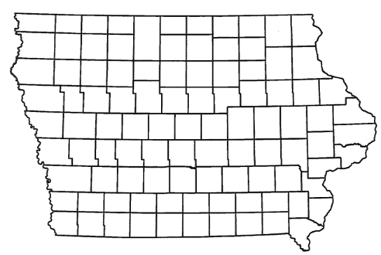
List of Local Development Applications Recommended
PROJECT NAME
SPONSOR
SCORE
TOTAL PROJECT COST
PERCENT PARTICIPATION
RECOMMENDED AMOUNT
Improvement of approximately 1,570 feet of South Riverside Drive and construction of approximately 1,860 feet of Collaboration Place | Ames | 62 | $2,588,702 | 70% | $1,812,091
Construction of approximately 1,215 feet of SE 77th Street, 3,440 feet of SE Crosswinds Drive and a right-turn lane on SE Four Mile Drive | Ankeny | 66 | $4,044,375 | 50% | $2,022,188
Paving of approximately 1,780 feet of QF Lane | Boone County | 33 | $188,963 | 50% | $94,482

Slide 6
Ames
(Local Development)
Improvement of approximately 1,570 feet of South Riverside Drive and construction of approximately 1,860 feet of Collaboration Place. This project is necessary to provide improved access to more than 200 acres for research park purposes.
Total Cost: $2,588,702
Requested: $1,812,091 (70%)

Slide 7
Ankeny
(Local Development)
Construction of approximately 1,215 feet of SE 77th Street, 3,440 feet of SE Crosswinds Drive and a right-turn lane on SE Four Mile Drive. This project is necessary to provide improved access to more than 159 acres for industrial, warehouse and professional office purposes.
Total Cost: $4,044,375
Requested: $2,022,188 (50%)

Slide 8
Boone County
(Local Development)
Paving of approximately 1,780 feet of QF Lane located west of Madrid. This project is necessary to support tourism by providing improved access to Grants Woods Park.
Total Cost: $188,963
Requested: $94,482 (50%)

Slide 9
QUESTIONS?
Craig Markley, Office of Systems Planning
craig.markley@iowadot.us
515-239-1027

