Slide 1
Iowa’s Strategic Highway Safety Plan (SHSP)|2019-2023

Slide 2
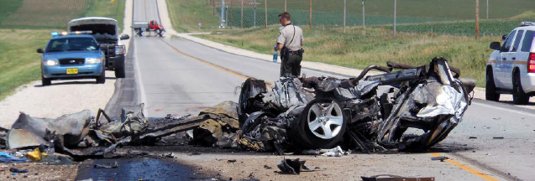
What is
an SHSP?
“is a statewide coordinated safety plan that provides a comprehensive framework for reducing highway fatalities and serious injuries on all public roads.”

Slide 3
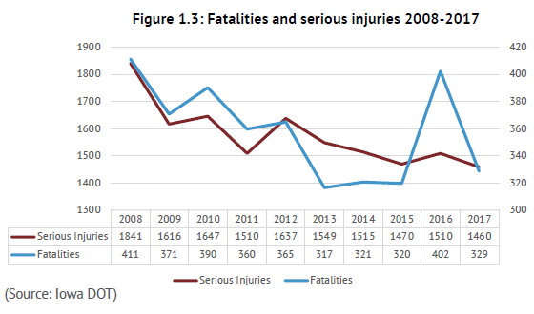
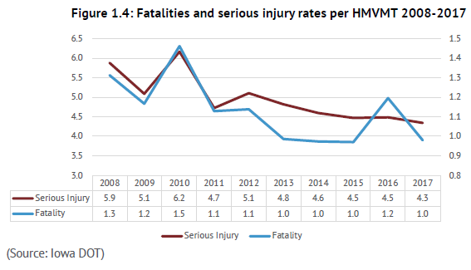
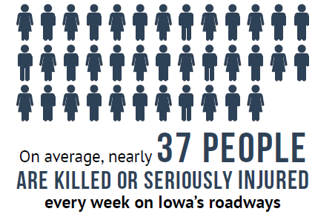

Slide 4
February
2018
August
2018
June 2017
February 8th, 2018 Implementation Team Meeting
Data analysis
Stakeholder input gathering and data analysis
August 1st, 2018 Implementation Team Meeting
Define Strategies
Define Implementation and evaluation
Plan Kickoff
Data collection and analysis
Identification of Strategies
Review previous plans and best practices
Gather stakeholder input
Finalize and publish plan draft SHSP
November
2017
May
2018
Dec 2018
Plan
Completion
November 9th, 2017 Implementation Team Meeting
Review of national best practices
Initial structure and content development
Development of stakeholder input process
May 3rd , 2018 Implementation Team Meeting
Prioritization of Safety Emphasis Areas
Completion of Stakeholder input process

Slide 5
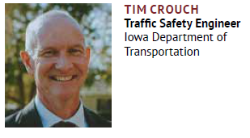
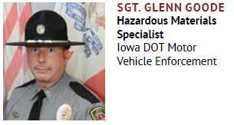
Five E’s of Safety
Engineering
Enforcement
Education
Emergency Medical Services

Slide 6
Everyone
“In 94 percent of crashes nationwide the critical reason for the crash can be attributed to driver error.”-NHTSA

Slide 7
Safety Emphasis Areas
Young Drivers
Work Zones
Winter Roads
Unprotected
Trains
Local Roads
Impaired
Road Side Collisions
Bicyclists
Pedestrian
Speed Related
Lane Departures
Motorcyclists
Distracted
Older Drivers
Heavy Truck
Other Vehicles
Intersections

Slide 8
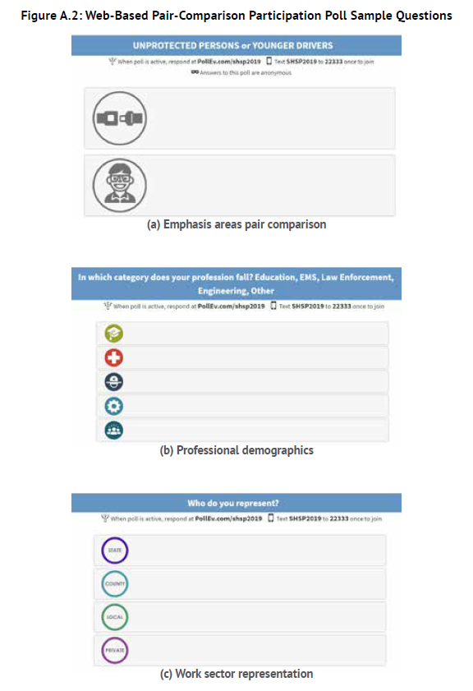
Stakeholder Input Process
Pair comparison poll
Safety Emphasis Areas
Input gathering was supported by Snyder and Associates
Over 600 stakeholders participated in the pair comparison poll.

Slide 9
Prioritization
Lane departures/Roadside collisions
Intersections
Distracted
Impaired
Unprotected Persons
Speed-related
Older drivers
Younger drivers

Slide 10
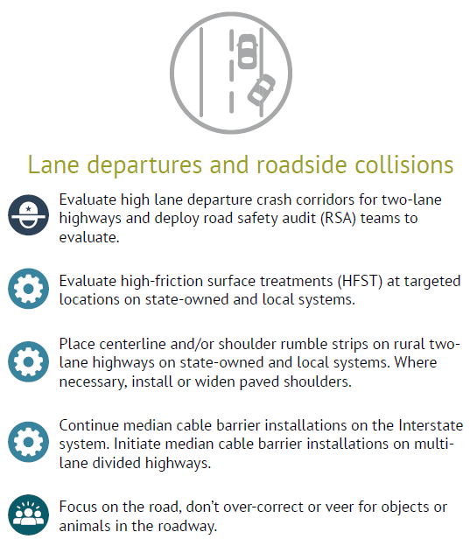
Strategies
The SHSP Implementation Team identified 40 strategies.
Strategies were identified by consulting several Sources including:
NCHRP Report 500
State Strategies to Reduce Highway and traffic fatalities
Previous SHSPs

Slide 11
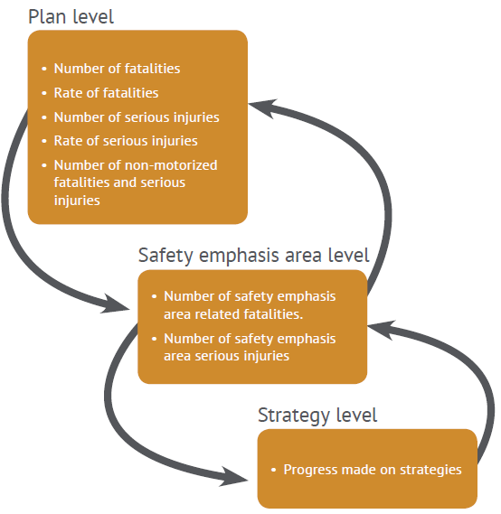
Implementation and Evaluation
Implementation
SHSP Implementation Team
Flexible and responsive to new strategies
Designated E Teams
Disseminate to broader audience
Evaluation
Evaluation of the plan and progress made on the identified strategies will be done on an annual basis.

Slide 12
THANK YOU FOR YOUR TIME AND ATTENTION
Jan Laaser-Webb
State Safety Engineer
Office of Traffic and Safety
515-239-1349
Jan.laaser-webb@iowadot.us
Samuel Sturtz
Transportation Planner
Office of Systems Planning
515-239-1788
Samuel.sturtz@iowadot.us

