Slide 1
FFY 2019 Federal Bus Replacement Discretionary Funding

Slide 2
Grants for Buses and Bus Facilities Program
Purpose: Federal Transit Administration (FTA) program to assist in the financing of buses and bus facility capital projects, including replacing, rehabilitating, purchasing or leasing buses or related equipment, and rehabilitating, purchasing, constructing or leasing bus-related facilities
Eligible Applicants: Designated recipients that allocate funds to fixed route bus operators, states, local governmental authorities that operate fixed route bus service, Native American tribes

Slide 3
Project Evaluation Criteria
Demonstration of need for capital investment in bus vehicles and/or supporting facilities
Demonstration of benefit for how the project will improve transit system condition, service reliability, and enhance access and mobility
Demonstration of how the project is consistent with transit priorities identified in the long range plan
Local financial commitment
Project implementation strategy
Demonstration of technical, legal and financial capacity to undertake the project

Slide 4
Available Funding and Funding Recommendation
Available funding
$423 million offered in FFY 2019
318 project submitted nationwide totaling approximately $1.9 billion in funding requests
94 projects funded nationwide averaging $4.5 million each
Iowa DOT awarded $9.4 million
Funding recommendation
Replace 107 of the oldest vehicles operating beyond their federal useful life at 21 public transit agencies
Utilized Public Transit Management System process
Points awarded based on age and mileage
Prioritize highest points down

Slide 5
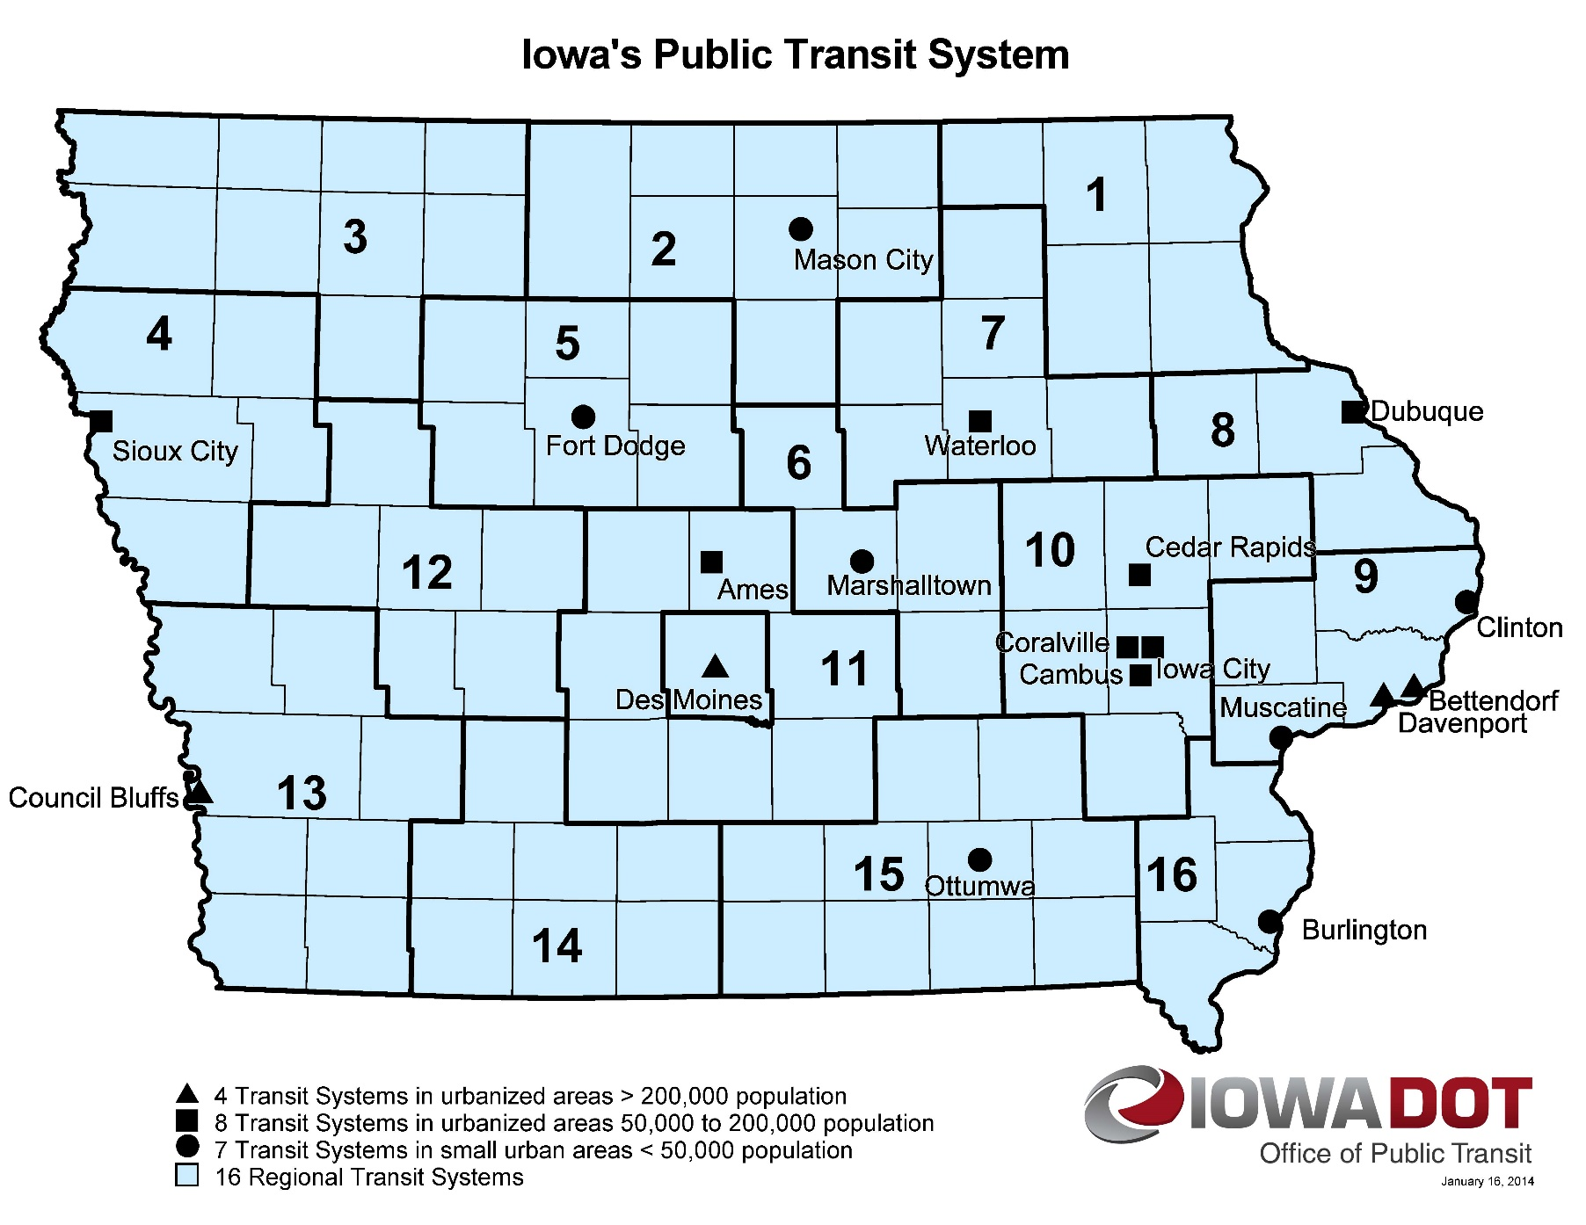
Transit System Vehicle Replacements
Notes:
21 Public Transit Agencies Awarded

Slide 6
QUESTIONS?
For more information on Iowa’s public transit programs, visit
www.iowadot.gov/transit

