Slide 1
Revitalize Iowa’s Sound Economy Program

Slide 2
Revitalize Iowa’s Sound Economy Program
Created in 1985
Purpose: To promote economic development through roadway improvements.
Eligible development shall have value-adding activities that feed new dollars into the economy
Available to cities and counties through an application program

Slide 3
Available Funding and Application Summary
Available Funding
Funded annually with dedicated state motor fuel and special fuel tax revenues
Application Summary for SFY2020
Total number of projects awarded: 9
Total project costs: $14,739,807
Total amount awarded: $6,841,914
 | CITY | COUNTY
Average funding generated monthly | $997,556 | $498,778
SFY 2020 current Road Use Tax Revenue (as of 11/25/2019) | $5,037,427.21 | $2,518,713.62
Current Unobligated Balance (as of 11/25/2019) | $15,960,605.08 | $2,032,318.04

Slide 4
Local Development Project Evaluation Criteria
Development Potential (35 points)
Economic impact and Cost Effectiveness (20 points)
Local Commitment and Initiative (33 points)
Transportation Need and Justification (4 points)
Local Economic Need (6 points)

Slide 5
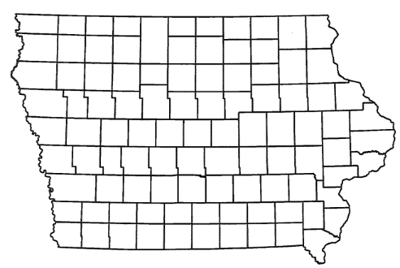
List of Local Development Applications Recommended
PROJECT NAME
SPONSOR
SCORE
TOTAL PROJECT COST
PERCENT PARTICIPATION
RECOMMENDED AMOUNT
Reconstruction of approximately 4,600 feet on 32nd Street SW and 1,250 feet on Grant Street and signal and intersection improvements along U.S. 65 and 32nd Street SW. | Bondurant | 74 | $14,275,472 | 60% | $8,565,283

Slide 6
Bondurant
(Local Development)
Reconstruction of approximately 4,600 feet on 32nd Street SW and 1,250 feet on Grant Street and signal and intersection improvements along U.S. 65 and 32nd Street SW on the south side of town.
Total Cost: $14,275,472
Requested: $8,565,283 (60%)

Slide 7
QUESTIONS?
Craig Markley, Systems Planning Bureau
craig.markley@iowadot.us
515-239-1027

