Slide 2
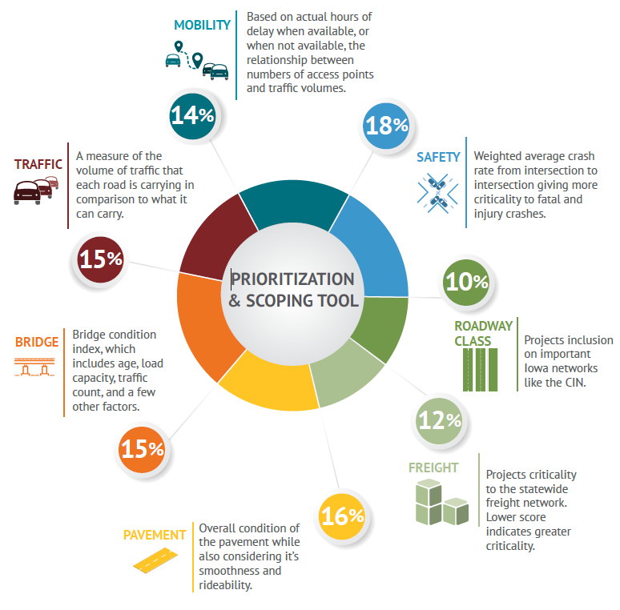
Prioritization & Scoping
SAFETY – 18%
ROAD CLASS – 10%
FREIGHT – 12%
PAVEMENT – 16%
BRIDGE – 15%
TRAFFIC – 15%
MOBILITY – 14%
100%

Slide 3
Prioritization & Scoping
Criteria | Weight | Basis for scoring
Safety | 18% | Score based on average crashes per mile adjusted for fatalities and major injuries
Roadway Class | 10% | Score is based on the projects inclusion on important Iowa networks like the CIN
Freight | 12% | Score is based on truck percentage, normalized by AADT and adjusted for freight bottlenecks
Pavement | 16% | Structural condition of the pavement adjusted for smoothness & rideability
Bridge | 15% | Bridge condition index, which includes age, load capacity, traffic count, and a few other factors
Traffic | 15% | A weighted measure of the volume of traffic that each road is carrying in comparison to what it can carry
Mobility | 14% | Based on actual hours of delay when available, or when not available, the relationship between incidents, numbers of access points, and traffic volumes

Slide 4
Weightings Exercise

Slide 5
Swing Weighting Process
Weight the criteria.
Assign a weight of 100 points to the highest ranked criterion
Assign a weight (between 0-100) to the next highest ranked criterion, and so on
Once you have weights for each criterion, review them for consistency and validity
Compare highs vs. lows to ensure the relative weightings make sense

Slide 6
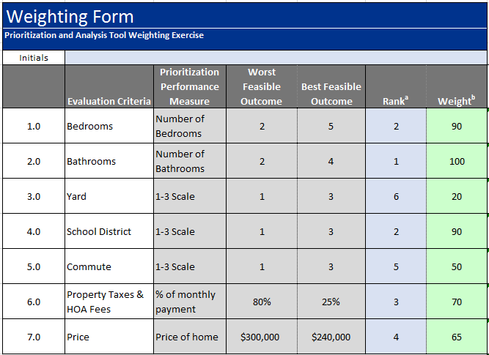
Swing Weighting Example – Home Purchase Establishing the Weights

Slide 7
BRAD HOFER
RIGHT OF WAY BUREAU
Brad.hofer@iowadot.us
Office: 515-239-1787
QUESTIONS ???

