Slide 1
State Transportation Plan Implementation Update
Iowa Transportation Commission
January 14, 2020

Slide 2
Discussion overview
Brief background
Plan strategies and recent implementation activities
Next plan update

Slide 3
Background
State Transportation Plan adopted by Iowa Transportation Commission in May 2017
Significant implementation activity has taken place
Several other planning documents have been or are being updated, and the update of Iowa in Motion will begin soon

Slide 4
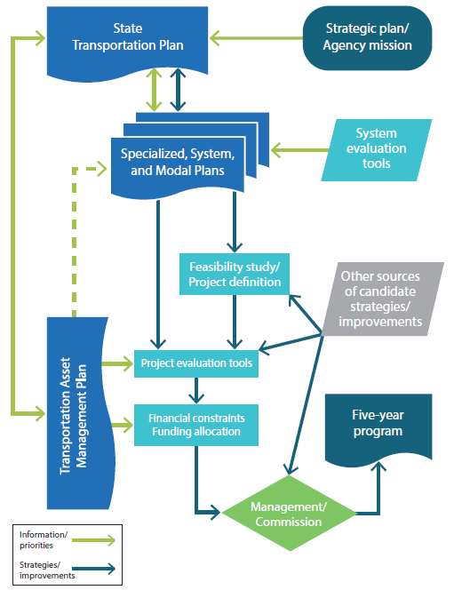
Continuous planning
Functional relationship between strategies in the long-range plan and other overarching planning documents, several of which are updated every four to five years
 | Last update | Next update
Public transit plan | 1997 | 2020
State rail plan | 2017 | 2021
Aviation system plan | 2010 | 2021
State long-range plan | 2017 | 2022
State freight plan | 2017 | 2022
Asset management plan | 2018 | 2022
Bicycle/pedestrian plan | 2018 | 2023
Strategic highway safety plan | 2019 | 2024

Slide 5
Strategies
In addition to modal needs analysis, the current Plan includes 80 strategies for the Iowa DOT and Commission
Categorized across 12 modal/subject areas
Asset management
Aviation
Bicycle/pedestrian
Bridge
Energy
Freight
Highway
Public transit
Rail
Safety
Technology
Transportation system management and operation (TSMO)

Slide 6
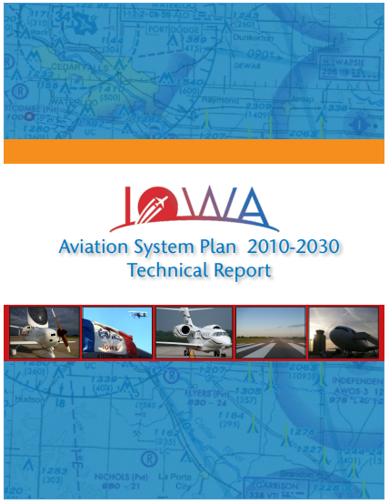
Strategy implementation Aviation
Starting development of an aviation system plan update
Consultant under contract
Technical Advisory Committee began meeting in December
Plan components
Update airport data inventory
Identify system issues
Forecast system demand
Evaluate system performance
Review airport roles
Recommendations and implementation
April 2021 completion

Slide 7
Strategy implementation Bicycle/Pedestrian
Completed first Bicycle and Pedestrian Long Range Plan
Complete Streets policy adopted
Policy effective January 1, 2020
Implementation began informally in 2019
Design guidelines updated

Slide 8
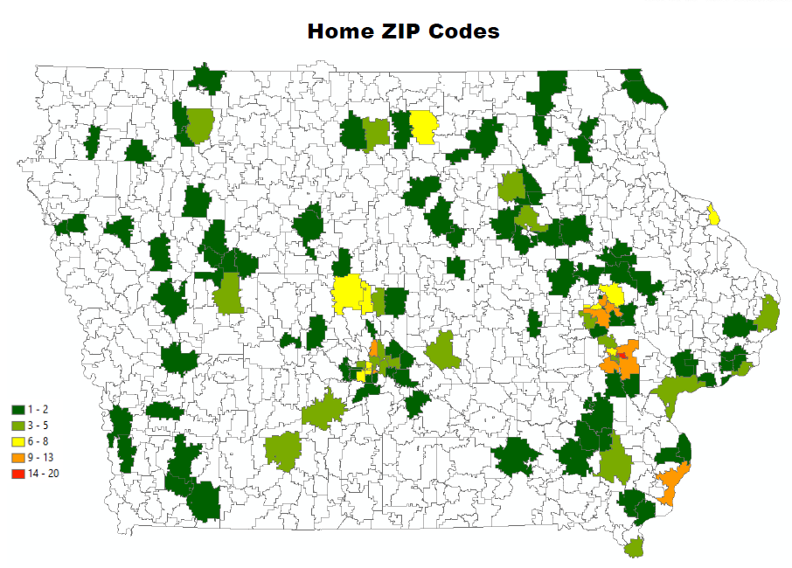
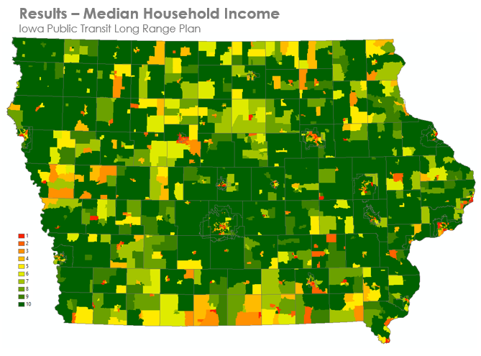
Strategy implementation Public Transit
Survey responses
Development of Public Transit Long Range Plan underway
Meeting with internal and external steering committees
Collected information on needs from Iowa’s 35 public transit agencies
Conducted public input survey on plan strategies – 583 responses
Analyzing transit dependency across the state
Forecasting costs and revenues
June 2020 completion

Slide 9
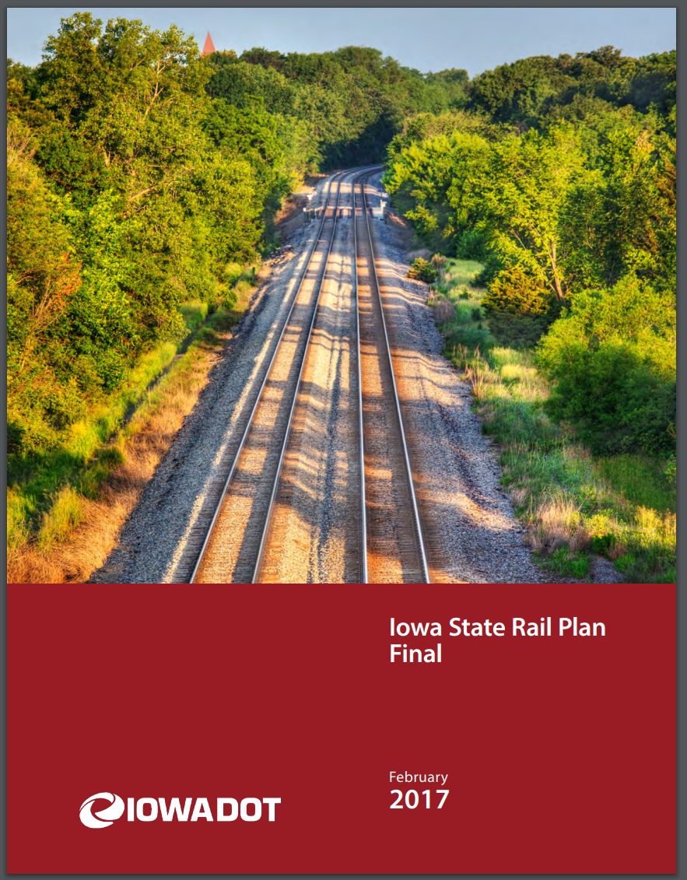
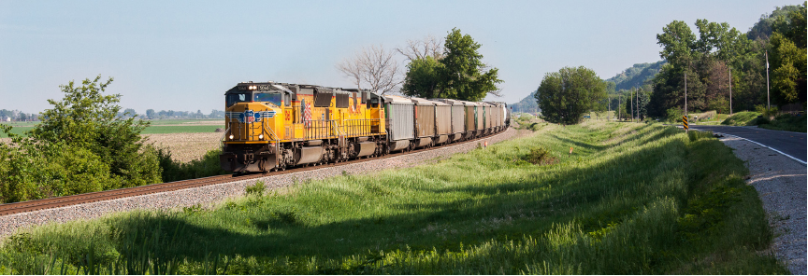
Strategy implementation Rail
Rail system plan completed in 2017
Reviewing potential project amendments
Starting plan update – due in February 2021
Update rail system data
Update rail bottlenecks and projects

Slide 10
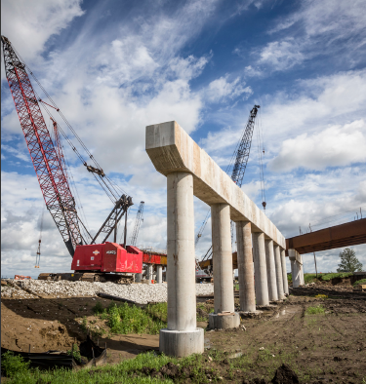
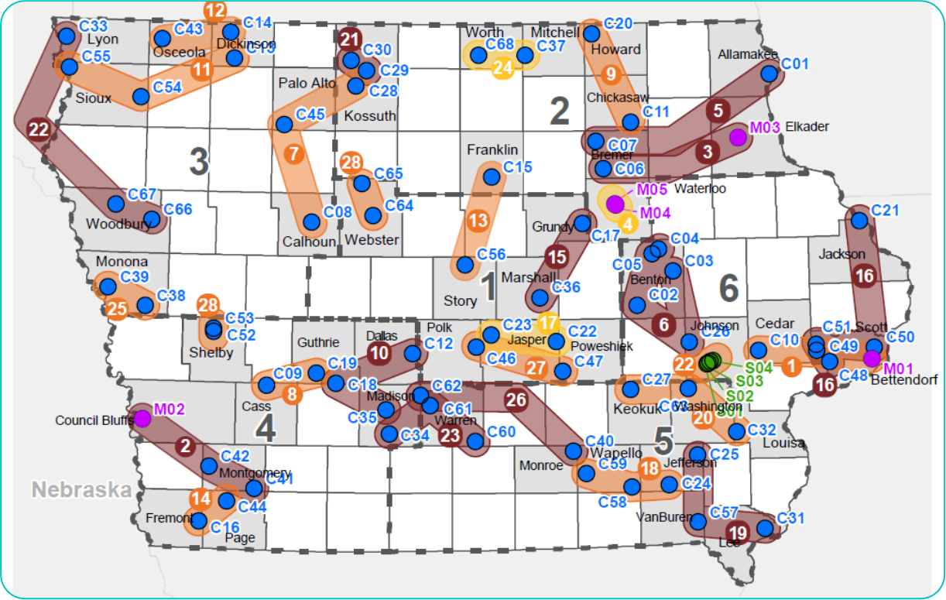
Strategy implementation Bridge
Received $33.4 million grant from Competitive Highway Bridge Program
Replace 77 bridges statewide
68 county
5 city
4 DOT
29 bundles of 2-5 bridges

Slide 11
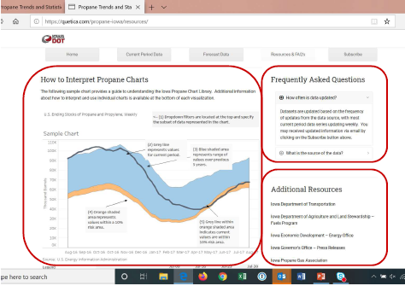
Strategy implementation Energy
Propane study completed, monitoring activities ongoing
Critical takeaway: Need for improved visibility into factors affecting propane demand and ability to meet it
Ongoing development of website and dashboard

Slide 12
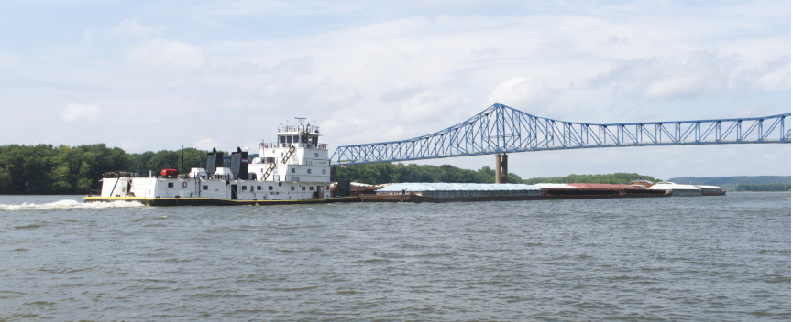
Strategy implementation Freight
Addressing freight bottlenecks, including non-highway modes (e.g., mooring cell concept)
Exploring use of freight-related data in design guidance
State Freight Plan update will be getting underway – due in July 2022
Beginning re-evaluation of bottlenecks

Slide 13
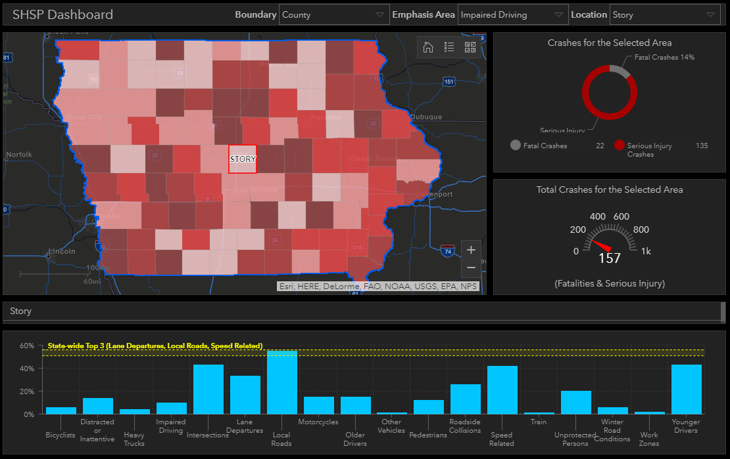
Strategy implementation Safety
Completed 2019-2023 Strategic Highway Safety Plan update and interactive webmap
Various analyses underway, including primary system intersections and bicycle/pedestrian accommodations

Slide 14
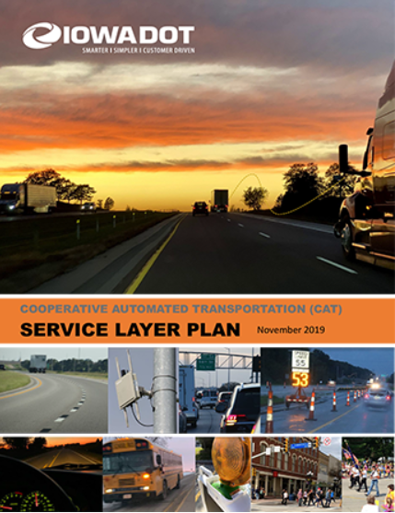
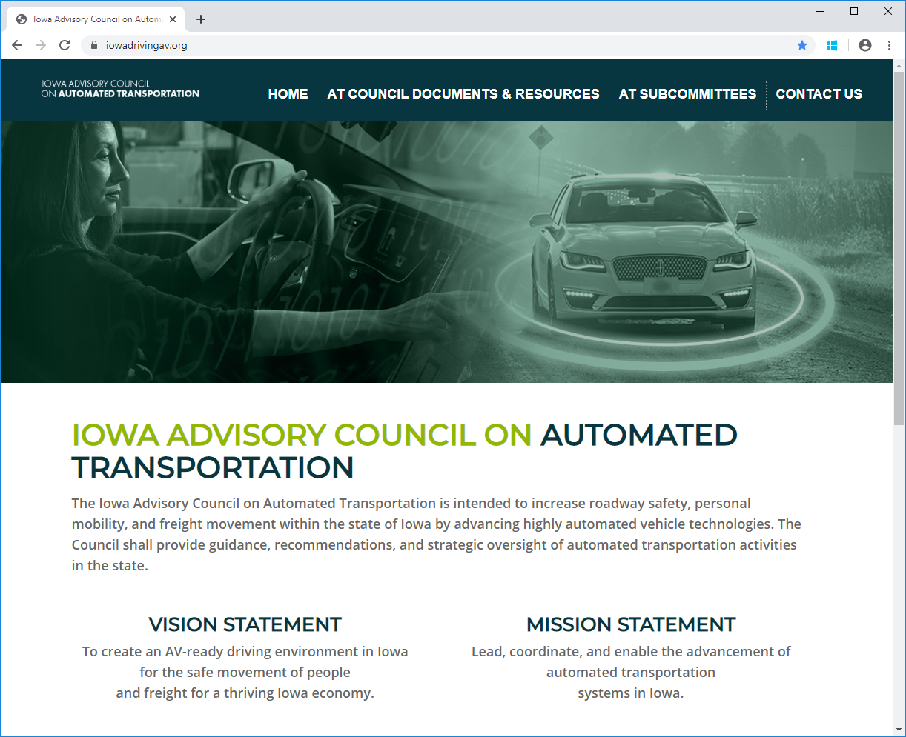
Strategy implementation Technology
Integrating pause points into project development and programming processes
Completed Cooperative Automated Transportation (CAT) Plan
Planning for integration of automated vehicle technology
Iowa Advisory Council on Automated Transportation
iowadrivingav.org
AV-related rulemakings

Slide 15
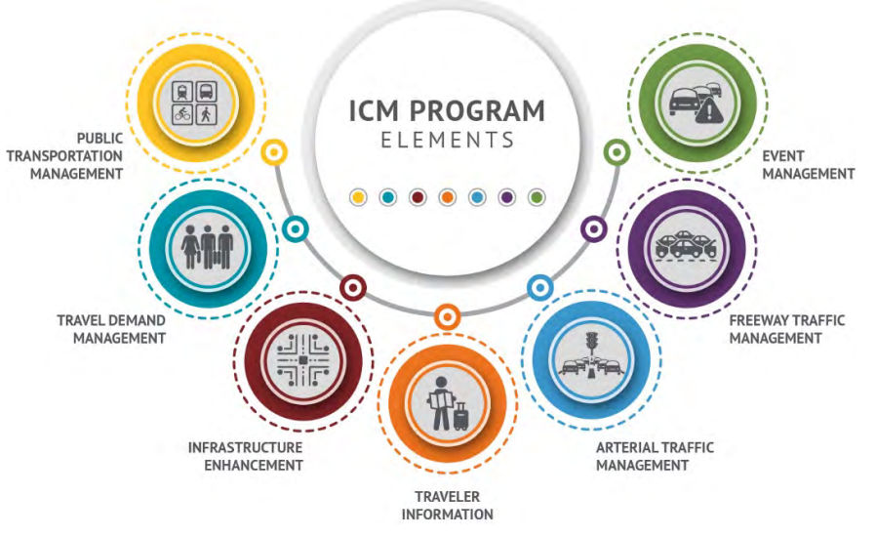
Strategy implementation TSMO
Integrated corridor management (ICM) studies of I-380 and the Des Moines area to analyze operational alternatives to improve system performance; potentially applicable to other urban corridors
Updating ICE-OPS analysis for estimating highway corridor susceptibility to operational challenges

Slide 16
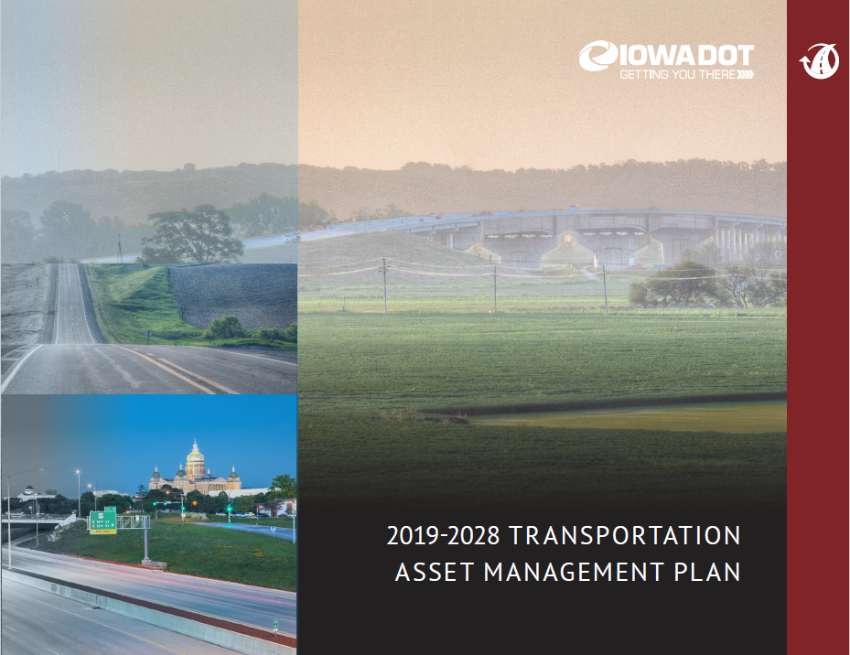
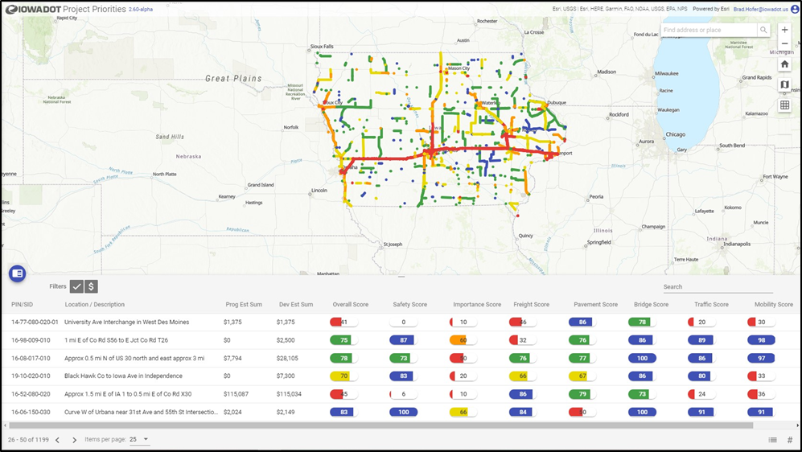
Strategy implementation Asset Management/Highway
Continued integration of asset management into department functions, including regular Commission presentations
Transportation Asset Management Plan updated
Project scoping/prioritization tool
Review of highway program candidates for Plan consistency
Additional funding for pavement/bridge stewardship needs
Targeting investments to capacity needs, including key interstate locations (I3P effort)

Slide 17
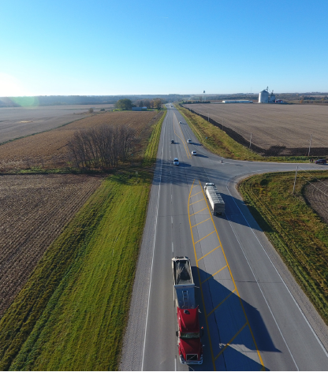
Strategy implementation Highway – Super-2 corridors
Design guidance developed
Super-2 elements being incorporated into project design or as an alternative in Planning and environmental linkage (PEL) studies on targeted corridors

Slide 18
2022 Iowa in Motion update
Plan update scheduled for Transportation Commission adoption in May 2022
“Planning for the plan” is underway
Plan development and Commission input likely to begin spring 2020
Commission feedback
How do you use the plan?
What information is most useful?
What could be done to make the plan more useful?
How do you want to be engaged during plan development?

Slide 19
Questions?
Garrett Pedersen, Planning Team Leader
Systems Planning Bureau
garrett.pedersen@iowadot.us
515-239-1520

