Slide 1
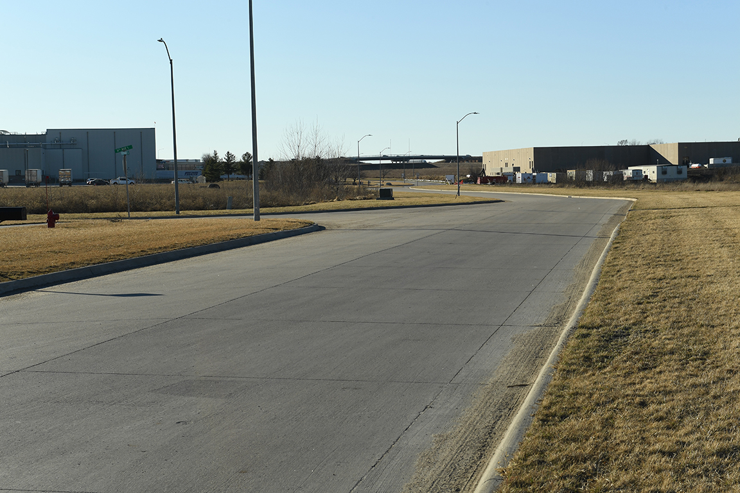

Revitalize Iowa’s Sound Economy Program

Slide 2
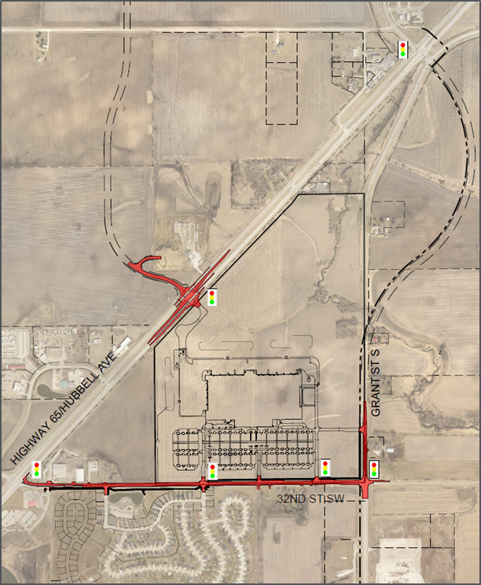
Local Development Application Recommended for Award
PROJECT NAME
SPONSOR
SCORE
TOTAL PROJECT COST
PERCENT PARTICIPATION
RECOMMENDED AMOUNT
Reconstruction of approximately 4,600 feet on 32nd Street SW and 1,250 feet on Grant Street and signal and intersection improvements along U.S. 65 and 32nd Street SW. | Bondurant | 74 | $14,275,472 | 60% | $8,565,283

