Slide 1
Transportation Commission Workshop
January 14, 2020

Slide 2
Pavement Management
Chris Brakke, PE
Iowa DOT Office of Construction and Materials

Slide 3
Pavement system components
Pavement
Subbase
Subgrade
Pavement
Concrete (rigid), Asphalt (flexible), or Composite
Subbase
Rock layer for support and drainage
Subgrade
Improved soil layer to provide support

Slide 4
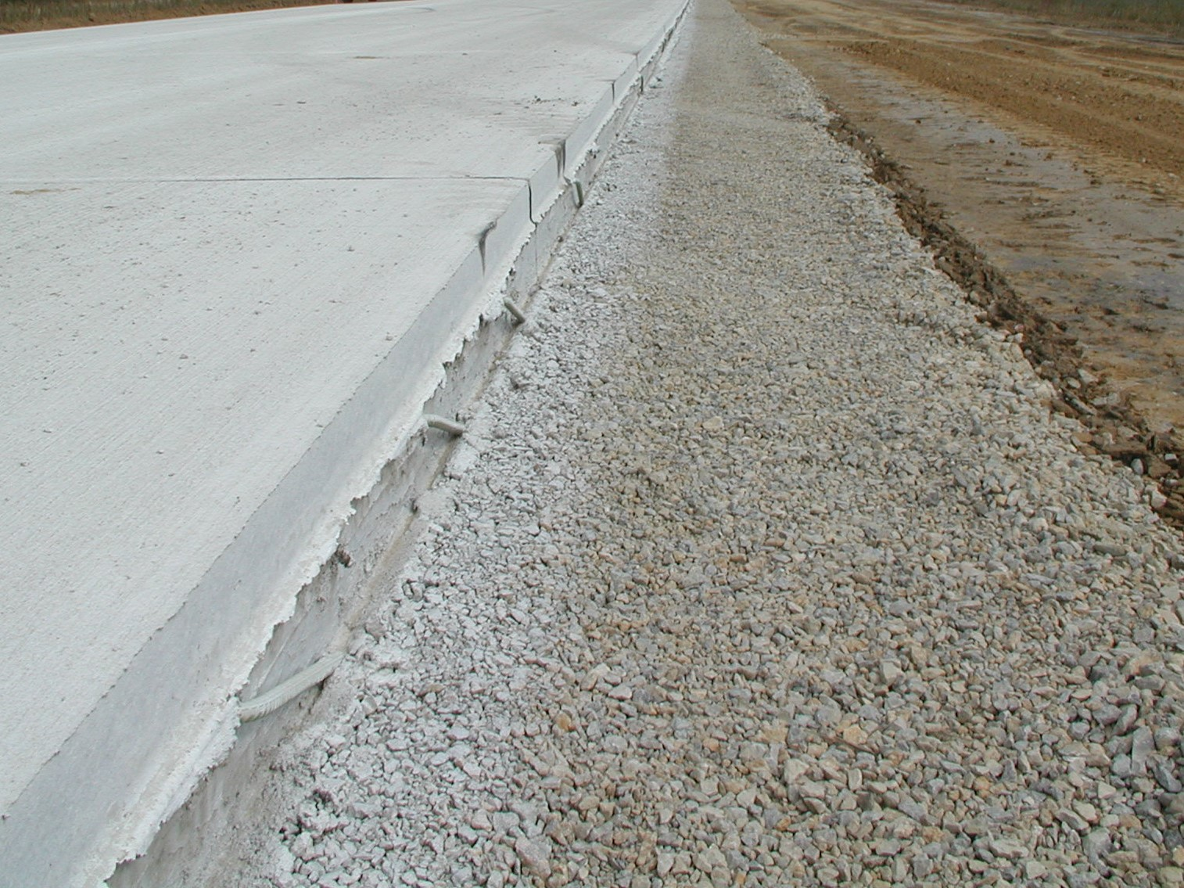
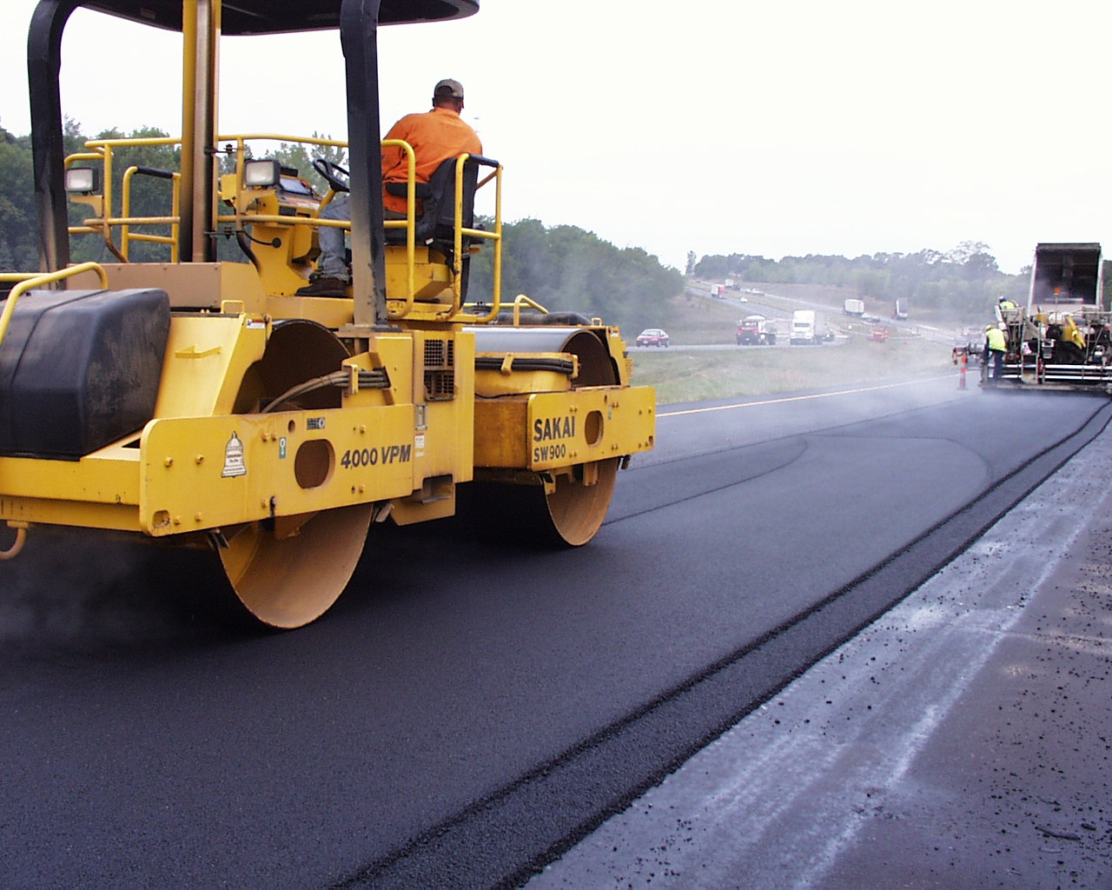
Pavement system components
Pavement design life is 40 years.
Can be extended with proper maintenance and rehabilitation, but not indefinitely.
Many factors influence the design
Truck traffic
Subgrade soil
Climate

Slide 5
Pavement Inventory
The Primary system includes 24,534 lane miles of pavement.
3,848 or about 16% on the Interstate
758 lane miles of ramps
If we had to replace the pavement on all of these roads today, the cost would exceed $14.2 billion.
Notes:
These mileages are based on the LRS data, not PMIS.

Slide 6
Pavement Inventory
Notes:
This chart includes 23,391 lane miles of mainline pavement on the Primary system (includes Interstates). The median pavement construction year is 1965 (50% were built prior to 1965) based on PMIS 2017. Using 2019 as our starting point, 55.2% of lane miles are at least 50 years old (CONYR = 1969 or older), and 29% are more than 70 years old.

Slide 7
Pavement Inventory
Half of the system’s original pavement is more than 55 years old.
29% (6,792 miles) is 70+ years old
If we only build/replace 2,000 miles per decade as we did in the first decade of the 2000’s, we would need original pavements to last at least 110 years.

Slide 8
Pavement Condition
Tracking the condition of pavements on the system is the key
Pavements deteriorate at different rates and for different reasons
Knowing the reason helps in making decisions on how to maintain pavements
We assess the condition of all pavements on a periodic basis.
Key indicators such as roughness and cracking are evaluated at least biennially.
Other indicators such as friction and structure are also evaluated on a 2 to 5 year cycle.
The condition information as well as details of construction and rehabilitation activities are all tracked in our Pavement Management Information System (PMIS).

Slide 9
Pavement Condition
Notes:
Note that there is a lag in the measurement of condition relative to the investment year. Typically condition lags investment by about three years (highlight how 2009 spike didn’t really show up until 2012).

Slide 10
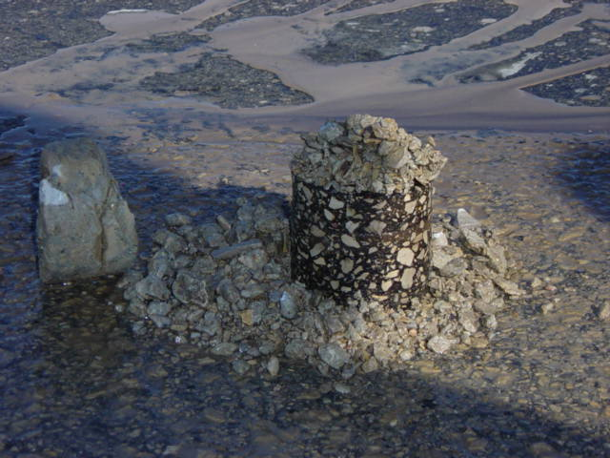
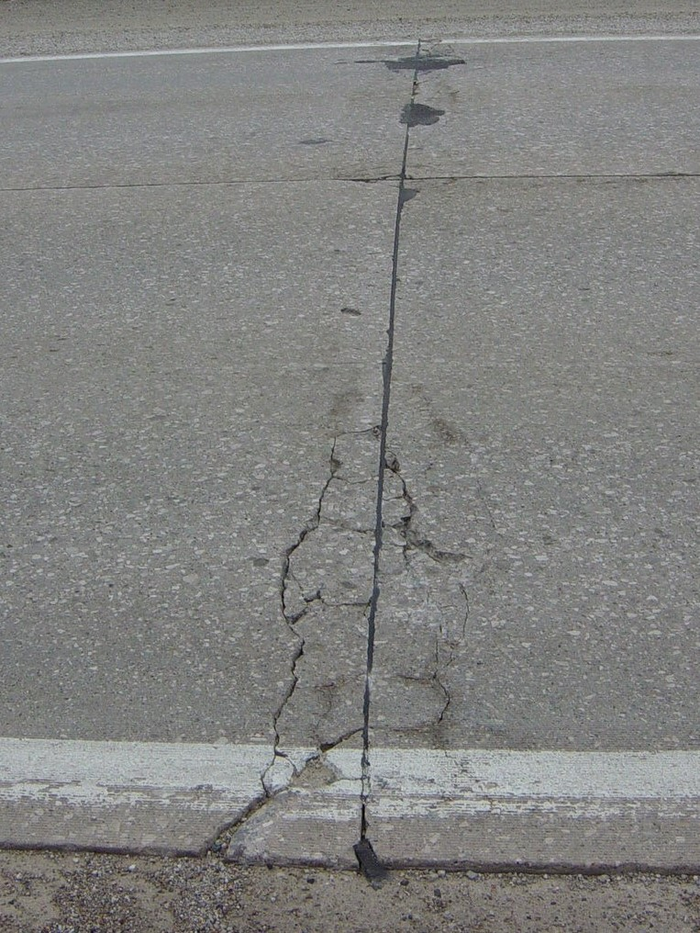
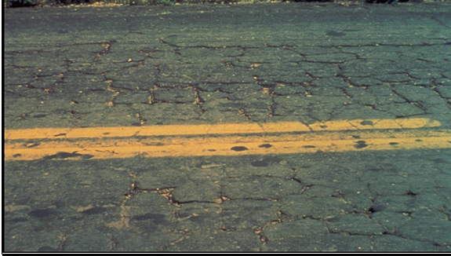
Pavement Deterioration
Pavement layers are designed for the anticipated truck loadings and for the environmental conditions
Pavements deteriorate after they are built due to many factors:
Iowa has one of the harshest environments
Year long moisture
Temperature extremes
Increased truck traffic or heavier trucks
Subgrade inconsistency
Drainage issues

Slide 11
Pavement Deterioration

Slide 12
Slowing down the deterioration
Reactive Maintenance
Necessary but not the best approach
Patching potholes
Spot overlays
Preventive Maintenance/Preservation
Treatments applied to pavements in relatively good condition to extend pavement life and/or improve performance.
Begin early in pavement life
Very cost effective
Treatments may be repeated on a schedule

Slide 13
Maintaining Good Condition Costs Less
Just like your car or home, routine and preventative maintenance can help extend the life.
Eventually things wear out and more extensive rehabilitation or replacement is required.
Over the life of a pavement, preservation treatments are like sealing the deck on your house – it can help extend the life, but eventually it will need rehabilitation or replacement.
We use pavement management data and tools to help us determine the optimal mix of treatments to get the most life at the least cost.

Slide 14
Pavement Treatments
Increasing Annualized Cost
Maintenance/Preservation treatments
Crack & joint sealing/filling
Diamond grinding
Thin surface treatments
Chip seals
Slurry seals
Microsurfacing
Thin lift asphalt overlays
Rehabilitations
Functional overlays (to address ride)
Cold-in-Place recycling
Structural overlays (asphalt and concrete)
Rubblization/crack & seat
Reconstruction
Completely replacing the pavement and sometimes the subgrade
$3,000/mile/year
$9,000/mile/year
$10,000/mile/year
$25,000/mile/year
$35,000/mile/year
Notes:
Costs (from TAMP): Maint/Pres Tx $20k - $50k per lane mile; Rehab Tx $220k - $500k per LM; Recon Tx $600k - $750k per LM

Slide 15
Pavement Management
Which treatment to use depends on the condition of the pavement and the life that is needed. A minimal treatment is not the right choice for every pavement.
The right treatment is cost effective because it has the lowest cost and will perform for the desired timeframe.
Some pavements require a higher cost treatment, but it will still be cost effective because it will provide a longer life or a higher level of performance.
The treatment cost and effectiveness are incorporated into the models used to predict pavement needs into the future.

Slide 16
Condition Forecast Process
Modeling software predicts the system-wide pavement condition under any given funding scenario.
Models are developed based on past pavement performance to predict future performance.
The tool evaluates all viable treatment alternatives for each pavement.
Optimization is used to select the mix of candidates that maximizes network condition.

Slide 17
Target Condition Index
Notes:
This chart shows past expenditures in the 3R program (Non-Interstate Pavement Modernization) and pavement condition. It is important to note there is about a 3-year lag in the condition measurement – projects in FY19 might not be complete until the fall of 2019, and often those won’t be evaluated again for another year or two so we might not see their condition reflected until the 2021 data. This lag is why we see the unexpected relationship between expenditures and condition.

Slide 18
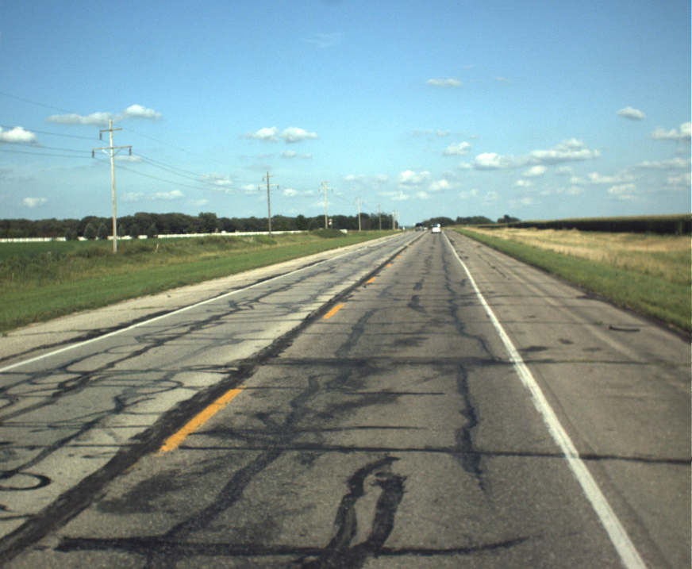
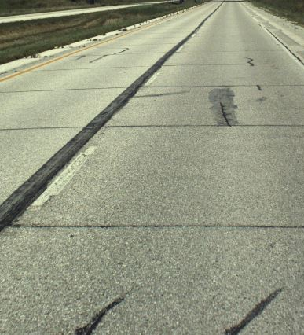
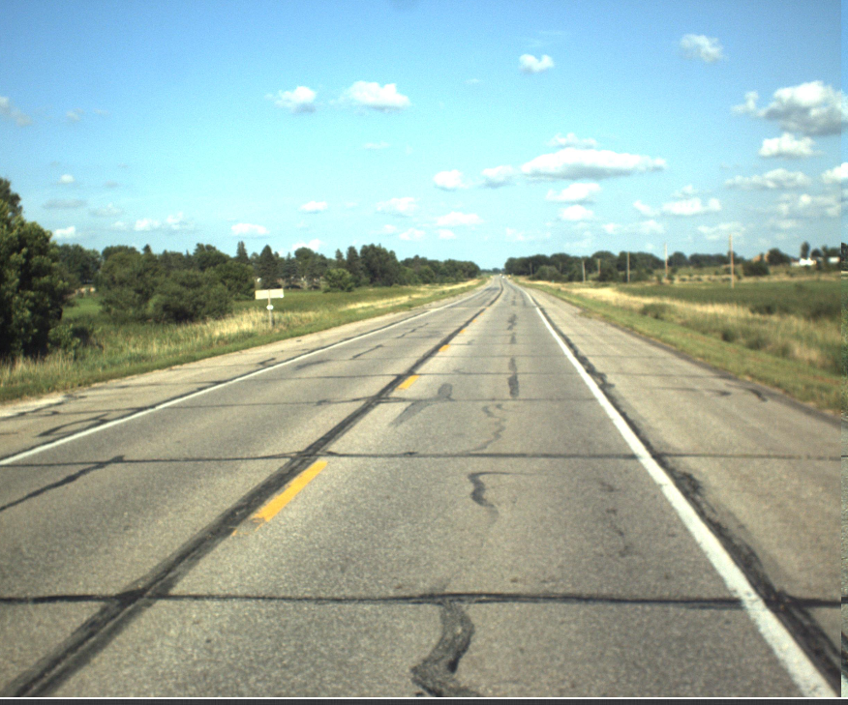
PCI = 33
PCI = 75
PCI = 67

Slide 22
Key Take-aways
Continuing at recent levels of funding for reconstruction will require our pavements to last at least 100 years.
Half of the system’s original pavement is more than 55 years old.
29% (6,792 miles) is 70+ years old
Iowa’s highway system has been built up over the past 100 years to the size it is today. At this point, current projected funding is not adequate to sustain a system of this size in a state of good repair.

