Slide 1
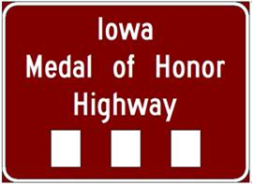
Admin Rule Chapter 131 – Signing on Primary Roads

