Slide 1
Revitalize Iowa’s Sound Economy Program
Iowa Transportation Commission Workshop
January 13, 2021

Slide 2
Revitalize Iowa’s Sound Economy Program
Created in 1985
Purpose: To promote economic development through roadway improvements.
Eligible development shall have value-adding activities that feed new dollars into the economy
Available to cities and counties through an application program

Slide 3
Available Funding and Application Summary
Available Funding
Funded annually with dedicated state motor fuel and special fuel tax revenues
Application Summary for SFY2021
Total number of projects awarded: 2
Total project costs: $3,472,219
Total amount awarded: $1,736,110
 | CITY | COUNTY
Average funding generated monthly | $970,179 | $485,089
SFY 2020 current Road Use Tax Revenue (as of 11/23/2020) | $4,472,080.82 | $2,236,040.41
Current Unobligated Balance (as of 11/23/2020) | $11,896,797.99 | $2,236,040.41

Slide 4
Local Development Project Evaluation Criteria
Development Potential (35 points)
Economic impact and Cost Effectiveness (20 points)
Local Commitment and Initiative (33 points)
Transportation Need and Justification (4 points)
Local Economic Need (6 points)

Slide 5
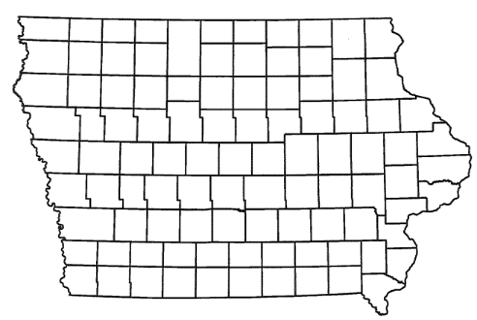
List of Local Development Applications Recommended
PROJECT NAME
SPONSOR
SCORE
TOTAL PROJECT COST
PERCENT PARTICIPATION
RECOMMENDED AMOUNT
Construction of approximately 1,680 feet of Ziegler Drive. | Altoona | 40 | $2,116,081 | 50% | $1,058,041
Construction of approximately 1,514 feet of 9th Avenue NW (Revised) | Farley | 44 | $762,179 | 50% | $381,089

Slide 6
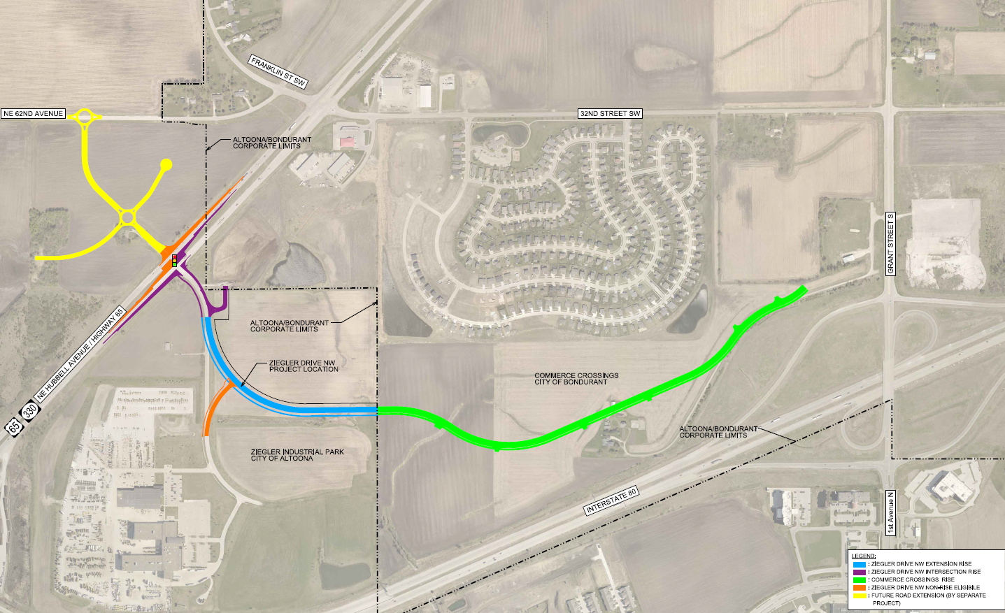
Altoona
(Local Development)
Construction of approximately 1,680 feet of Ziegler Drive located on the northwest side of town. This project is necessary to provide access to four lots totaling more than 34 acres for light industrial purposes.
Total Cost: $2,116,081
Requested: $1,058,041 (50%)

Slide 7
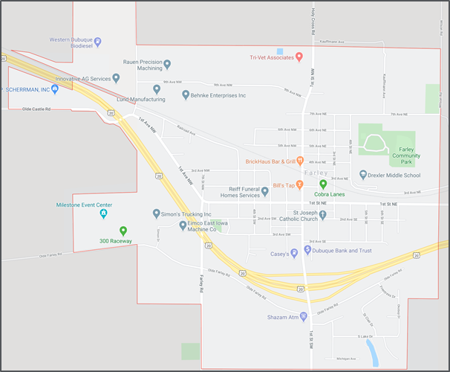
Farley - Revised
(Local Development)
Construction of approximately 1,514 feet of 9th Avenue NW located on the northwest side of town. This project is necessary to provide access to eight lots totaling more than 24 acres for industrial purposes.
Total Cost: $762,179
Requested: $381,089 (50%)

Slide 8
Immediate Opportunity Project Evaluation Criteria
Growth Potential
Average wages meet at least 100% laborshed wage
Quality of Jobs
No pattern of violations
In-state suppliers
Impact on import substitution
Few Iowa competitors
Operating expenditures spent in Iowa
Out-of-state sales
Hiring preferences to Iowa residents

Slide 9
List of Immediate Opportunity Applications Recommended
PROJECT NAME
SPONSOR
JOBS
TOTAL PROJECT COST
PERCENT PARTICIPATION
RECOMMENDED AMOUNT
Construction of turn lanes and a roundabout on 6th Street SW. | Cedar Rapids | 232 | $3,766,856 | 80% | $3,013,485

Slide 10
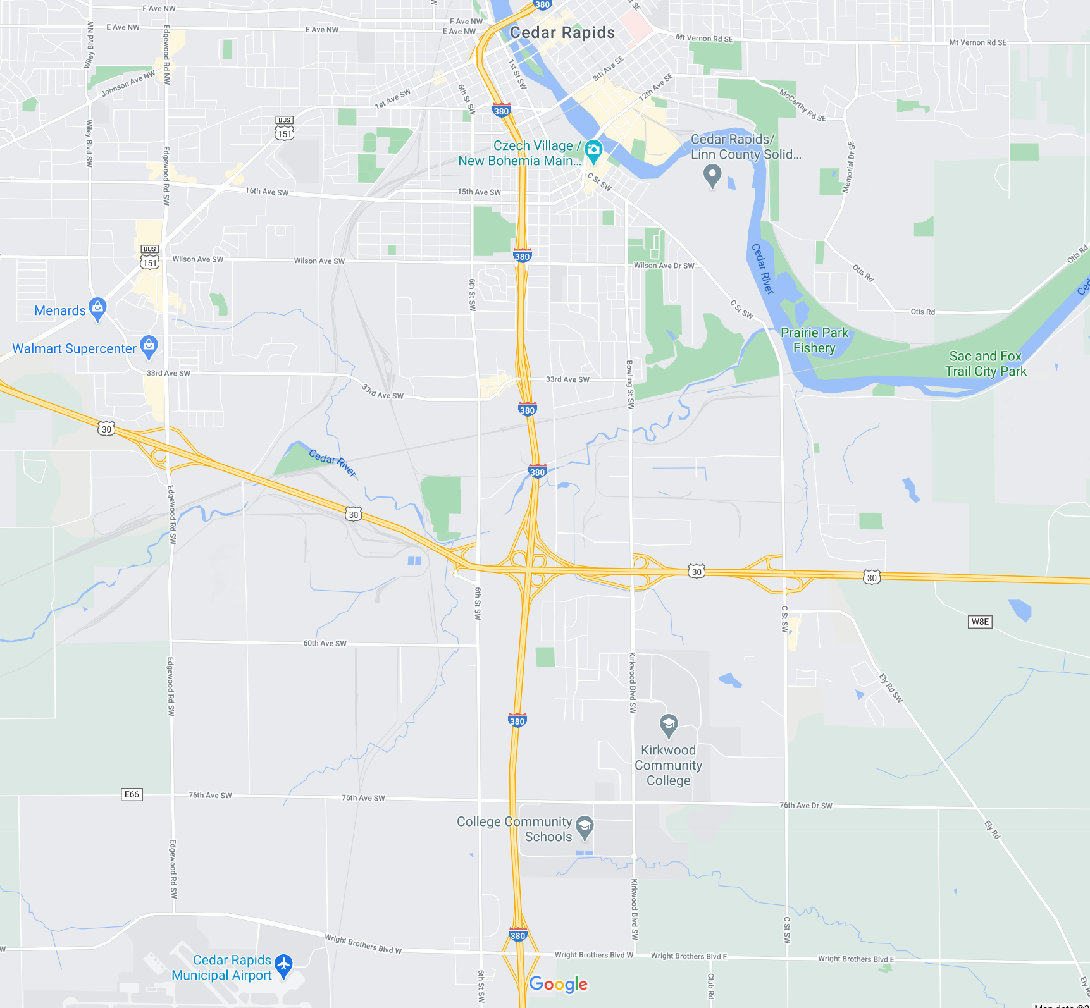
Cedar Rapids
(Immediate Opportunity)
Construction of turn lanes and a roundabout on 6th Street SW located on the southwest side of town. This improvement is necessary to provide improved access to the proposed site of BAE Systems Inc., an international defense, aerospace and security company.
Total Cost: $3,766,856
Requested: $3,013,485 (80%)
Jobs Retained: 232
RISE Cost/Job Assisted: $12,989.16 (225% of laborshed)
Capital Investment/RISE $: $58.85
Company Average Wages: $52.21

Slide 11
QUESTIONS?
Craig Markley, Systems Planning Bureau
craig.markley@iowadot.us
515-239-1027

