Slide 1
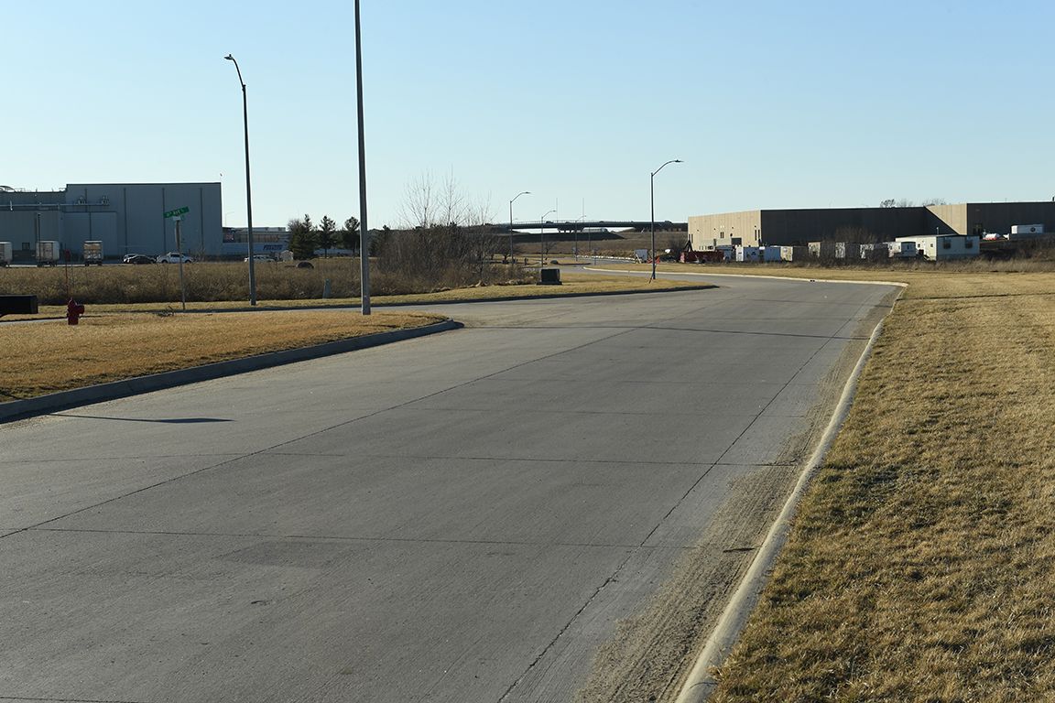
Revitalize Iowa’s Sound Economy Program
Past Survey Results and Potential Empower Rural Iowa Housing Related Policy Next Steps
January 13, 2021

Slide 2
History
March 2018 – Initiated discussion of proposal from former Transportation Commissioner Rose
April 2018 – Continued discussion, provided RISE award information, and proposed doing a survey
May 2018 – Survey conducted
July 2018 – Presented survey results to Commission
August 2019 – Discussions with IEDA concerning Empower Rural Iowa
February 2020 – Met with IEDA and ISU Extension on Rural Iowa Housing Program

Slide 3
RISE Grants Awarded
 | Projects Awarded | % of All Projects Awarded | Grant Dollars Awarded | % of All Grant Dollars Awarded
ALL RISE PROJECTS | 915 | 100% | $513,471,441 | 100%
Cities over 30,000 pop. | 183 | 20% | $231,321,136 | 45%
Cities under 30,000 pop. | 554 | 61% | $199,600,462 | 39%
Counties over 50,000 pop. | 31 | 3% | $23,655,588 | 5%
Counties under 50,000 pop. | 147 | 16% | $58,894,255 | 11%

Slide 4
RISE Survey Response
Cities (mostly city clerks), county engineers and economic developers participated
Series of 17 questions asking if aware of the RISE program, do they have adequate RISE-eligible vacant lots, are there barriers in applying for RISE, should RISE eligibility be expanded for other types of development
185 responses with about 136 completing the full survey
Many respondents from very small towns: Half of the city responses came from cities with less than 845 population
55% of the respondents were aware of the RISE program (100% counties; 48% of cities)

Slide 5
RISE Survey - Development
59% felt their community does not have an adequate number of vacant lots available for development (33% counties; 64% cities)
The biggest barriers to developing lots
Willing sellers of land
Lack of private developers
Cost of new roads

Slide 6
RISE Survey - Program
8% answered that they did not apply for funding even though they had a RISE opportunity (10% counties; 8% cities)
Reasons cited were:
Project was not RISE-eligible
Lack of matching funds
Used other financing
Project did not proceed

Slide 7
RISE Survey - Program
81% felt RISE is effective in promoting economic development in Iowa
Ineffectiveness reasons cited by the other 19% were:
Unsure due to unfamiliarity with program
Good for larger towns, but not for small towns
Difficult to find business to fit the program
Program requirements are difficult (match requirements, company disclosures, etc.)

Slide 8
RISE Survey - Program
36% felt there were barriers to applying to the RISE program (43% counties; 35% cities)
Such as:
Application process is hard without professional help
Lack of available development land
Lack of business opportunities that qualify
Reluctance of business to commit to jobs
Local match requirements
Reimbursement for costs versus up-front cash payments

Slide 9
RISE Survey - Program
20% suggested the following expansion of eligible development opportunities (24% counties; 20% cities)
Suggestions included:
Street resurfacing
Local business development (vs statewide)
Downtown redevelopment supporting residential and commercial development
Residential, commercial development
Schools, assisted living facilities
Regional medical facility parking lots

Slide 10
Potential Empower Rural Iowa RISE Housing Policy Next Steps
Continue working with Iowa Economic Development Authority Empower Rural Iowa staff and their statewide advisory committees on potential RISE policy concepts
Continue working with Iowa State University Extension staff and their pilot communities in assessing how their housing needs may be assisted by a potential RISE policy
Review draft policy concepts at future Transportation Commission workshops

Slide 11
QUESTIONS?
Craig Markley, Systems Planning Bureau
craig.markley@iowadot.us
515-239-1027

