Slide 1


Bridge Asset Management
Scott Neubauer, PE
Iowa DOT Bridges and Structures Bureau
Transportation Commission Workshop
January 13, 2021

Slide 2


Presentation Overview
Bidge Preservation
How we assess bridges
Condition summary
Funding scenarios

Slide 3
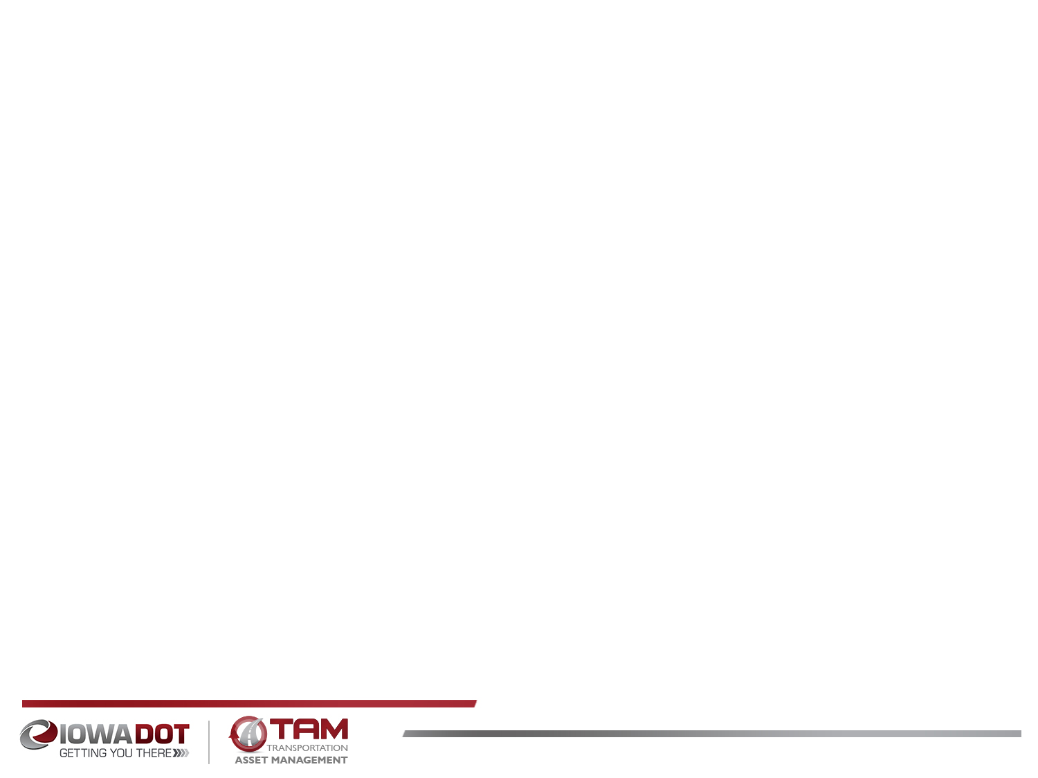
Bridge Preservation and Maintenance
What are some of the things we’re doing to preserve and maintain bridges?
Replace aging deck joints
Overlay decks with new wearing surface
  Dense concrete layer
  Polyester Polymer layer
  Latex modified concrete layer
  Epoxy polymer layer
  Repair beams ends
  Patch deteriorated deck areas
  Install berm and bank protection
  Use stainless steel reinforcing in areas with high potential for corrosion
  Use High Performance Concrete (HPC) in new bridge decks
  Use fewer or no deck joints
  Use of None Destructive Evaluation (NDE) methods to assess condition

Slide 4
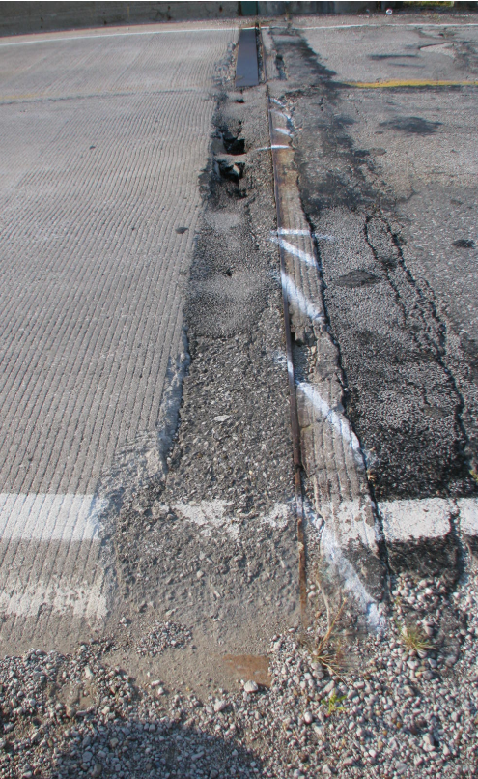
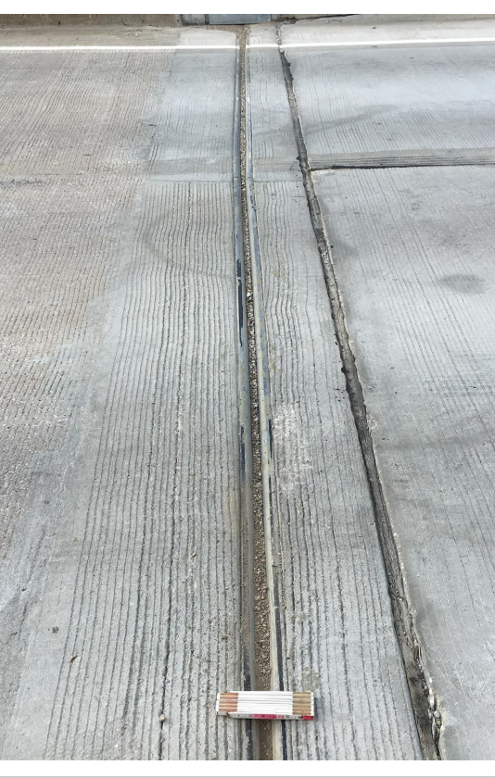
Notes:
Bridge 7834.9S092

Slide 5
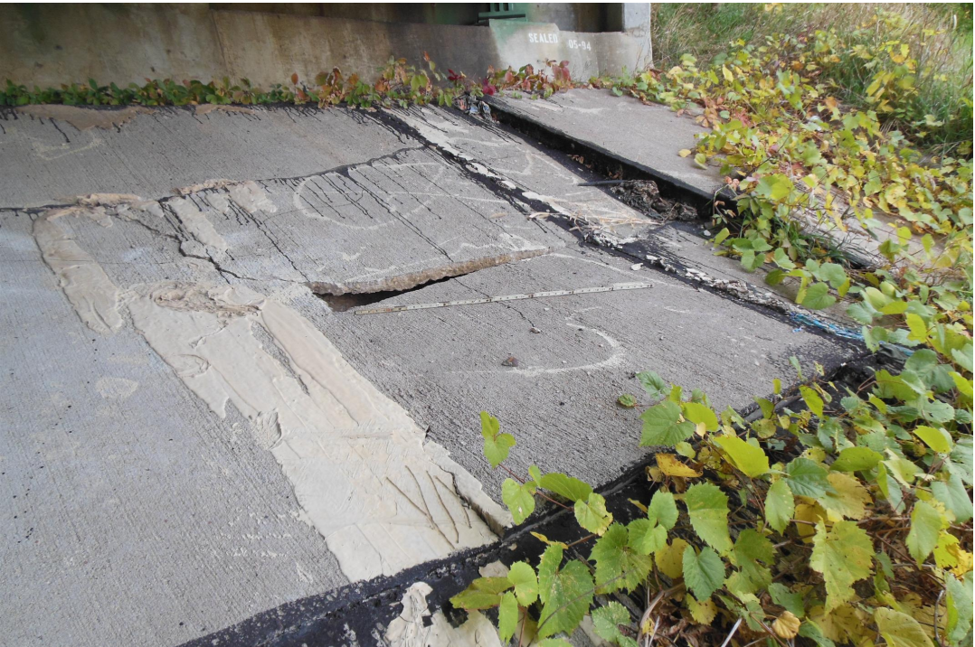
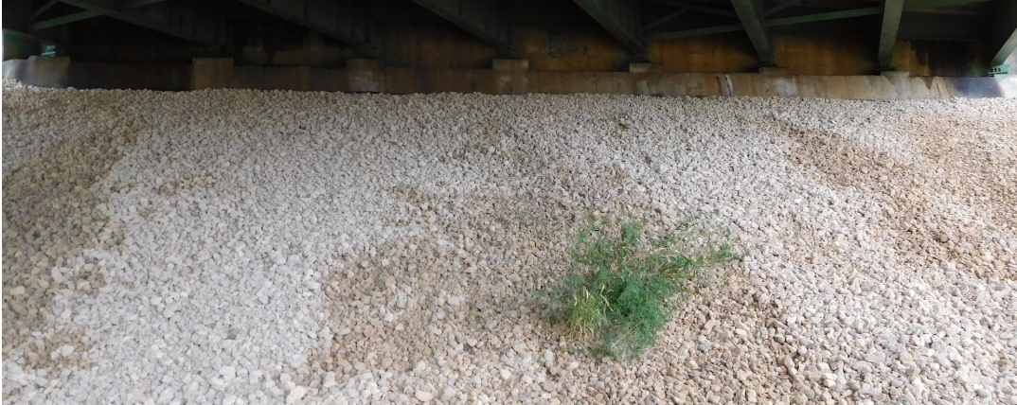
Notes:
Macadam stone – uniform crushed stone.

Slide 6
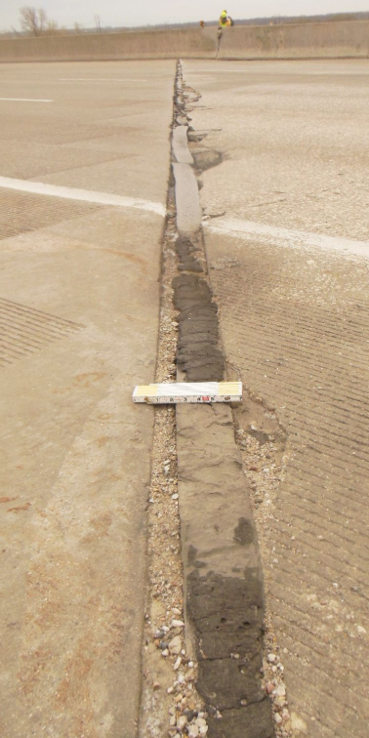
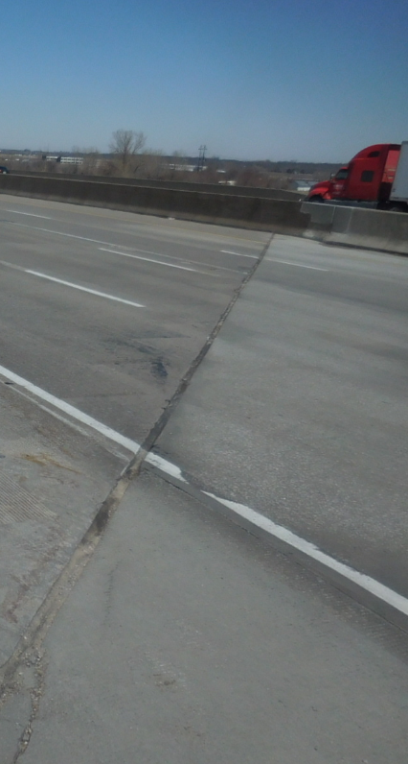
Notes:
Bridge 7788.3L035

Slide 7
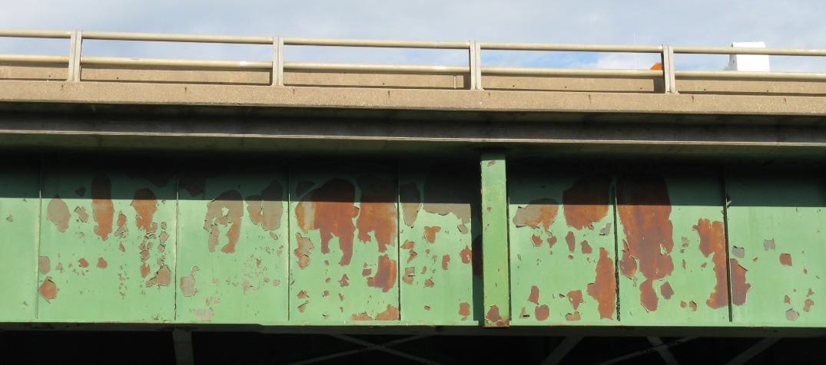
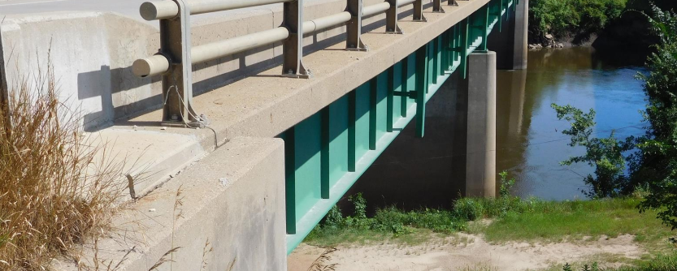
Notes:
Bridge 032220
Three coat paint system for field painting. Epoxy system or Moisture cured Urethane system. The two coat Zinc Silicate is not used in the field. Prime coat, Intermediate coat, and Finish coat.

Slide 8
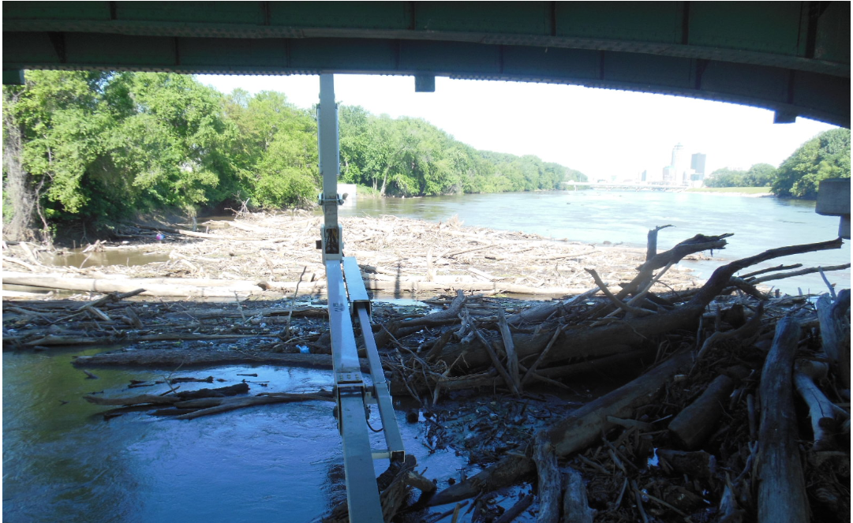
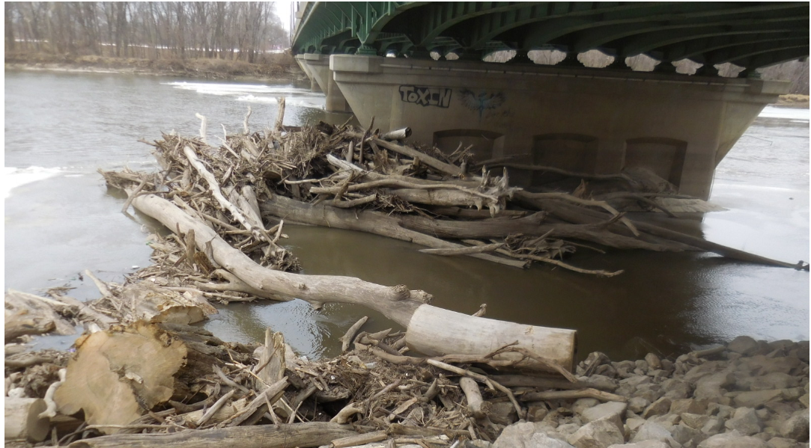
Notes:
Bridge 7784.2S069

Slide 9
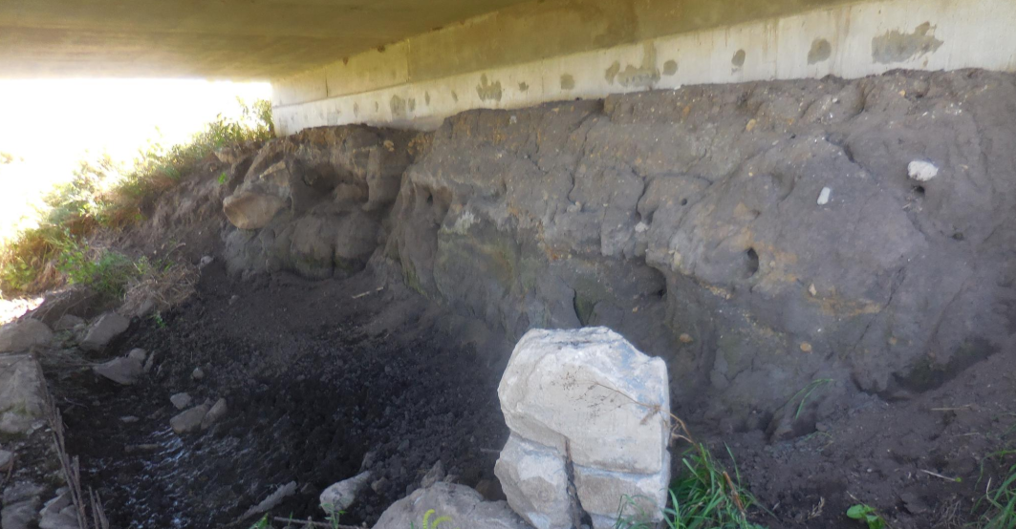
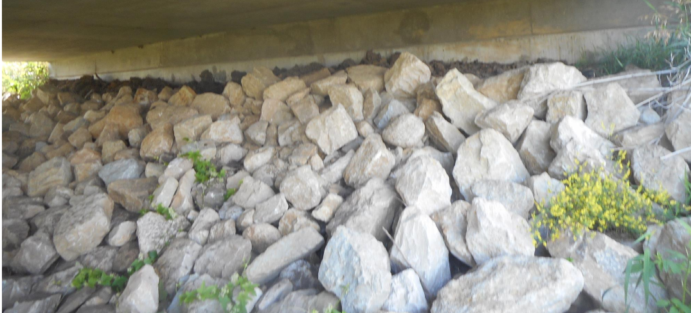
Notes:
Bridge 6669.0S218

Slide 10
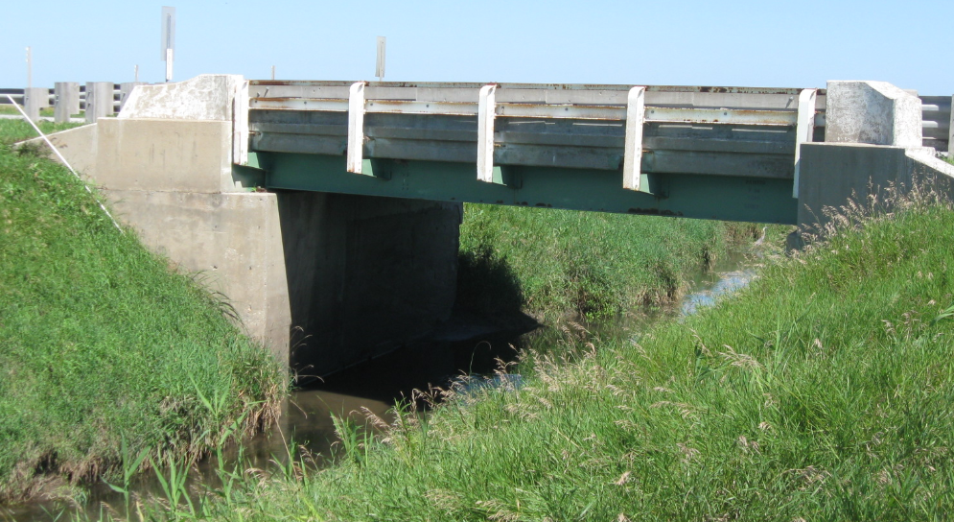
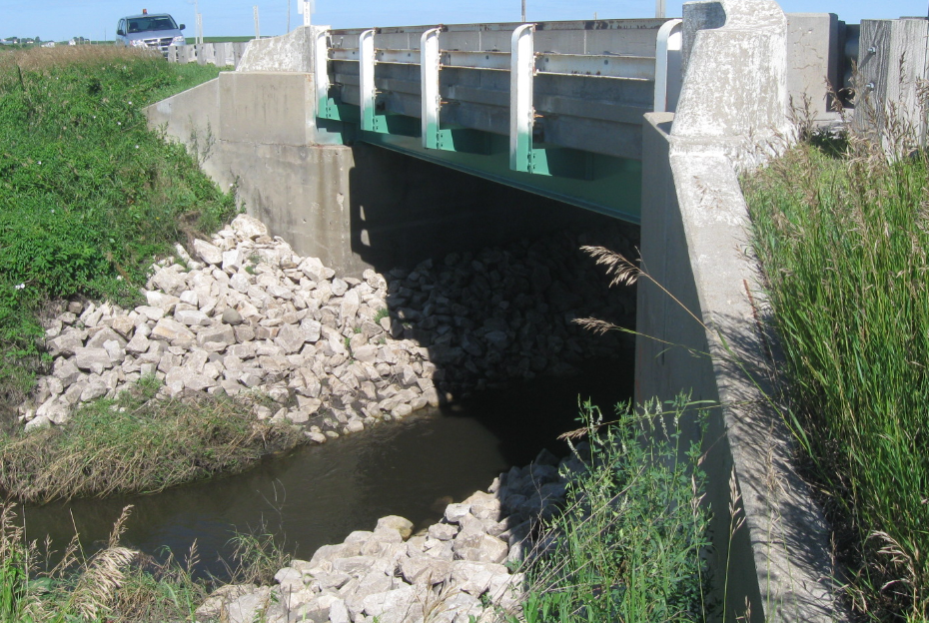
Notes:
7601.2S003

Slide 11
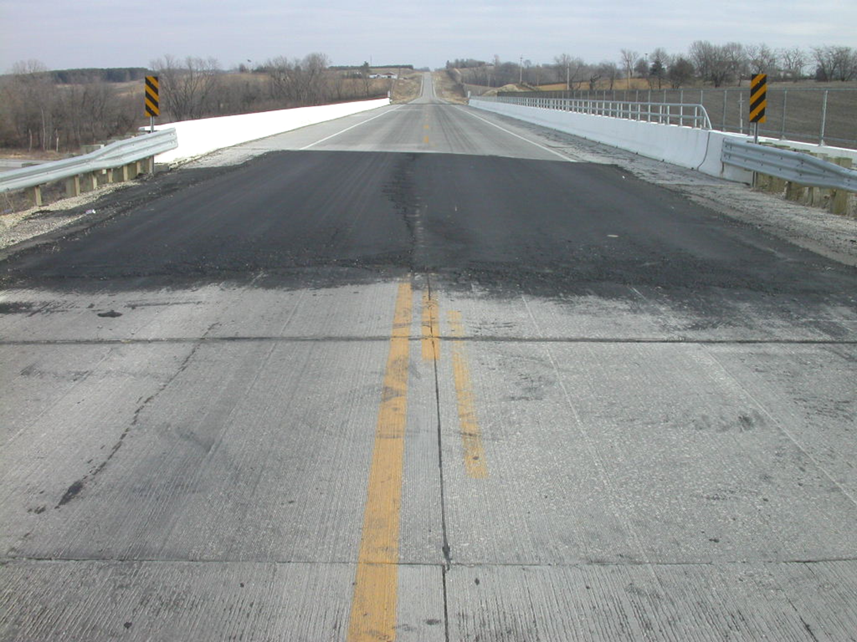
Notes:
Bridge 7767.7O035

Slide 12
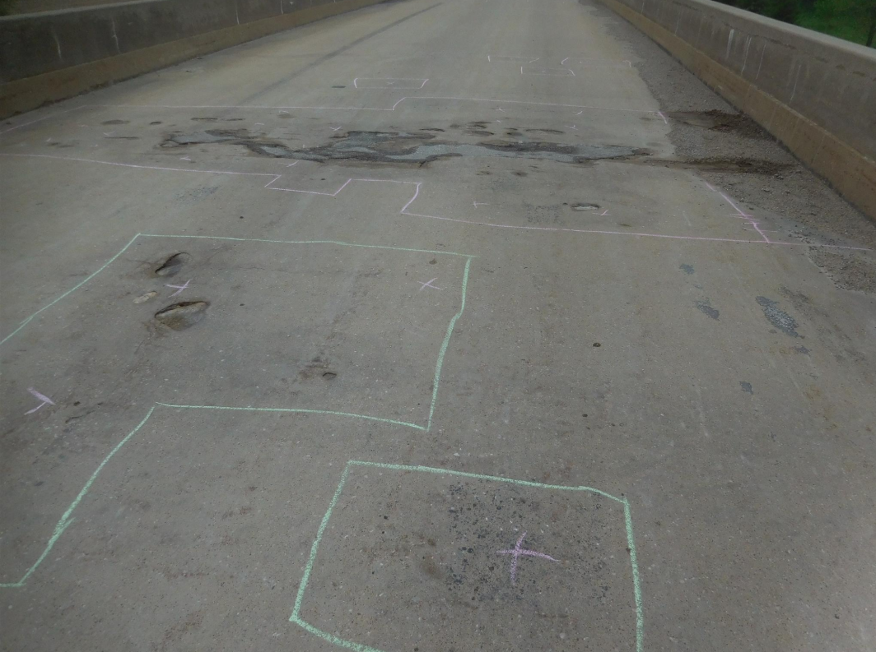
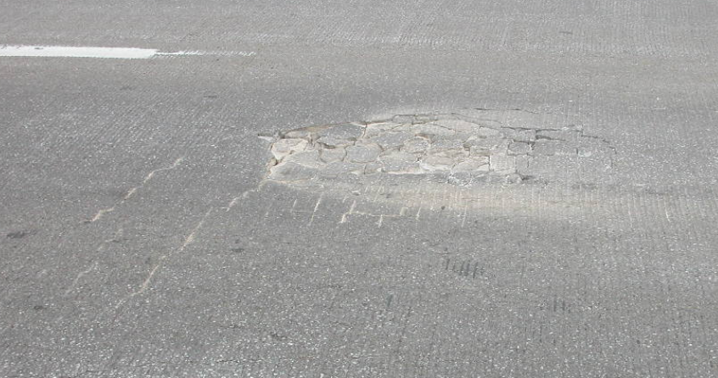
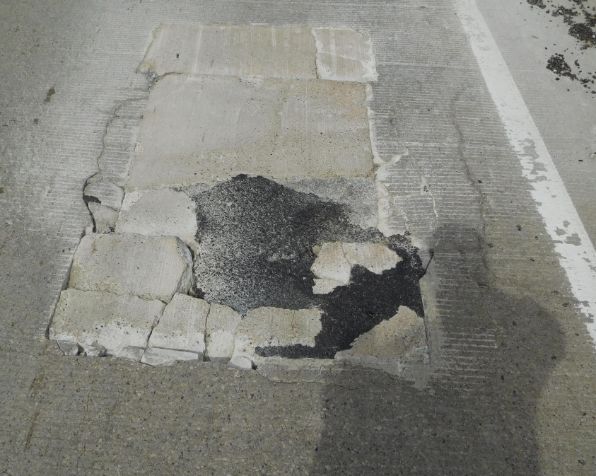
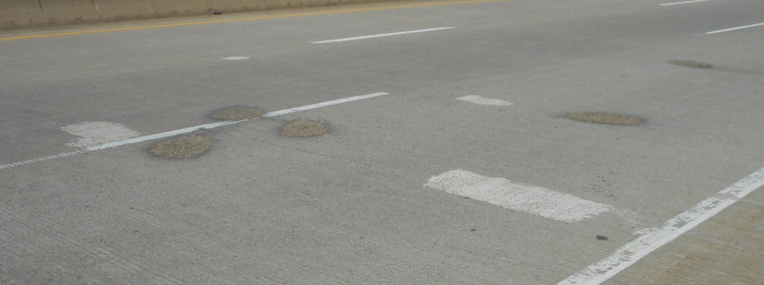
Notes:
5233.0O080
8295.9R080
3190.2S061 Peosta Channel
0625.7S030

Slide 13
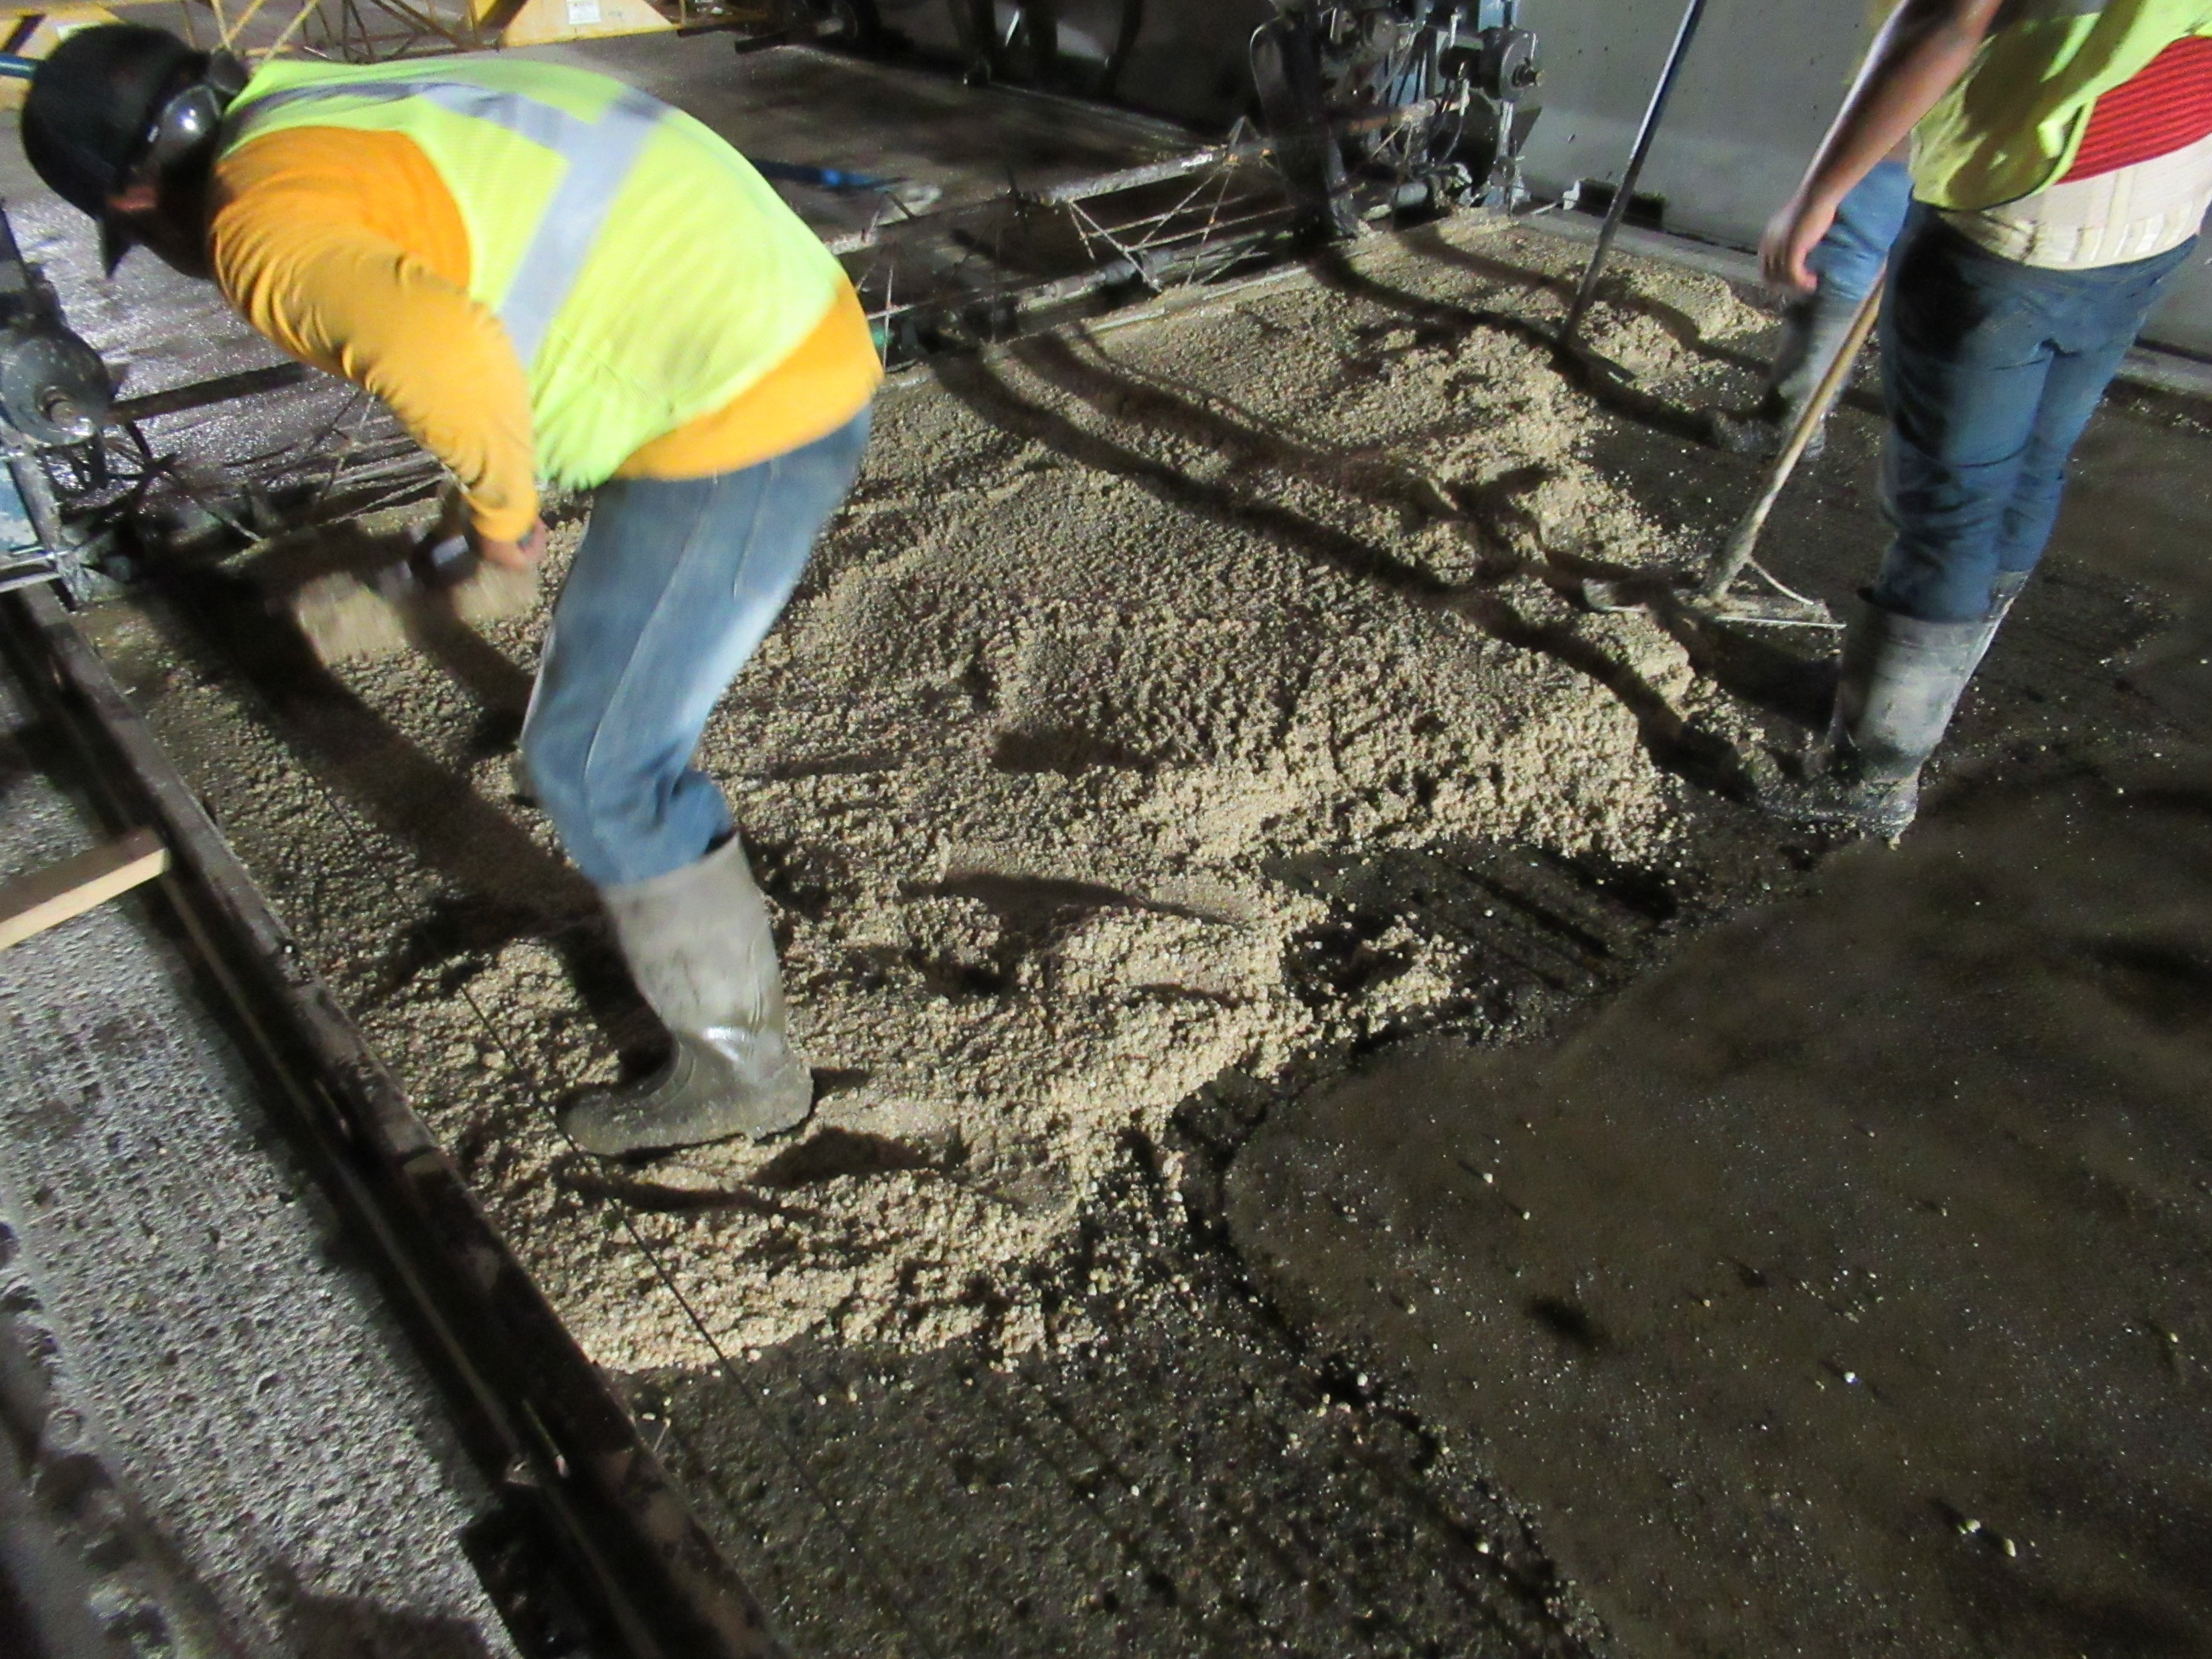
Notes:
Polyester Polymer overlay
Cedar Rapids over I-380 – 5720.8O380 8th st.

Slide 14
Bridge Inventory
The primary system includes 4,178 bridges and large culverts
Added together, the deck area of all primary system bridges is over 45 million square feet – that’s over 1½ square miles. (over 780 football fields)
If we had to replace these bridges today, the cost would exceed $16 billion. (this would be 20 years or more of our entire program)
Average VPD 6,560. Median VPD 3,450.
Notes:
2613 bridges on the NHS. 35 total Poor. 16 Poor on NHS. 711 interstate bridges. 3467 non-interstate bridges. 4178 total bridges.
Make comment that there are 24,000 bridges statewide. Iowa’s status as number one state with the most Poor/SD bridges due to local bridges.
17.0% of bridges are on the interstate. 24.1% of the total deck area in on the interstate.
$9 billion to replace in-kind. $355/ft^2 vs $200/ft^2

Slide 15
Bridge Inspection
Federal Highway Administration requires all bridges to be inspected every 24 months or less. (approximately 24,000 city, county and state bridges)
State bridge condition data is collected by 18 trained bridge inspectors.
It takes up to 5 years of training to be qualified to be a bridge inspector.
Inspection documentation is used to evaluate the need for replacement, rehab, or repair.
Notes:
99 FC bridges. 4161 bridges on state highways. 708 interstate (92 culverts, 28 FC), 3453 non-interstate (716 culverts, 71 FC).
Mention Scour Critical bridge inspection and how we have mitigated the scour critical bridges.

Slide 16
Bridge Project Selection Process
Bridge conditions are documented during inspections
Project recommendations are made during the inspection review process or by District personnel
Project recommendations are prioritized annually with each District
Projects are prioritized based on bridge condition, cost, development time and public need
Bridges and Structures Bureau reviews the highest priority projects and recommends projects based on available funding

Slide 17
Typical Bridge Costs
Replacements cost from $1.5 to $3.0 million (outliers not included)
Rehabilitations cost from $0.25 to $1.3 million
New Bridges cost from $2.3 to $3.5 million (outliers not included)
Notes:
910 Steel Girder Bridges
1832 PPCB bridges
561 Slab bridges
825 culverts
6 Other types of bridges
1 cable stayed
2 Concrete Arches
4 prestressed tee beams
2 prestressed box beams
2 prestressed channel beams
1 segmental concrete box beam
8 steel arches
1 steel deck truss
9 steel thru trusses
3 suspension bridges
2 Timber girders
1 Timber Slab

Slide 19
FHWA Terms Describing Bridge Condition:
Good
Fair
Poor
Notes:
Poor is the same as SD. The SD term was misleading to people who don’t know bridges. It does not mean the bridge is near failure.

Slide 20
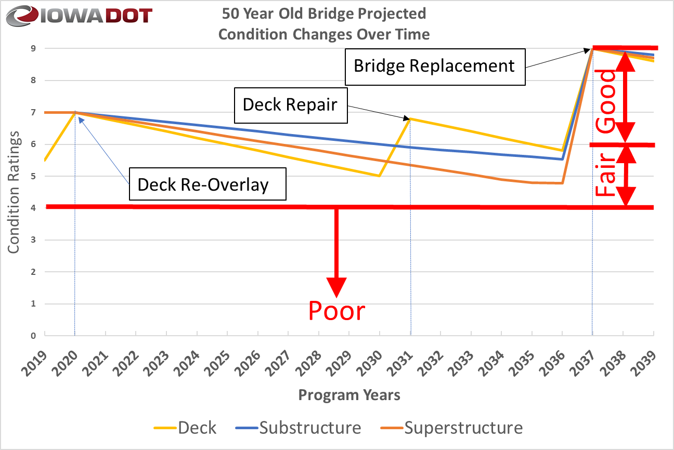
Notes:
This is a scenario recommended by our deterioration modeling system for a given bridge. Bridge 3826, IA-28 over Walnut Creek in Polk Co. Built in 1969. Second overlay in 2020. As bridges age, it is difficult to repair and maintain superstructures and Substructures.
Non-Interstate Unlimited budget CI42 Corrected.xlsx

Slide 21
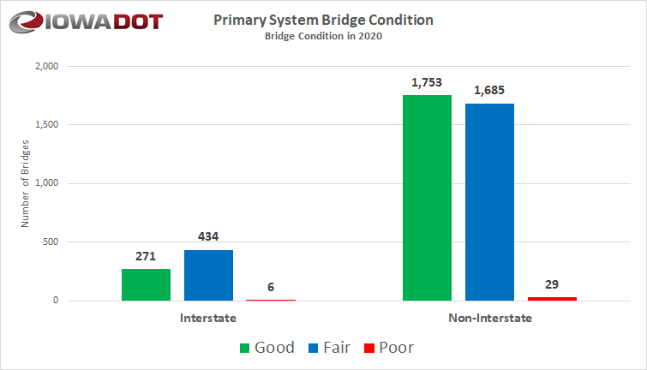
Notes:
SIIMS query 3-11-2020.xlsx

Slide 22
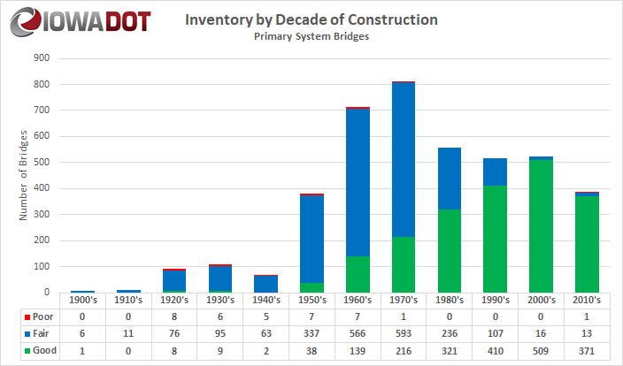
Notes:
SIIMS query 3-11-2020.xlsx . We built 43 bridges in FY2020 (30 replacements and 13 new)
1384 bridges are over 50 years old. 33.1%% of states bridges and 23.2% of state deck area.
The poor bridge in the 2010’s is the I-29 bridge that sustained damage from a fire and the bridge superstructure had to be replaced only 3 years after it was built.
The 13 fair bridges in the 2010’s are from the deck condition. 7 are on the I-29 corridor project. An issue with deck concrete quality. HPC

Slide 23
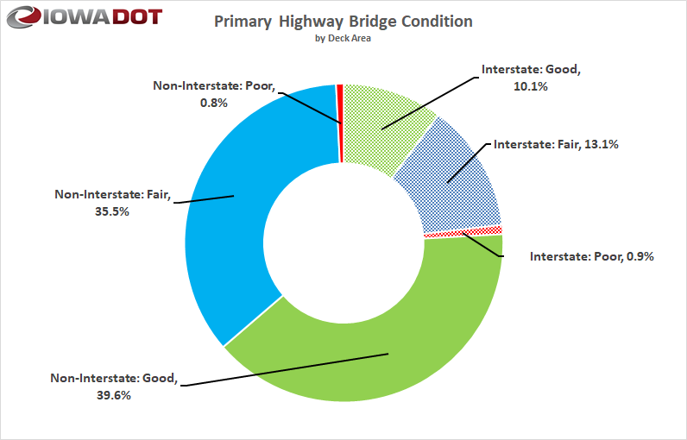
Notes:
SIIMS query 3-11-2020.xlsx
Need to discuss minimum condition on NHS required by FHWA. How do I show this without another chart?
2613 bridges on NHS (2571 state owned), 2.2% of the deck area is poor.

Slide 24
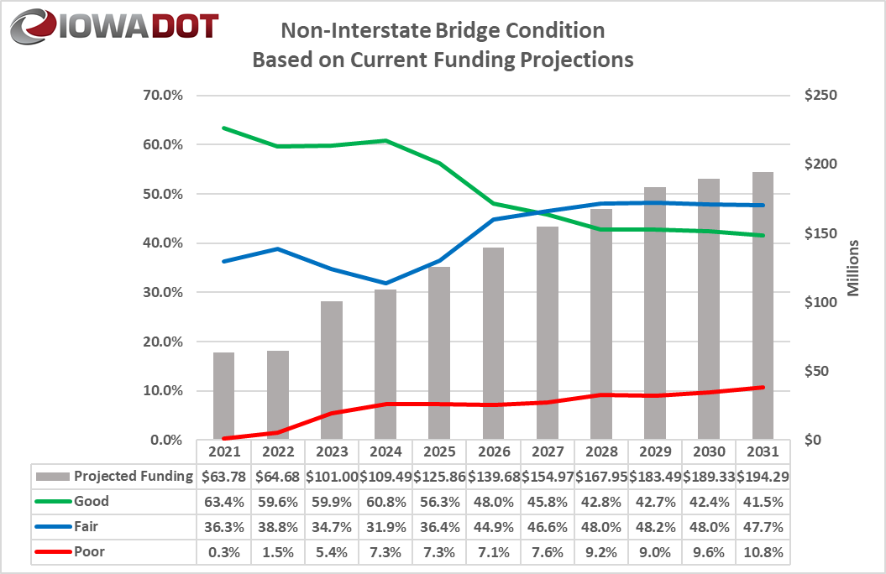
Condition Forecast
Border Bridges and culverts excluded
Notes:
W:\Highway\Bridge\BridgeInspection\Deterioration Modeling\IDS Project\Phase VII 2020\Non-Interstate\Non-Interstate Current budget 2020.xlsx
The 0.3% poor is based on the model spending the FY2021 money on the Poor bridges shown previously as 0.8%.

Slide 25
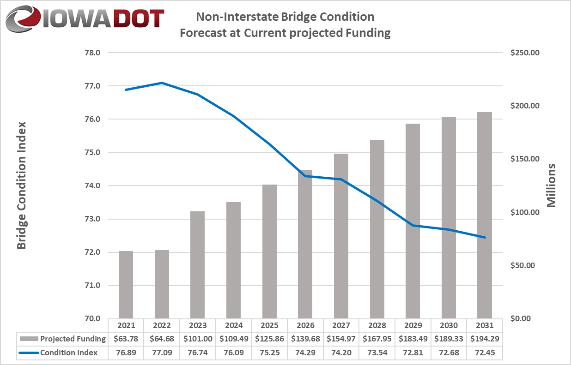
Condition Forecast
Notes:
W:\Highway\Bridge\BridgeInspection\Deterioration Modeling\IDS Project\Phase VII 2020\Non-Interstate\Non-Interstate Current Budget 2020.xlsx

Slide 26
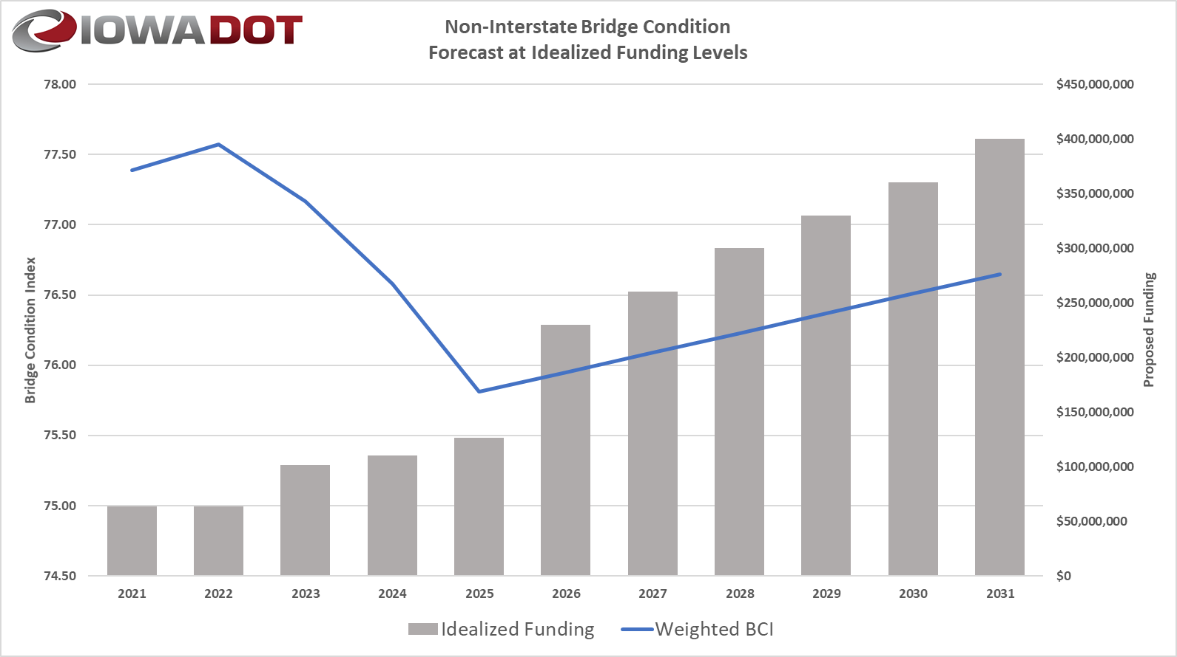
Condition Forecast
Notes:
W:\Highway\Bridge\BridgeInspection\Deterioration Modeling\IDS Project\Phase VII 2020\Non-Interstate\revised runs\2020_NonInterstate_5YR_Budget_CI42.2_Target_Gap.xlsx
Mention the age of bridge replacements and how these numbers are reasonable for the need to replace 60 or more bridges per year.

Slide 27
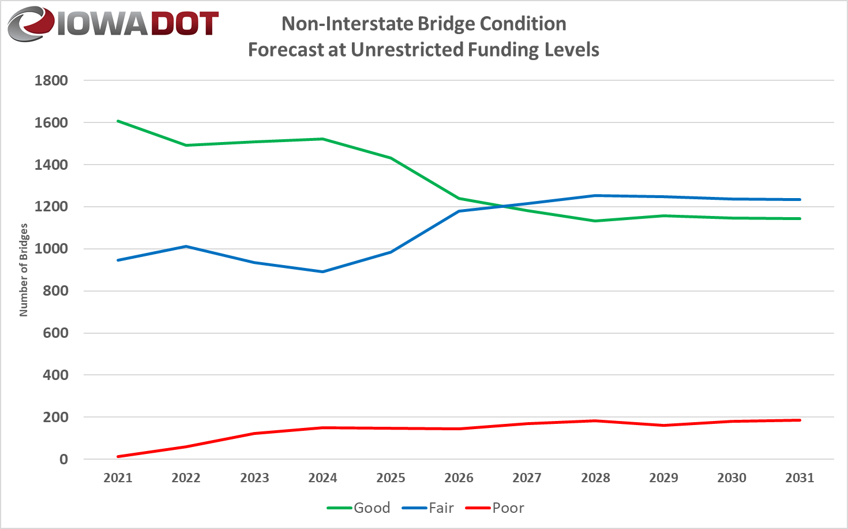
Condition Forecast
Notes:
W:\Highway\Bridge\BridgeInspection\Deterioration Modeling\IDS Project\Phase VII 2020\Non-Interstate\2020_NonInterstate_5YR_Budget_CI42.2_Target_Gap.xlsx

Slide 28


Additional Needs
There is a need to replace or rehabilitate several large bridges over the next 20 years.
  I-280: Rock Island over the Mississippi River (re-deck in FY2021, $17 million)
  I-129: Sioux City over the Missouri River (deck overlay in FY2021, $4.97 million)
  IA-9: Lansing over the Mississippi River (replace in FY2024, $40 million)
  I-80: Le Claire over the Mississippi River (replace in FY2026, $150 million)
  IA-12: Sioux City Gordon Drive Viaduct (replace in FY2027, $105 million)
  US-67: Davenport over the Mississippi River (replace beyond 2028, $110 million)
  IA-175: Decatur over the Missouri River (replace - $60 million )
  US-20: Dubuque over the Mississippi River (replace - $175 million )
  US-30: Clinton over the Mississippi River (replace - $125 million )
  US-63: Ottumwa Viaduct (replace - $80 million)
Note: the costs shown above represent Iowa’s estimated share.
In 10 Years
In 15 Years
In 20 Years
28
Notes:
15 bridges over Mississippi River, 12 bridges over Missouri River and 11 bridges over other waterways

Slide 29
Key Take-Aways
There is a large inventory of bridges built in the 1960’s and 1970’s.
Good progress has been made reducing the number of bridges classified as poor. This trend is likely to reverse due to the large number of aging bridges.
Border bridges represent large capital improvement projects that need to be planned for far in advance.
A sustained focus on stewardship is critical.

