Slide 1
State Transportation Plan Implementation Update
Iowa Transportation Commission
January 13, 2021

Slide 2
Discussion overview
Brief background
Plan implementation highlights
Strategy implementation monitoring effort
Ongoing plan update

Slide 3
Background
State Transportation Plan adopted by Iowa Transportation Commission in May 2017
Significant implementation activity has taken place
Several other plans have been or are being updated, including Iowa in Motion

Slide 4
Continuous planning
Functional relationship between strategies in the long-range plan and other overarching plans
Continuous process; most plans updated every ~5 years
 | Last update | Next update
Aviation system plan | 2010 | 2021
State rail plan | 2017 | 2021
State long-range plan | 2017 | 2022
State freight plan | 2017 | 2022
Asset management plan | 2018 | 2022
Bicycle/pedestrian plan | 2018 | 2023
Strategic highway safety plan | 2019 | 2024
Public transit plan | 2020 | 2025

Slide 5
Strategies
In addition to modal needs analysis, the current Plan included:
80 strategies for the Iowa DOT and Commission
Categorized across several modal/subject areas
Today’s highlights: key recent activities for each mode

Slide 6
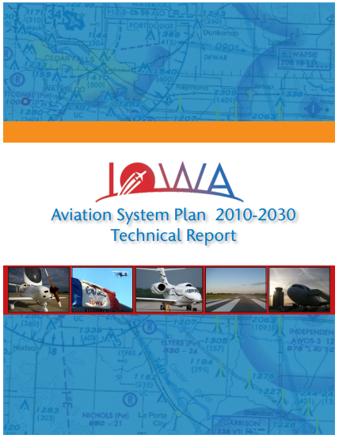
Aviation
Aviation System Plan update nearly complete
Critical planning outputs:
Updated airport data inventory
System issues identification
System demand forecast
System performance evaluation
Airport roles evaluation
Completion by April 2021

Slide 7
Bicycle/Pedestrian
Complete Streets Policy implementation
Policy effective January 1, 2020
Reviewed 57 project concepts against policy
Finalizing fiscal impact analysis
Completed statewide systemic safety analysis

Slide 8
Public Transit
Public Transit Long Range Plan completed
Critical planning outputs:
Needs analysis for Iowa’s 35 public transit agencies
Statewide transit dependency analysis
Costs and revenues forecast

Slide 9
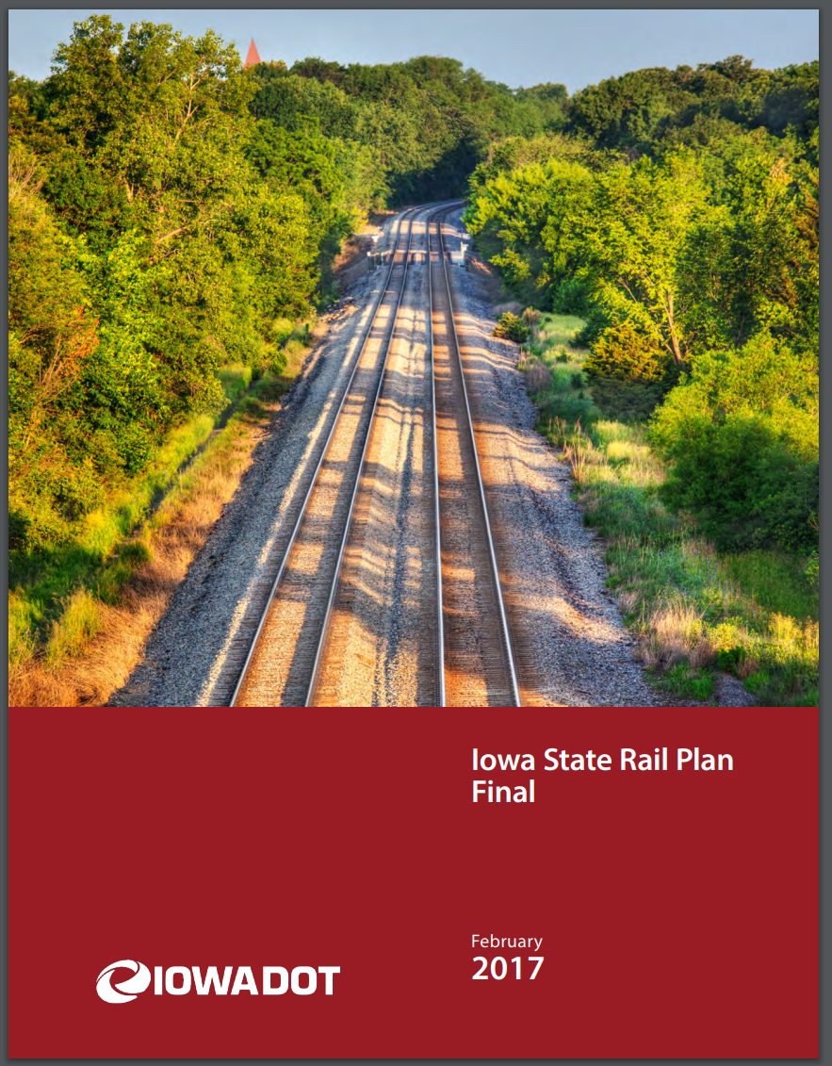
Rail
State Rail Plan refresh underway
Critical planning outputs:
Rail system data update
Rail bottlenecks update
Project amendments

Slide 10
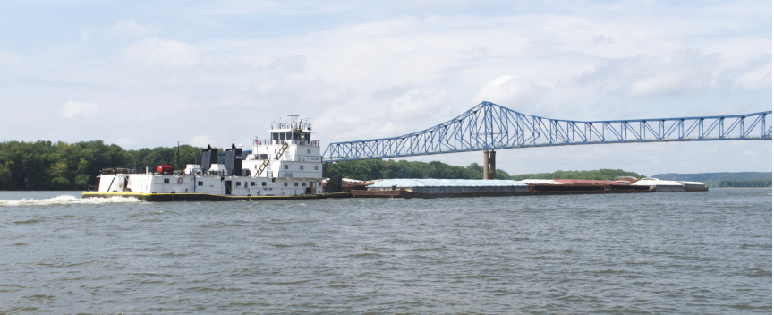
Waterway
Supported Marine Highway M-29 with RISE funding for the Missouri River barge facility under construction near Blencoe
Implementation of Upper Mississippi Inland Waterway Evaluation report recommendations
Continued development of mooring cell pilot concept
State Freight Plan update underway
Re-evaluation of freight mobility issues, including waterway

Slide 11
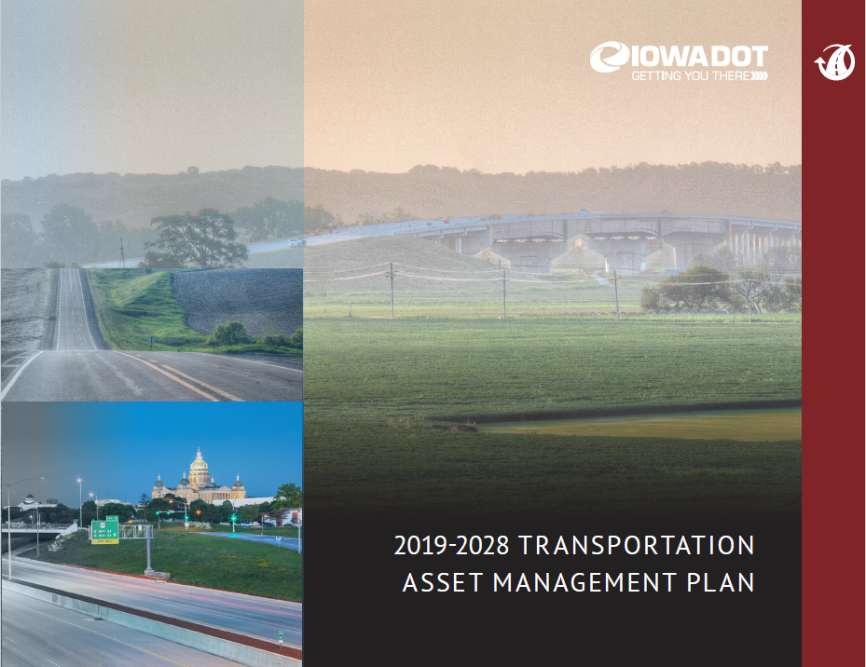
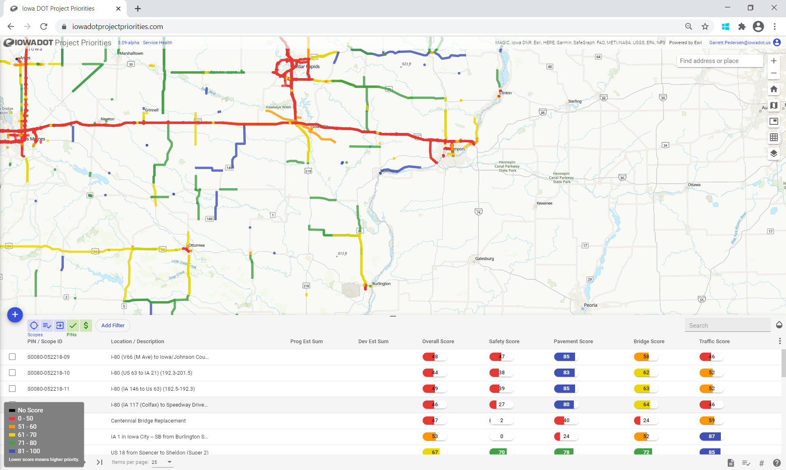
Highway
Ongoing integration of asset management into department functions; regular Commission presentations
Ongoing training and refinement of Project Prioritization/Scoping tool
Review of highway program candidates for Plan consistency
Super 2 implementation

Slide 12
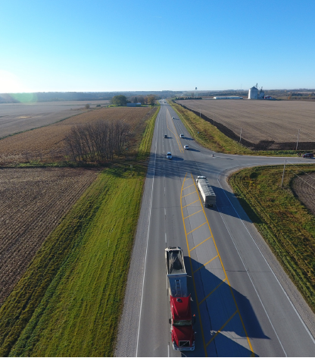
Highway – Super-2
Super-2 design guidance developed
Super-2 elements being incorporated into project design
Super-2 considered in Planning and Environmental Linkage (PEL) studies on targeted corridors
US 30 Cedar/Clinton PEL reaffirmed Plan needs analysis
First Super-2 project programmed –Lisbon-Mechanicsville (ROW) FY 2025

Slide 13
Strategy implementation monitoring
Review of 260+ strategies included in current plans
Status/effectiveness of implementation?
Can the implementation approach be enhanced?
Can strategy development be enhanced?
Answers to these questions will:
Inform immediate priority actions
Enhance future strategy development
Improve implementation/performance monitoring

Slide 14
Iowa in Motion update
Plan update scheduled for Transportation Commission adoption in May 2022
Upcoming discussions:
System objectives – March/April
(relates to recent Project Prioritization discussion)
System condition/needs – Summer
Strategies and recommendations – Fall

Slide 15
Questions?
Garrett Pedersen, Planning Team Leader
Systems Planning Bureau
garrett.pedersen@iowadot.us
515-239-1520

