Slide 1
Transportation Commission Update #2
January 13, 2021

Slide 2
Agenda
Discuss 2020 Airport System Role Designations
Discuss Non-NPIAS Airport Evaluation
Discuss Facility and Service Objectives
Next Steps and Wrap-Up

Slide 3
System Airport Roles
Based on the roles developed in 2010 plan
Used to assess system and develop facility and service recommendations
Iowa’s 5 airport roles:
Commercial Service
Enhanced Service (5,000 ft rwys, jets)
General Service (4,000 ft rwys, mid-sized jets)
Basic Service (3,000 ft rwys, fuel)
Local Service (turf, limited services)

Slide 4
Airport Role Designations
2010 Iowa system – 117 airports
2020 Iowa system – 114 airports
Includes
Sioux County Regional
Peltz Field
Airports closed since 2010
Sioux Center
Orange City
Morningstar
Onawa
Primghar

Slide 5
Airport Role Designations
Commercial Service – Support commercial service airline service and support all types of general aviation activity
Enhanced Service – Includes airports with runways over 5,000 feet that serve as economic centers for the region
General Service – Airports hat have runways of 4,000 feet or greater and services that cater to small and mid-sized jets. Recognized as community assets.
Basic Service – Airports with runways greater than 3,000 feet and services that meet recreational general aviation activity
Local Service – Supports local activity and provide limited aircraft services

Slide 6
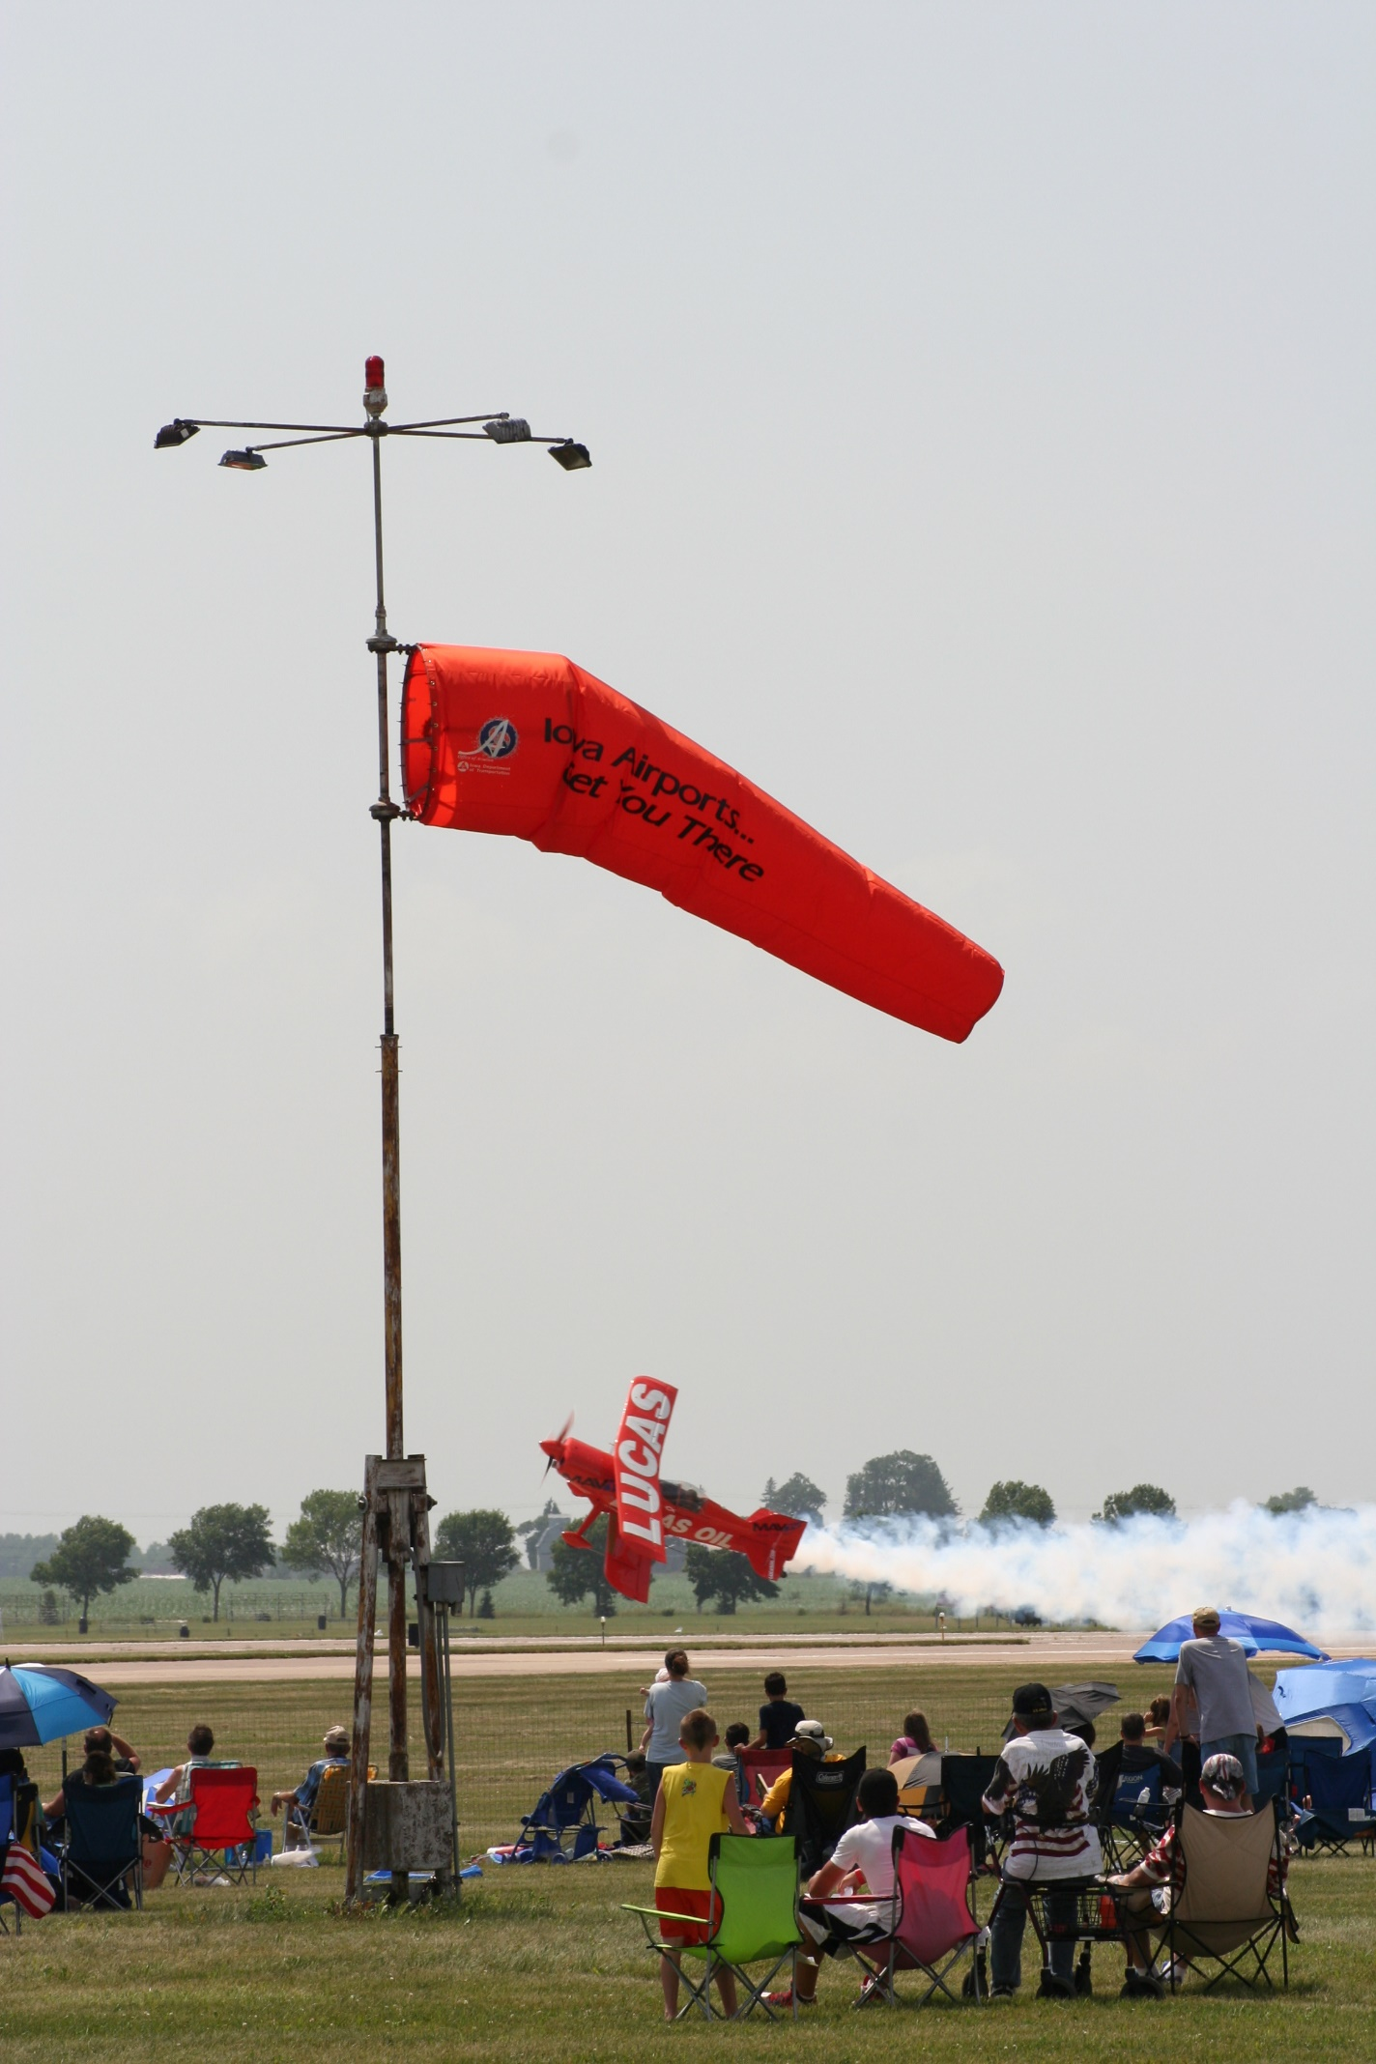
Airport Role Evaluation
Reviewed 2010 airport role designations to determine if changes are warranted
Evaluated key facility improvements made since 2010
Reviewed recommended system improvements from 2010 SASP to determine current status
Determined current role for:
Sioux County Regional
Peltz Field

Slide 7
Iowa Facility Changes – 2010 to 2020
 | Commercial and Enhanced Service Airports | General Service Airports | Basic Service Airports | Local Service Airports
Runway Length | - | Iowa Falls (4,000’ – 4,600’) | Jefferson (3,200’ to 4,000’) | Lamoni (2,900’ – 3,400’) Waverly (2,800’ – 3,200’)
Runway Lighting | Davenport (medium to high intensity) | - | - | Belmond (none to NSTD) Larchwood (none to LOW) Rockwell City (LOW to MED)
VGSI | - | - | Bloomfield (none to 2L PAPI) | -
REIL | - | Harlan (none to both) Mount Pleasant (one end to both) Oelwein (one end to both) | Emmetsburg (none to both) Shenandoah (one end to both) | Albia (none to both)
Fuel | - | Estherville (Jet A) | Marion (Jet A) West Union (Jet A) Winterset (Jet A) | Audubon (Jet A) Lamoni (Jet A) Larchwood (100LL - private system) Waverly (Jet A)

Slide 8
Status of 2010 Recommended Improvements
Airport | 2010 Role | Next Highest Role Classification | Facility or Services Improvement | 2020 Status
Albia | Local | Basic | Availability of staffing or on-call 24/7 | Unattended
Audubon | Local | Basic | Availability of staffing or on-call 24/7 | Unattended
Clarinda | Basic | General | Availability of based services | No Flight Instruction, Aircraft Charter, or Aircraft Rental
Guthrie Center | Local | Basic | Availability of staffing or on-call 24/7 | Unattended
Humboldt | Local | Basic | Availability of staffing or on-call 24/7 | Unattended
Lamoni | Local | Basic | Availability of staffing or on-call 24/7 Lengthen 2,900 feet runway | On-call 3,400 feet runway
Mapleton | Local | Basic | Lengthen 2,801 feet runway | No change in runway length
Maquoketa | Local | Basic | Availability of staffing or on-call 24/7 | Unattended
Rockwell City | Local | Basic | Availability of staffing or on-call 24/7 | Unattended
Shenandoah | Basic | General | Availability of based services | Flight instruction, aircraft maintenance, and aircraft rental available
Tipton | Local | Basic | Availability of staffing or on-call 24/7 | Unattended
Waverly | Local | Basic | Lengthen 2,800 feet runway | 3,200 feet runway

Slide 9
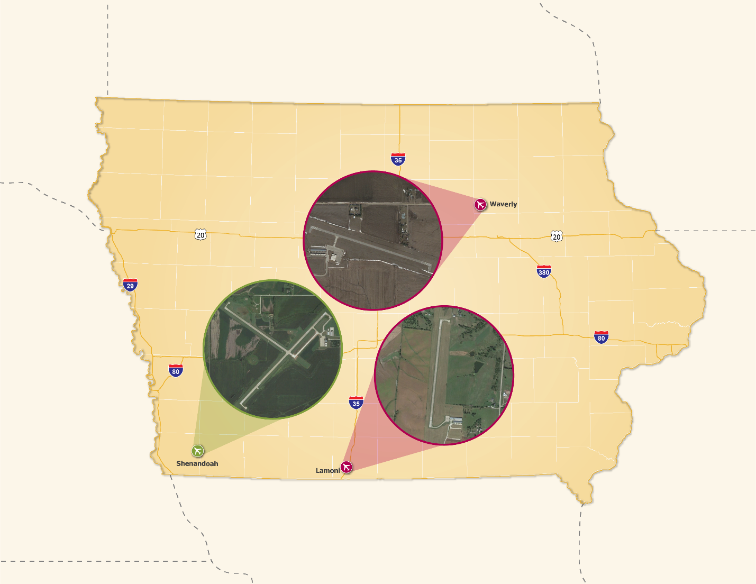
2020 Updated Roles
Airport | 2010 Role | New 2020 Role
Lamoni | Local | Basic
Shenandoah | Basic | General
Waverly | Local | Basic

Slide 10
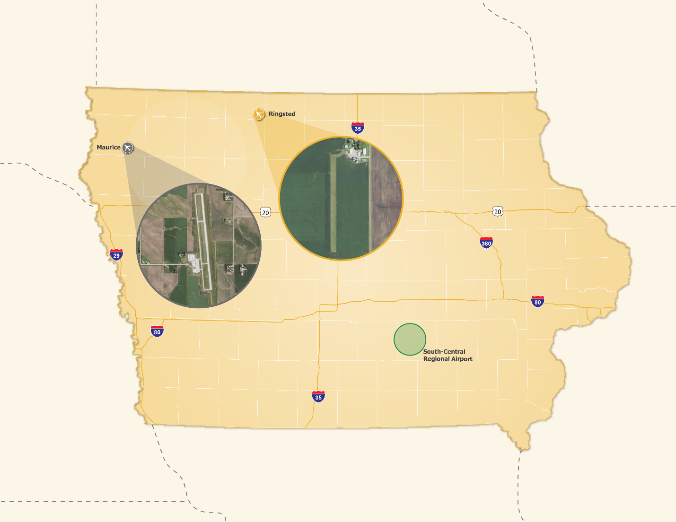
2020 New System Airports
Airport | 2020 Role
Maurice/Sioux County | Enhanced
Ringsted/Peltz Field | Local

Slide 11
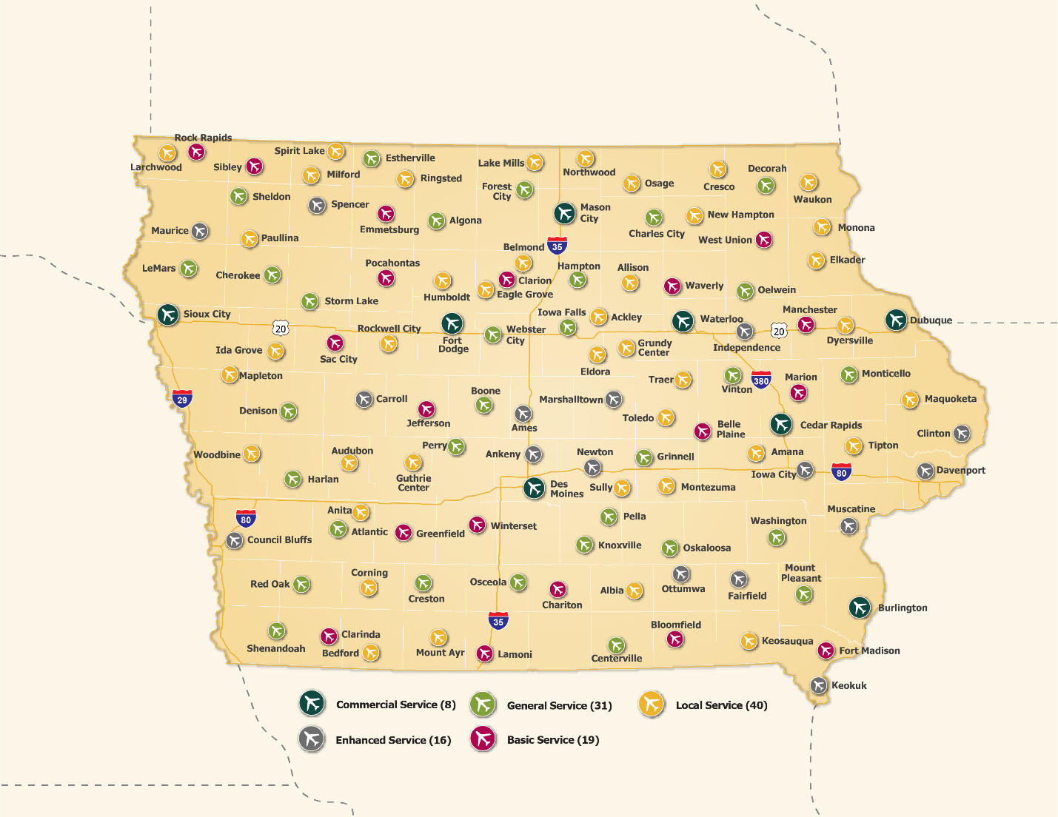
2020 Recommended Airport Roles
Commercial Service – 8 airports
Enhanced Service – 16 airports
General Service – 31 airports
Basic Service – 19 airports
Local Service – 40 airports

Slide 12
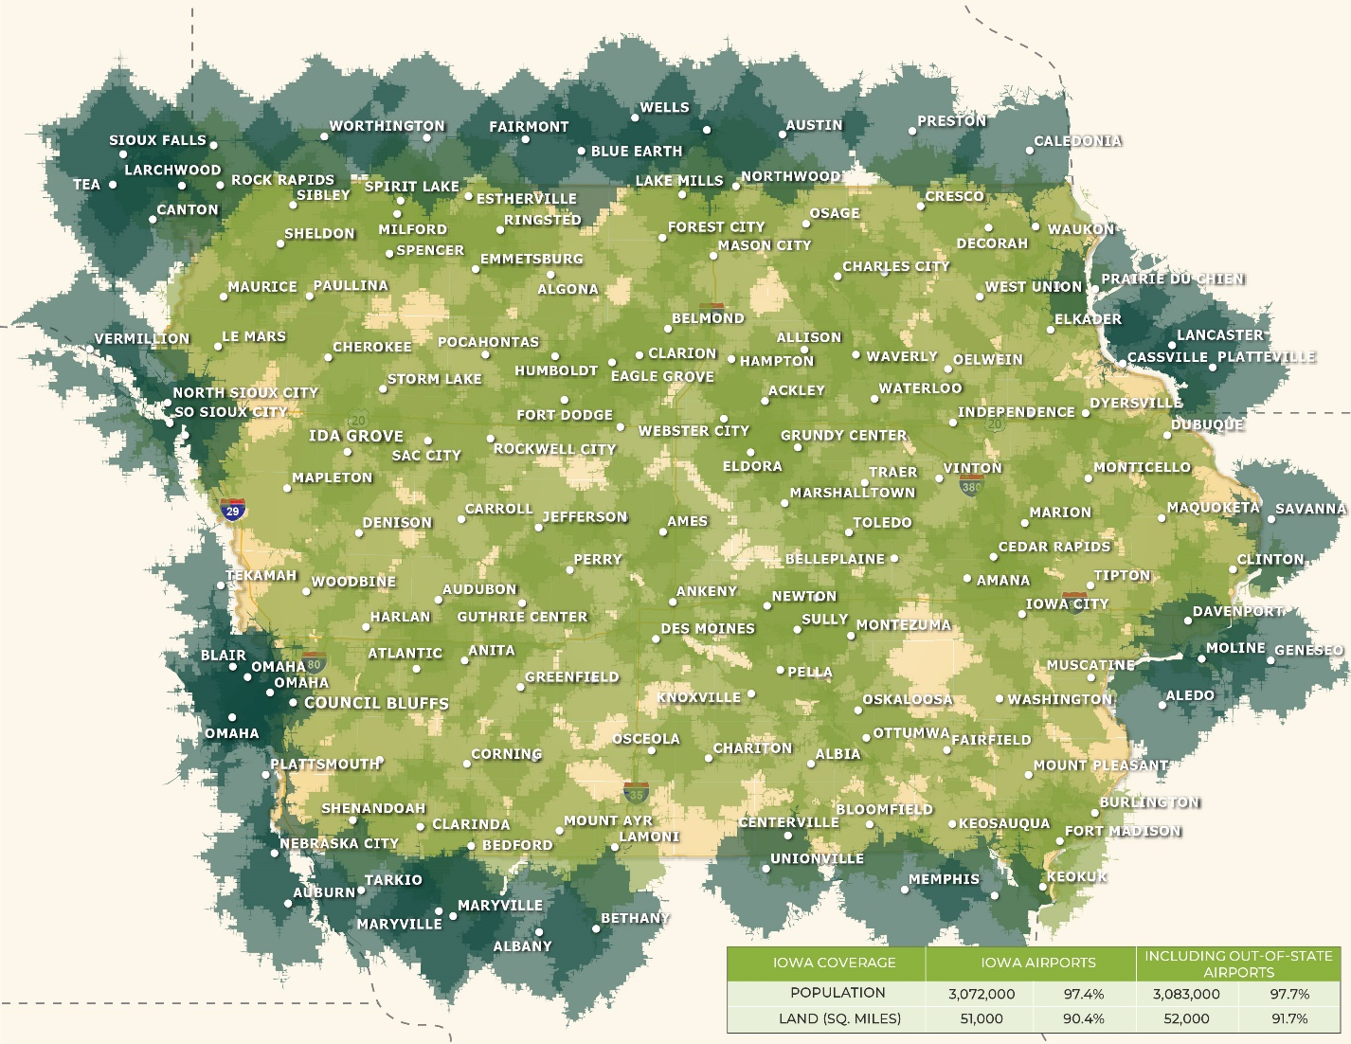
System Performance – General Aviation Airports
30-Minute Drive Time
Iowa has outstanding coverage
Population - 97 percent
Geographic– 90 percent
Out-Of-State airports provide additional coverage along states borders
Will develop coverage by role in Recommendations

Slide 13
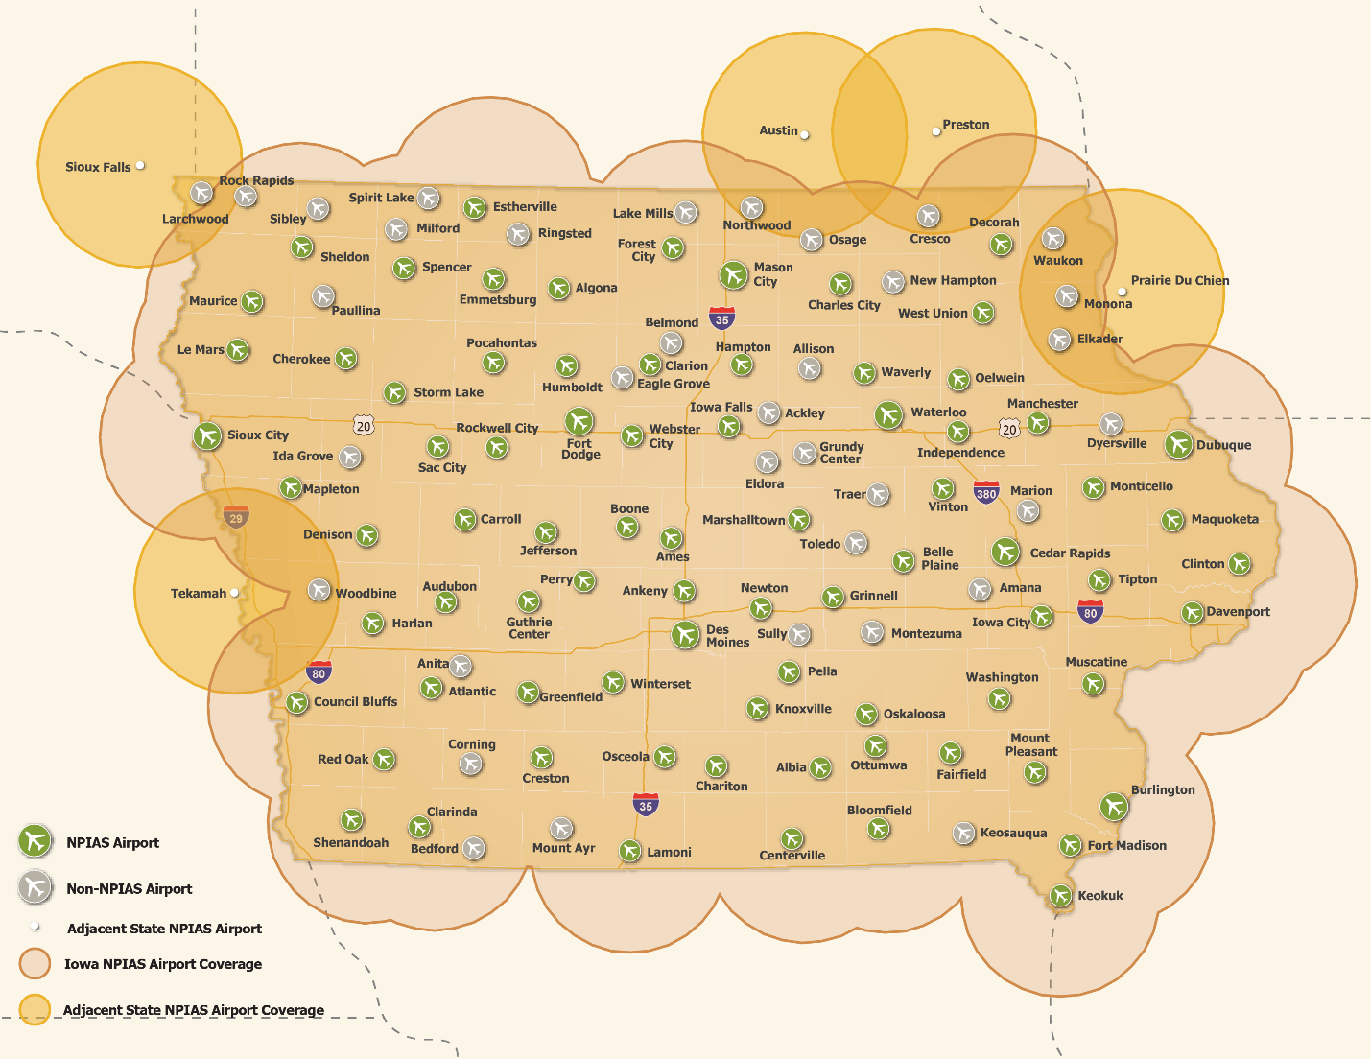
Non-NPIAS Airport Evaluation
Must meet FAA NPIAS Requirements, including:
10 based aircraft
Outside 30-mile radius of other NPIAS airport
Operated by public sponsor
35 Non-NPIAS airports in system
8 airports have 10 or more based aircraft
No airports are beyond 30 miles of a NPIAS airport
No airports appear eligible for NPIAS inclusion

Slide 14
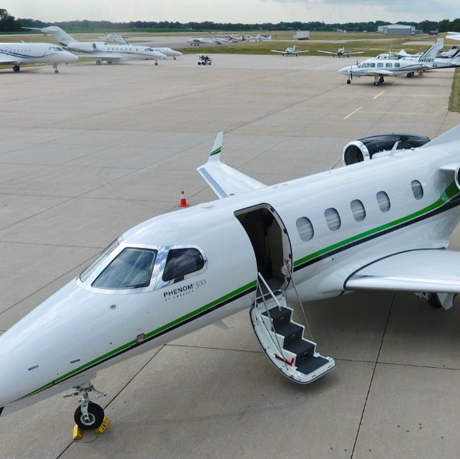
Airport Facility and Service Objectives
Develop facility and service objectives (i.e. runway, taxiway, approach, lighting, weather, etc.)
Recommendations vs. requirements
Based on 2010 plan objectives
Must be measurable and in database
Scaled to each airport role
Will be used to develop project needs and development costs

Slide 15
Facility and Service Objectives
Description | Commercial Service/Enhanced Service Objectives | General Service Objectives | Basic Service Objectives | Local Service Objectives
Airside Facilities
Airport Reference Code | C-II | B-II | B-I or below | A-I
Primary Runway Length | 5,000 feet | 4,000 feet | 3,000 feet | Not an objective
Primary Runway Width | 100 feet | 75 feet | 60 feet | 50 feet
Type of Parallel Taxiway | Full parallel | Turnarounds (both ends meet standards) | Exits as needed | Not an objective
Type of Runway Approach | Vertical guidance | Non-precision | Visual | Visual
Runway Lighting | MIRL | MIRL | LIRL | Not an objective
Taxiway Lighting | MITL | MITL | Not an objective | Not an objective
Visual Glide Slope Indicator | Both runway ends (or ILS) | Both runway ends | Not an objective | Not an objective
Runway End Identifier Lights | Both runway ends (or ILS) | Both runway ends | Not an objective | Not an objective
Rotating Beacon | Yes | Yes | Yes | Not an objective
Lighted Wind Indicator | Yes (multiple as needed) | Yes | Yes | If open for night
Weather Reporting | Yes | Yes | Not an objective | Not an objective
Landside Facilities
Covered Storage | 100% of based aircraft | 100% of based aircraft | 100% of based aircraft | Not an objective
Overnight storage for business aircraft | Typical average aircraft/business user demand | Typical average aircraft/business user demand | Not an objective | Not an objective

Slide 16
Facility and Service Objectives Continued
Description | Commercial Service/Enhanced Service Objectives | General Service Objectives | Basic Service Objectives | Local Service Objectives
Terminal building | Yes | Yes | Yes | Not an objective
Paved entry/terminal parking | Yes | Yes | Not an objective | Not an objective
Services
Fixed Base Operator | Yes | Yes | Yes | Not an objective
Fuel | 100LL & Jet A - 24 hour - single point | 100LL & Jet A | 100LL | Not an objective
Attendance | Standard business hours, after hours on-call | Standard business hours, after hours on-call | On-call | Not an objective
Ground transportation | Courtesy car/car rental available | Courtesy car/car rental available | Not an objective | Not an objective
WiFi | Yes | Yes | Not an objective | Not an objective
Restrooms (24/7 or key code) | Yes | Yes | Yes | Not an objective
Security | 8-foot perimeter fencing | Posted signs/visual barrier | Posted signs/visual barrier | Posted signs
Snow removal | Dedicated on-site equipment | On-site, shared, or contracted removal | Timely snow removal | Not an objective
Aircraft Maintenance/Repair | Based | Based | Not an objective | Not an objective
Flight instruction | Available | Available | Available | Not an objective
Aircraft Rental | Based | Based | Not an objective | Not an objective
Aircraft Charter | Based | Available | Available | Not an objective
Planning
Land Use Plan | Yes | Yes | Yes | Yes
Height Zoning | Yes | Yes | Yes | Yes
Airport Layout Plan | Updated within past 10 years | Updated within past 10 years | Yes | Not an objective

Slide 17
Required Role Criteria from 2010 System Plan
Commercial and Enhanced Service
C-II ARC
5,000 feet
Jet A and 100LL (24/7)
Standard business hours, after hours on-call
Based aircraft maintenance, charter, and aircraft rental. Flight instruction available.
General Service
4,000 feet
Jet A and 100LL
Standard business hours, after hours on-call
Basic Service
3,000 feet
100LL
On-call

Slide 18
Next Steps
Complete Roles and Facility/Service Assessment (Drafts being developed)
Recommendations and Cost Estimates (Now through March)
Prepare various deliverables (Begin in January)
Next Advisory Committee meeting and public webinar to present draft recommendations (Early 2021)

Slide 19
Thank you Any Questions?

