Slide 1
COVID-19 Transportation Impact
Transportation Commission Workshop
January 12, 2022

Slide 2
Overview
Economic Recovery Index
Travel trends
US total rail carloads
Commercial air service passenger counts
Vehicular traffic

Slide 3
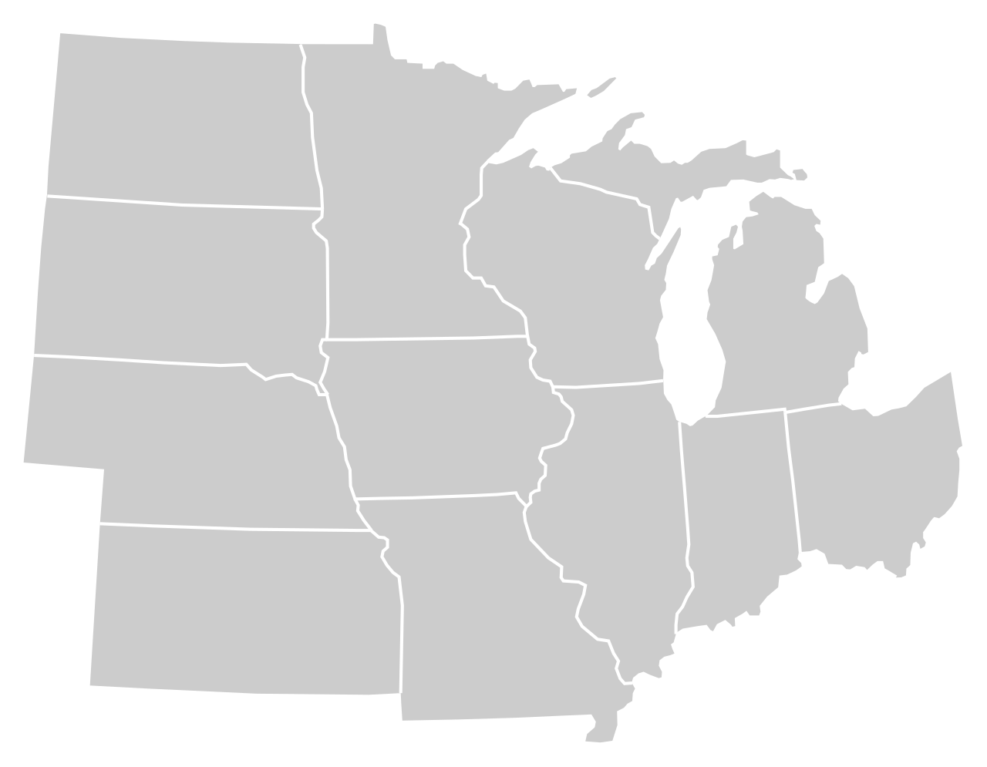
Moody’s/CNN Recovery Index - Midwest (Pre-Pandemic = 100) As of 1/7/2022
87%
84%
93%
87%
84%
87%
(93% last month)
88%
85%
77%
87%
85%
84%
Nation is at 85% (90% last month)

Slide 5
Monthly Passenger Counts at Iowa’s Eight Commercial Service Airports
(through November 2021)

Slide 6
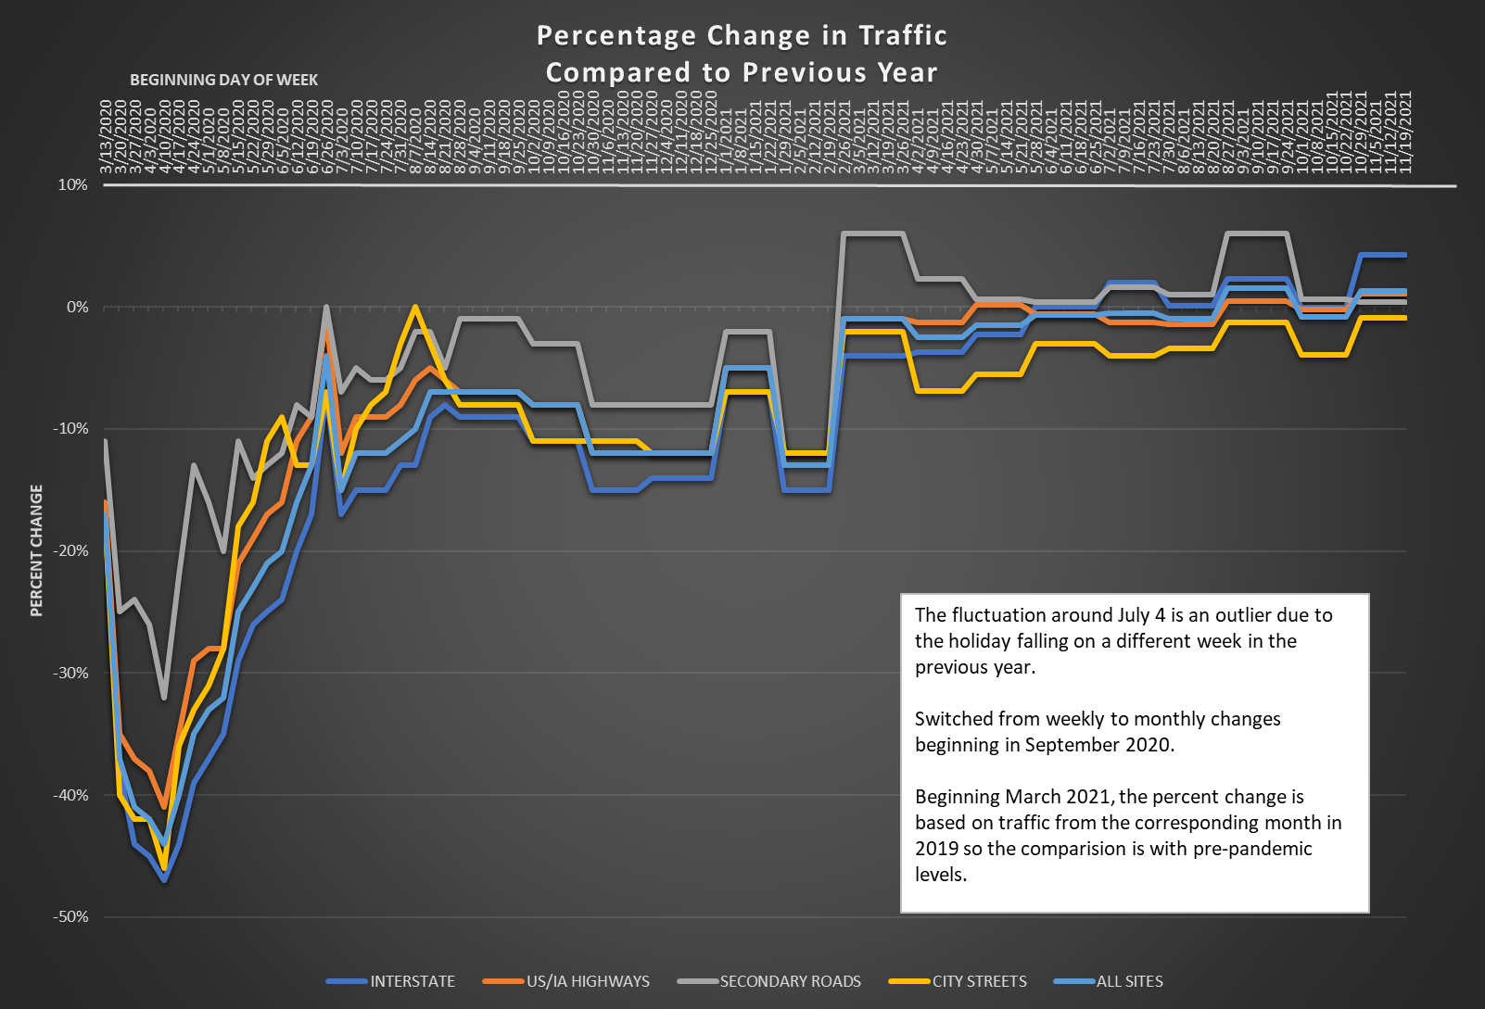

Slide 7
Questions?

