Slide 1
Railroad Revolving Loan and Grant Program January 12, 2022
FY 2022 Funding Cycle – Amendment

Slide 2
Railroad Revolving Loan and Grant Program
Created by legislation in 2005
Purpose: To provide loans and grants for railroad related improvement projects to benefit Iowa.
Funded by loan repayments and appropriations by the Iowa Legislature. Funding is available to cities, counties, economic development organizations and other non-profit organizations through an application program.

Slide 3
FY 22 Program Modification Recommendation
TOTAL RAIL PROJECT COST
REQUESTED AMOUNT
(% of Total Project Cost)
RECOMMENDED AMOUNT
(% of Total Project Cost)
PROJECT NAME
SPONSOR
SCORE
Project Peony | City of Sioux City | 36.2 (Grant Only) | $5,197,674 | Grant: $2,160,000 (41.6%) | Grant: $2,000,000 (38.5%)
Cold Link Logistics | City of Sioux City | 18.9 (Grant Only) | $1,375,866 | Grant: $687,933 (50%) | Grant: $687,933 (50%)
The Sioux City is requesting a change to the project.
The City remains the project sponsor and the project is located at the Southbridge/27 Flags Industrial site.

Slide 4
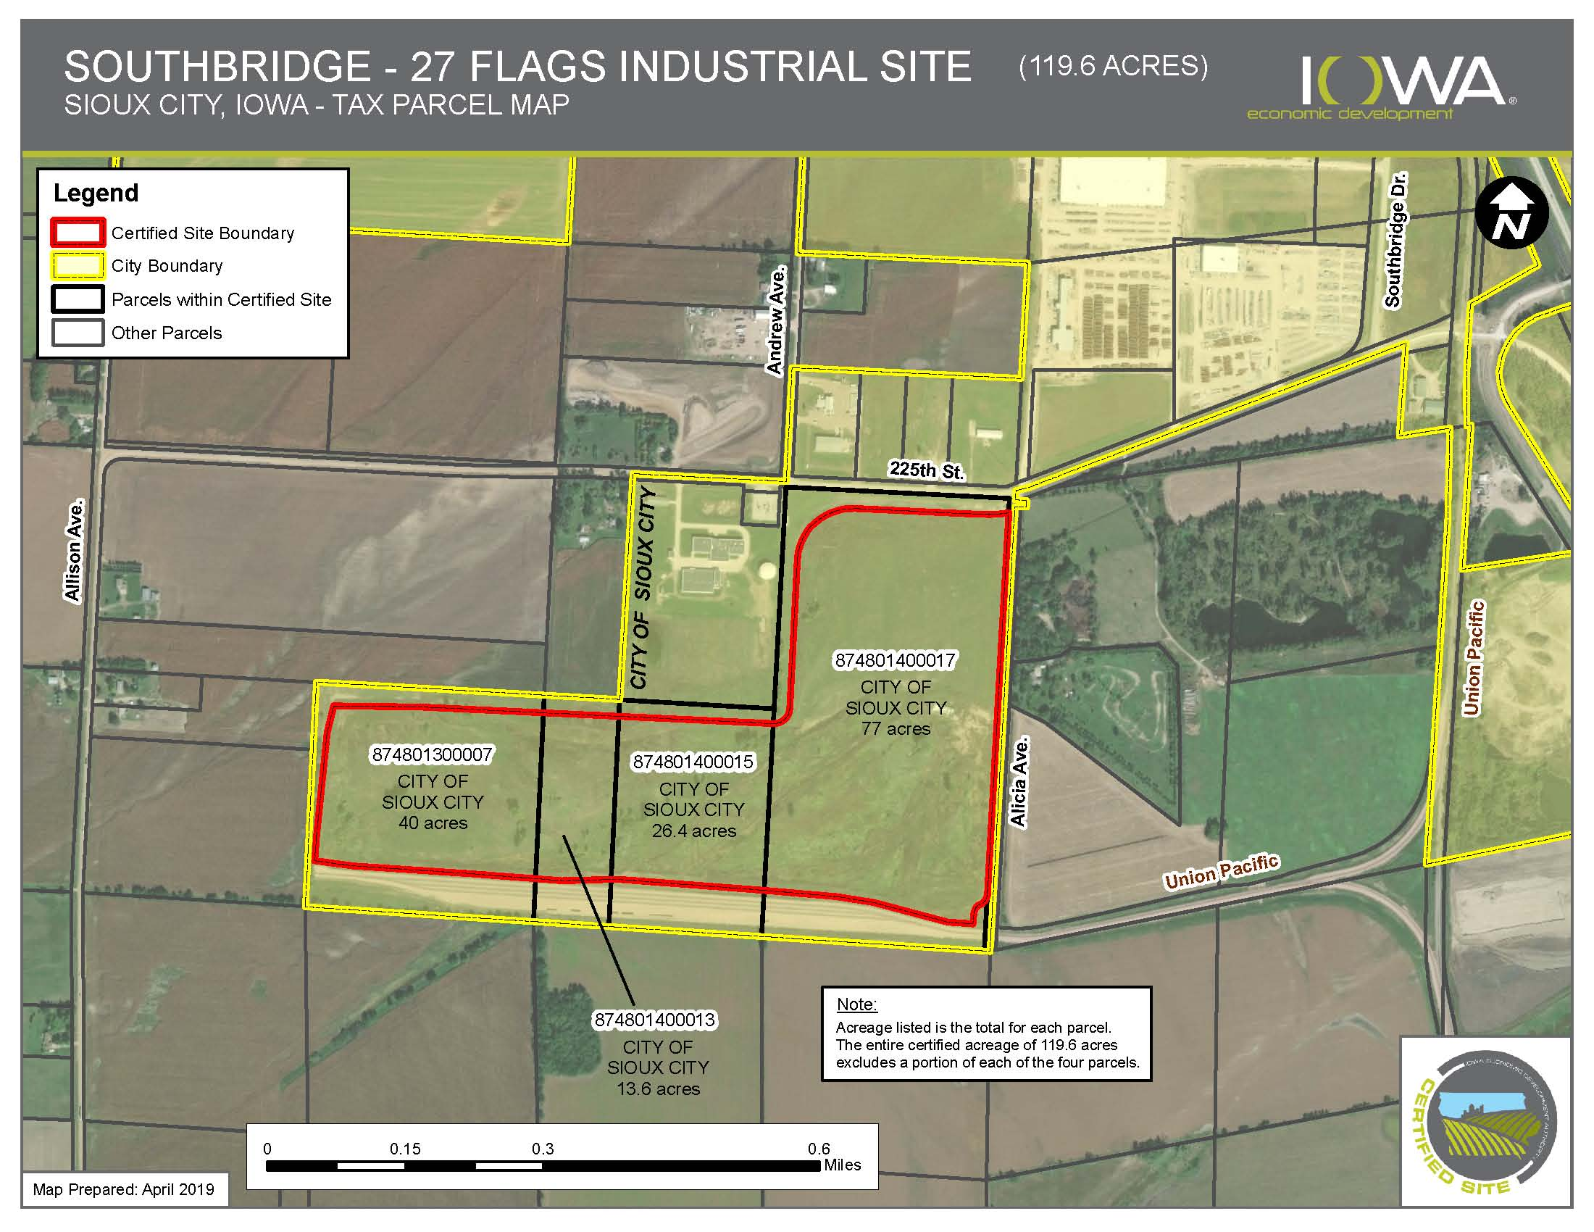
Project Location
Project will be in the east portion of the Southbridge – 27 Flags Industrial Site

Slide 5
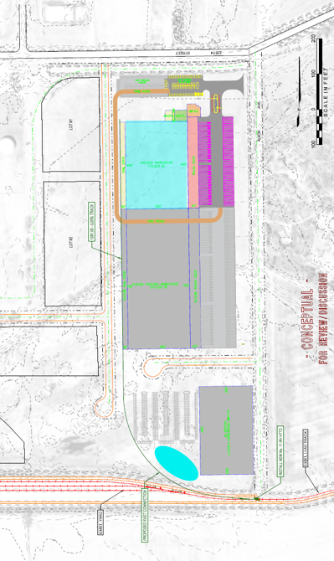
Cold Link Logistics
Project is adding a switch and 2,500-foot rail spur to the planned industrial facility connecting it to the railroad network. The project is expected to create 60 new jobs (plus additional contractor jobs to support daily operations of the finished manufacturing facility).
Total Cost: $1,375,866
Requested: $687,933 (50%) Recommended: $687,933 (50%)

Slide 6
QUESTIONS?
Tammy Nicholson,
Modal Transportation Bureau
Tamara.nicholson@iowadot.us
515-239-1052

