Slide 1
State Transportation Plan & State Freight Plan
2022 Updates
Commission Workshop
January 12, 2022

Slide 2
Discussion items
SLRTP implementation
Strategy development/review
Public comment period
Next steps

Slide 3
SLRTP implementation
Commission Workshop
January 12, 2022

Slide 4
SLRTP implementation
Current State Transportation Plan adopted by the Commission in May 2017
Continuous cycle of implementation and improvement
Update slated for adoption in May 2022

Slide 5
SLRTP implementation highlights
Integration with modal, system, and specialized plans
Adoption and implementation of the Complete Streets Policy
Ongoing integration of asset management into dept. functions
Integration of SLRTP needs into project prioritization/scoping
Super 2 implementation through new design guidance, Planning and Environmental Linkage (PEL) studies, and programmed projects
2017 SLRTP as a building block to 2022 SLRTP enhancements:
System objectives to help prioritize investments and measure progress
Enhanced discussion of emerging planning areas (accessibility)
Expanded highway needs analyses (flood resiliency, safety, bike/ped)
Rightsizing policy to help implement rightsizing concept
Notes:
Integration with modal, system, and specialized plans
Functional relationship between strategies in the SLRTP and other overarching plans
Continuous process; most plans updated every ~5 years
SLRTP vision operationalized through Business Plan

Slide 6
Strategy development
Commission Workshop
January 12, 2022

Slide 7
SLRTP & SFP strategies
Strategies are meant to help define and guide implementation activities
Relate to broader goals/objectives, both at the state level and nationally
Focus areas:
Plan-specific content (e.g., system objectives, rightsizing policy, design considerations)
Detailed needs analyses
Emerging and priority planning areas

Slide 8
SLRTP & SFP strategies
Sources of content:
Review of prior strategies from 2017 plans
Examination of emerging trends and issues
Stakeholder input
Director’s roundtables
Freight Advisory Council
MPOs and RPAs
Internal Planning Steering Committee

Slide 9
SLRTP & SFP strategies
Format of draft strategies
20-30 strategies in each plan
Strategy statement with 2-3 sentences of explanatory text
Will eventually tie to related system objectives (safety, sustainability, accessibility, flow)
Reviewed by Internal Planning Steering Committee
Next steps
Commission review
Public review

Slide 10
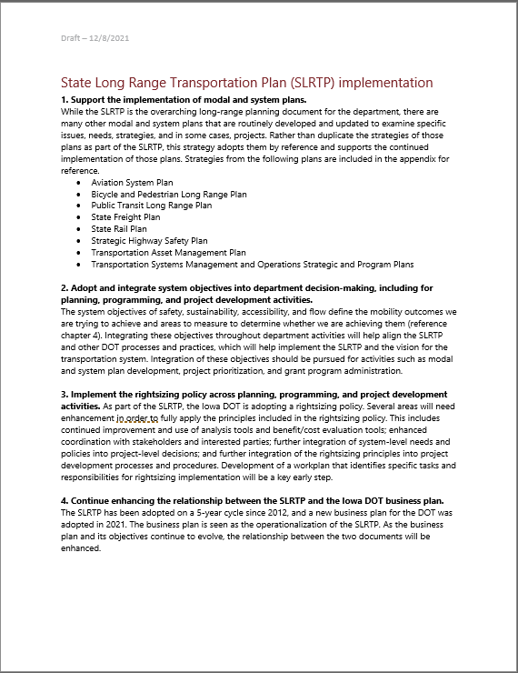
SLRTP & SFP strategies

Slide 11
Public comment period
& Next steps
Commission Workshop
January 12, 2022

Slide 12
Public comment period
45-day comment period to begin late February
Full draft documents will be posted online
Availability of plans and public comment period will be advertised (media release, social media, stakeholder distributions, etc.)
Comments will be accepted through multiple means (via webpage, e-mail, mail, phone)
Final comment period will supplement earlier public/stakeholder input efforts

Slide 13
Next steps
Conduct final reviews with internal committee
Finalize draft plans for public review
Open 45-day comment period and address comments
Present draft plans and summary of public comments at April Commission workshop
Final editing
Present final plans:
SLRTP for adoption at May business meeting
SFP for information at May or June workshop

Slide 14
THANK YOU
Garrett.Pedersen@iowadot.us

