Slide 1
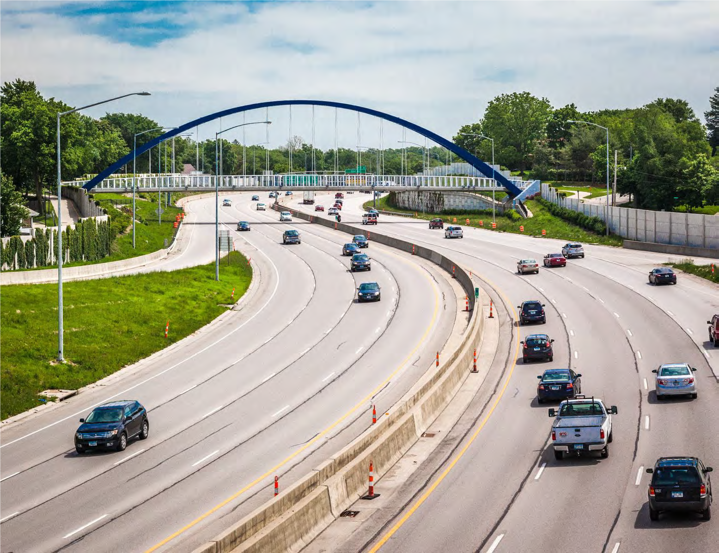

Iowa Interstate Investment Plan
Transportation Commission
January 12, 2022

Slide 2

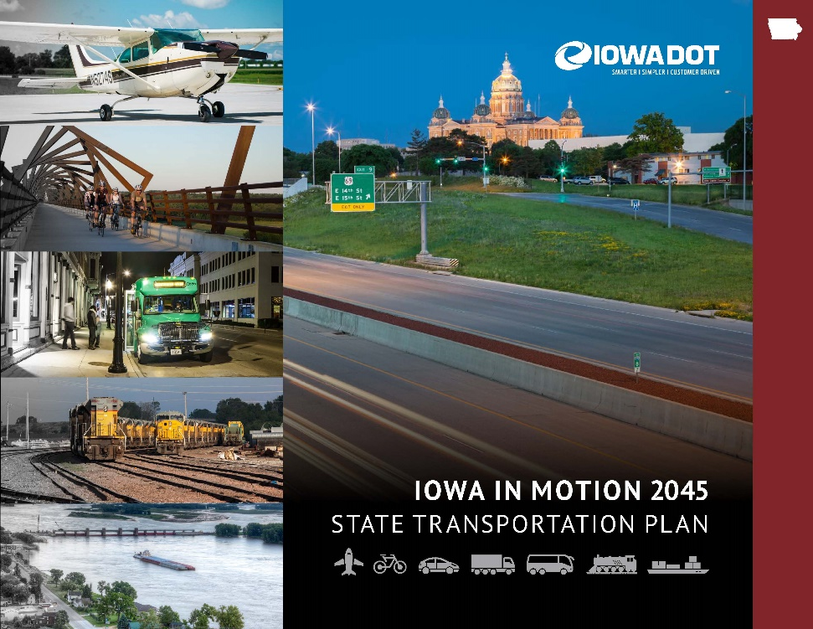

Planning Efforts Highlight that
Transportation Needs Exceed Funding

Slide 3
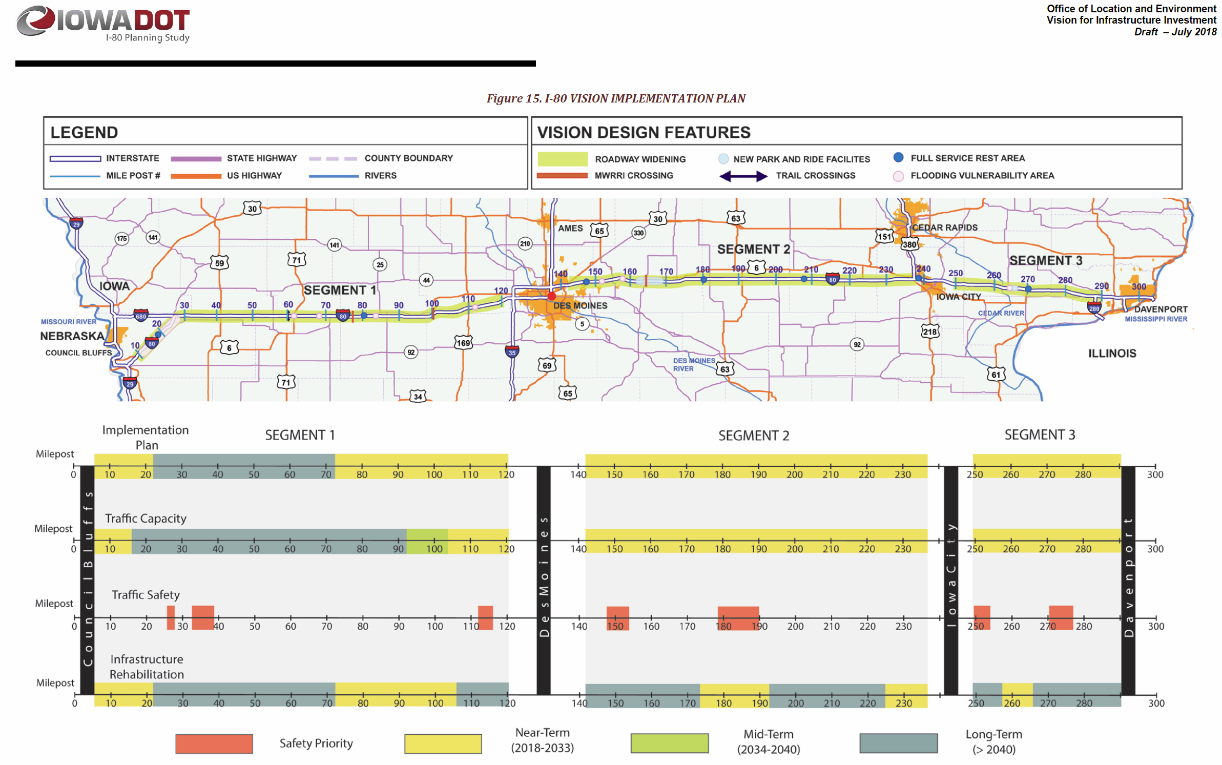
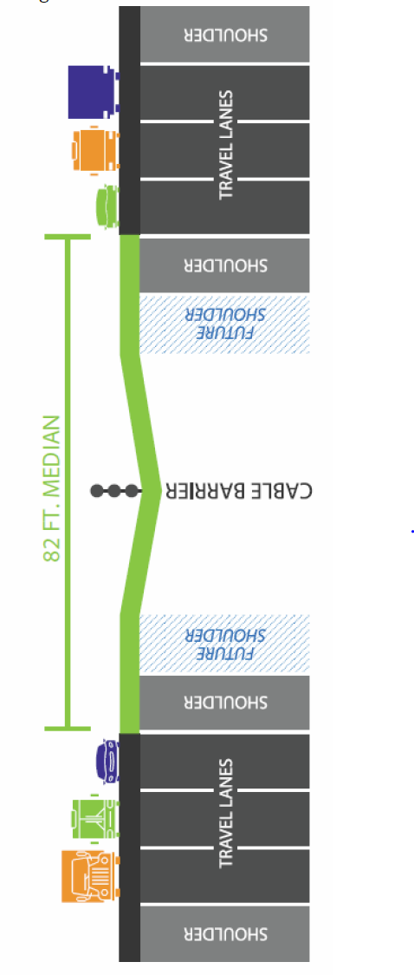
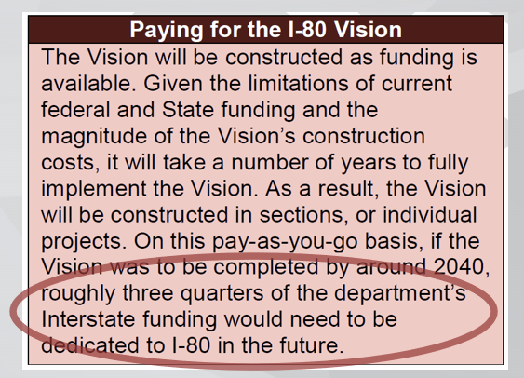
Interstate 80
Planning and Environmental Linkage Study (PEL)
Based on current funding limitations, these assumptions are likely untenable in the long term

Slide 4

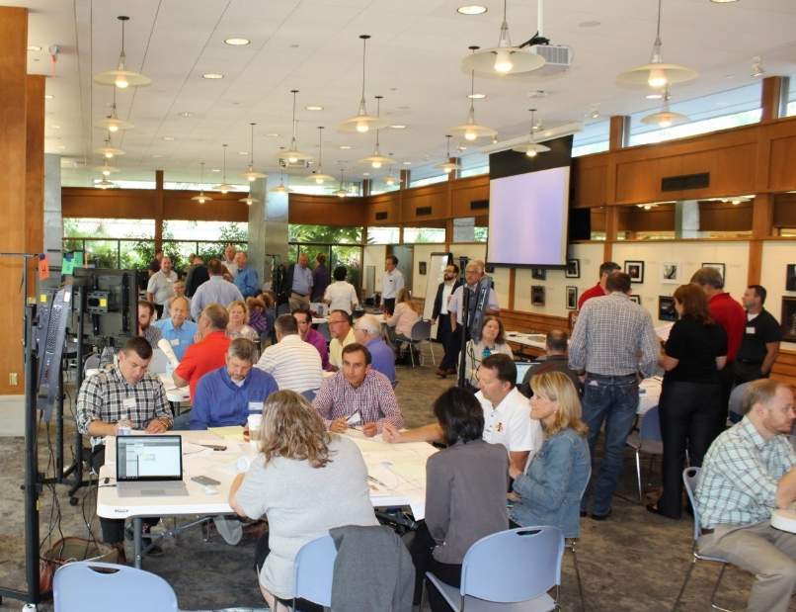

Interstate Plan Proposed
Workshop
2 Days - 70 Participants
Balancing Design and $$
Emphasis on “Rightsizing Projects”
Notes:
The I3P is primarily a planning tool that helps us identify realistic candidates for future programming based on a constrained interstate budget.
The projects highlighted in this presentation are not our formal recommendation for MI highway candidates, but it does help us prioritize projects for inclusion on this list.

Slide 5
Workshop Recommendations
Stewardship - All participants recommended that the focus should be on preservation treatments to keep the system in its current state of good repair
  $80m of pavement stewardship is included each year
Widening Options - Many segments of I-80 have significant pavement life remaining, so expansion in those areas will first consider widening the existing pavement rather than a complete rebuild
Don’t Add Capacity As First Priority - Some areas previously studied for expansion were not prioritized to be completed by 2050
Delay with Technology - Expansion projects in urban corridors will be limited and focus on technology solutions and other management strategies.
  Transportation Systems Management & Operations (TSMO)
  Integrated Corridor Management (ICM)

Slide 6
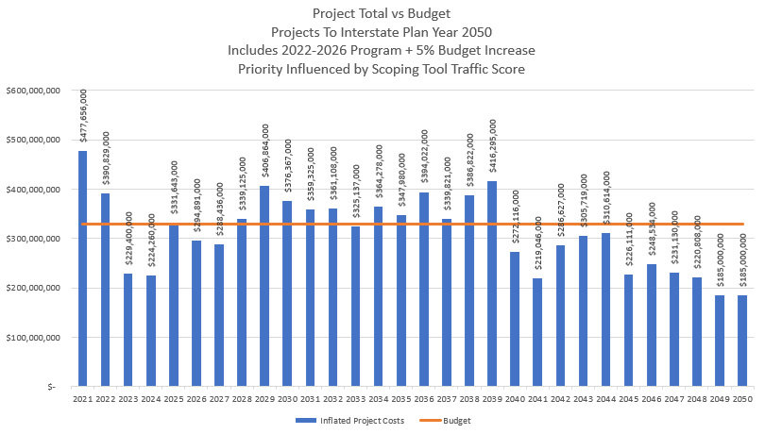
Project Totals and Annual Budget
$330 Million
Project Budgets Set Very Tight to Promote Right Sizing

Slide 7
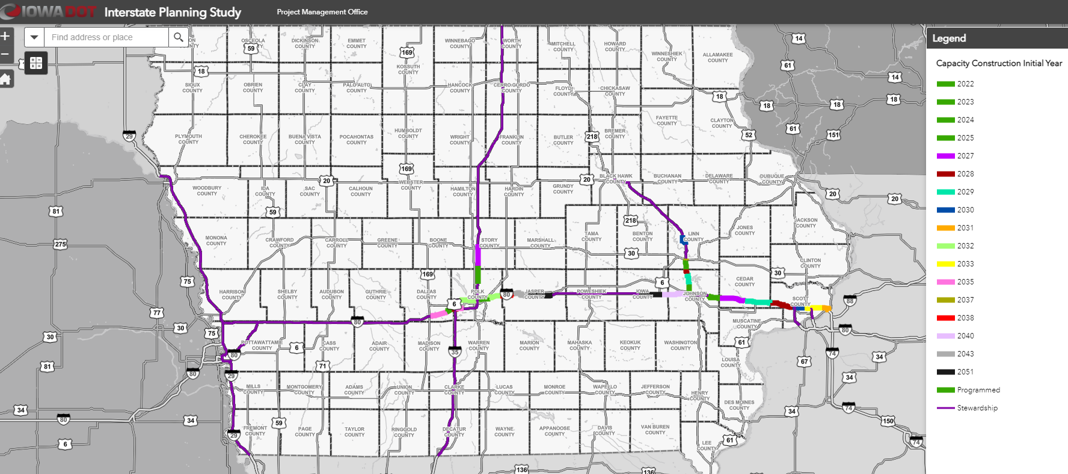
Interstate Plan Map

Slide 8
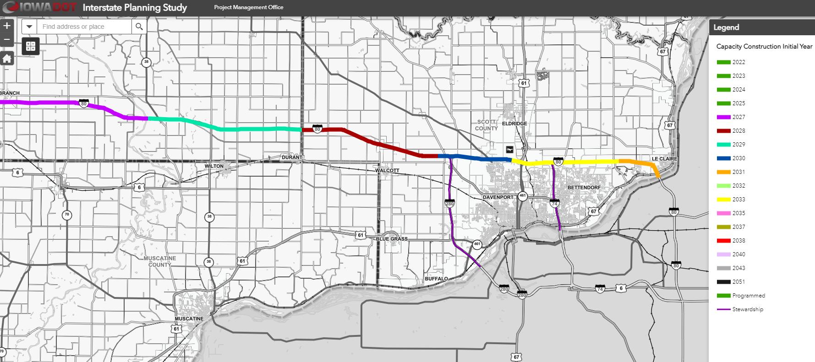
Interstate 80 Davenport/Bettendorf

Slide 9
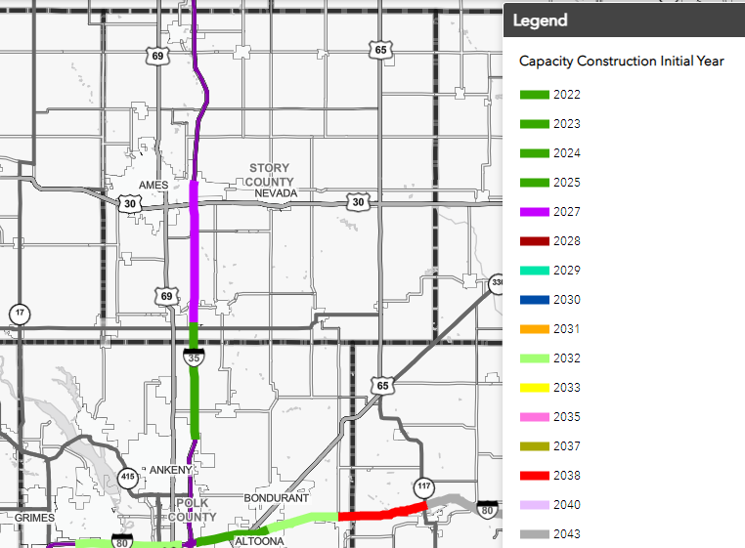
Interstate 35 Ankeny to Ames

Slide 10
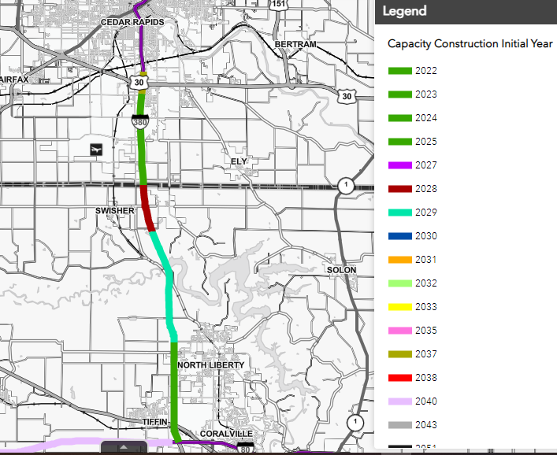
I-380 Iowa City to Cedar Rapids

Slide 11
Coordination of Department Goals
Performance Based Design or “Right Sizing”
  System thinking rather than project thinking
  Don’t over-solve the problem
  Reducing low impact upgrades on one project will allow us to get more miles addressed to achieve the high value upgrades
  Better Timing of Projects to Minimize Potential Waste
Transportation Systems Management and Operations (TSMO)
  Which is more valuable; traffic management or geometric improvements?
  Does our process reflect this? It is starting to…
    Des Moines Integrated Corridor Management Study
  Adding “Capacity” as a last resort
Asset Management
  Maintaining the System in a “State of Good Repair”

Slide 12
Potential Modifications to Project Timing
As we continually monitor needs on the Interstate System and assess the positive funding impact of the Infrastructure Bill, we recognize some projects may need to be accelerated or delayed in the Interstate Plan.

Slide 13
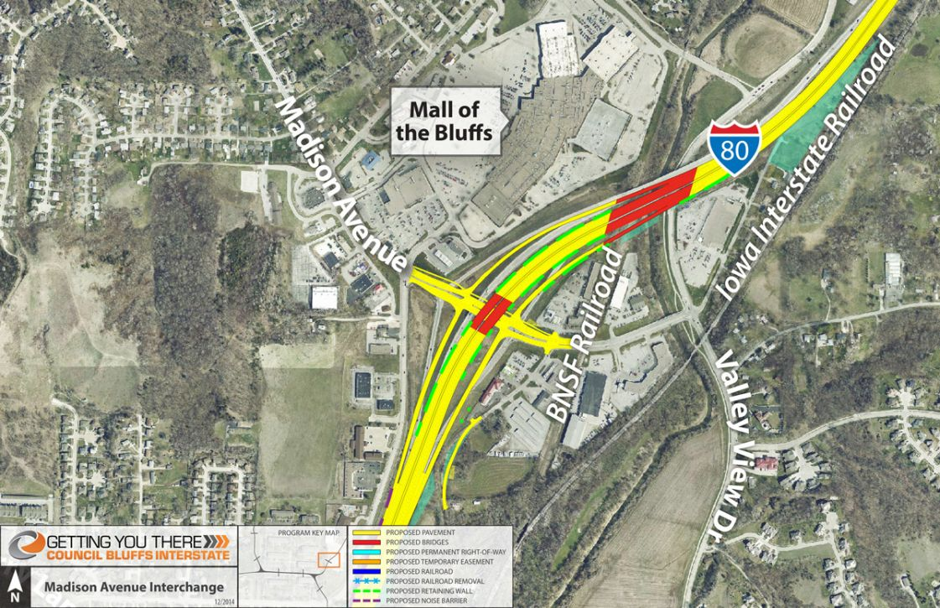
Council Bluffs: Interstate 80 and Madison Ave Interchange
Previous $115 million – 2022
New
2022 - $5.0 million
2025 - $37.8 million
2026 - $22.7 million
2027 - $20.7 million
Beyond - $24.8 million
Next Program Cycle: Consider moving project sooner and package over a two-year period.

Slide 14
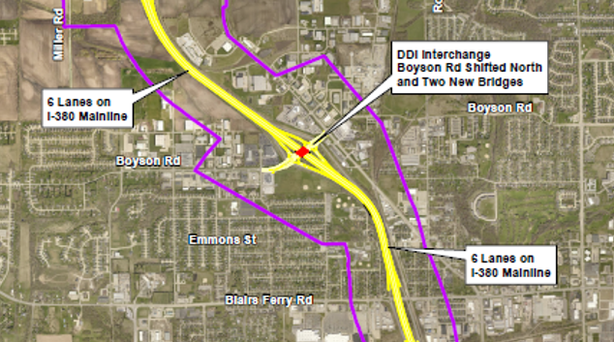
Cedar Rapids: Interstate 380 and Boyson Road Interchange

Slide 15
Boyson Rd Interchange programmed with construction in 2025.
I-380 widening to 6-lanes between Blairs Ferry and County Home Road is in Interstate Plan for 2030-2032.
Recommendation to combine the widening project from Blairs Ferry to Boyson Rd. with the interchange work.
  Simplify Staging and Design
  Lessen Impact to Traffic
  Reduce Throw Away Pavement
Cost Estimate to add widening - $10.1 to $11.8 million
Cedar Rapids: Interstate 380 and Boyson Road Interchange

Slide 16
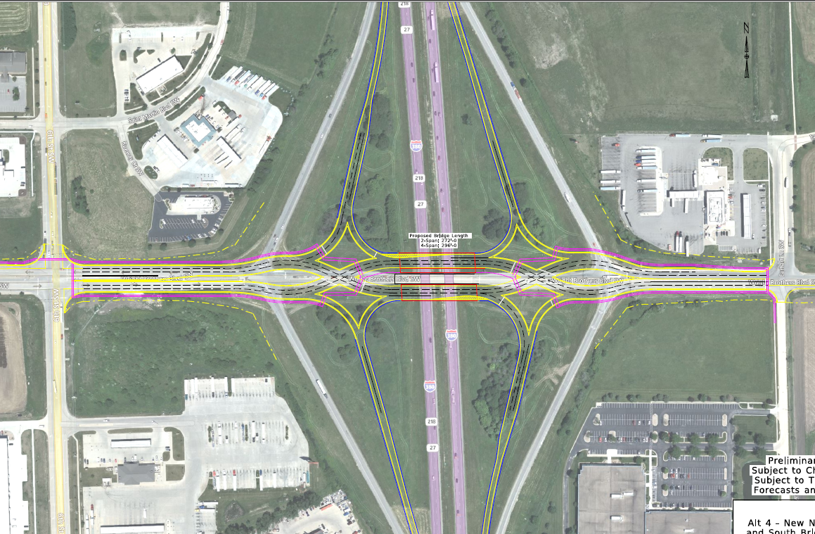
Interstate 380 and Wright Bros. Blvd. Interchange

Slide 17
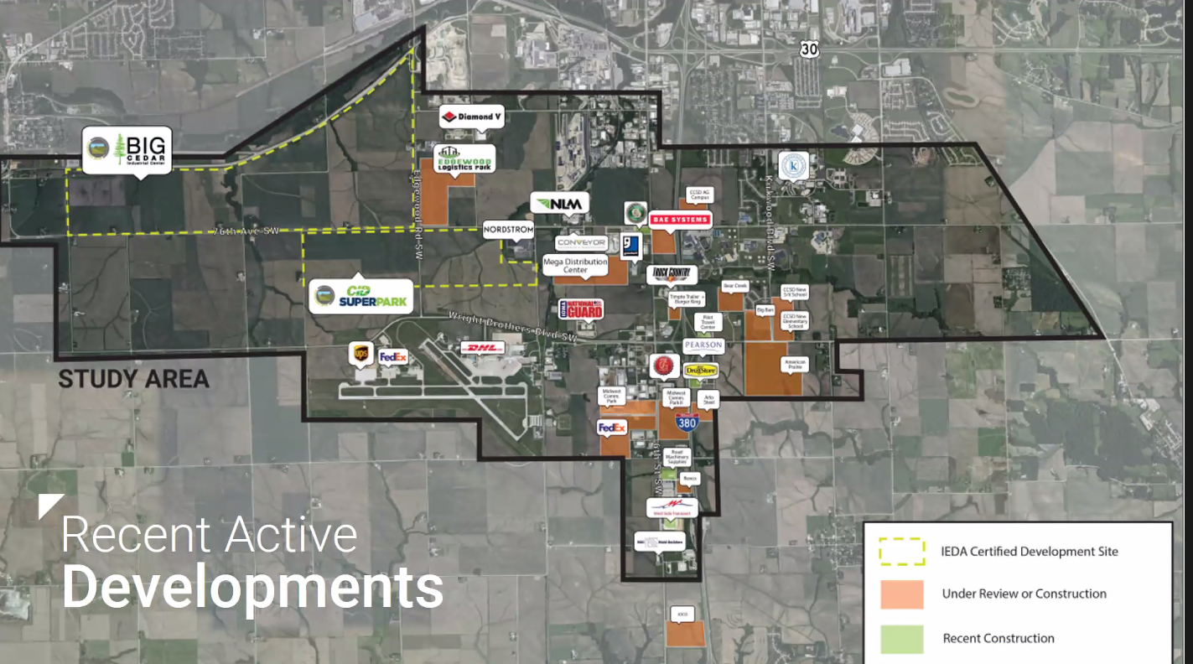
Area Development Drives Traffic Growth

Slide 18
Interstate 380 and Wright Bros. Blvd. Interchange
Replacing both bridges over I-380
Growth in traffic and area development drives the need for project acceleration.
I-380 mainline expansion to 6-lanes at the same time.
Expecting Wright Bros. Blvd. expansion to 6-lanes
Analyzing impacts to interchange with US 30
Interstate Plan Budgets
  2025 - $20.0 million for interchange
  2026 – $33.5 million
  2027 - $19.2 million
Proposal to begin in FY 2025

Slide 19
Interstate 80
Mississippi River Bridge
PEL Study Completed
Beginning Phase 1 Engineering
Originally 2026-2028
Moving to 2027-2029
Illinois DOT - lead Agency

Slide 20

THANK YOU
Phil Mescher, AICP, CPM
PROJECT MANAGEMENT BUREAU
IOWA DEPARTMENT OF TRANSPORTATION
Phil.Mescher@iowadot.us
Office Phone: 515-233-7969

