Slide 1
Transportation Trends Update
Transportation Commission Workshop
January 11, 2023

Slide 2
Overview
US total rail carloads
Commercial air service passenger counts
Vehicular traffic

Slide 4
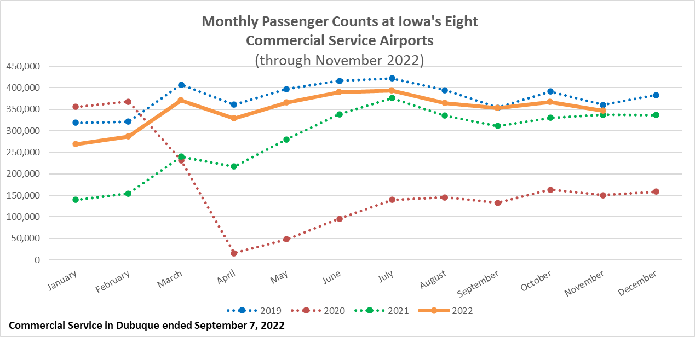

Slide 6
Questions?

