Slide 1
Revitalize Iowa’s Sound Economy Program
Iowa Transportation Commission Business Meeting
January 11, 2023

Slide 2
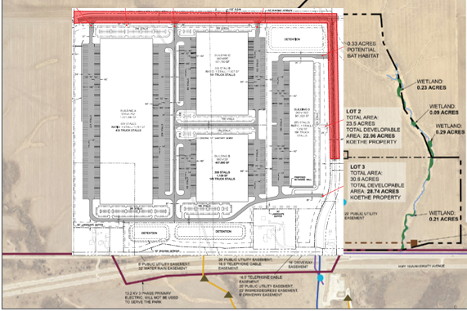
List of Local Development Applications Recommended
PROJECT NAME
SPONSOR
SCORE
TOTAL PROJECT COST
PERCENT PARTICIPATION
RECOMMENDED AMOUNT
Construct approximately 1,520 feet of NE 75th Street and 2,740 feet of new roadway (Modification). | Pleasant Hill | 64 | $4,239,400 | 60% | $2,543,640

