Slide 1
Revitalize Iowa’s Sound Economy Program
Iowa Transportation Commission Workshop
January 11, 2023

Slide 2
Revitalize Iowa’s Sound Economy Program
Created in 1985
Purpose: To promote economic development through roadway improvements.
Eligible development shall have value-adding activities that feed new dollars into the economy
Available to cities and counties through an application program

Slide 3
Available Funding and Application Summary
Available Funding
Funded annually with dedicated state motor fuel and special fuel tax revenues
Application Summary for SFY2023
Total number of projects awarded: 4
Total project costs: $11,249,282
Total amount awarded: $5,624,642
 | CITY | COUNTY
Average funding generated monthly | $905,101 | $452,550
SFY 2023 current Road Use Tax Revenue (as of 11/30/2022) | $5,966,417.21 | $2,522,623.70
Current Unobligated Balance (as of 11/30/2022) | $9,277,751.94 | ($1,307,007.30)

Slide 4
Local Development Project Evaluation Criteria
Development Potential (35 points)
Economic impact and Cost Effectiveness (20 points)
Local Commitment and Initiative (33 points)
Transportation Need and Justification (4 points)
Local Economic Need (6 points)

Slide 5
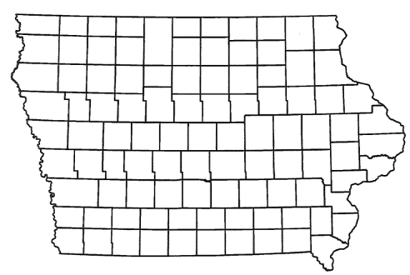
List of Local Development Applications Recommended
PROJECT NAME
SPONSOR
SCORE
TOTAL PROJECT COST
PERCENT PARTICIPATION
RECOMMENDED AMOUNT
Construct approximately 1,520 feet of NE 75th Street and 2,740 feet of new roadway (Modification). | Pleasant Hill | 64 | $4,239,400 | 60% | $2,543,640

Slide 6
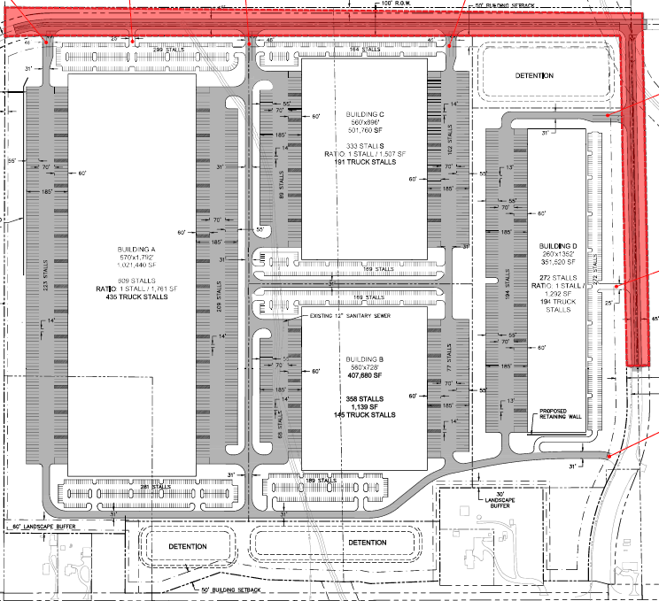
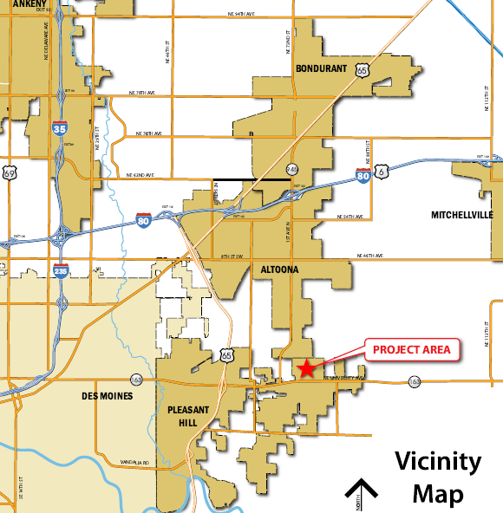
Pleasant Hill - Modification
(Local Development)
A modification to the scope and grant award was requested to construct approximately 1,520 feet of NE 75th Street and 2,740 feet of new roadway located on the northeast side of town. This project is necessary to provide improved access to the Pleasant Hill Commerce Park, an Iowa Economic Development Authority certified site of more than 213 acres.
Total Cost: $4,239,400
Requested: $2,543,640 (60%)

Slide 7
QUESTIONS?
Stu Anderson
stuart.anderson@iowadot.us
515-239-1661

