Slide 1
State Transportation Plan
Implementation Update
Commission Workshop
January 11, 2023

Slide 2
Discussion items
Background
Transition to updated plan
Implementation highlights
System objectives
Highway needs/risks
Rightsizing
Work plan development

Slide 3
Iowa in Motion 2050
State long-range transportation plan (SLRTP)
Federally required per Title 23 of United States Code
Also required per Iowa Code chapter 307A as a function of the Commission
Adopted by the Commission May 10, 2022
Staff transition from 2017 plan implementation to 2022 plan

Slide 4
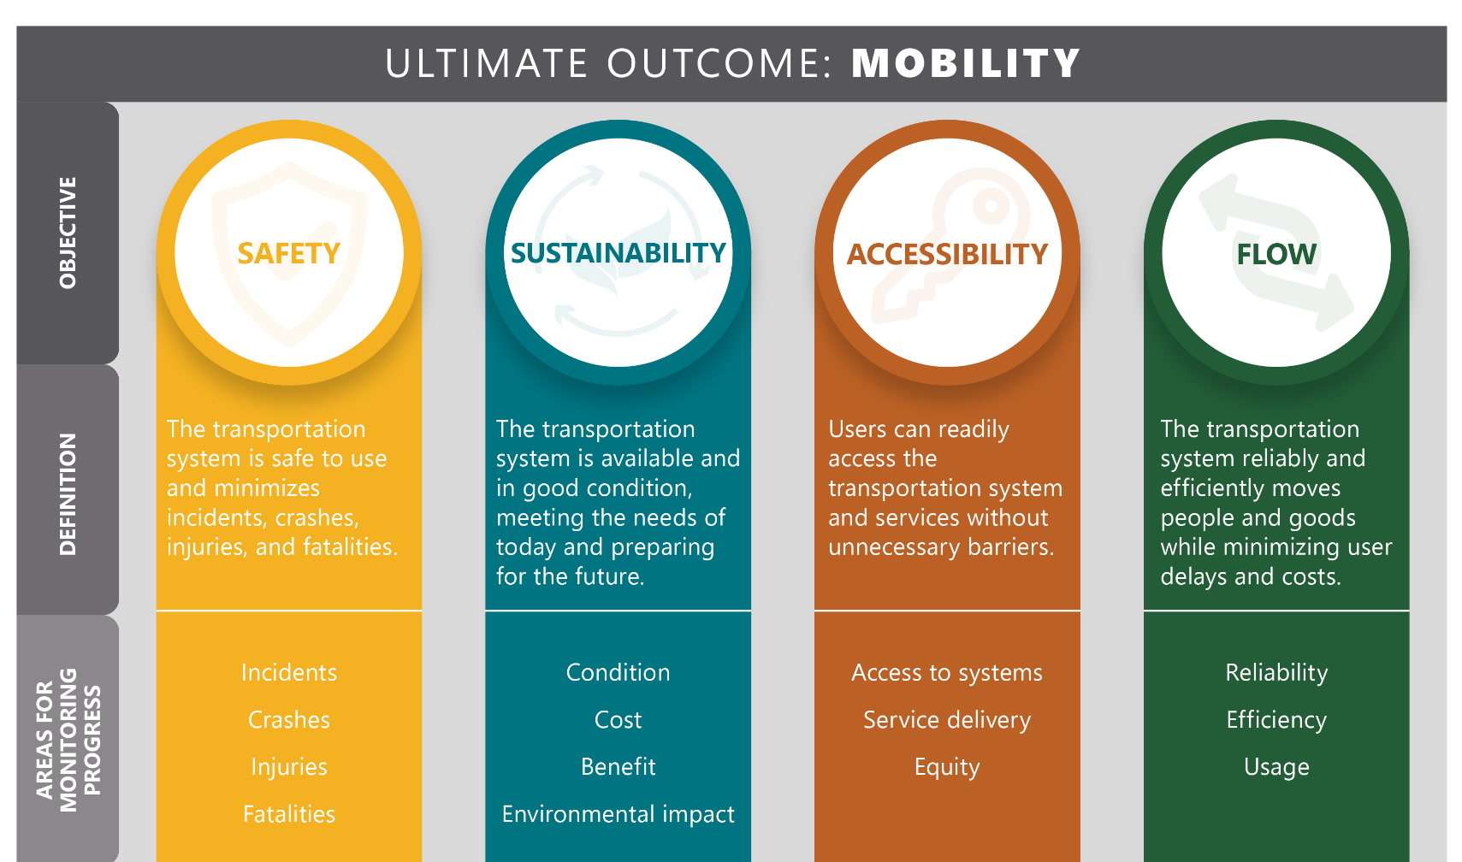
System objectives

Slide 5
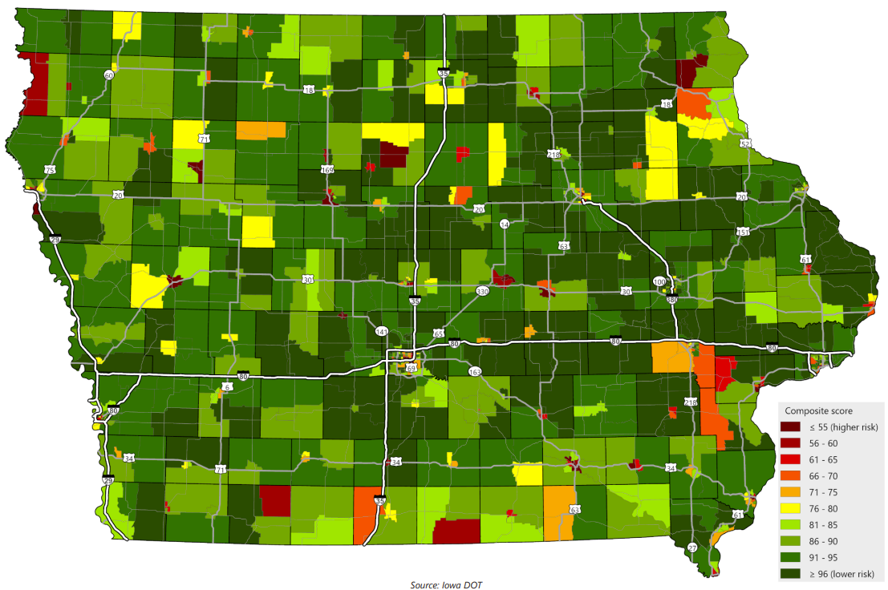
Accessibility/mobility analysis
Identify populations at higher risk of mobility challenges
Analyzed factors that may limit mobility, ability to access transportation system/services
Attributes considered
Youth – under 18
Older adults – 65 and over
Minority (non-White and/or Hispanic/Latino)
Foreign-born
Limited English proficiency
With a disability
Households below poverty level
Zero vehicle households
College enrolled
Single parent households

Slide 6
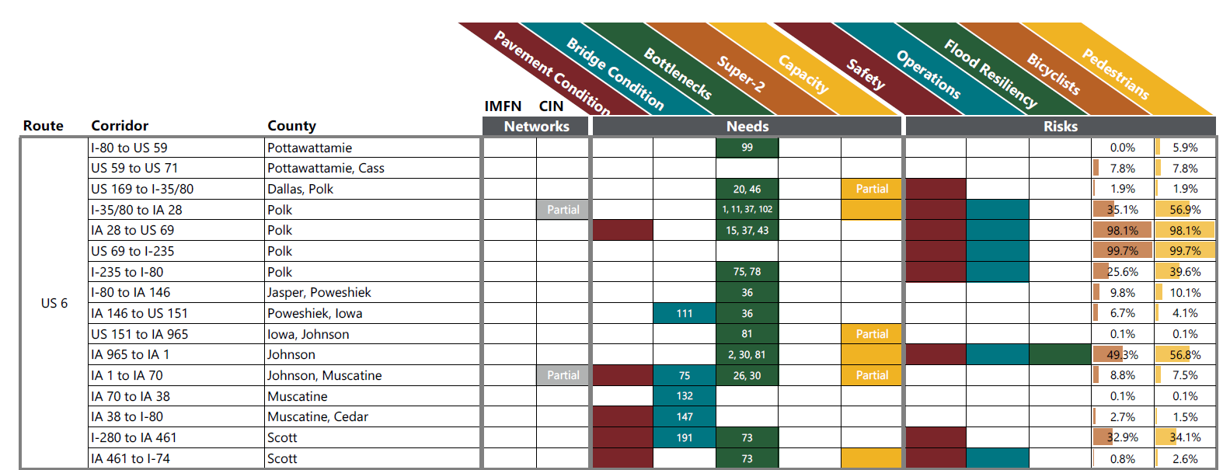
Highway needs and risks
Ten-layer analysis across 464 corridors covering entire Primary Highway System
Targeted locations based on each need/risk analysis; combined in a matrix of all corridors
Needs
Pavement Condition
Bridge Condition
Risks
Safety
Operations
Bottlenecks
Mobility and Safety (Super-2)
Capacity
Flood Resiliency
Pedestrians
Bicyclists
Notes:
Integration into PP/S tool

Slide 7
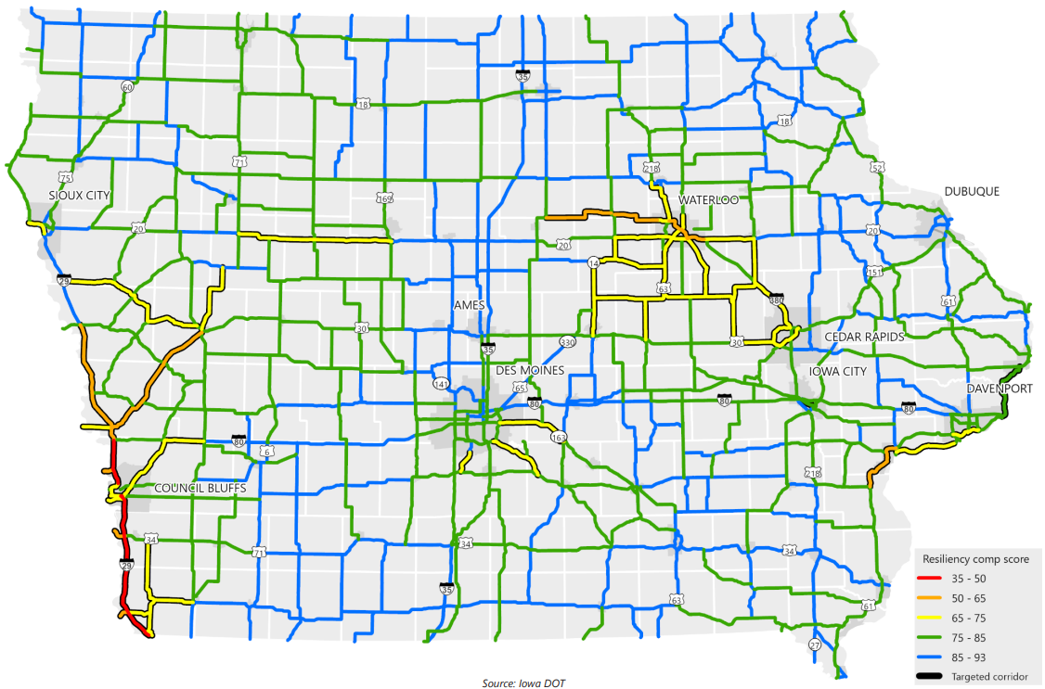
Flood resiliency analysis
Being used to help screen/prioritize resiliency projects
PROTECT program

Slide 8
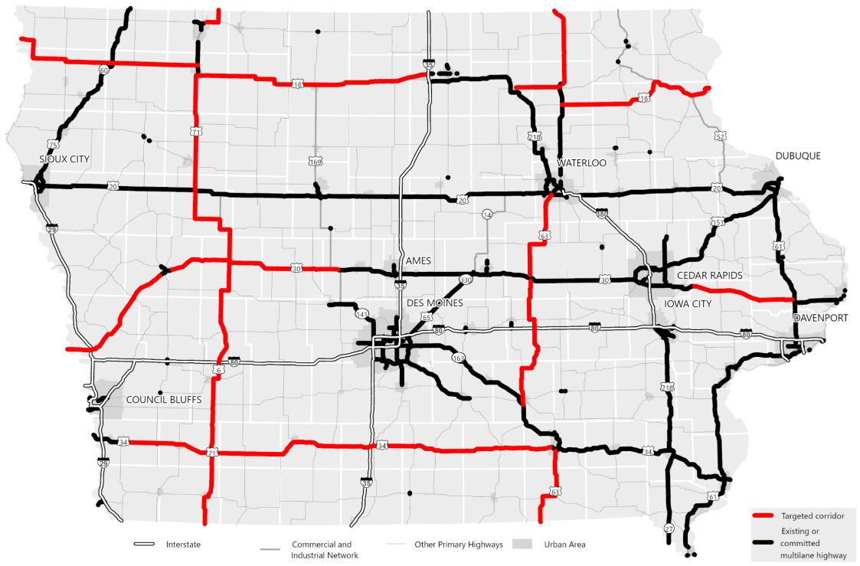
Super-2 improvements
Studies proceeding on targeted corridors
Design guidance enhancements to clarify:
Paved shoulders
Turn lanes
Access

Slide 9
Rightsizing policy
Objective: provide parameters/principles to help guide project development activities
Definition: Rightsizing means seeking an appropriate level and type of investment that avoids overinvesting or underinvesting, overbuilding or underbuilding, and overserving or underserving the market based on user and system needs.

Slide 10
Rightsizing “sweet spot”

Slide 11
Policy statements by topic
Project needs
Comprehensive needs
Stewardship priority
Stratification of the system
Equity
Resiliency
Congestion or operational issues
Emerging technologies
Speculative development
New or revised interchange access

Slide 12
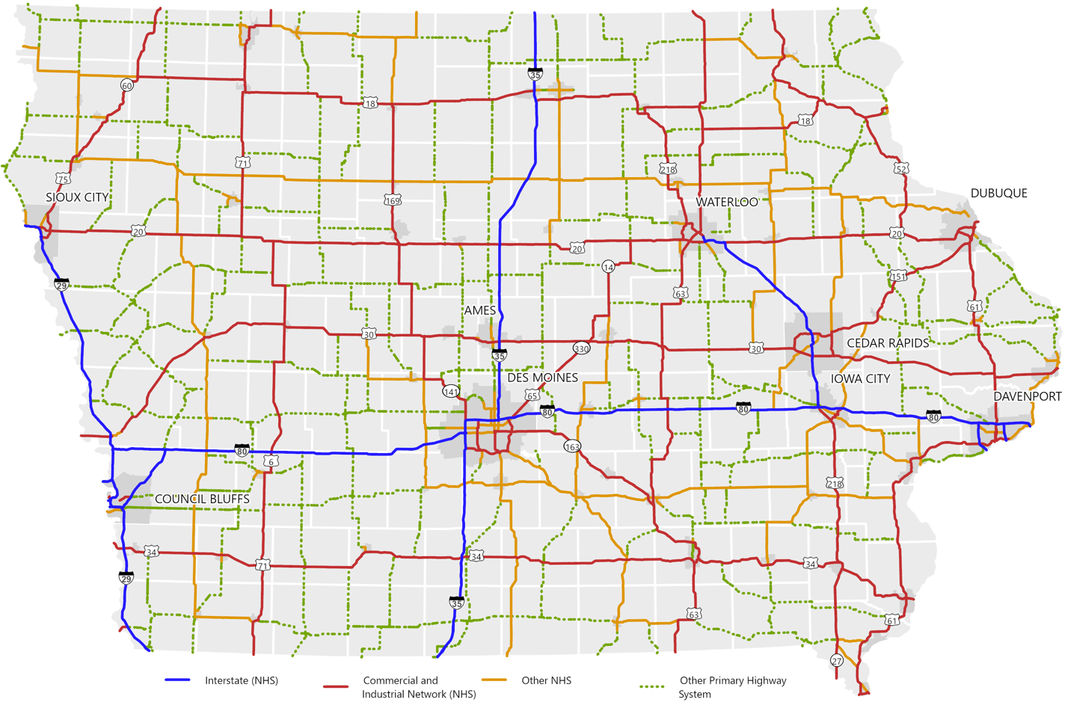
System Stratification
Asset management working group effort
Possible uses:
Condition targets
Treatments
Funding decisions

Slide 13
Work plan development
Intended to help guide staff through implementation
Useful for ongoing monitoring and Commission updates

Slide 14
THANK YOU
Garrett.Pedersen@iowadot.us
515-239-1520

