Slide 1
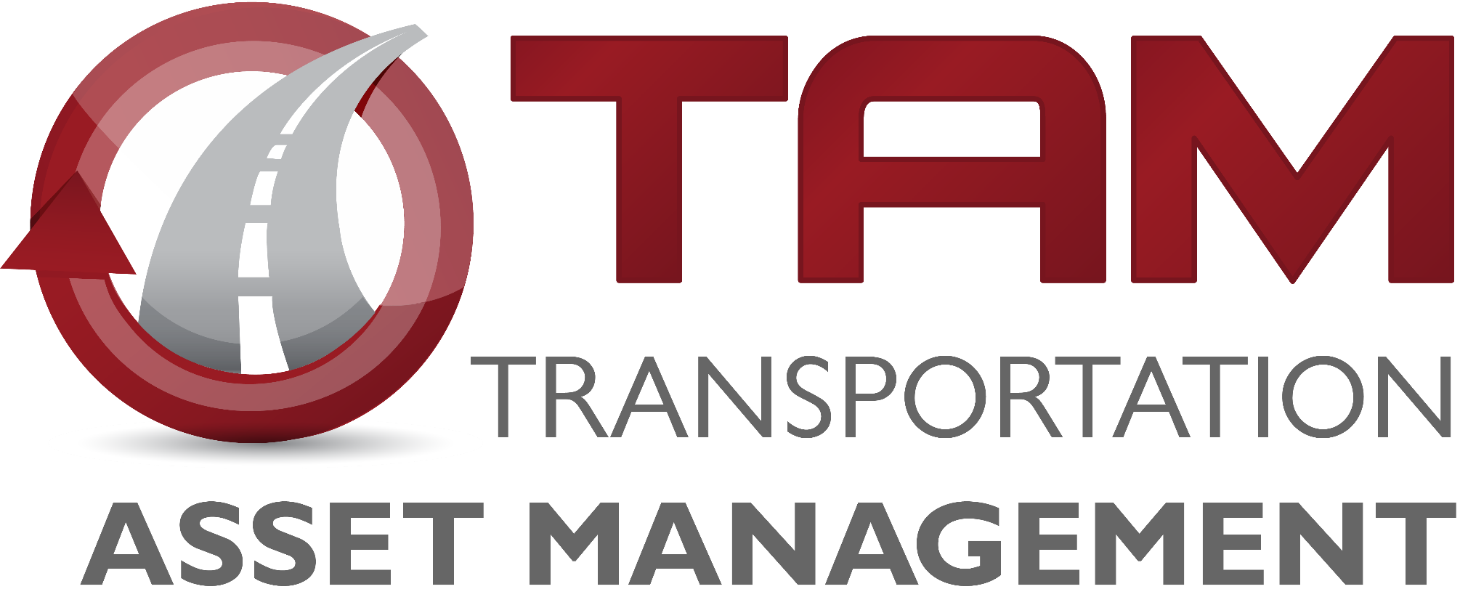
Transportation Commission Workshop
January 11, 2023

Slide 2
Pavement Management
Chris Brakke, PE
Iowa DOT Construction and Materials Bureau

Slide 3
Pavement system components
Pavement
Concrete (rigid), Asphalt (flexible), or Composite
Subbase
Rock layer for support and drainage
Subgrade
Improved soil layer to provide support
Pavement
Subbase
Subgrade

Slide 4
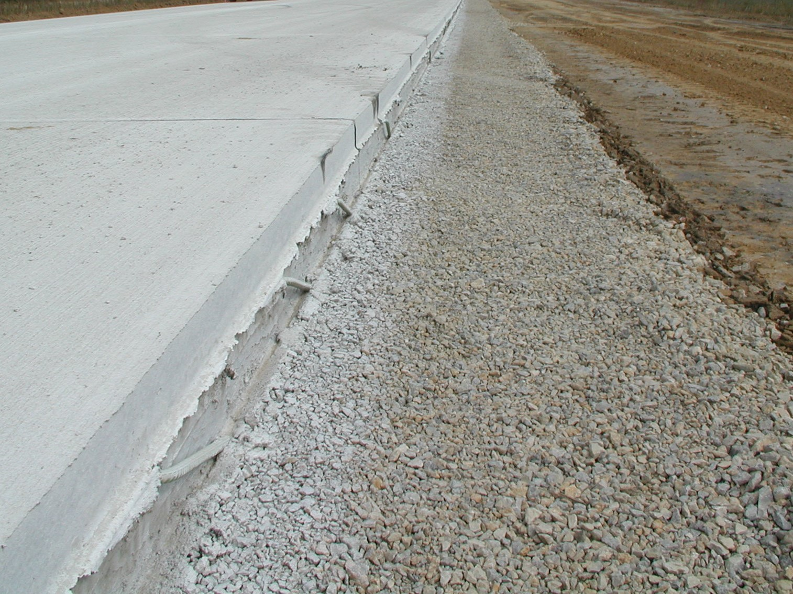
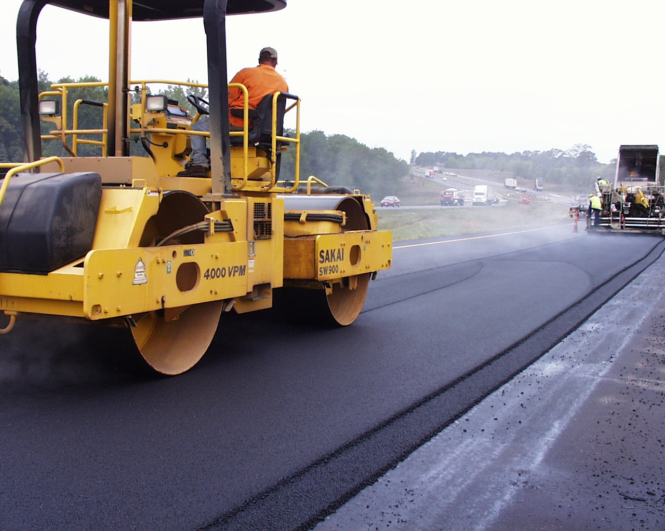
Pavement system components
Design life = 40 years
Serviceable life can be extended with maintenance and rehabilitation …but not indefinitely
Many factors influence design:
Truck traffic
Subgrade soil
Climate

Slide 5
Pavement Inventory
Primary system = 24,534 lane miles of pavement
Interstate = 3,848 or 16%
Ramps = 758 lane miles
Today’s pavement replacement cost
Over $39 Billion
Notes:
These mileages are based on the LRS data, not PMIS.

Slide 6
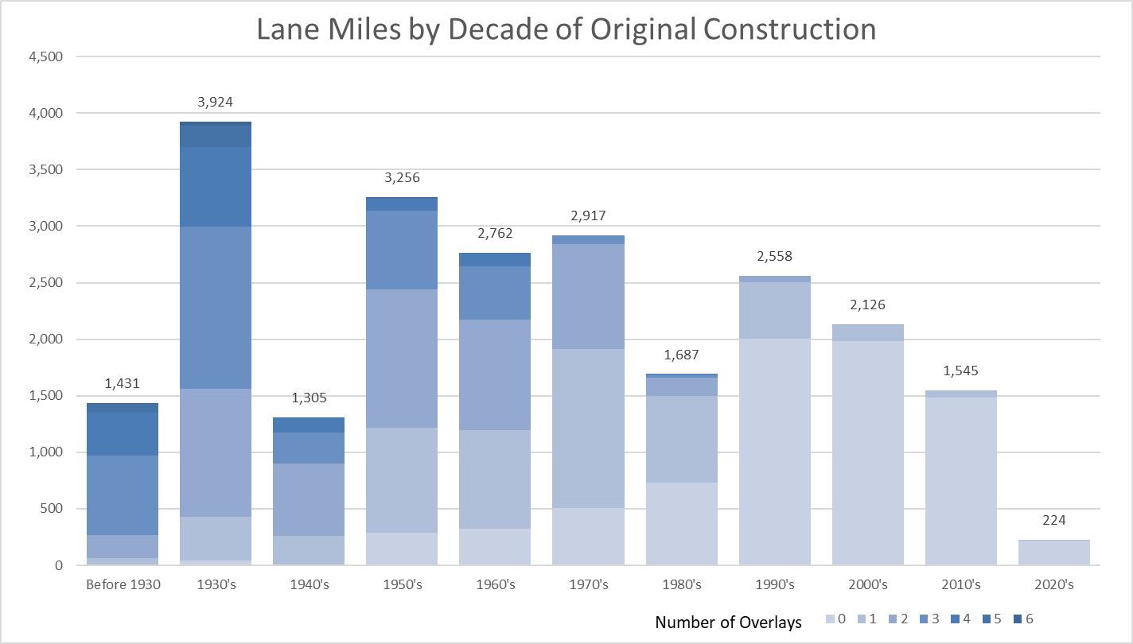
Pavement Inventory
Notes:
This chart includes 23,724 lane miles of mainline pavement on the Primary system (includes Interstates). The median pavement construction year is 1966 (50% were built prior to 1966) based on PMIS 2021. Using 2021 as our starting point, 56.8% of lane miles are at least 50 years old (CONYR = 1971 or older), and 29.9% are more than 70 years old.

Slide 7
Pavement Inventory
Half of original pavement = more than 55 years old
30% = 70+ years old (7,082 miles)
Size + Age of our system =
Significant financial challenge facing us for the foreseeable future

Slide 8
The Challenge
Past 30 years - constructed/replaced 25% of the system
Same investment in pavement replacements only Pavements will need to remain serviceable for at least 120 years
No pavements have reached that age.....
Yet we have already replaced many miles that have not hit that milestone.
Notes:
If we were to make that same investment strictly into pavement replacements (not any new miles), then our pavements will need to remain serviceable for at least 120 years.
To date, we do not have any pavements that have reached that age.....Yet we have already replaced many miles that have not hit that milestone.

Slide 9
The Challenge
Long Range Transportation Plan recommendation: 100-year pavement life
To achieve: $260M/year for primary system to address pavement replacement/rehabilitation
Notes:
Long Range Transportation Plan analysis led to the recommended that we plan for a 100 year pavement life.
To achieve that replacement schedule will require $260M per year in funding for the primary system to address pavement replacement and rehabilitation.

Slide 10
Construction Costs for Highway Projects
2-lane highway (rural)
New construction - $6.9 million/mile
Pavement replacement - $2.1 million/mile
Resurfacing (3”) - $460,000/mile

Slide 11
Managing our assets is critical to address this challenge and ease the financial burden
Make efficient investments when managing our pavements.
Use cost-effective methods to extend pavement life.

Slide 12
Pavement Condition Tracking
Why we track
Pavements deteriorate at different rates/for different reasons
Those reasons help in maintenance decisions
When we track
Condition of all pavements - periodic basis
Roughness and cracking - biennially
Friction and structure - 2 to 5-year cycle
Where we track
Pavement Management Information System (PMIS)
Tracks condition and details of construction and rehabilitation activities
Notes:
Tracking the condition of pavements on the system is vital
Pavements deteriorate at different rates and for different reasons
Knowing the reason helps in making decisions on how to maintain pavements
We assess the condition of all pavements on a periodic basis.
Key indicators such as roughness and cracking are evaluated at least biennially.
Other indicators such as friction and structure are also evaluated on a 2 to 5 year cycle.
The condition information as well as details of construction and rehabilitation activities are all tracked in our Pavement Management Information System (PMIS).

Slide 13
Pavement Condition
Notes:
Note that there is a lag in the measurement of condition relative to the investment year. Typically condition lags investment by about three years (highlight how 2009 spike didn’t really show up until 2012).

Slide 14
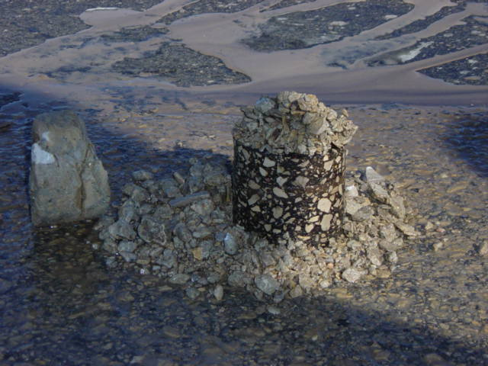
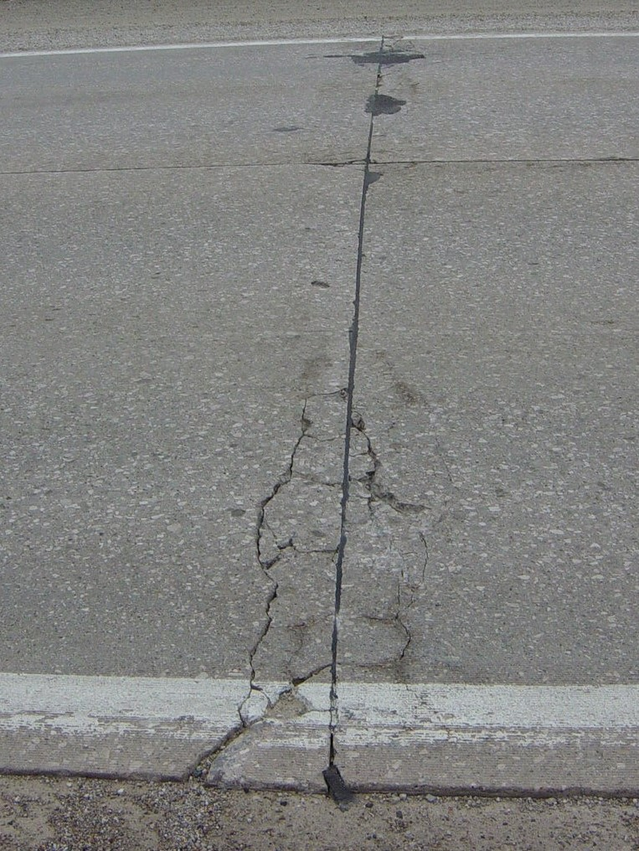
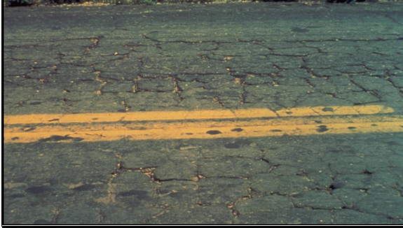
Pavement Deterioration
Pavement layers designed for
Anticipated truck loadings
Environmental conditions
Pavements deteriorate due to:
Iowa’s harsh environment
Year-long moisture
Temperature extremes
Increased truck traffic/heavier trucks
Subgrade inconsistency
Drainage issues

Slide 15
Pavement Deterioration

Slide 16
Slowing down the deterioration
Preventive Maintenance/Preservation
Treatments to pavements in relatively good condition to extend pavement life and/or improve performance
Begin early in pavement life
Very cost-effective
Treatments may be repeated on a schedule

Slide 17
Maintaining Good Condition Costs Less
Like your car or home, routine/preventative maintenance helps extend the life
Eventually it will need rehabilitation or replacement
Pavement management data and tools help us determine the optimal mix of treatments
Goal: most life at the least cost
Notes:
Just like your car or home, routine and preventative maintenance can help extend the life.
Eventually things wear out and more extensive rehabilitation or replacement is required.
Over the life of a pavement, preservation treatments are like sealing the deck on your house – it can help extend the life, but eventually it will need rehabilitation or replacement.
We use pavement management data and tools to help us determine the optimal mix of treatments to get the most life at the least cost.

Slide 18
Pavement Treatments
Increasing Annualized Cost
Maintenance/Preservation treatments
Crack & joint sealing/filling
Diamond grinding
Thin surface treatments
Chip seals
Slurry seals
Microsurfacing
Thin lift asphalt overlays
Rehabilitations (20 year life)
Reconstruction (40 year life)
$3,000/mile/yr of life
$9,000/mile/year
$10,000/mile/year
$35,000/mile/year
$50,000/mile/year
Notes:
Costs (from TAMP): Maint/Pres Tx $20k - $50k per lane mile; Rehab Tx $220k - $500k per LM; Recon Tx $600k - $750k per LM

Slide 19
Pavement Treatments
Increasing Annualized Cost
Maintenance/Preservation treatments
Crack & joint sealing/filling
Diamond grinding
Thin surface treatments
Rehabilitations (20 year life)
Functional overlays (to address ride)
Cold-in-Place recycling
Structural overlays (asphalt and concrete)
Rubblization/crack & seat
Reconstruction (40 year life)
Completely replacing the pavement and sometimes the subgrade
$3,000/mile/yr of life
$9,000/mile/year
$10,000/mile/year
$35,000/mile/year
$50,000/mile/year
Notes:
Costs (from TAMP): Maint/Pres Tx $20k - $50k per lane mile; Rehab Tx $220k - $500k per LM; Recon Tx $600k - $750k per LM

Slide 20
Pavement Management
Which treatment to use depends on the condition of the pavement and the life that is needed.
The right treatment is cost-effective because it has the lowest cost and will perform for the desired timeframe.
Some pavements require a higher cost treatment, can still be cost-effective because it will provide a longer life or a higher level of performance.
Models used to predict pavement needs into the future incorporate treatment cost and effectiveness.

Slide 21
Condition Forecast Process
Modeling software predicts the system-wide pavement condition under any funding scenario.
Developed based on past pavement performance to predict future performance.
Evaluates all viable treatment alternatives for each pavement.
Optimization is used to select the mix of candidates that maximizes network condition.

Slide 22
Target Condition Index
Notes:
This chart shows past expenditures in the 3R program (Non-Interstate Pavement Modernization) and pavement condition. It is important to note there is about a 3-year lag in the condition measurement – projects in FY19 might not be complete until the fall of 2019, and often those won’t be evaluated again for another year or two so we might not see their condition reflected until the 2021 data. This lag is why we see the unexpected relationship between expenditures and condition.

Slide 23
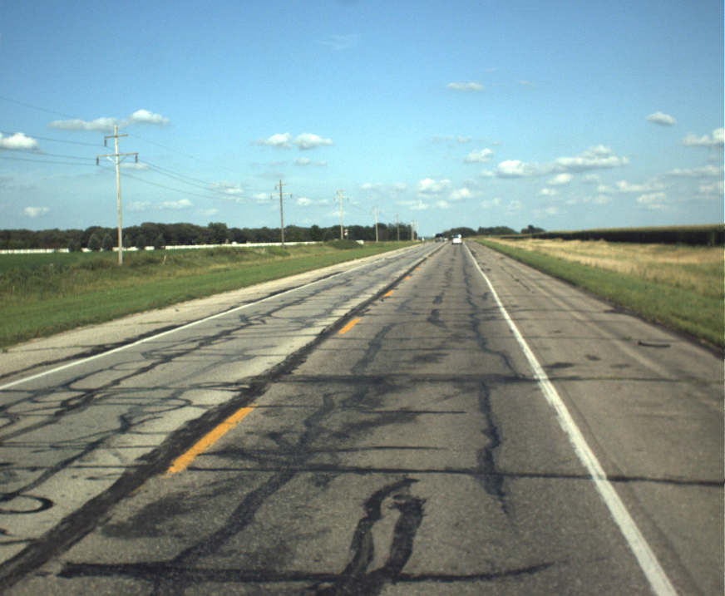
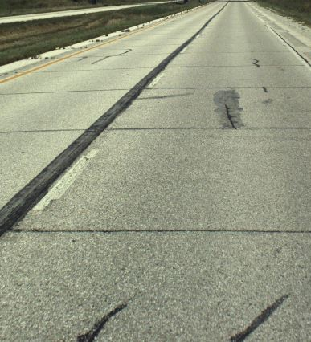
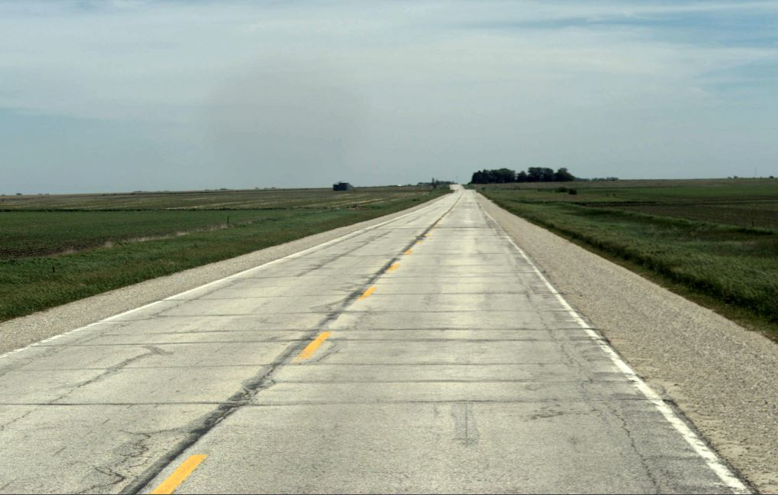
PCI = 33
PCI = 75
PCI = 50

Slide 26
Key Take-aways
Recent funding increases have helped slow the decline in condition of the system.
Short-term funding can meet our target condition, However, long-term needs are out-pacing our level of investment in pavement reconstruction
Iowa’s system built over 100 years
Current projected funding is not adequate to sustain a system of this size in a state of good repair.
$260M/year in investment in the Primary system necessary to achieve a 100-year replacement cycle.
Notes:
Recent funding increases have helped slow the decline in condition of the system.
While short term funding can meet our target condition, the long-term needs are out-pacing our level of investment in pavement reconstruction………
The reason is that Iowa’s highway system has been built over the past 100 years to the size it is today. At this point, the current projected funding is not adequate to sustain a system of this size in a state of good repair.
To address the need for replacing our aged system will require $260M per year in investment to the Primary system to achieve a 100 year replacement cycle.

