Slide 1
FY 2024 Highway Program Balance ($ in millions)
January 9, 2024
FY 2024 Program Balance (June 2023) |  | (24.9)
Forecast PRF Receipts (November) | 377.7
Actual PRF Receipts (November) | 400.1
Difference |  | 22.4
Programmed Amounts (December) | 431.1
Project Costs (December) | 433.5
Difference |  | (2.4)
Program Balance (December 2023) |  | (4.9)
Previous Balance Reported: (7.5)

Slide 2
January 9, 2024
Fiscal Year 2024 Overview
Revenue: Expect monthly revenue fluctuations.
Lettings:
Approximately 55 percent of the FY 2024 Program has been awarded.
The December letting was approximately $71 million.
Next letting scheduled for January 16, 2024.

Slide 3
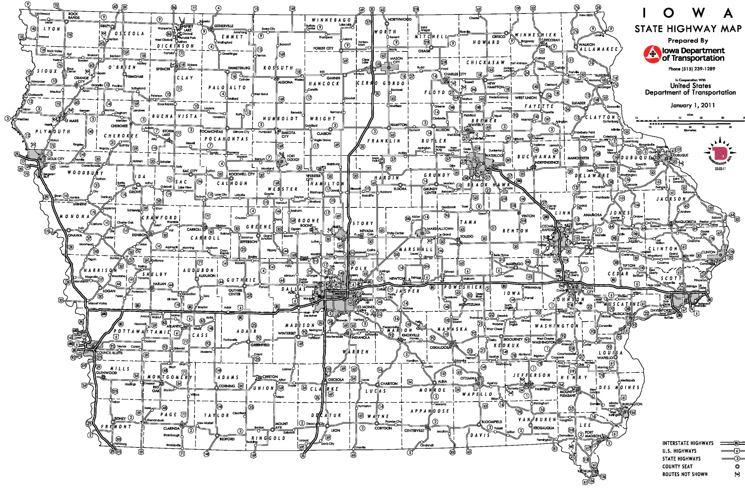
Possible 2024 Commission Tour Routes
December 2023
October-Decorah
-IA 9 Lansing Bridge
April-Cedar Rapids
-I-80/380 Interchange
-I-380 Corridor
June-Council Bluffs
-CBIS
= meeting location
August-Moravia/Honey Creek
-US 34 Corridor

