Slide 1
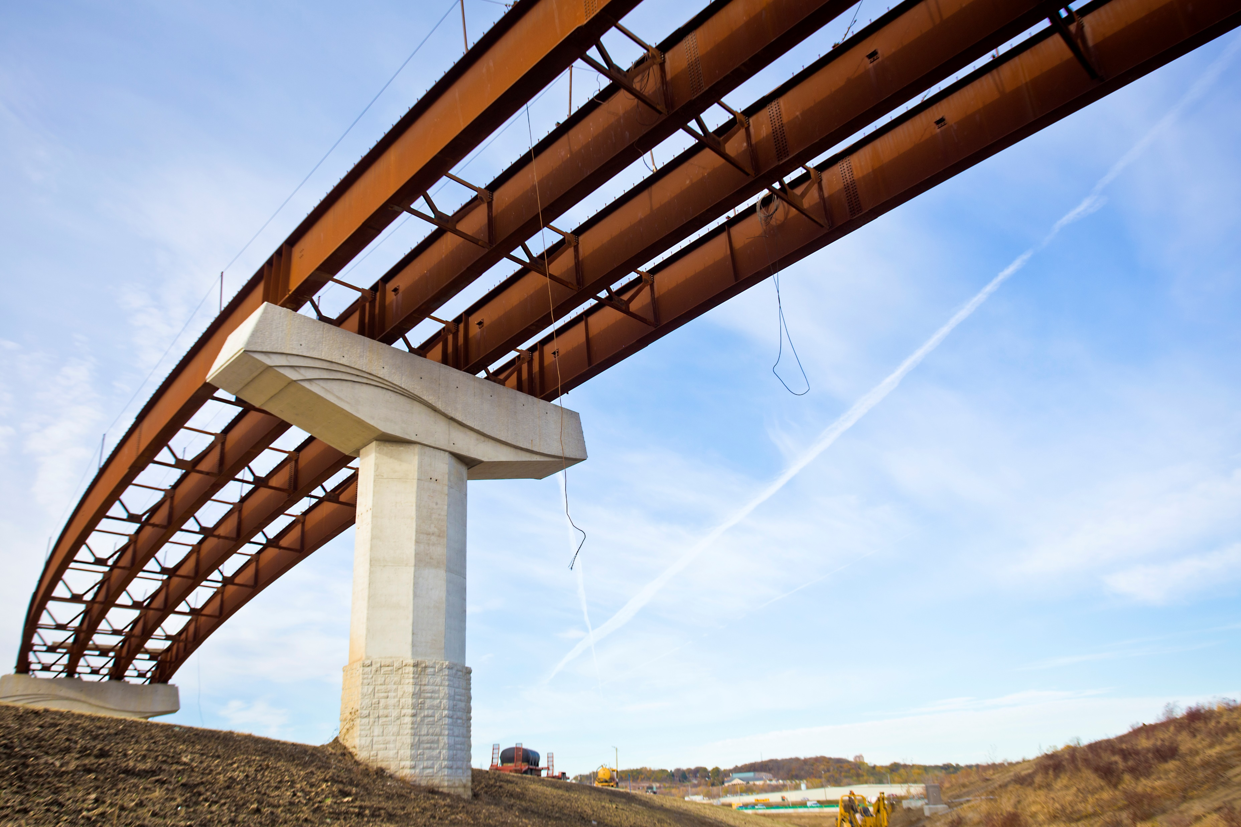
State Transportation Plan
Implementation Update
Garrett Pedersen, Director
Systems Planning Bureau
1/9/2024

Slide 2
System objectives
Define what we are trying to achieve and how to measure whether we are achieving it, allowing us to make better decisions about what projects to fund and which activities to undertake.
2

Slide 3
Implementation activities
WORKPLAN
SUPER-2
ADMINISTRATIVE MODIFICATION
Completed to help guide staff through and monitor implementation of the Plan.
Clarified design guidance and prioritizing the timing of short-term and long-term corridor planning studies.
Adding references and implementation strategies from three planning efforts that further refine existing strategies in the Plan.

Slide 4
Strategy area
Responsibility
SLRTP Integration
Workplan
Planning
Workplan monitoring:
Systems Planning
Defines and monitors implementation activities for the strategies defined in the 2022 State Transportation Plan
Focuses on activities that are not being led by other groups
Fluid document reviewed and updated on a regular basis
Accessibility & Equity
Rightsizing & Project Dev.
Resiliency & Sustainability
Resiliency & Sustainability Working Groups
Motor Vehicle
Motor Vehicle Division
Technology
Traffic Operations Bureau & Iowa Advisory Council on Automated Transportation
4

Slide 5
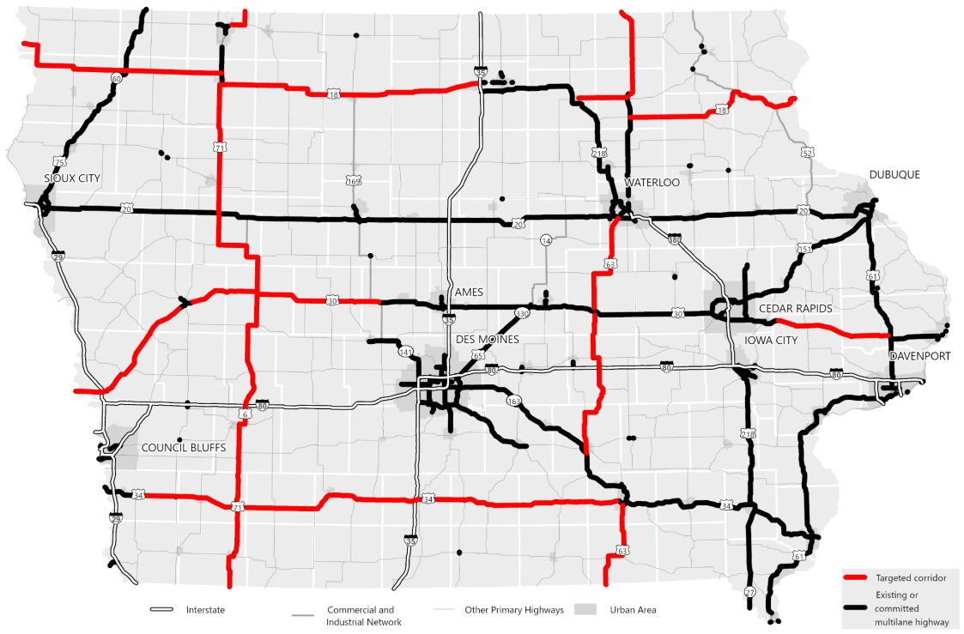
Design guidance enhancements to clarify paved shoulders, turn lanes, and access
Prioritization of short-term vs long-term corridor planning studies
Super-2
Studies proceeding on targeted corridors
5

Slide 6
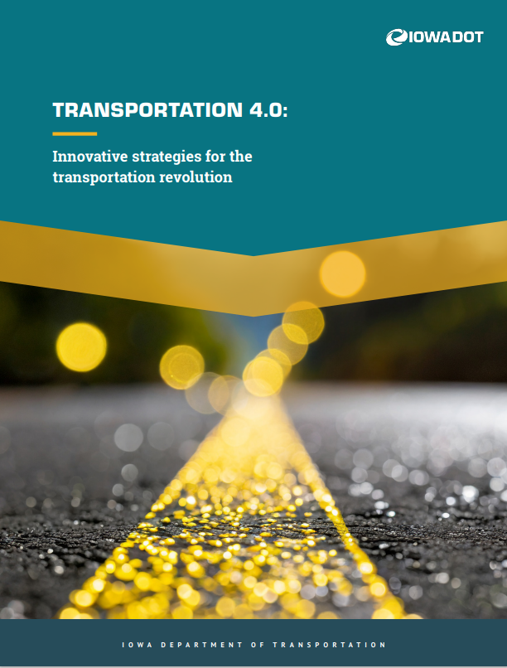
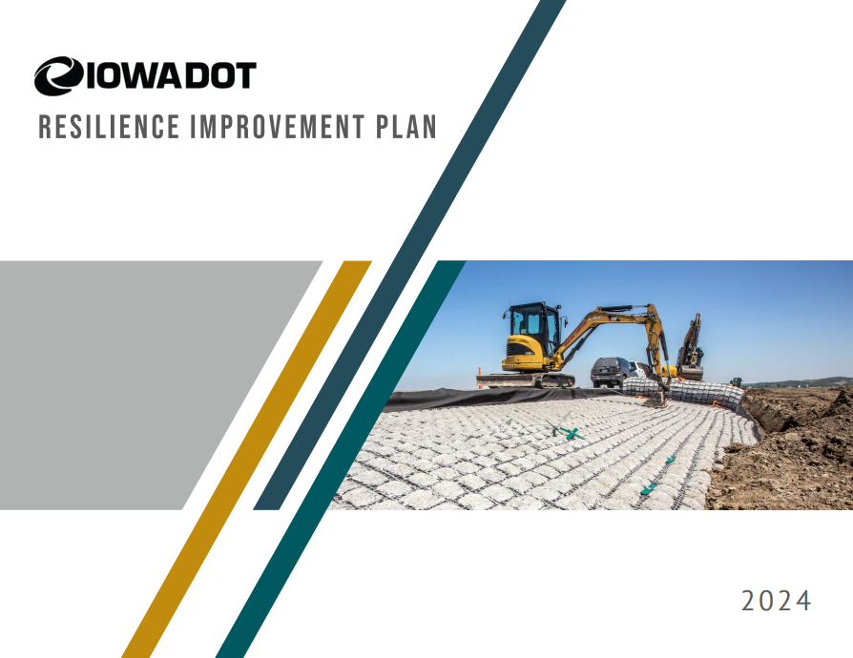
Administrative modification
Adding references and implementation activities from three planning efforts that further refine existing strategies in the State Transportation Plan
6

Slide 7
Transportation 4.0
Statewide strategy supporting economic development by implementing technologies and strategies that move products and goods to market safer and more efficiently
Further refines existing and/or undeveloped strategies and considerations from State Transportation Plan and State Freight Plan
8 strategy areas with 51 short-term (1-3 year) action items
Input from Executive Leadership Team, internal working group, and Iowa Economic Development Authority
Artificial intelligence, machine learning & advanced analytics
Advanced highway
planning & analysis
Transportation system resiliency & sustainability
Energy & alternative
fuel planning & infrastructure
Roadway digital infrastructure & dual benefit investments
Highest & best use
of right-of-way
Freight design & superload route capability
Emerging freight technologies
7
7

Slide 8
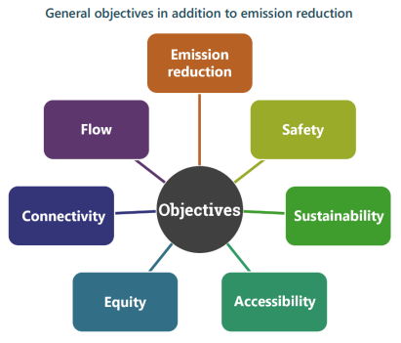
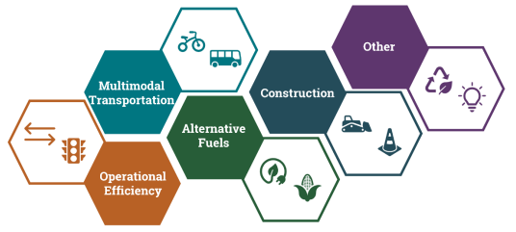
Carbon Reduction Strategy
General objectives
New requirement in Infrastructure Investment and Jobs Act
Compiled 17 relevant strategies (grouped into five areas) from the State Transportation Plan and other existing state and metropolitan planning organization (MPO) plans
Implementation strategies to reduce carbon emissions used to help determine projects funded with Carbon Reduction Program funding
Input from Iowa’s nine MPOs
Strategy areas
8

Slide 9
Resiliency Improvement Plan
Voluntary planning activity
If completed, allows for a reduced non-federal share of the cost of Promoting Resilient Operations for Transformative, Efficient, and Cost-Saving Transportation (PROTECT) projects
Builds on existing resiliency planning strategy in State Transportation Plan
Resiliency Toolbox (30 strategies, 25 countermeasures for mitigating hazards, and project selection and programming processes for PROTECT funds)
Input from Iowa DOT Resiliency Working Group, State agency partners, and universities.
9

Slide 10
Administrative modification next steps
Address any questions or comments from the Commission
Administratively update the State Transportation Plan
Chapter 4 – Objectives and Considerations
Add discussion of Transportation 4.0 to the Economic Vitality section
Add discussion of Carbon Reduction Strategy and Resiliency Improvement Plan to the Resiliency & Sustainability section
Chapter 5 – Needs, risks, and strategies
Add references to each effort in strategy section
Appendix 4 – Strategies from other plans
Add strategies from each effort
Upload to the Iowa in Motion webpage
10
10

Slide 11
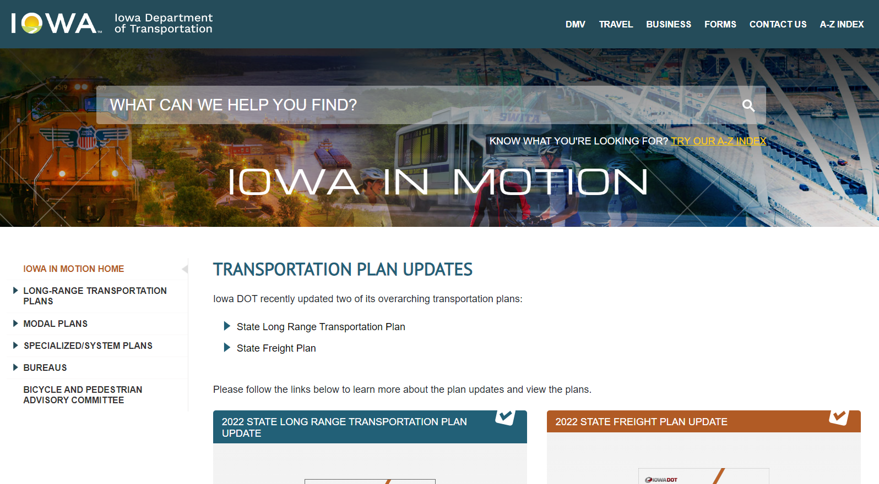
Iowa in Motion
Resources related to the State Transportation Plan and other modal and specialized/system plans are available at: iowadot.gov/iowainmotion/
11

Slide 12
Questions?
garrett.pedersen@iowadot.us
515-239-1027

