Slide 1
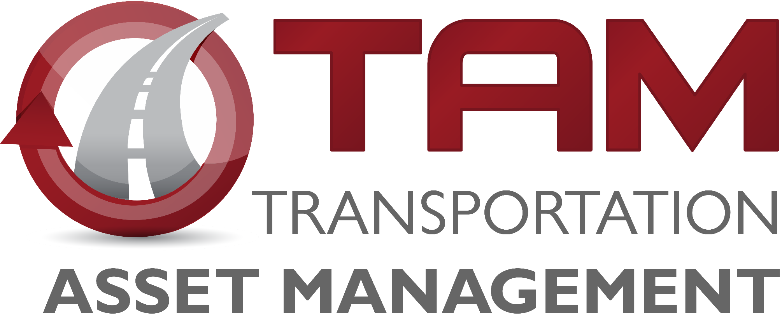
Transportation Commission Workshop
January 9, 2024

Slide 2
Pavement Management
Chris Brakke, PE
Iowa DOT Construction and Materials Bureau

Slide 3
Pavement system components
Pavement
Subbase
Subgrade
Pavement
Concrete (rigid), Asphalt (flexible), or Composite
Subbase
Rock layer for support and drainage
Subgrade
Improved soil layer to provide support

Slide 4
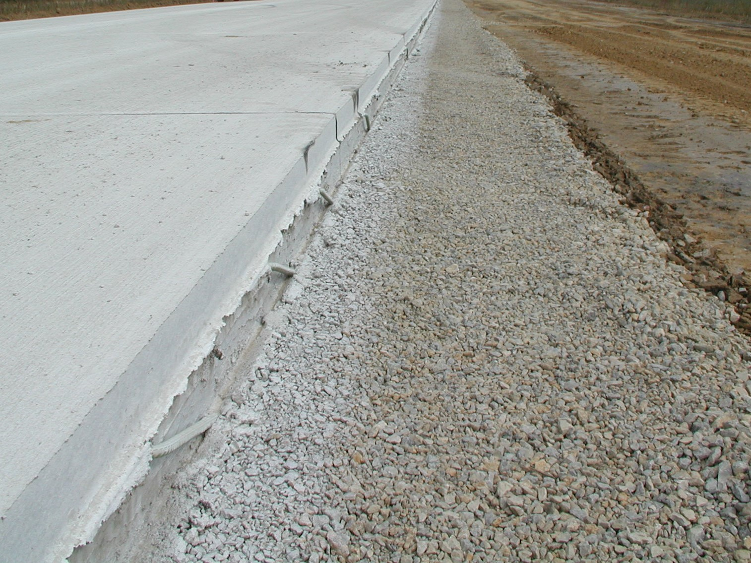
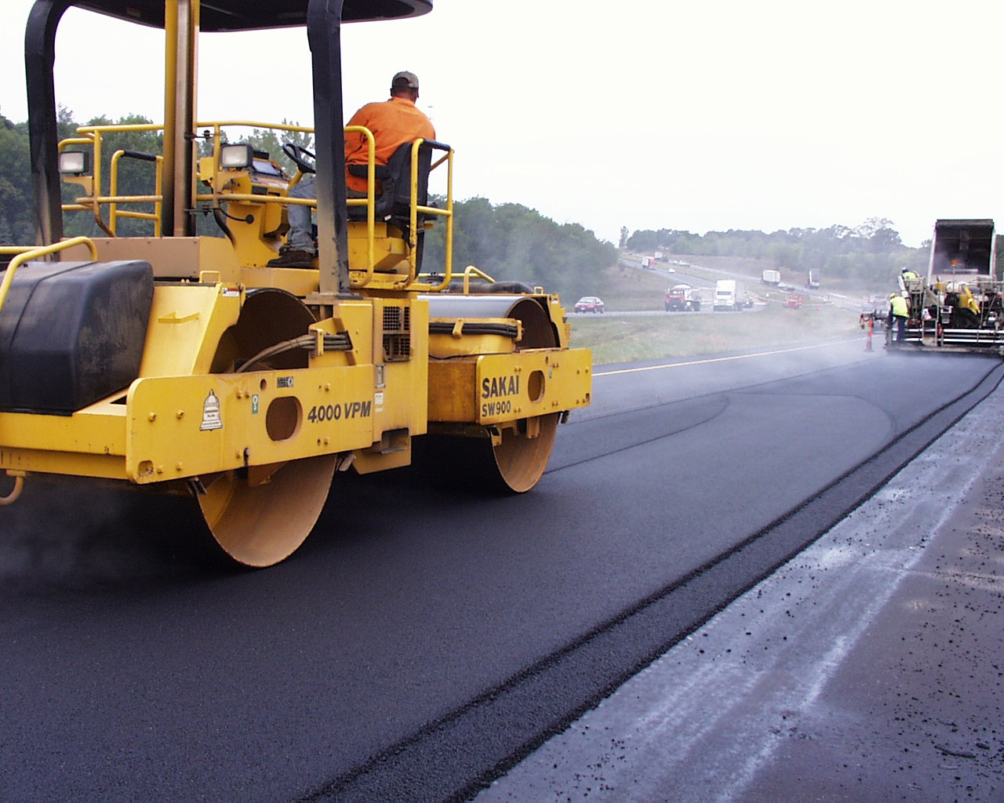
Pavement system components
Pavement design life is 40 years.
Serviceable life can be extended with maintenance and rehabilitation, but not indefinitely.
Many factors influence the design….
Truck traffic
Subgrade soil
Climate

Slide 5
Pavement Inventory
The Primary system includes 24,534 lane miles of pavement.
3,848 or about 16% on the Interstate
758 lane miles of ramps
Our Investment
If we had to replace the pavement on all of these roads today, the cost would exceed $31 billion.
Notes:
These mileages are based on the LRS data, not PMIS.

Slide 6
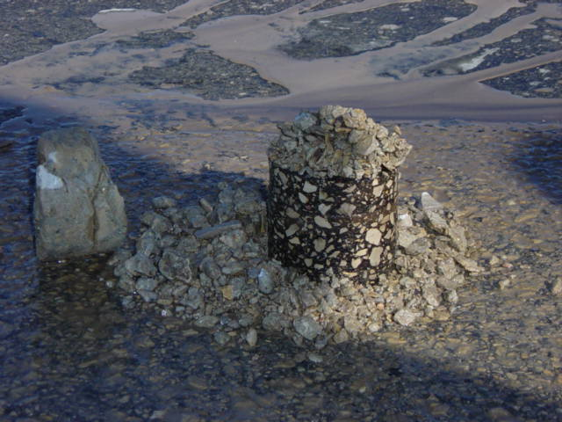
Pavement Inventory
Notes:
This chart includes 23,723 lane miles of mainline pavement on the Primary system (includes Interstates). The median pavement construction year is 1968 (50% were built prior to 1968) based on PMIS 2022. Using 2022 as our starting point, 58.7% of lane miles are at least 50 years old (CONYR = 1973 or older), and 31.4% are more than 70 years old.

Slide 7
Pavement Inventory
Half of the system’s original pavement is more than 55 years old.
31% (7,449 miles) is 70+ years old
Based on the size and age of our system we have a significant financial challenge facing us for the foreseeable future.

Slide 8
The Challenge
We need to be replacing more pavements on our aging system.
An achievable life for a pavement is something less than 100 years (this will include 3-4 overlays).
To date, we only have a few pavements that have reached that age.....Yet we have already replaced many miles that have not hit that milestone.

Slide 9
The Challenge
Last year $35M was approved for pavement replacements beginning in FY 2027
Good start to begin addressing needs
A 100 year life requires 1% replacement/year.
Which equates to roughly $310M/year in additional funding beyond projected 3R funds.
Currently $35M/yr = 0.1% of the system/year
Propose to keep this as a priority and continue to grow additional funding for pavement

Slide 10
Construction costs for highway projects
2-lane highway (rural)
New Construction - $ 7.4 million per mile
Pavement replacement - $3.2 million per mile
Resurfacing (3”) - $625,000 per mile

Slide 11
Managing our assets is critical to address this challenge and to ease the financial burden
We need to make efficient investments when managing our pavements.
Use cost effective methods to extend pavement life.

Slide 12
Pavement Condition
Notes:
Note that there is a lag in the measurement of condition relative to the investment year. Typically condition lags investment by about three years (highlight how 2009 spike didn’t really show up until 2012).

Slide 13
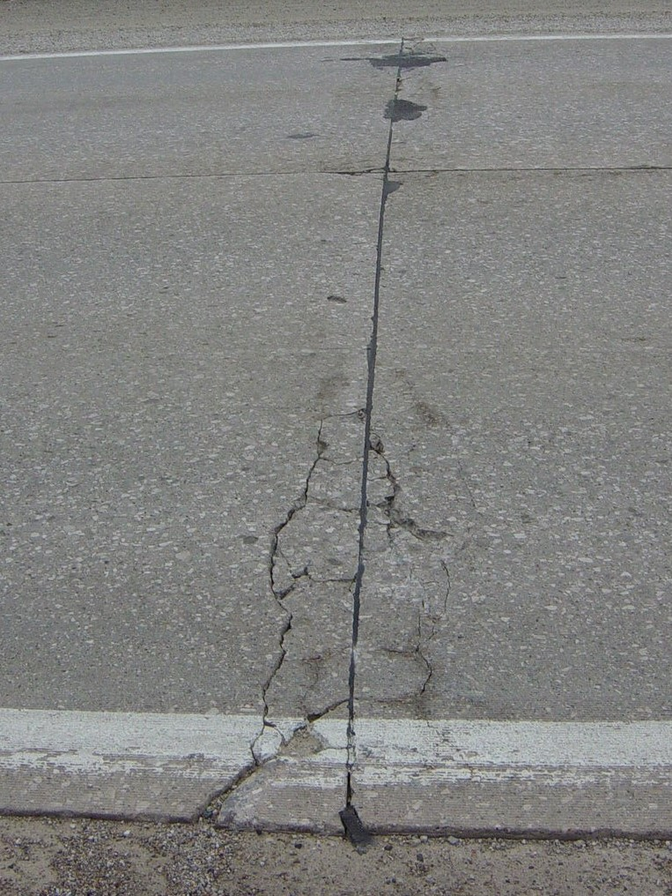
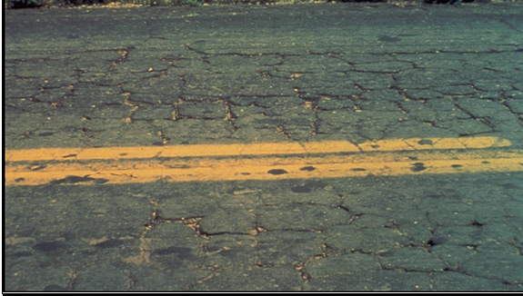
Pavement Deterioration
Pavement layers are designed for the anticipated truck loadings and for the environmental conditions
Pavements deteriorate after they are built due to many factors:
Iowa has one of the harshest environments
Year long moisture
Temperature extremes
Increased truck traffic or heavier trucks
Subgrade inconsistency
Drainage issues

Slide 14
Pavement Deterioration

Slide 15
Slowing down the deterioration
Preventive Maintenance/Preservation
Treatments applied to pavements in relatively good condition to extend pavement life and/or improve performance.
Begin early in pavement life
Very cost effective
Treatments may be repeated on a schedule

Slide 16
Maintaining Good Condition Costs Less
Just like your car or home, routine and preventative maintenance can help extend the life.
Eventually things wear out and more extensive rehabilitation or replacement is required.
Over the life of a pavement, preservation treatments are like sealing the deck on your house – it can help extend the life, but eventually it will need rehabilitation or replacement.
We use pavement management data and tools to help us determine the optimal mix of treatments to get the most life at the least cost.

Slide 17
Pavement Treatments
Increasing Annualized Cost
Maintenance/Preservation treatments
Crack & joint sealing/filling
Diamond grinding
Thin surface treatments
Chip seals
Slurry seals
Microsurfacing
Thin lift asphalt overlays
Rehabilitations (20 year life)
Functional overlays (to address ride)
Cold-in-Place recycling
Structural overlays (asphalt and concrete)
Rubblization/crack & seat
Reconstruction (40 year life)
Completely replacing the pavement and sometimes the subgrade
$3,000/mile/year of life
$9,000/mile/year
$12,000/mile/year
$40,000/mile/year
$80,000/mile/year
Notes:
Costs (from TAMP): Maint/Pres Tx $20k - $50k per lane mile; Rehab Tx $220k - $500k per LM; Recon Tx $600k - $750k per LM

Slide 18
Target Condition Index
Notes:
This chart shows past expenditures in the 3R program (Non-Interstate Pavement Modernization) and pavement condition. It is important to note there is about a 3-year lag in the condition measurement – projects in FY19 might not be complete until the fall of 2019, and often those won’t be evaluated again for another year or two so we might not see their condition reflected until the 2021 data. This lag is why we see the unexpected relationship between expenditures and condition.

Slide 19
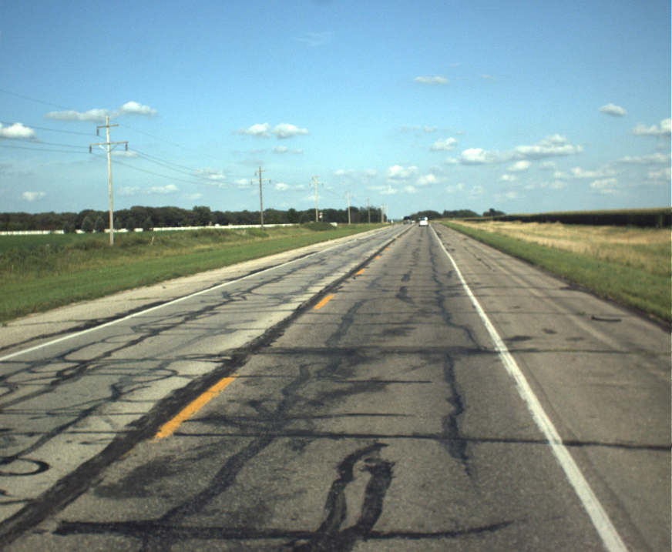
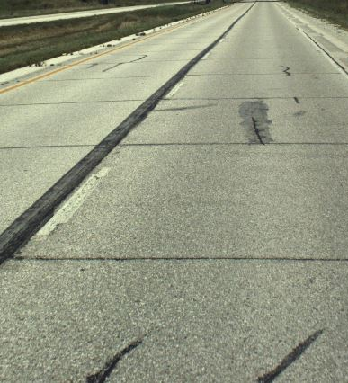
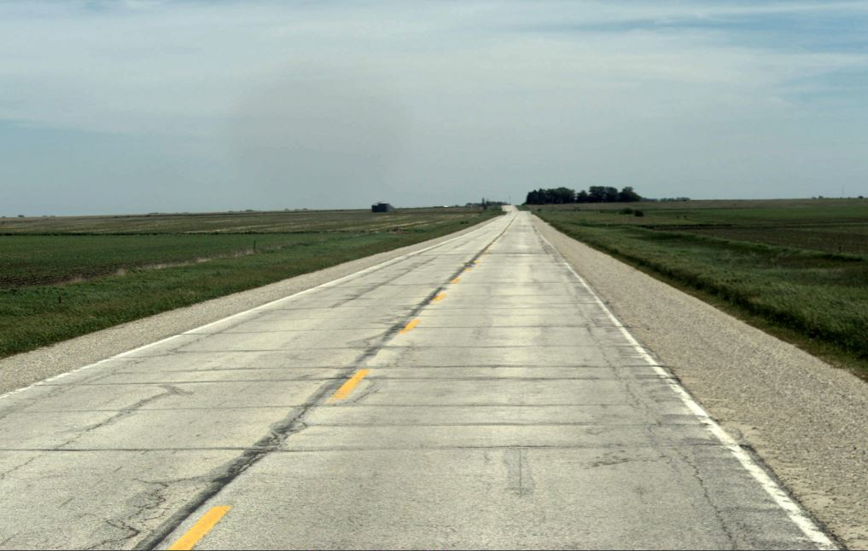
PCI = 33
PCI = 75
PCI = 50

Slide 22
Key Take-aways
We have 2 competing goals for pavement funding
Achieve the target 75 PCI condition
Replace pavements on a reasonable cycle to limit risk of our aging system
While short term funding can meet our target condition, the long-term needs for pavement replacement are out pacing our level of investment…….
This is because Iowa’s highway system has been built to the current size over the past 100 years. At this point, the projected funding is not adequate to sustain a system of this size in a state of good repair.
Addressing the need for replacing our aged system will eventually require $310M per year (2023 $) in investment to the Primary system to achieve a 100 year replacement cycle.
This is in addition to the 3R funding already in place.
If additional funding becomes available, use analytics to determine where to direct additional funding between rehabilitation and reconstruction.

Slide 23
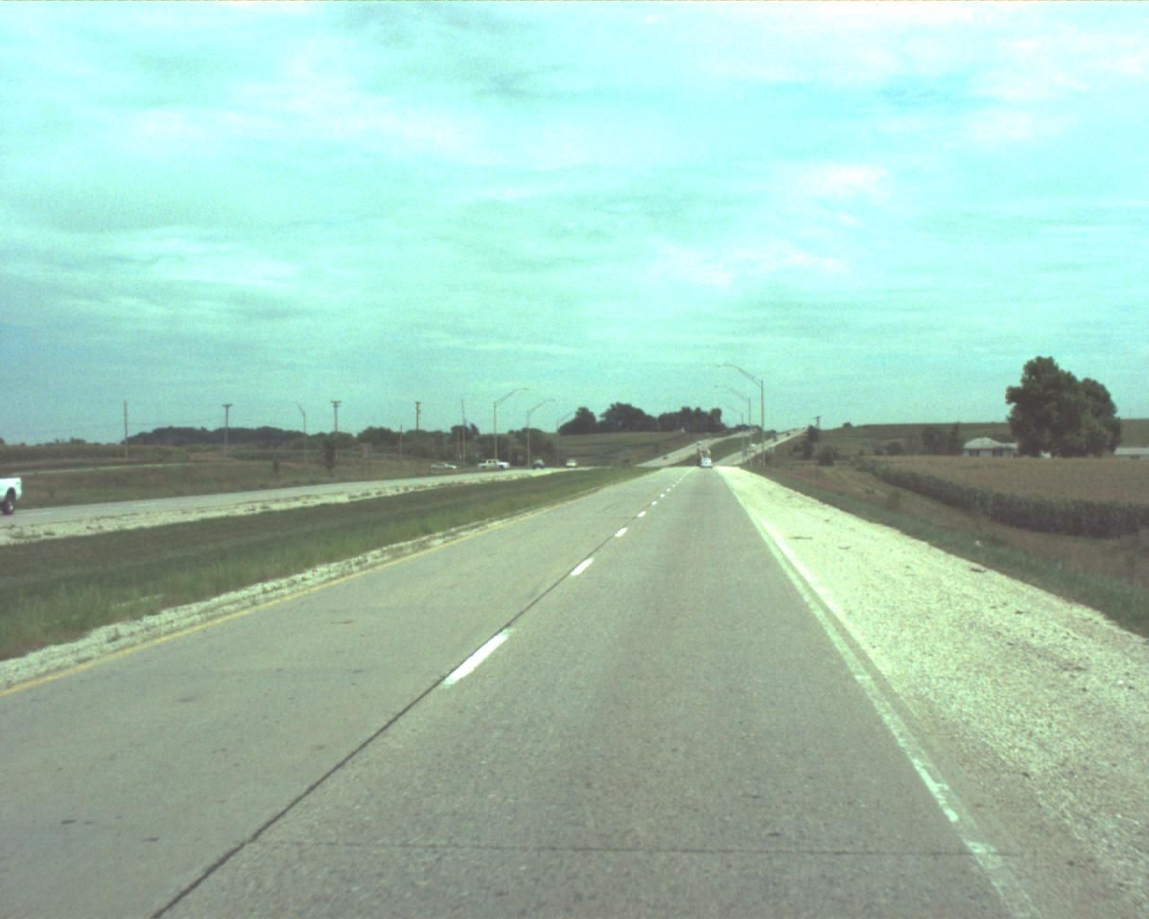
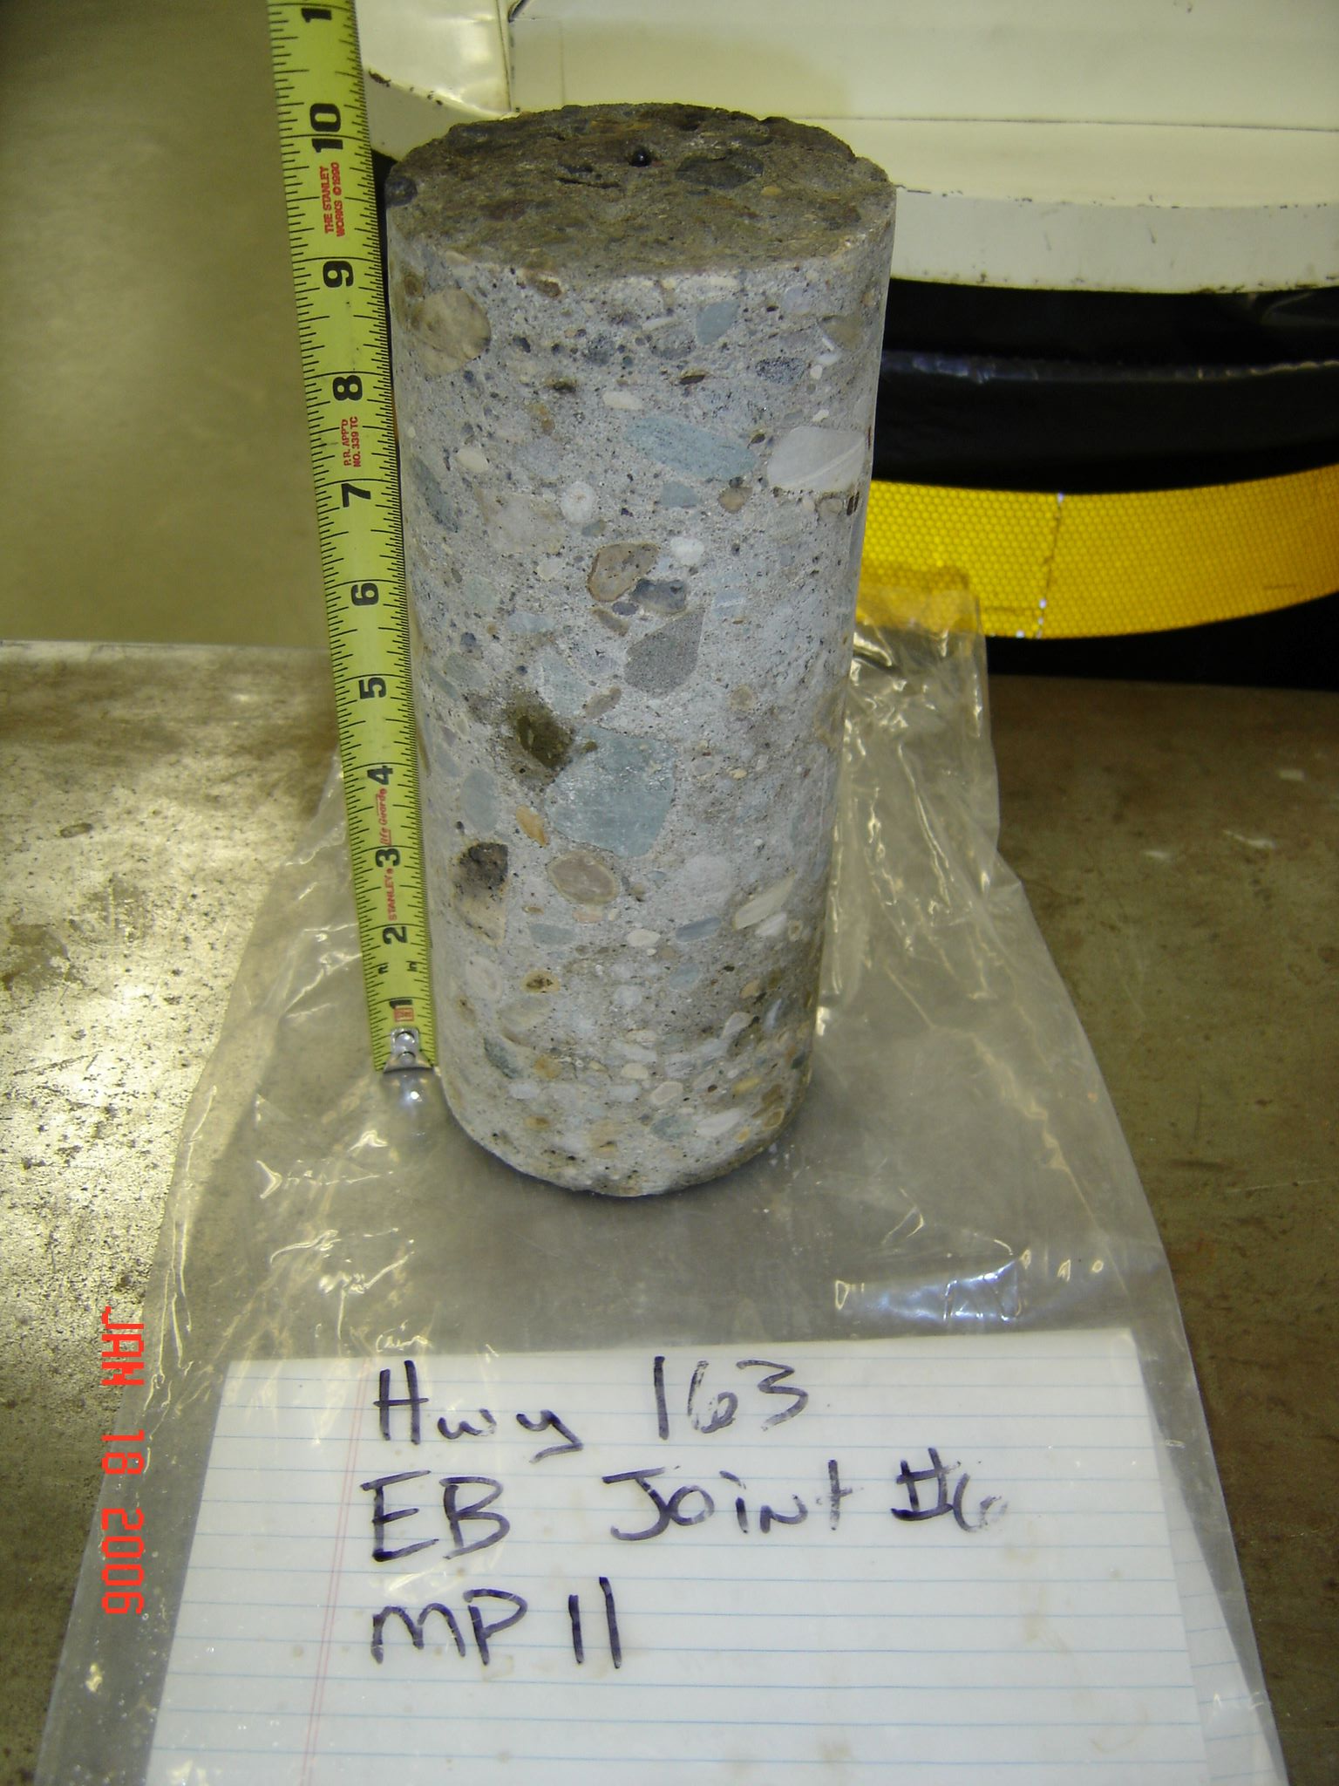
Case history IA 163
Condition in 2006
Rough ride but pavement in good shape
1964 PC Concrete
2006

Slide 24
Case history IA 163
Truck wheels
Joint
Steel Dowel bar
PCC Pavement

Slide 25
Case history IA 163
Truck wheels
Joint
PCC Pavement

Slide 26
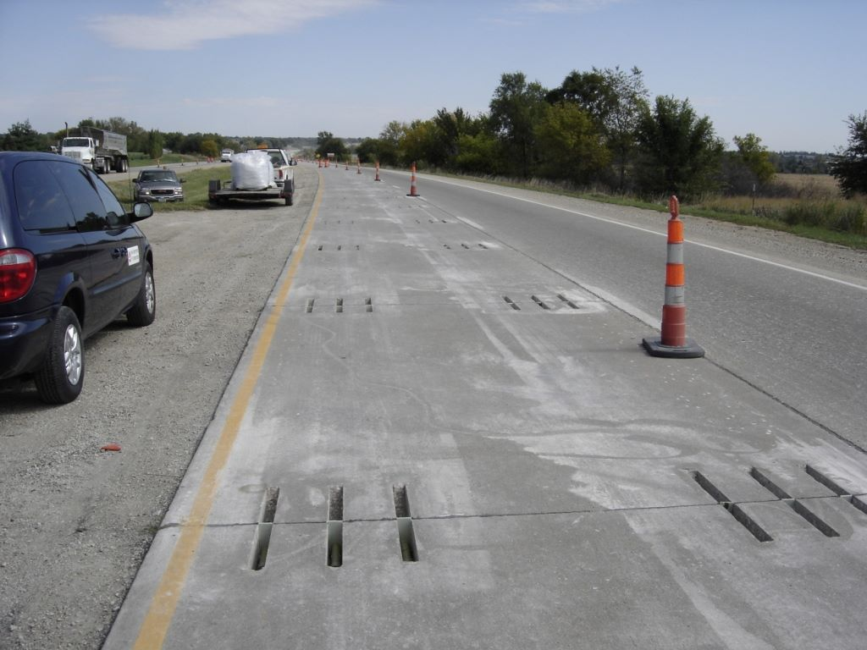
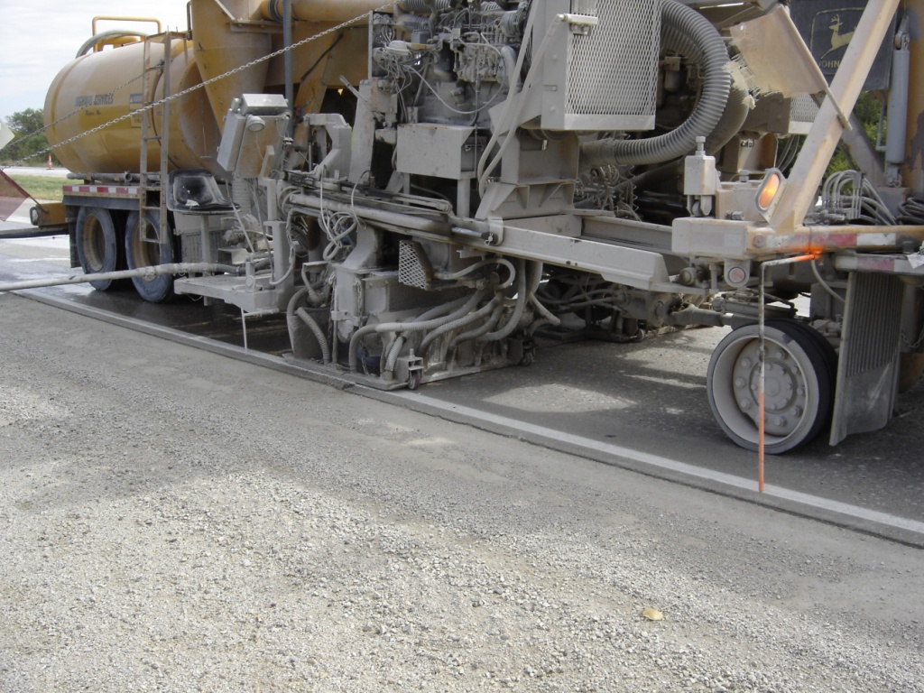
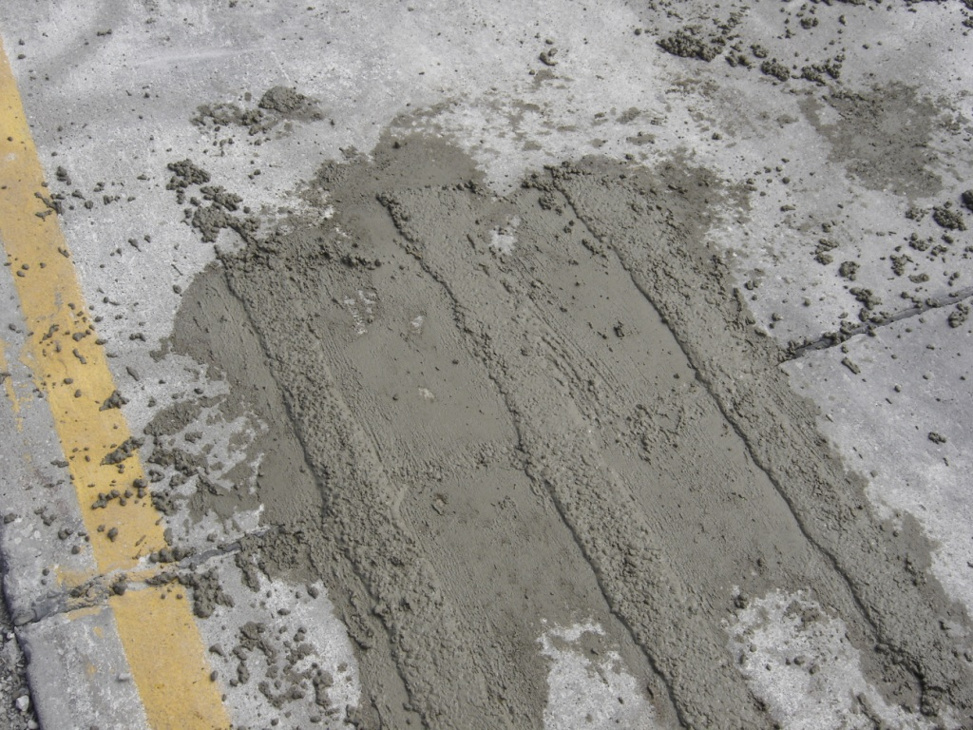
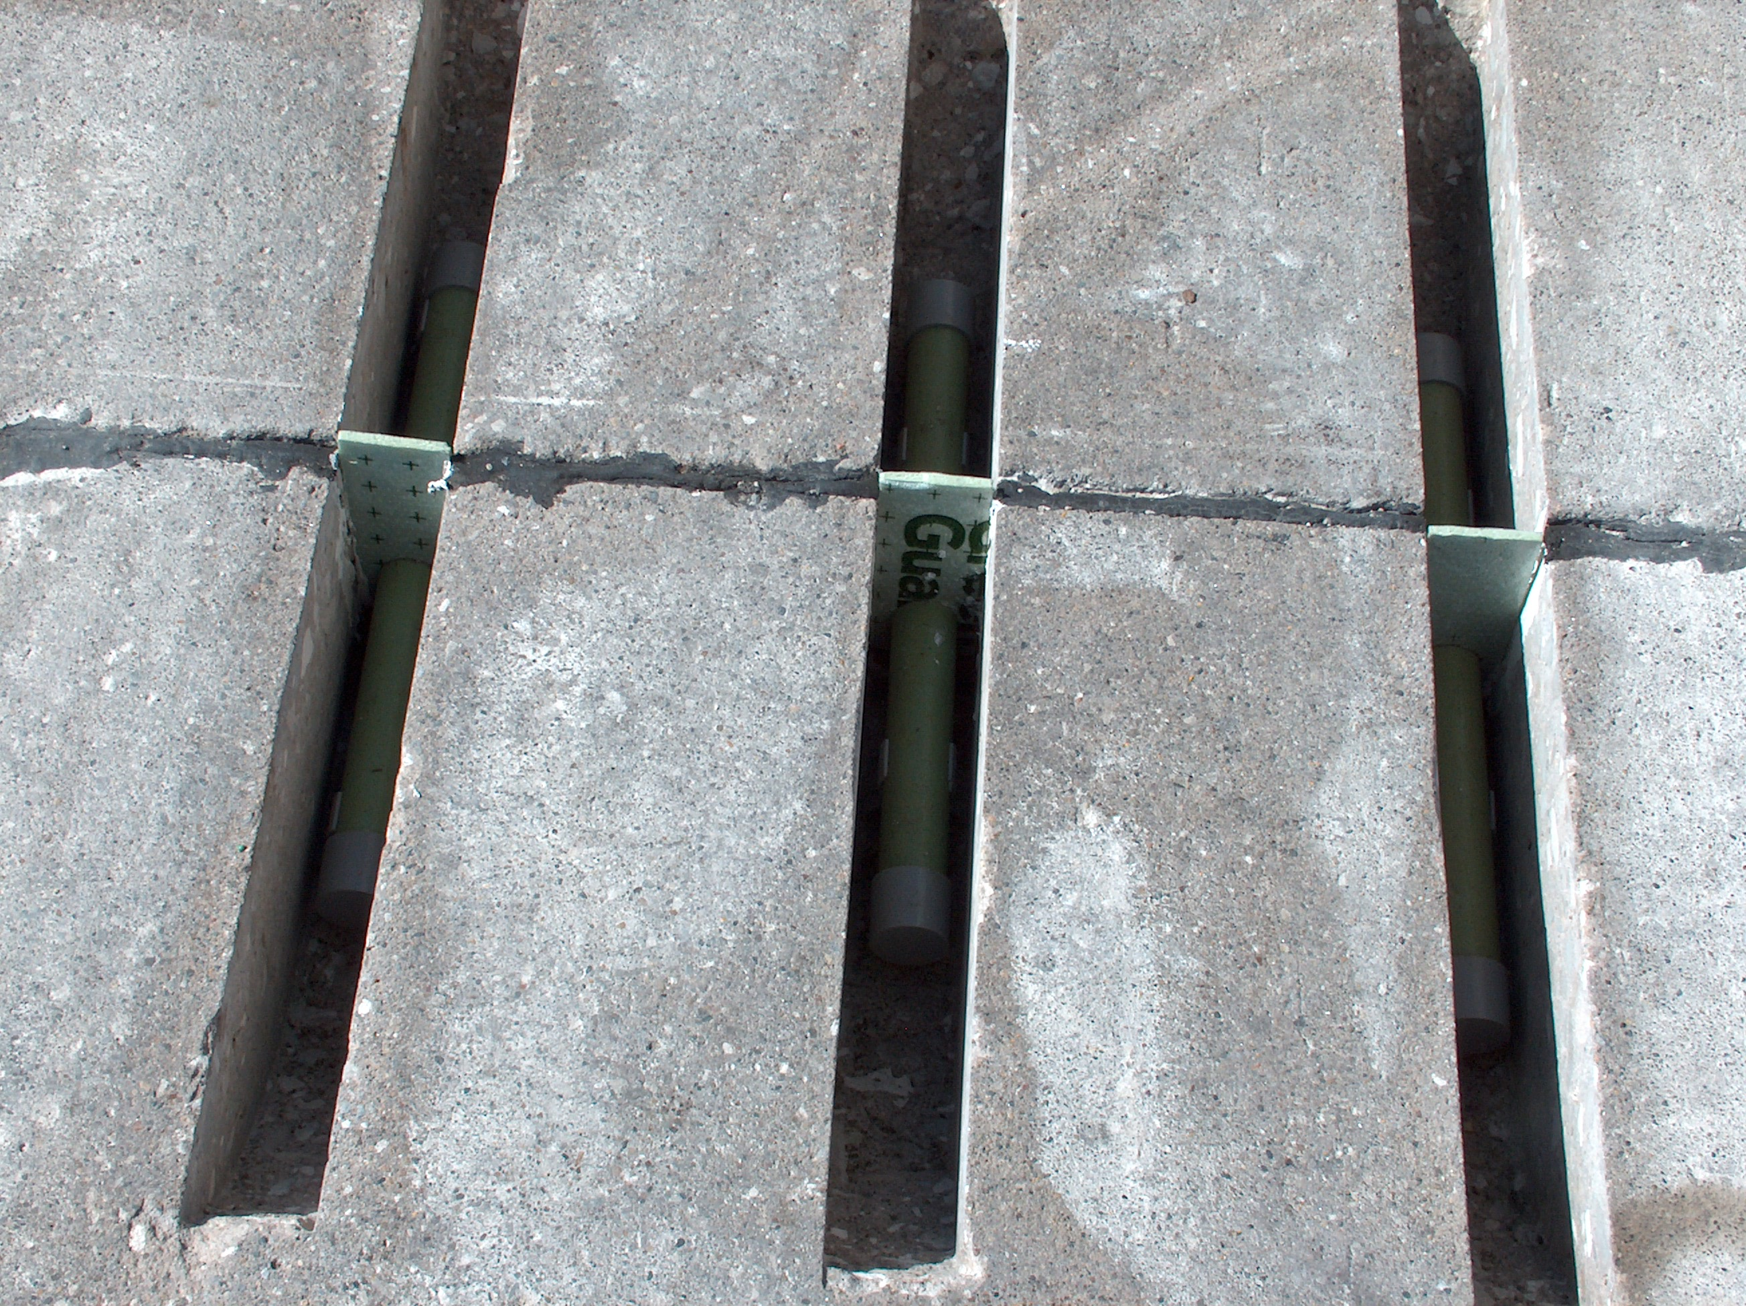
Decision - preservation/rehab
2007 Dowel bar retrofit & diamond grind

Slide 27
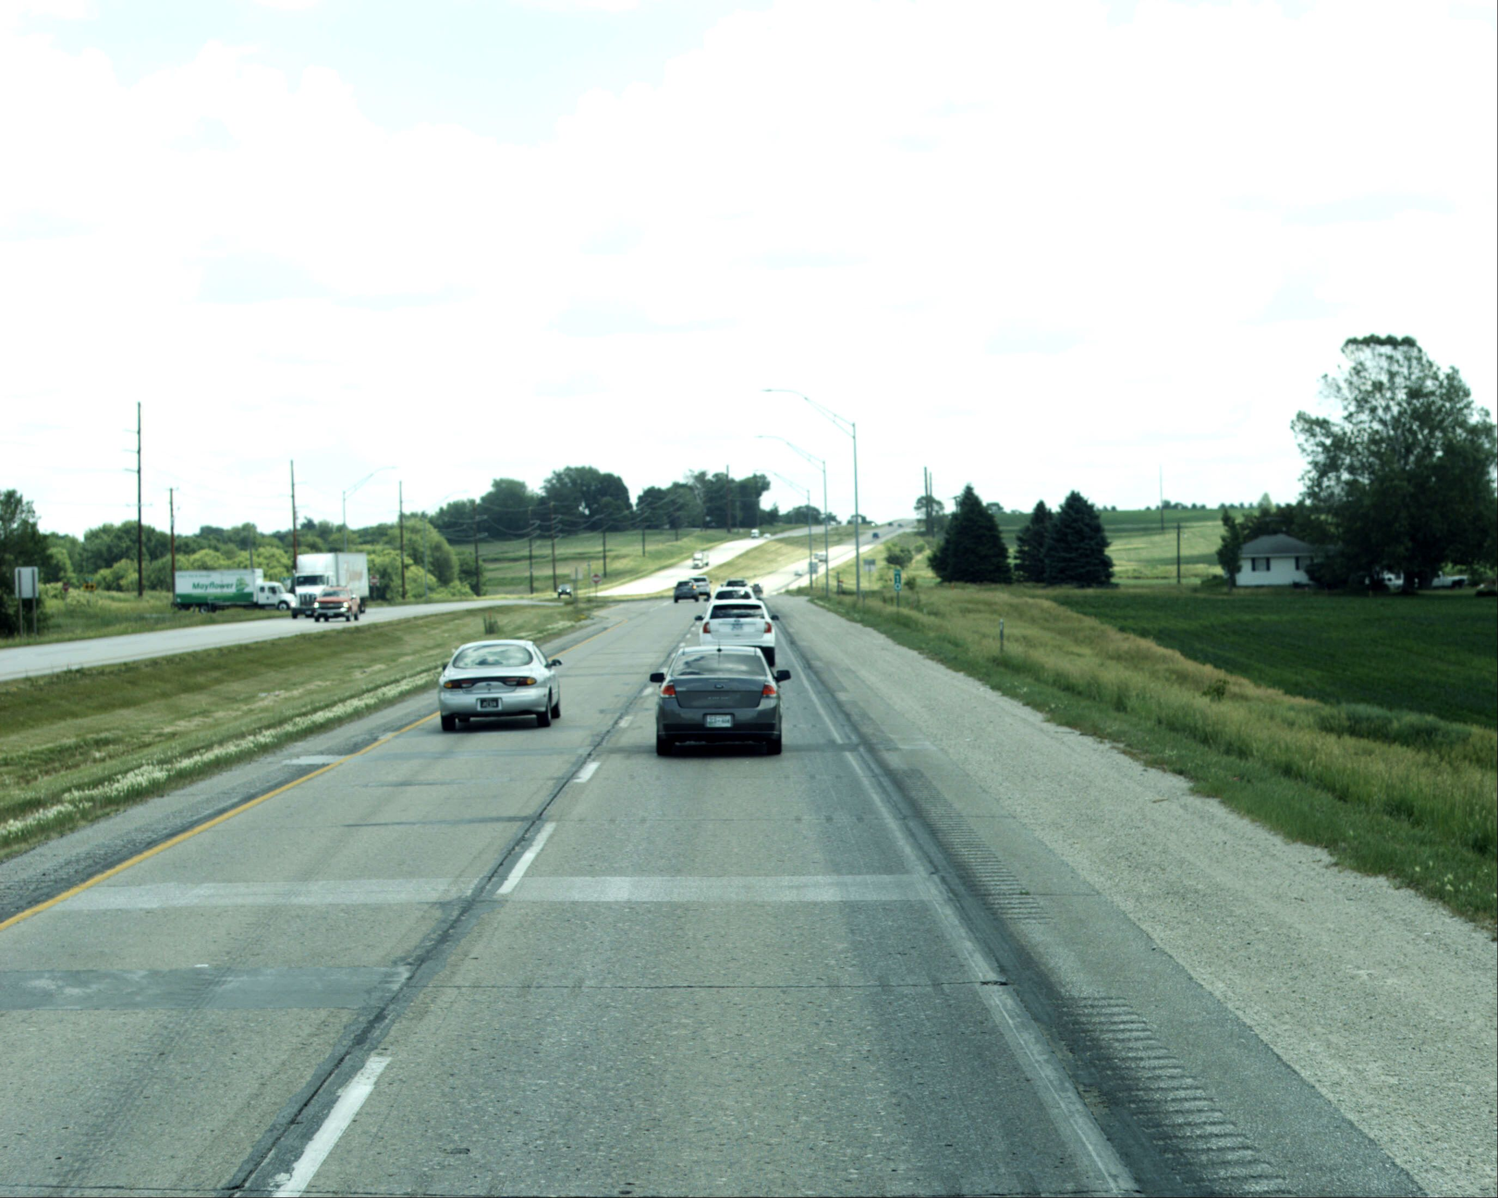
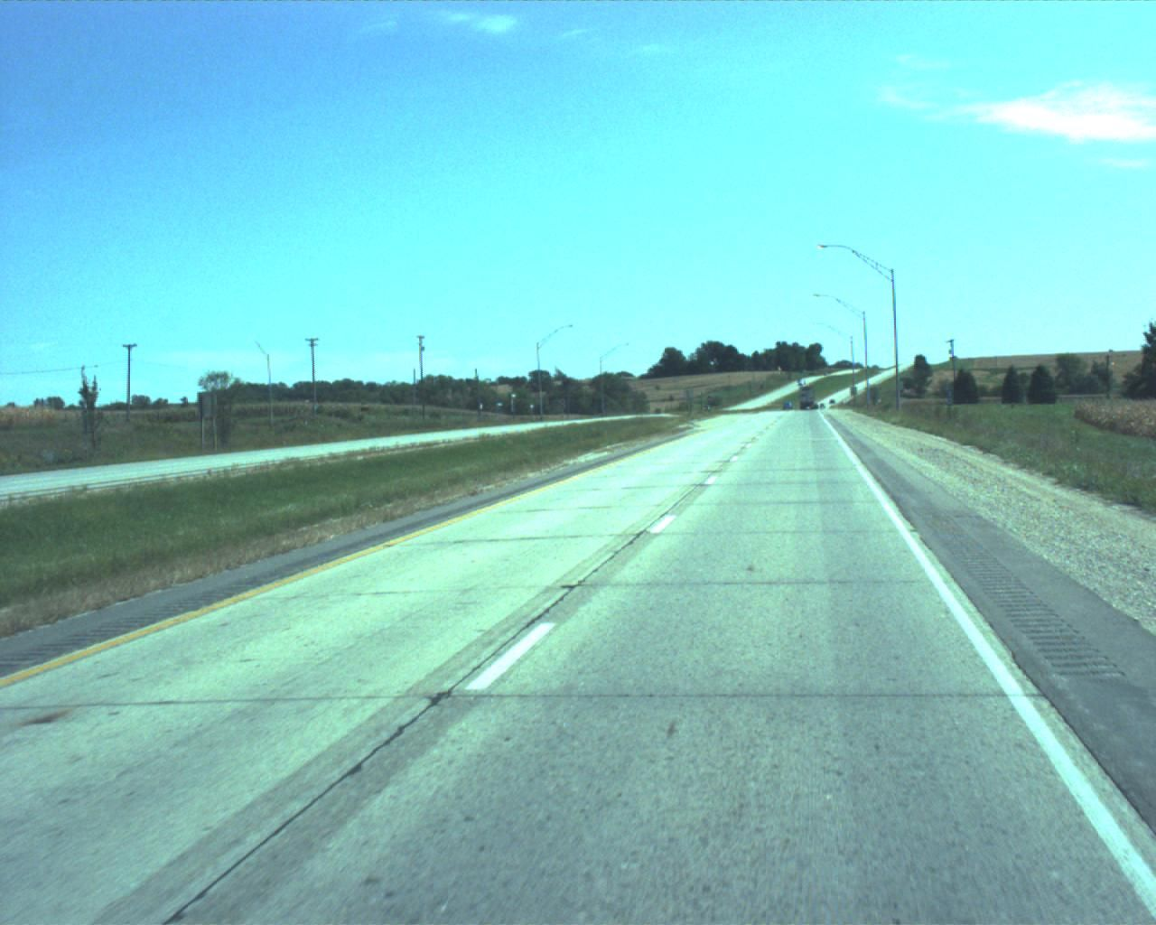
Decision - preservation/rehab
2007 Dowel bar retrofit & diamond grind
Next rehab is likely an asphalt overlay
2007
2023

Slide 28
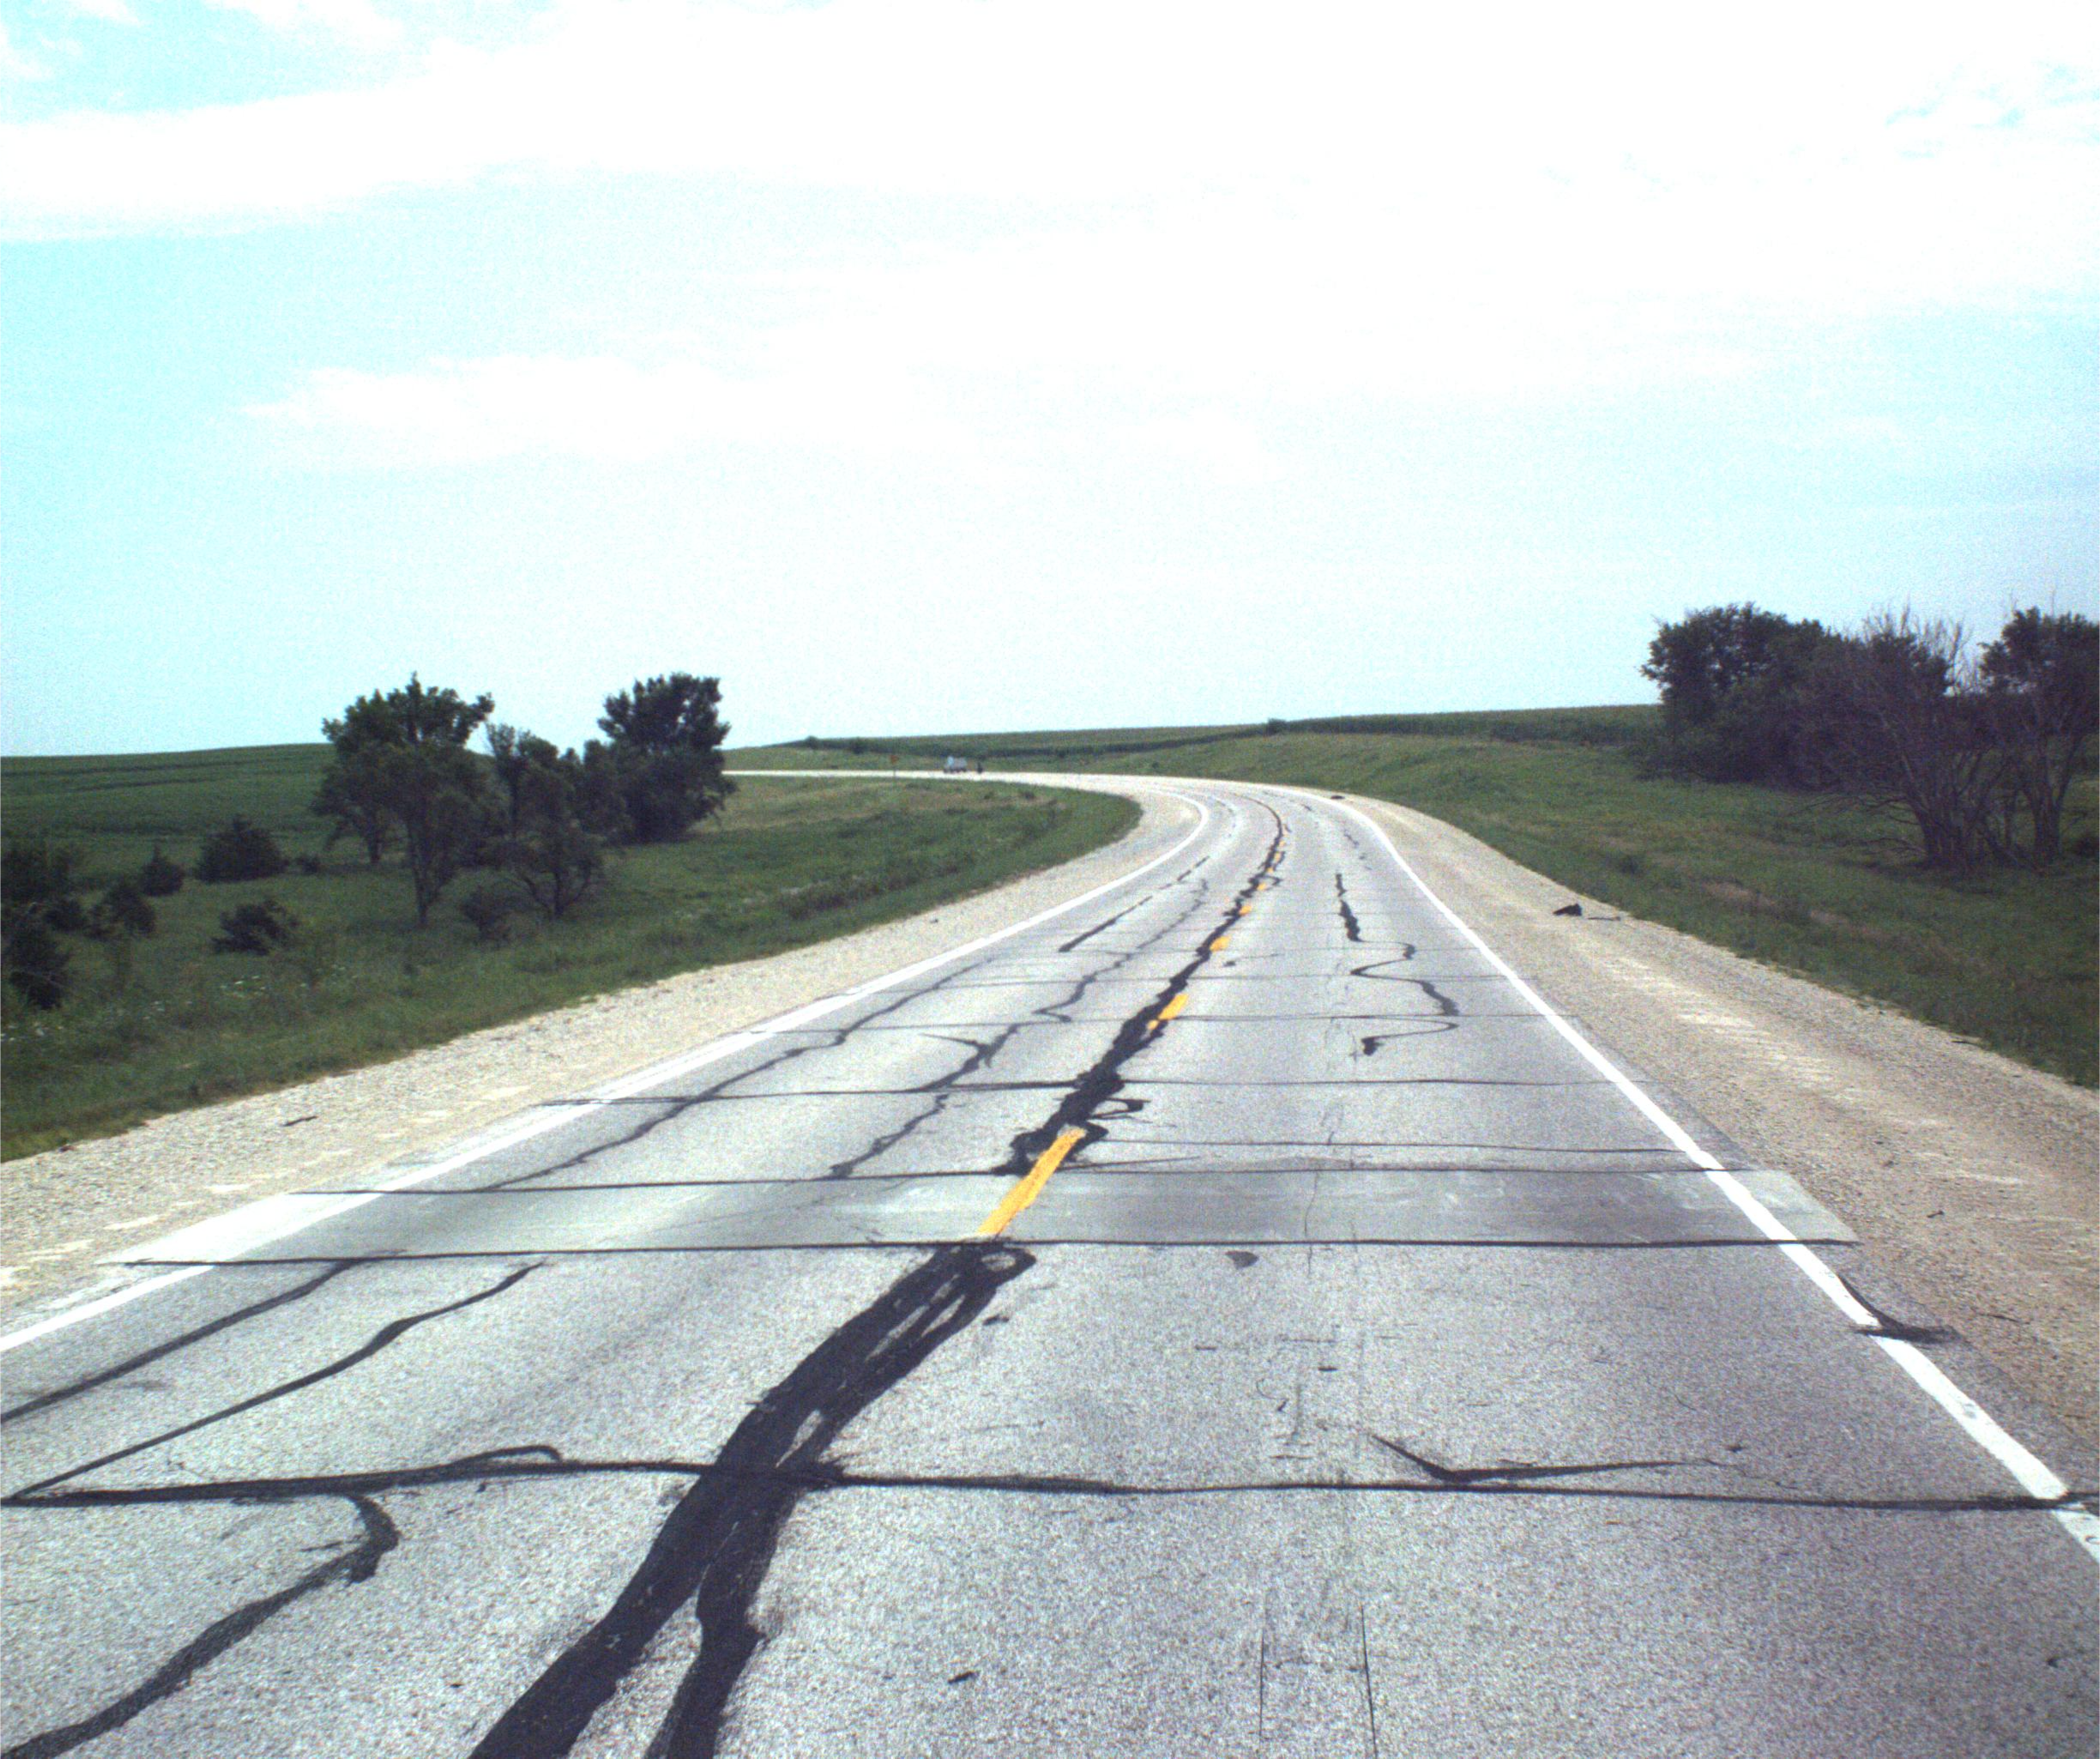
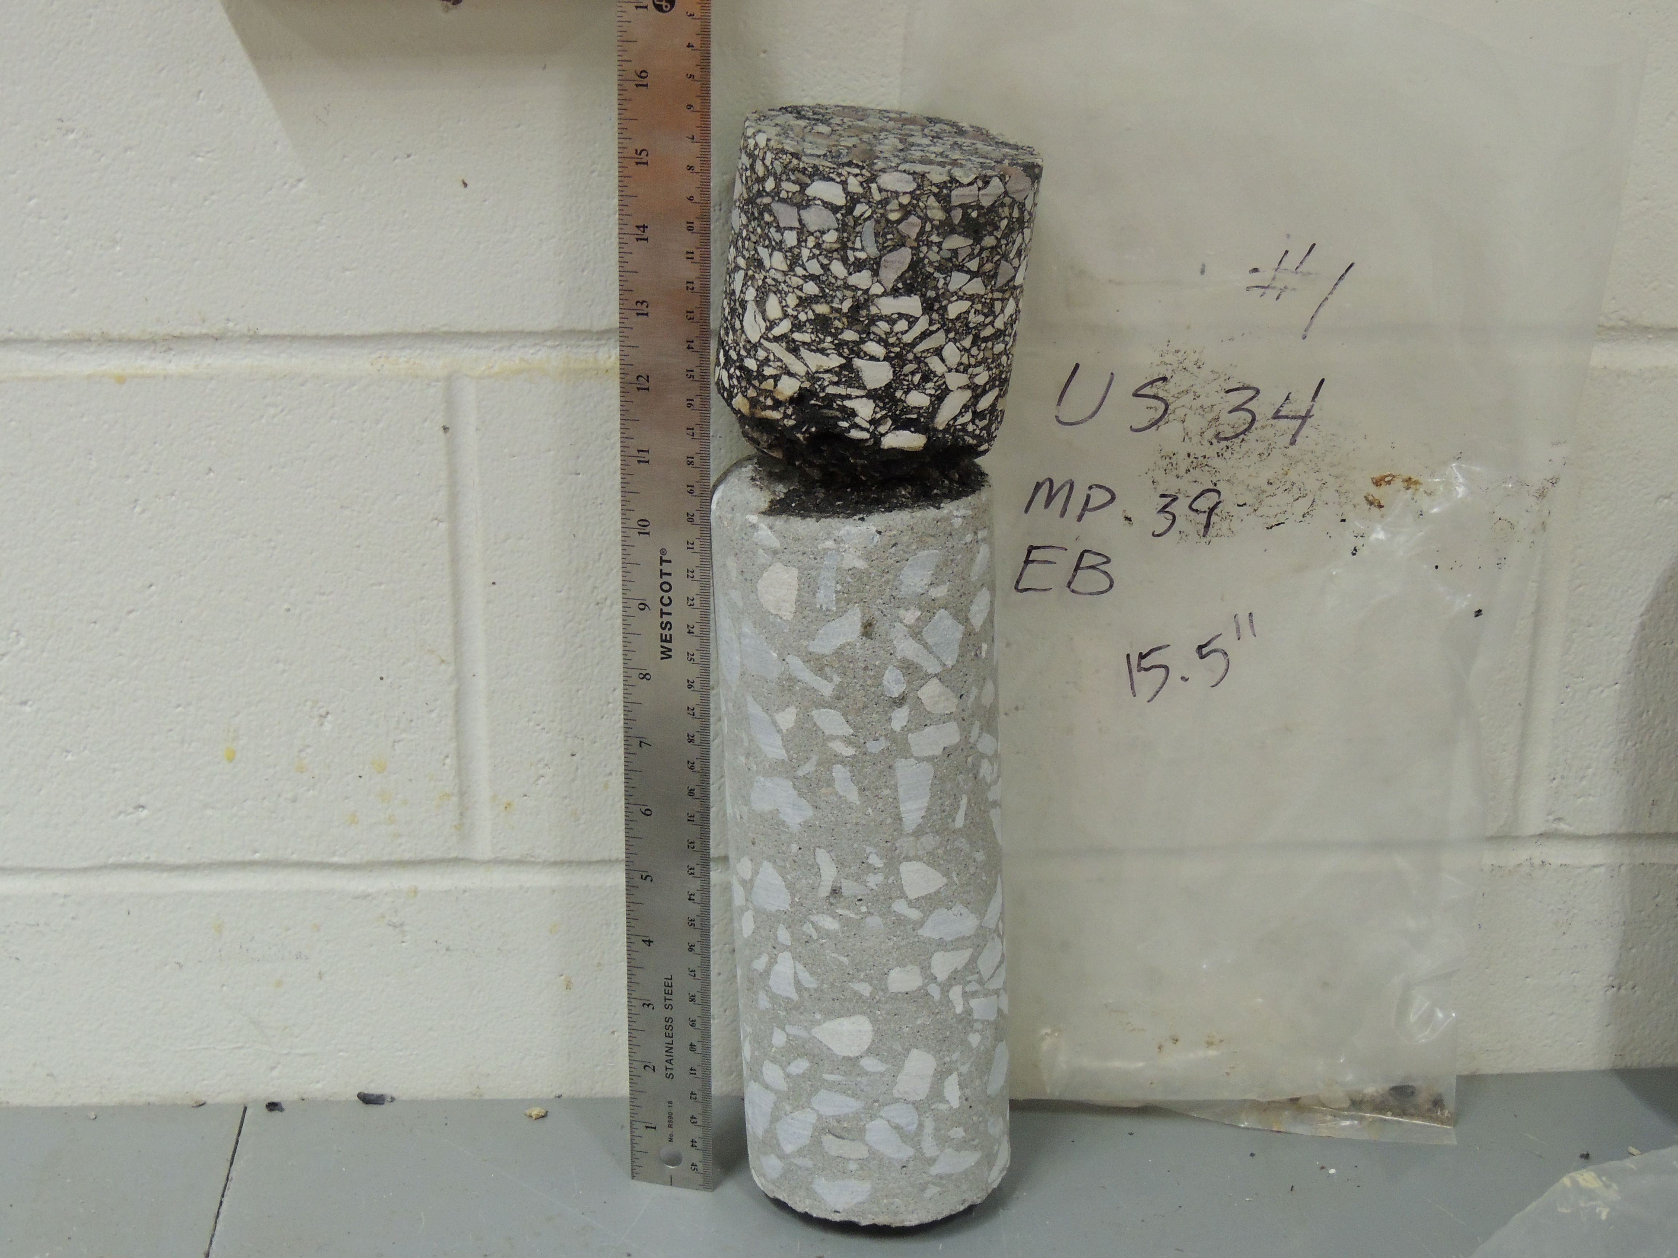
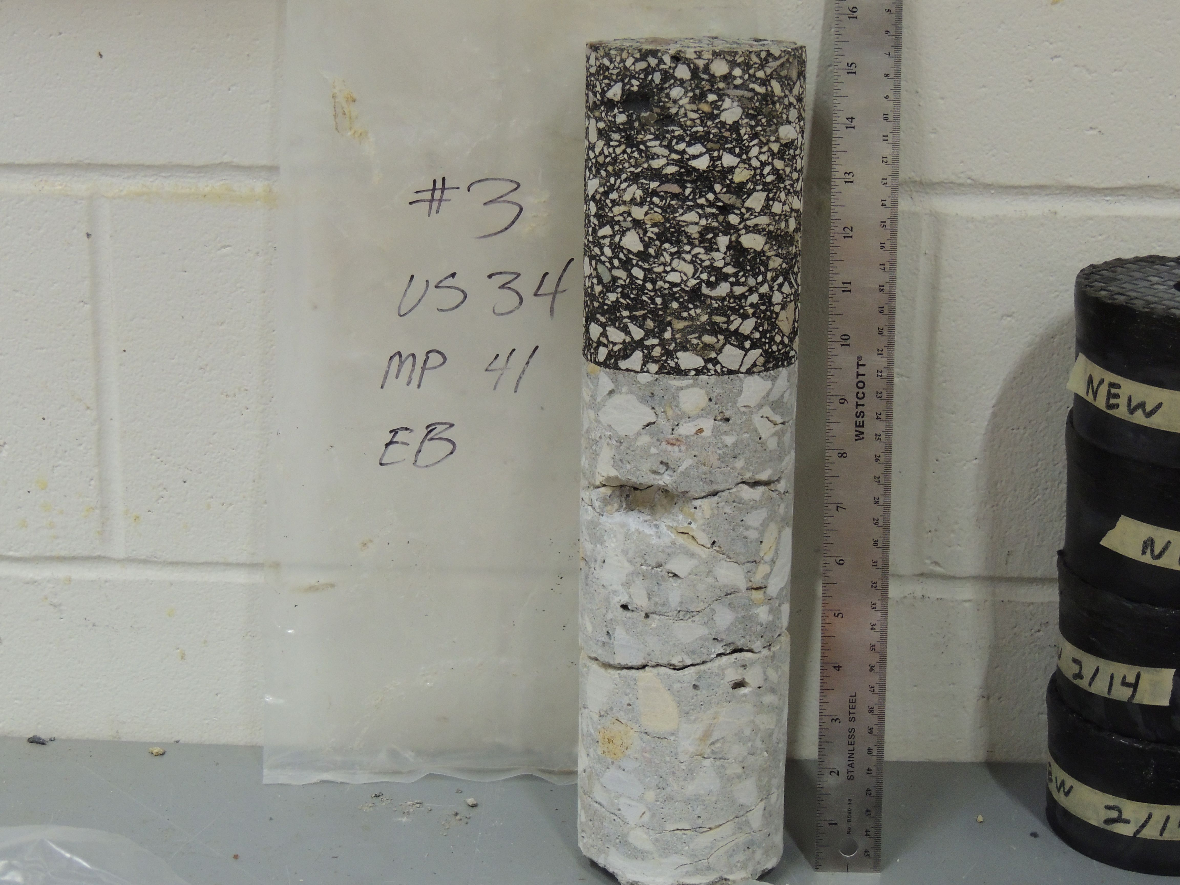
Case history US 34
Condition in 2016
Cracking and rough ride
1965 PC Concrete
1983 asphalt overlay
1998 asphalt overlay
2016

Slide 29
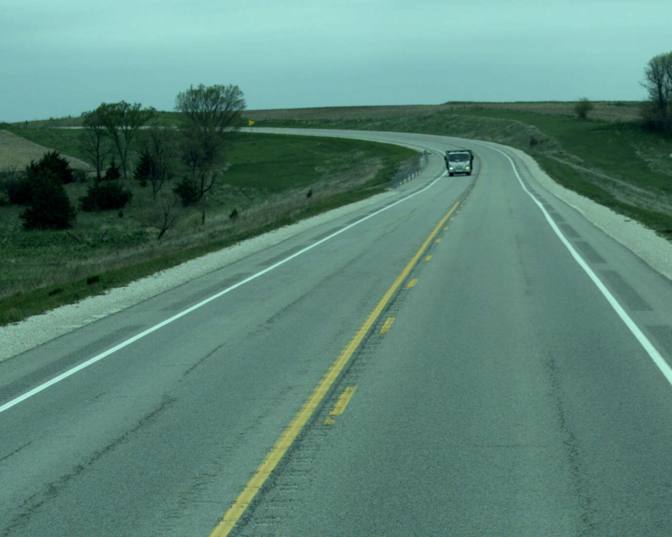
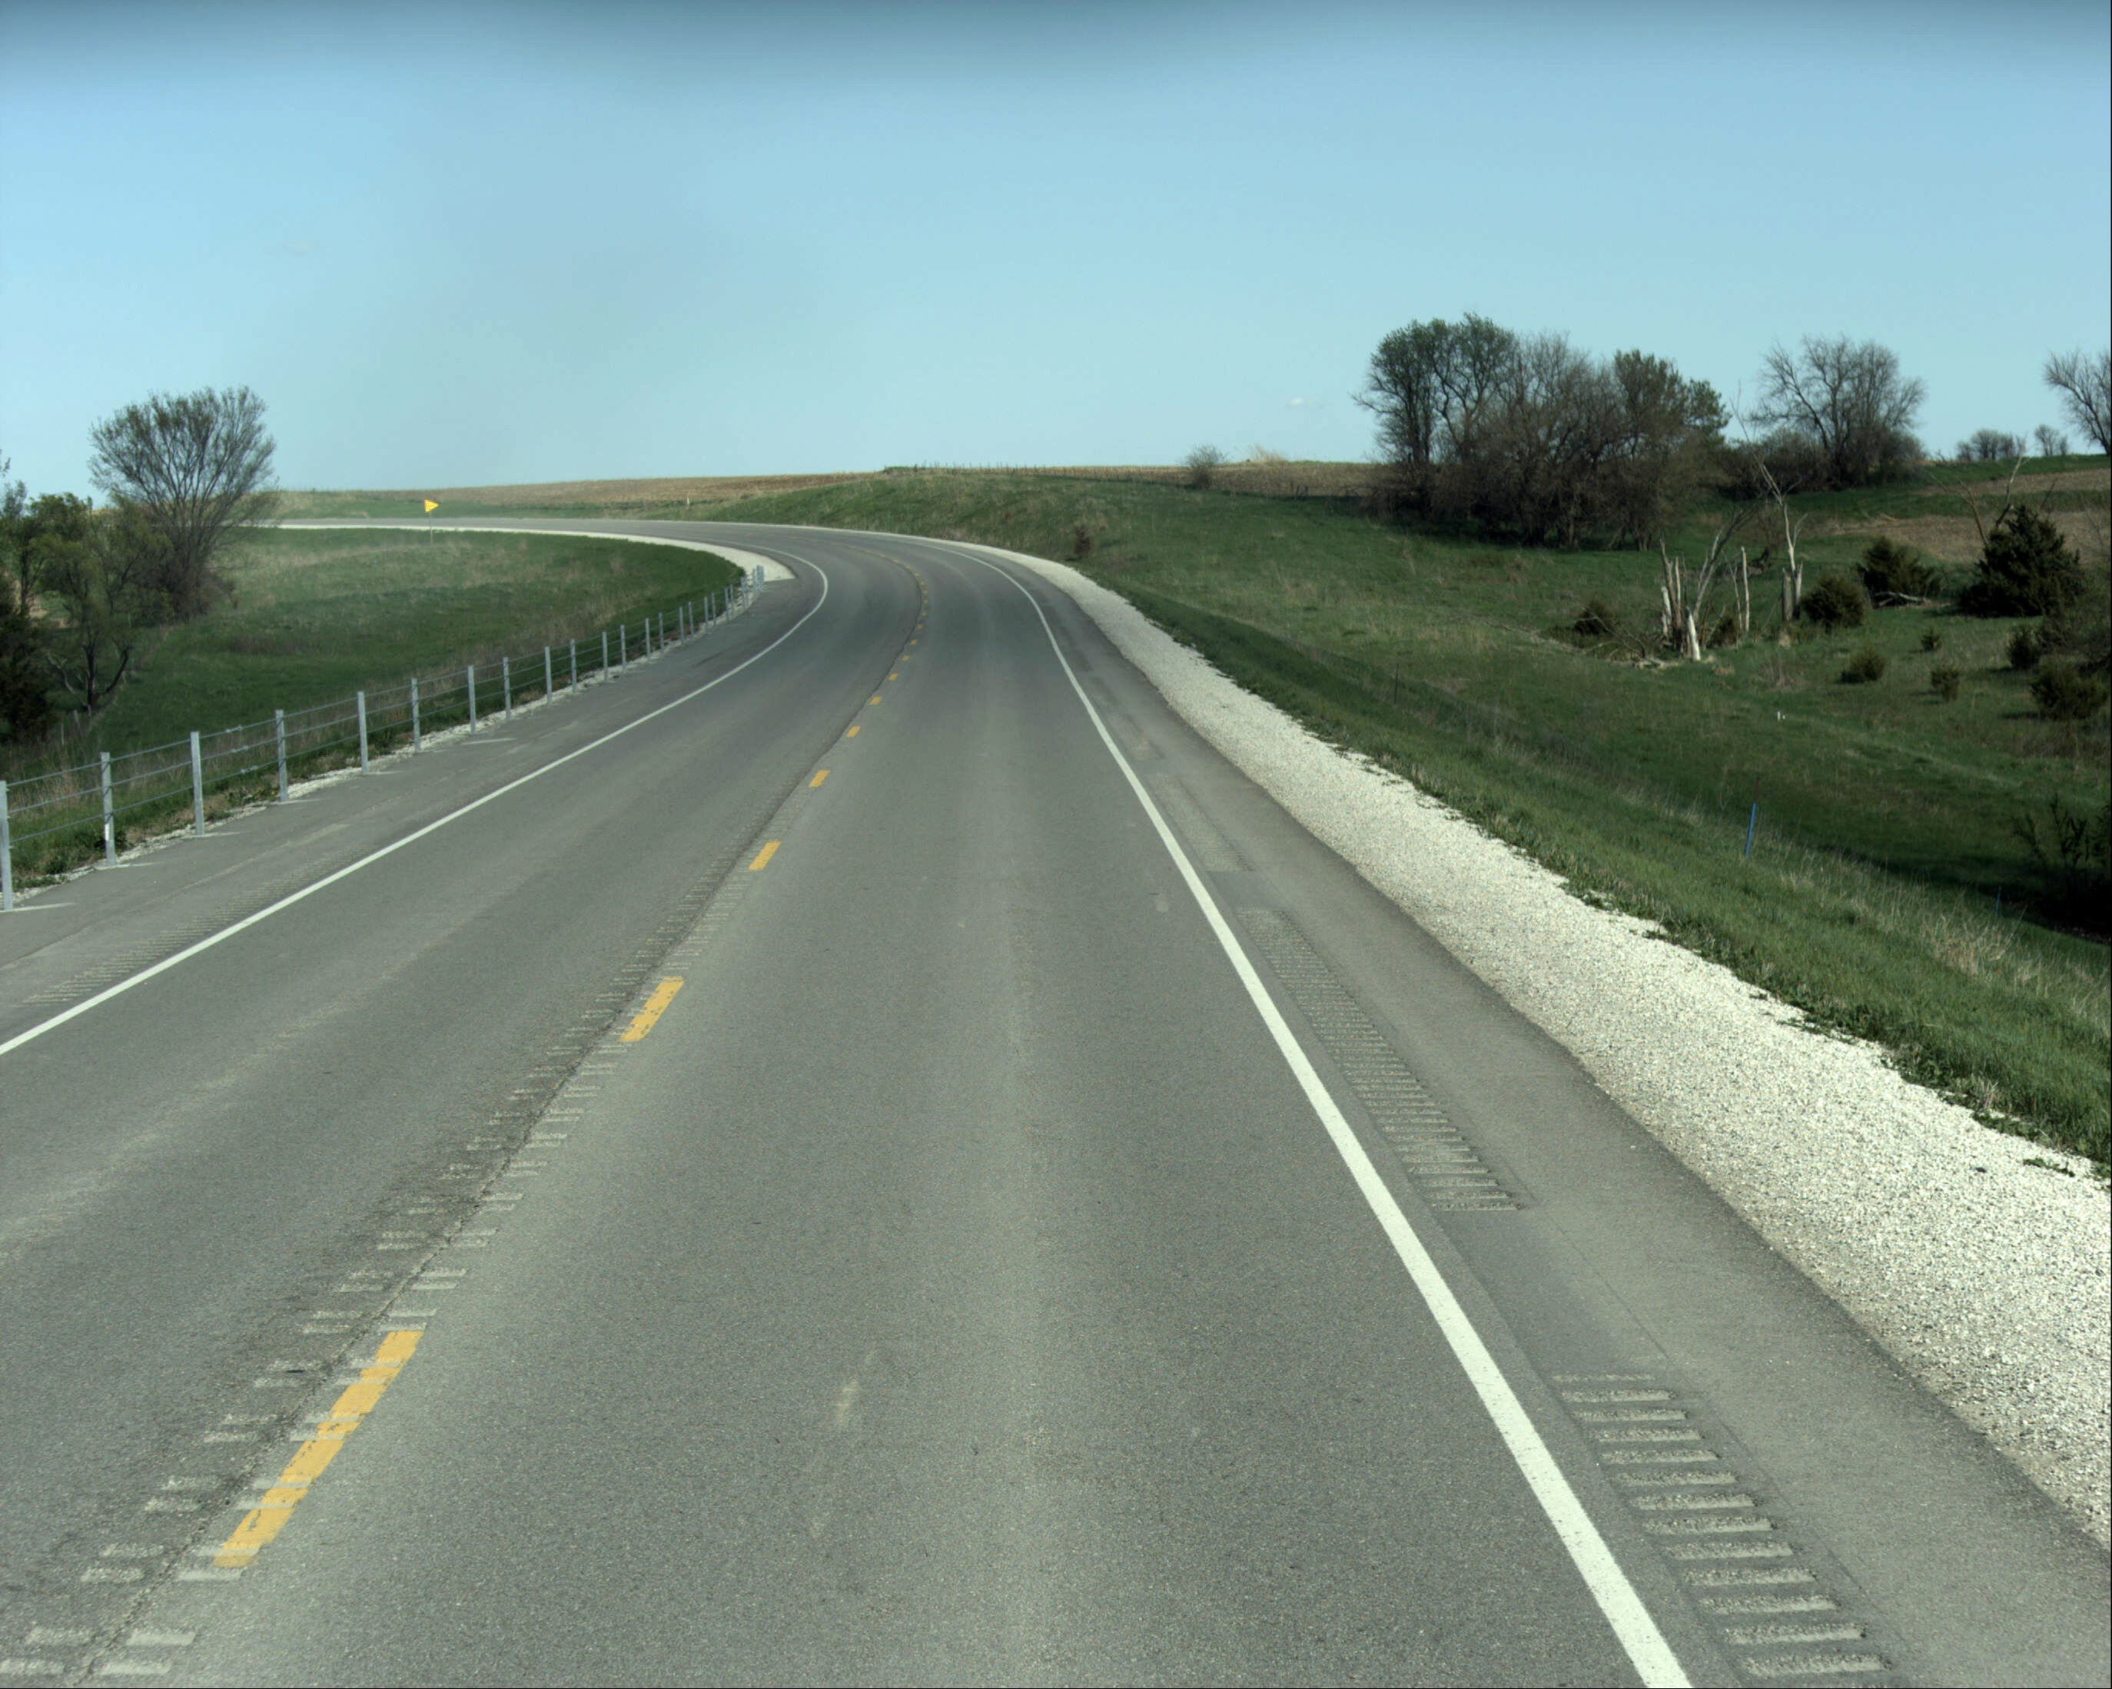
Decision - rehabilitate again
2017 Cold-in-place-recycling w/ asphalt overlay
Next time will require major rehabilitation or possibly reconstruction
2023
2017

Slide 30
Case history IA 14
Condition in 2004
Cracking and rough ride
1972 PC Concrete
2004

Slide 31
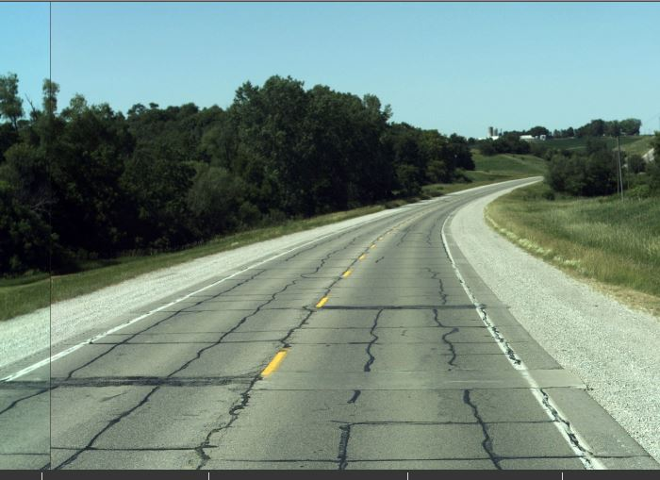
Decision – Rehabilitation (2005)
2005 asphalt overlay
2022

Slide 32
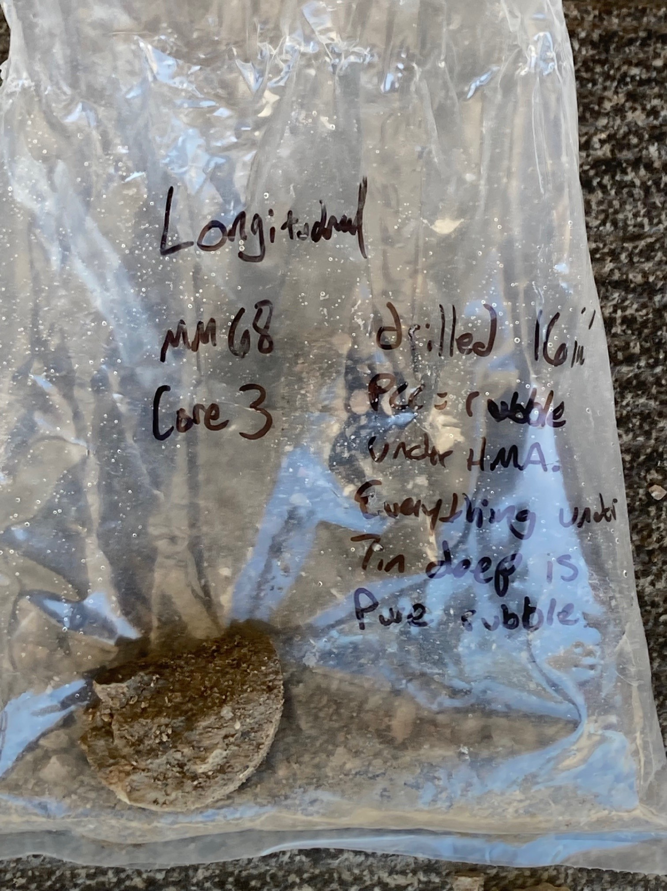
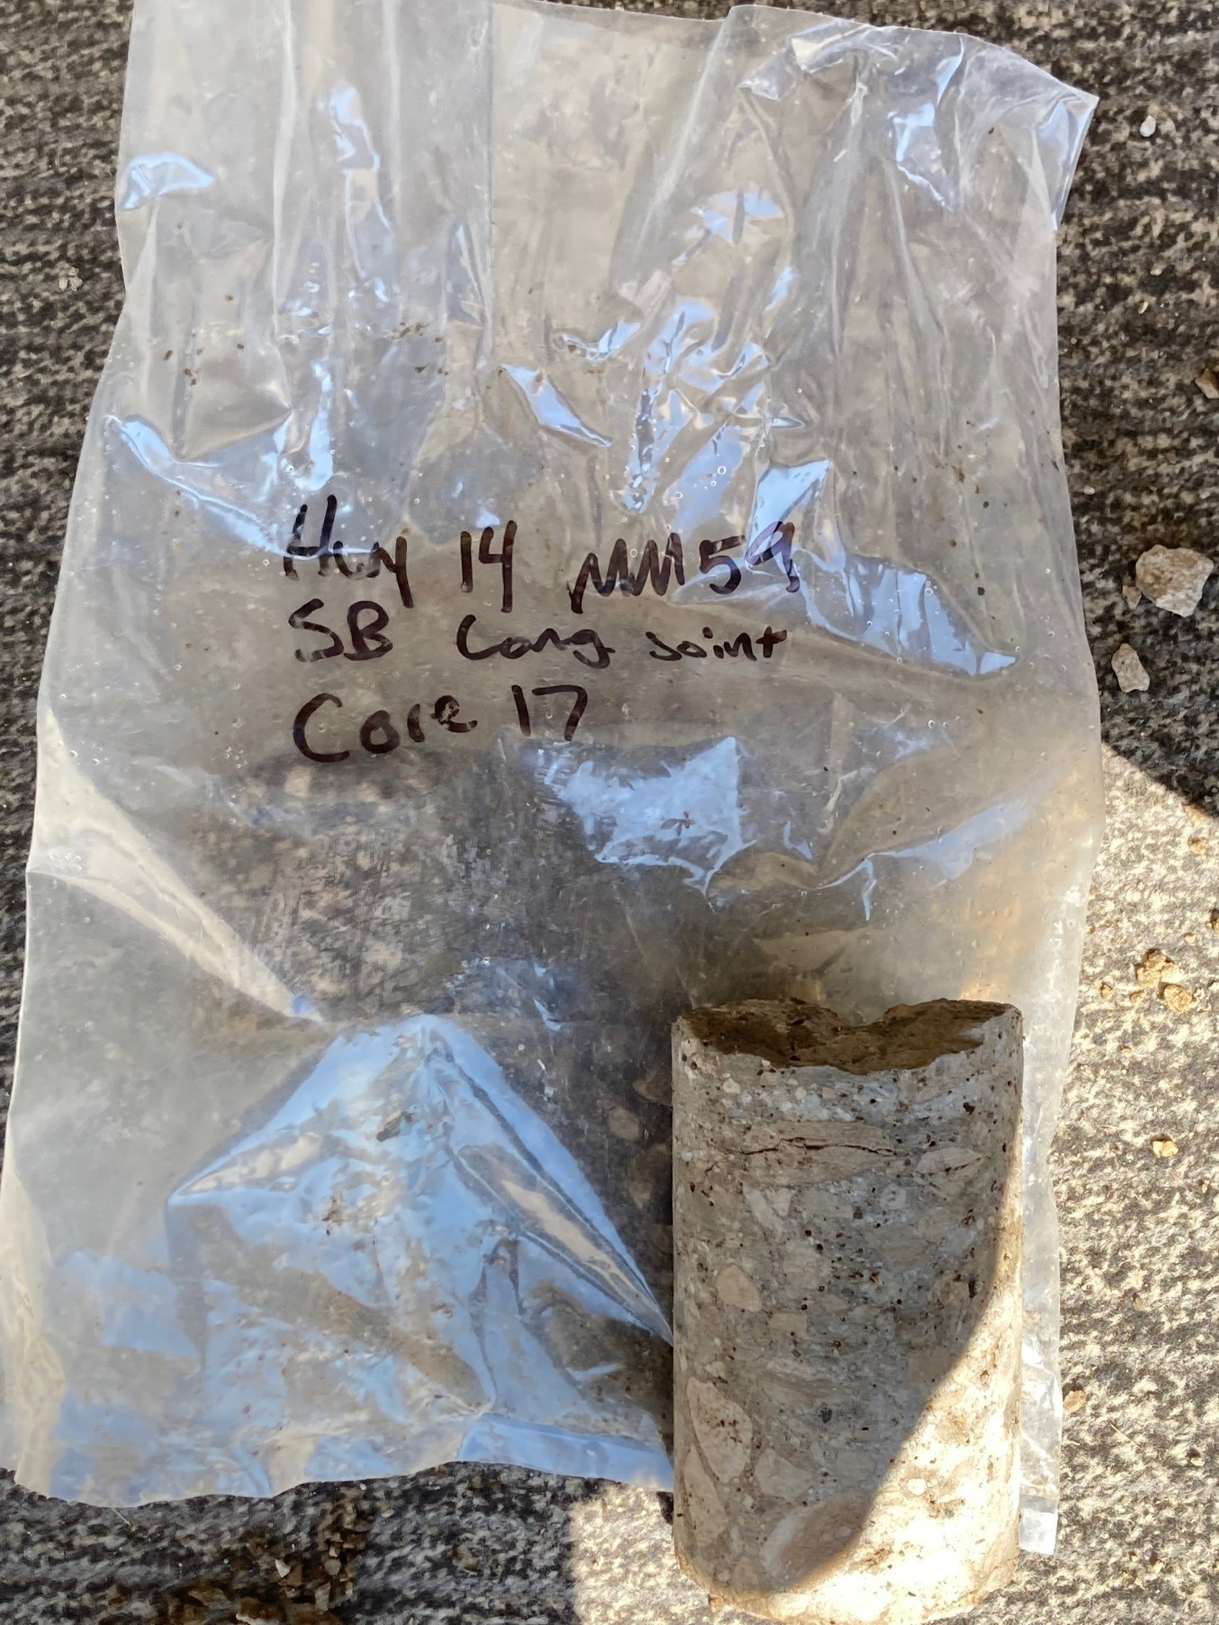
Cores - 2022

Slide 33
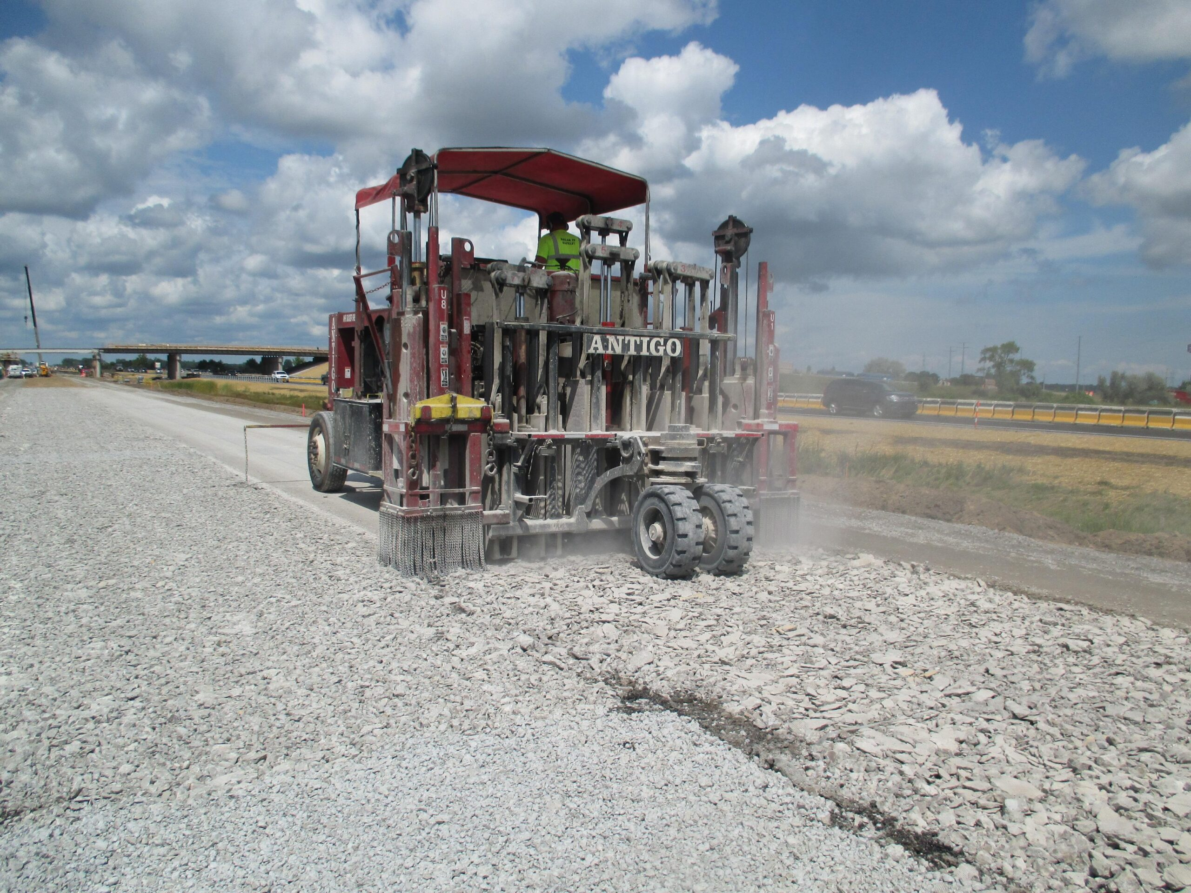
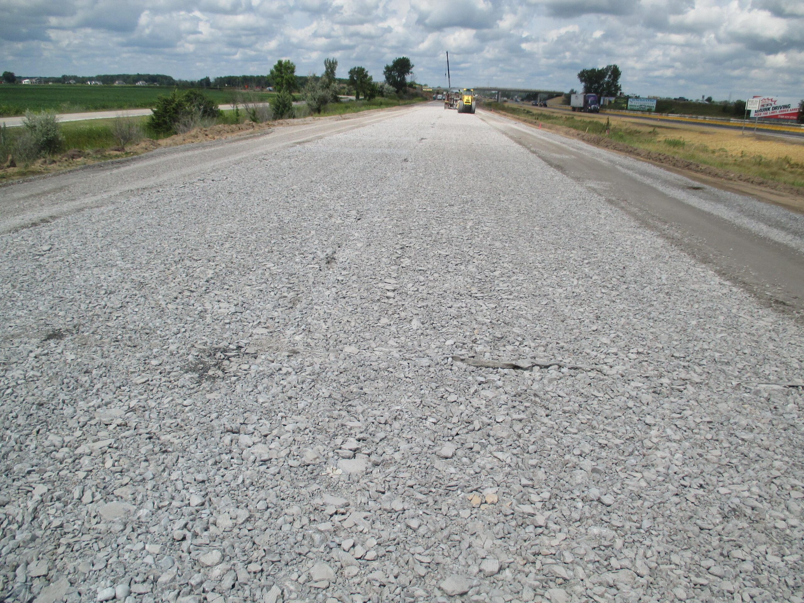
Decision - major rehabilitation
Rubblize existing concrete and place heavy overlay
6.5” thick asphalt overlay
20 year design life with ability to place additional overlays in the future. Similar to new pavement.

Slide 34
Key Take-aways
We have 2 competing goals for pavement funding
Achieve the target 75 PCI condition
Replace pavements on a reasonable cycle to limit risk of our aging system
While short term funding can meet our target condition, the long-term needs for pavement replacement are out pacing our level of investment…….
This is because Iowa’s highway system has been built to the current size over the past 100 years. At this point, the projected funding is not adequate to sustain a system of this size in a state of good repair.
Addressing the need for replacing our aged system will eventually require $310M per year (2023 $) in investment to the Primary system to achieve a 100 year replacement cycle.
This is in addition to the 3R funding already in place.
If additional funding becomes available, use analytics to determine where to direct additional funding between rehabilitation and reconstruction.

