Slide 1
2025-2029 Highway Program Development
Transportation Commission
January 9, 2024

Slide 2
Overview
Highway Program development process
2025-2029 Highway Program development schedule
2024-2028 Highway Program recap
Funding categories
Federal funding status
Program development considerations
Next steps

Slide 3

Highway Program Development Process
Public Policy and Input
What direction do we have?
Transportation Plans
What type of system do we need?
Performance Monitoring
Are we successful?
Five-Year Program
What projects will be done and when?

Slide 4
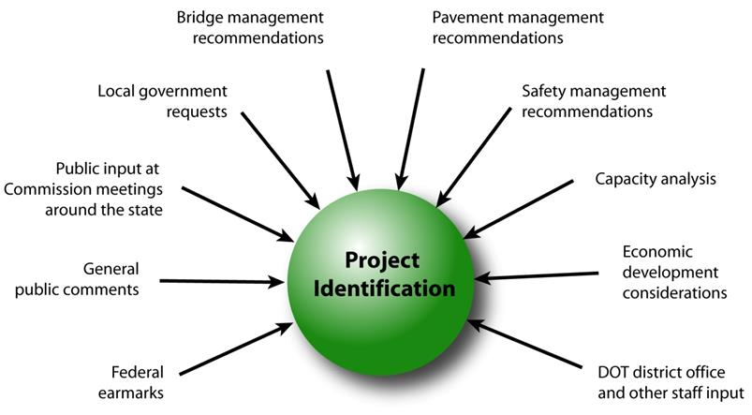
Step 1: Project identification

Slide 5
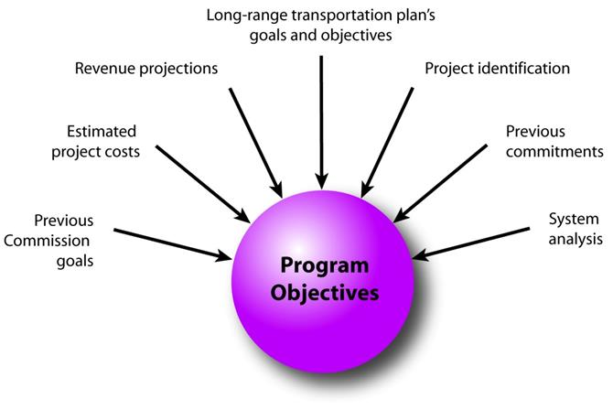
Step 2: Establishing the Transportation Commission’s annual programming objectives

Slide 6
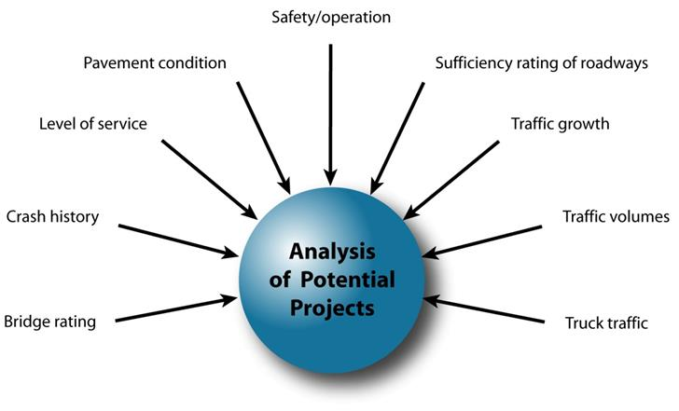
Step 3: Evaluating potential project candidates

Slide 7
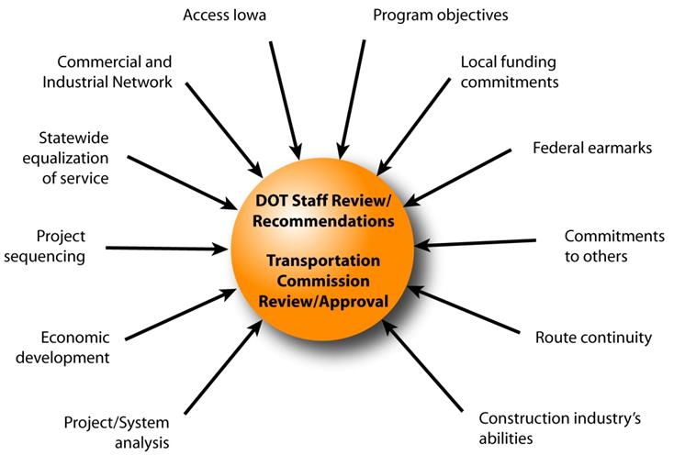
Step 4: Developing the final program

Slide 8
2025-2029 Highway Program Development Schedule
January 2024
Discuss Highway Program Development Process
Discuss 2025-2029 Highway Program Development Schedule
Discuss Program Objectives/Priorities/Considerations
February 2024
Discuss Extended Highway Program Analysis
Discuss Statewide Line Items
At what levels should the line item targets be programmed?
March 2024
Discuss 2025-2029 available Highway Program funding
Discuss 2025-2029 Highway Program Options
Determine 2025-2029 Highway Program Objectives
Action Item: Line Item Targets for Programming
April 2024
Develop the Draft 2025-2029 Highway Program
Action Item: 2025-2029 Highway Program Objectives
May 2024
Present the Draft 2025-2029 Iowa Transportation Improvement Program to the public
(including all previous program approvals and Draft 2025–2029 Highway Program)
June 2024
Action Item: Approve the 2025–2029 Iowa Transportation Improvement Program

Slide 9
2024-2028 Highway Program Recap
Challenges
No additional funding
Increased project cost estimates due to ongoing inflation
FY 2023 negative program balance adjustment
Actions
Prioritized stewardship
Project rescheduling
Project underfunding

Slide 10
Rescheduling Summary
10
Maintains stewardship and safety targets
Currently programmed projects remain in program
No projects delayed more than one year
Includes projects from each District (statewide)
Programmed dollars for projects rescheduled in this scenario make up approximately 8 percent of the total program
Only 12 of the 623 projects in the program are rescheduled in this scenario

Slide 11
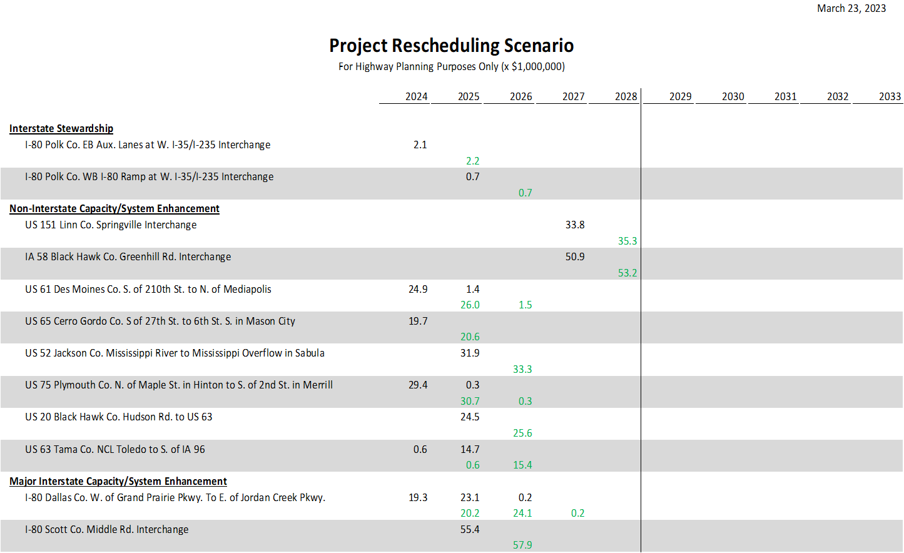
11
April 10, 2023 as presented on March 23, 2023

Slide 12
Underfunded Projects
12
April 10, 2023 as presented on March 23, 2023
Recommendation:
Consider identifying a few projects as not fully funded in the Program.
Identify projects that would have a good opportunity for receiving funding through other sources.
Highlight those projects in the Program to be transparent and indicate they could be delayed if additional funding not received.
Justification:
There are other sources of funding available such as discretionary grants at the federal level.
The Iowa DOT has had success in securing other funding and those opportunities are greater now than in the past.
Showing projects as not fully funded will help those projects compete for funding by demonstrating the critical need for funds.

Slide 14
FY 2024-2028 Highway Program Objectives
Update to shift to the System Objectives of the new State Long Range Transportation Plan
Safety
Maintain increasing funding levels for safety
Sustainability
Maintain increasing Interstate funding levels for pavement reconstruction, modernization, bridges, pavement patching/maintenance, rest areas, and other miscellaneous projects
Maintain increasing funding levels for non-interstate pavement modernization
Maintain increasing funding levels for non-interstate bridge modernization
Invest in additional stewardship projects
Transfer of jurisdiction for portions of primary roadways to cities and counties
Accessibility
Invest in truck parking at Interstate Rest Areas
Invest in corridor improvements
Flow
Invest in intelligent transportation systems infrastructure
Invest in Super-2 improvements
Invest in operational and Integrated Corridor Management improvements

Slide 15
May 9, 2023

Slide 17
Stewardship Funding Categories
Category
Interstate Stewardship
Non-Interstate Pavement Modernization
Non-Interstate Bridge Modernization
Safety Specific
Commission defines targets for these categories for a ten-year period
Commission has focused on increasing these targets
Asset Management presentations are intended to support this process

Slide 18
Interstate Stewardship (4R)
Funds available based on stewardship target.
Funding generally targeted to pavements (2/3) and bridges (1/3).
Several line items that reduce overall target for projects.
Other “off the tops” for Rest Areas and Weigh Station Ramps
Requires coordination with multiple bureaus and Districts.
Seeking opportunity to increase Interstate pavement investment

Slide 19
Non-Interstate Pavement Modernization (3R)
Funding available based on stewardship target.
Allocation to each District based on formula.
Starting in 2027 an additional $35 m in 3R funding is available for reconstruction projects.
Seeking opportunity to increase investment

Slide 20
Non-Interstate Bridge Modernization (BR)
Funding available based on stewardship target.
Significant increase in target over past several years.
Recommended projects determined by Bridges and Structures Bureau.

Slide 21
Safety Specific (SR)
Funds available based on stewardship targets.
Recommended projects selected by Traffic and Safety Bureau.
Some funding used on 3R projects (paved shoulders).

Slide 22
Non-Interstate Capacity/System Enhancement (NR)
Non-stewardship funding category
Capacity to add projects based on overall funding available after deduction for stewardship targets and consideration of Major Interstate project additions.
Recommended projects selected from Highway Candidates list.

Slide 23
Major Interstate Capacity/System Enhancement (MI)
Non-stewardship funding category.
While not a stewardship category, projects do include stewardship benefits.
Primarily driven by Interstate Plan (I3P).

Slide 24
Federal Funding Status
Infrastructure Bill authorizes federal funding through September 30, 2026, leaving some funding uncertainty for the last three years of this Program.
Infrastructure Bill funding allocations based on Commission action in June 2022.
The next Highway Trust Fund cliff is in FFY 2028

Slide 25
Program Development Considerations
Construction cost inflation is moderating
State road funding continues to come in higher than forecast
The last three years of federal funding in this Program are not part of an authorization
Continue to prioritize bridge and pavement stewardship investments on existing highway system
Assess balance of pavement and bridge stewardship investments
Balance capacity improvements with stewardship needs
Address major river crossing needs

Slide 26
Next Steps
Discuss Extended Highway Program Analysis
Discuss Statewide Line Items
At what levels should the line item targets be programmed?

Slide 27
Questions?

