Slide 1
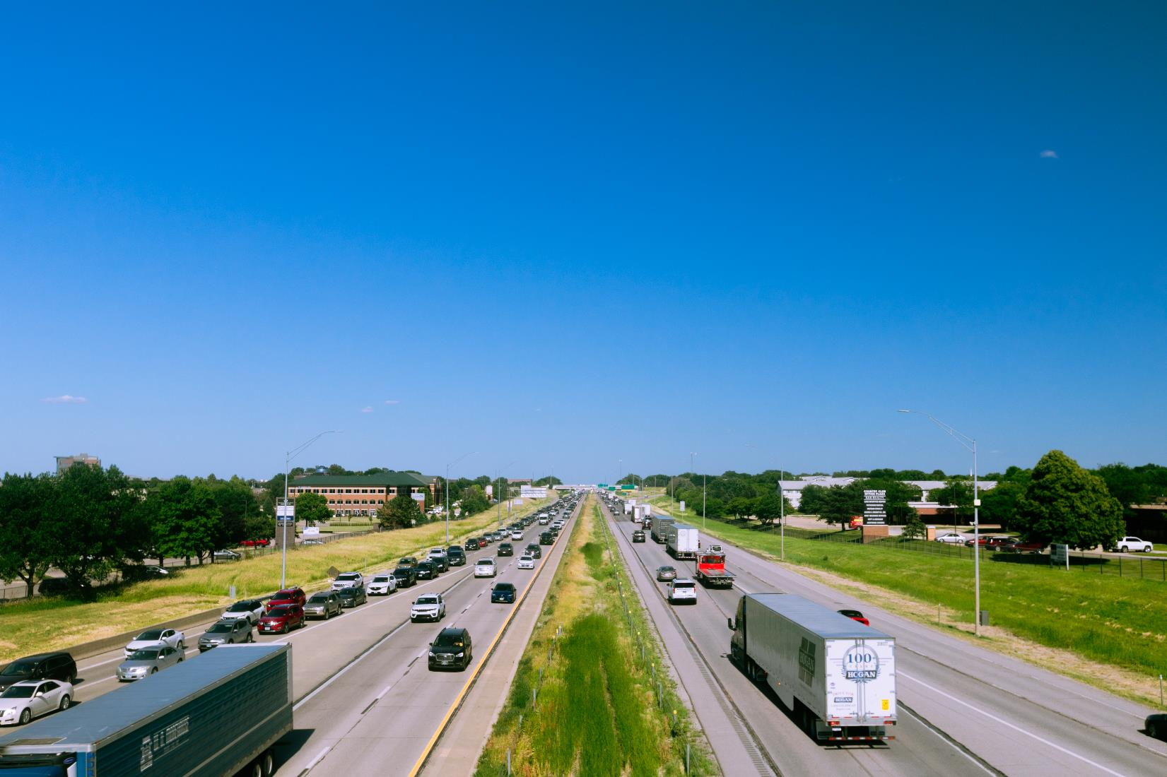
FY 2025 Highway Program Balance Report
January 21, 2025
3/2/2023

Slide 2
Receipts / Costs
Revenue
Forecast PRF Receipts (November) $399.1m
Actual PRF Receipts (November) $402.8m
Lettings
Programmed Amounts (December) $601.9m
Project Costs (December) $548.9m

Slide 3
Balance
FY 2025 Program Balance (August 2024) ($45.2m)
November PRF Receipts Difference $3.7m
December Project Letting Difference $53.0m
Program Balance (December 2024) $11.5m
Previous Balance Reported: ($4.4m)
FY 2025 Highway Program Balance Overview

Slide 4
Fiscal Year 2025 Overview
Revenue: Expect monthly revenue fluctuations.
Lettings:
Approximately sixty-one percent of the FY 2025 Program has been awarded.
The December letting was approximately $100 million.
Next letting scheduled for January 21, 2025.

Slide 5
Possible 2025 Commission Tour Routes
I O W A
STATE HIGHWAY MAP
Prepared by the
9
75
9
⁶⁰ 59
9
86
71
4
15
169
69
35
65
218
63
139
52
76
26
18
182
75
9
9
9
27
9
9
18
60
59
15
169
9
9
218
9
9
52
9
18
71
4
69
122
65
218
52
51
76
In Conjunction with
United States Department of Transportation
10
75
60
18
18
18
¹⁸ 27
14
18
63
24
18
76
10
10
150
18
18
April-Sioux Center
52
60
10
71
4
169
17
35
65
27
218
346
63
18
56
18
13
128
52
January 1, 2015
12
3
75
59
10
15
14
188
188
93
56
0
10 20 30
40
3
3
3
3
3
3
3
63
3
150
187
13
0
Miles
10 20 30 40 50
12
140
7
3
65
14
27
281
3
3
52
Kilometers
29
75
140
31
59
110
143
7
169
17
69
35
218
150
187
13
38
52 ₃
61
151
77
129
75
20
20
20
20
4
7
20
57
57
281
136
32
20
71
175
20
20
20
20
14
20
58
175
27
20
20
38
20
136
20
29
31
196
169
17
65
21
380
13
151
151
52
141
175
39
175
175
175
175
63
8
218
218
150
27
61
62
52
175
141
59
30
71
4
144
169
17
69
35
330
14
96
380
13
136
64
52
65
218
October-Clinton
175
37
141
30
30
30
63
21
151
64
136
64
64
67
29
37
25
144
169
30
69
30
146
30
30
30
30
1
38
30
61
136
136
30
183
30
30
59
141
71
141
210
330
63
212
220
151
₂₇ 218
130
30
37
4
141
141
415
160
65
117
14
224
6
6
151
380
1
61
67
29
127
44
191
44
44
44
415
330
80
117
6
80
63
80
80
38
6
130
30
30
173
25
6
163
14
146
85
21
149
27
6
61
280
67
80
80
80
80
146
22
1
218
22
70
38
67 74
29
680
80
59
83
6
83
6
25
³⁵ 28
65
69
5
316
14
163
21
22
92
22
280
6
680
6
148
92
92
163
92
92
92
70
61
192
6
71
June-Des Moines
92
92
6
80
92 ²⁷⁵
92
92
92
169
92
92
23
21
149
1
29
59
48
71
148
25
⁶⁹ 65
14
5
149
78
1 78
27
61
34
34
34
34
34
34
137
63
218
78
275
34
169
5
34
34
34
61
59
48
148
August-Corning
14
63
16
1
27
2
71
25
35
69
65
98
16
16
34
29
2
2
2
2
2
2
218
61
2
333
₂₉ 275
69
35
69
2
81
2
61
Interstate Highways
80
59
71
148
169
65
5
202
63
27
218
61
U.S. Highways
65
27
136
State Highways
Unsigned State Highways
78
61 ¹³⁶
102

Slide 6
Questions?

