Slide 1
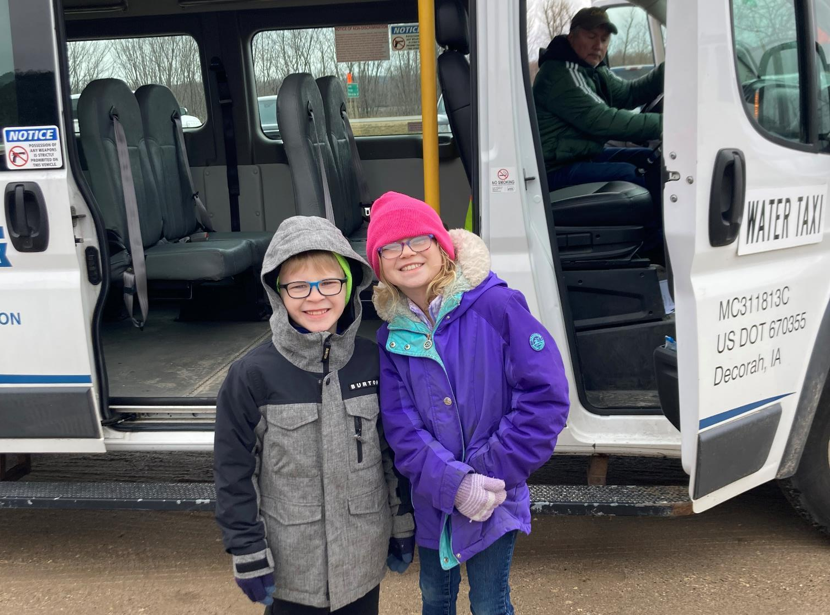
FY 2026 State Transit Assistance
Special Project Applications
3/2/2023
Kristin Haar
Public Transit Director
Commission Workshop January 21, 2025

Slide 2
State Transit Assistance Special Project Program
$600,000 set aside from State Transit Assistance funds annually to fund training fellowships ($175,000) and special projects ($425,000).
After consulting with Iowa’s public transit agencies in Spring 2024, the total amount of State Transit Assistance funds set aside annually for special projects and large urban training fellowships was increased from $300,000 to $600,000. This allows for more training opportunities for large urban transit systems, more flexibility to fund projects of statewide transit significance, and greater ability to fund pilot projects and studies.
All 35 designated Iowa public transit systems are eligible to apply. Iowa Public Transit Association also may apply for projects benefiting all public transit agencies.
Notes:
The Public Transit Infrastructure Grant Program (PTIwas created in 2006 by the General Assembly. This program funds vertical infrastructure projects for public transit. All 35 transit systems are eligible. Projects can involve new construction, reconstruction or remodeling.

Slide 3
Special Projects are extraordinary, emergency, or innovative in nature and may include but are not limited to:
Expanding the scope of planning, managerial, or technical expertise.
Increasing the public’s awareness and understanding of transit.
Enhancing the capacity for administration consolidation and service coordination.
Reducing impediments to intramodal or intermodal transfers.
Increasing the cooperation and coordination between private and public sectors.
Developing, demonstrating, or refining a technical, procedural, or mechanical innovation that may be utilized by other public transit systems in Iowa.
Responding to an emergency situation that places an extraordinary and unforeseen strain on the resources of a public transit system.
Notes:
For this program, no more than 40-percent of the appropriation can be awarded to an individual transit system. The PTIG share is up to 80 percent of the project cost. The structural integrity of existing facilities, potential safety enhancements to existing facilities, as well as new facilities that will enhance the life of the transit fleet or optimize service are project considerations. Projects should be “shovel ready” and capable of completion within 18 months. Projects may include but are not limited to facilities for the administration of public transit operations, facilities for servicing, maintenance or storage of public transit vehicles, transit vehicle fueling facilities, bus wash bays, passenger waiting facilities.

Slide 4
Program Details:
Grants can include projects which support transit services developed in conjunction with human service agencies or local community partners or statewide projects to improve public transit in Iowa.
Projects are intended to assist with start-up of new services that have been identified as needs by health, employment or human service agencies or other community partners.
Statewide projects may be used on transit marketing and projects exploring new transit technologies.
Operating and small capital projects are eligible for funding up to a maximum of 50% state participation for two years. Vehicles and facilities are not eligible under this program.
Notes:
For this program, no more than 40-percent of the appropriation can be awarded to an individual transit system. The PTIG share is up to 80 percent of the project cost. The structural integrity of existing facilities, potential safety enhancements to existing facilities, as well as new facilities that will enhance the life of the transit fleet or optimize service are project considerations. Projects should be “shovel ready” and capable of completion within 18 months. Projects may include but are not limited to facilities for the administration of public transit operations, facilities for servicing, maintenance or storage of public transit vehicles, transit vehicle fueling facilities, bus wash bays, passenger waiting facilities.

Slide 5
Program Details (continued):
One project per transit system at a time is allowed.
Priority is given to projects which include a financial contribution from human service agencies or community partners.
Applications due October 1. Projects begin July 1 of the following fiscal year. Up to two years of funding may be requested.
Notes:
For this program, no more than 40-percent of the appropriation can be awarded to an individual transit system. The PTIG share is up to 80 percent of the project cost. The structural integrity of existing facilities, potential safety enhancements to existing facilities, as well as new facilities that will enhance the life of the transit fleet or optimize service are project considerations. Projects should be “shovel ready” and capable of completion within 18 months. Projects may include but are not limited to facilities for the administration of public transit operations, facilities for servicing, maintenance or storage of public transit vehicles, transit vehicle fueling facilities, bus wash bays, passenger waiting facilities.

Slide 6
Special Project application evaluation criteria:
Financial contribution from human service agency(ies) or community partners.
Demonstration of Need.
Demonstration of Benefits.
Demonstration of Coordinated Transportation.
Addressing Long Range Public Transit Needs.
Notes:
For this program, no more than 40-percent of the appropriation can be awarded to an individual transit system. The PTIG share is up to 80 percent of the project cost. The structural integrity of existing facilities, potential safety enhancements to existing facilities, as well as new facilities that will enhance the life of the transit fleet or optimize service are project considerations. Projects should be “shovel ready” and capable of completion within 18 months. Projects may include but are not limited to facilities for the administration of public transit operations, facilities for servicing, maintenance or storage of public transit vehicles, transit vehicle fueling facilities, bus wash bays, passenger waiting facilities.

Slide 7
Available Funding and Application Summary
Annual appropriation: $425,000
Underrun/withdrawals: $106,622
Funds available: $531,622
Total number of projects: 6
Total project costs: $1,263,757
Total amount requested: $654,616
Notes:
The PTIG annual appropriation for FY25 is $1.5 million. There are $220,923 in underrun/withdrawal funds to add to the annual appropriation totaling $1,720,923 in available funding. Five projects were submitted totaling $2,427,000 in federal, state, and local project costs. The total amount of PTIG requested is $1,873,600.

Slide 8
FY 2026 Iowa DOT-sponsored Projects
Project Name | Sponsor | Total Project Cost | Requested Amount (% of Total Project Cost) | Recommended Amount (% of Total Project Cost)
Discretionary Bus Program grant project administration (FY22 and FY23 Awards) | Iowa DOT | $315,000 | $63,000 (20%) | $63,000 (20%)
General Transit Feed Specification Contractor | Iowa DOT | $77,500 | $77,500 (100%) | $77,500 (100%)
Iowarideshare.org Ridematching software | Iowa DOT | $42,000 | $42,000 (100%) | $42,000 (100%)
Notes:
Four projects were recommended for Award. The first project is Heat Pump Condenser Water Piping Replacement Project for Sioux City Transit. It has a total project cost of $835,000, with a requested and recommended funding amount of $600,000 or 72% of the total project cost. The second project is a Two Bay Parking Garage for Indoor Storage of Winnebago County Transit and Forest City Transit buses. The total project cost is $625,000, with a requested and recommended amount of $500,000 or 80% of the total project cost. The third project is Bus Storage Facility for River Bend Transit The total funds requested is $137,000 with a requested and recommended amount of $109,600 or 80% of the total project cost. The fourth project is Phase 1: Bus Storage Fire Mitigation Upgrade for Ames Transit Agency. The total project costs is 750,000 with a requested amount of $600,000 and recommended amount of $511,323.

Slide 9
FY 2026 Competitive Applications Recommended
Project Name | Sponsor | Total Project Cost | Requested Amount (% of Total Project Cost) | Recommended Amount (% of Total Project Cost)
Trip Connect – North Johnson County (Year 2) | Corridor Rides, Region 10 | $350,025 | $175,000 (49.9%) | $175,000 (49.9%)
Quad Cities Municipal Transit Route Study | Davenport | $250,000 | $185,000 (74%) | $125,000 (50%)
Notes:
Four projects were recommended for Award. The first project is Heat Pump Condenser Water Piping Replacement Project for Sioux City Transit. It has a total project cost of $835,000, with a requested and recommended funding amount of $600,000 or 72% of the total project cost. The second project is a Two Bay Parking Garage for Indoor Storage of Winnebago County Transit and Forest City Transit buses. The total project cost is $625,000, with a requested and recommended amount of $500,000 or 80% of the total project cost. The third project is Bus Storage Facility for River Bend Transit The total funds requested is $137,000 with a requested and recommended amount of $109,600 or 80% of the total project cost. The fourth project is Phase 1: Bus Storage Fire Mitigation Upgrade for Ames Transit Agency. The total project costs is 750,000 with a requested amount of $600,000 and recommended amount of $511,323.

Slide 10
FY 2026 Competitive Applications
Projects Not Recommended For Award
Project Name | Sponsor | Total Project Cost | Requested Amount (% of Total Project Cost) | Recommended Amount (% of Total Project Cost)
Grimes Connect: Inclusive Paratransit & Door to Door service | Heart of Iowa Regional Transit Agency, Region 11 | $229,232 | $112,116 (48.9%) | $0
Notes:
There was one application not recommended for funding – Paved Parking Lot from Southeast Iowa Regional Planning Commission.

Slide 11
Recommended Project Funding Summary
Total number of projects: 6
Total amount requested: $654,616
Funds available: $531,622
Projects recommended for funding: 5
Recommended funding amount: $482,500
Remaining balance: $49,122
Notes:
The PTIG annual appropriation for FY25 is $1.5 million. There are $220,923 in underrun/withdrawal funds to add to the annual appropriation totaling $1,720,923 in available funding. Five projects were submitted totaling $2,427,000 in federal, state, and local project costs. The total amount of PTIG requested is $1,873,600.

Slide 12
Questions?
Kristin Haar
515-233-7875
Kristin.Haar@iowadot.gov​
iowadot.gov
For more information on Iowa’s public transit and intercity bus programs, visit
www.iowadot.gov/transit

