Slide 1
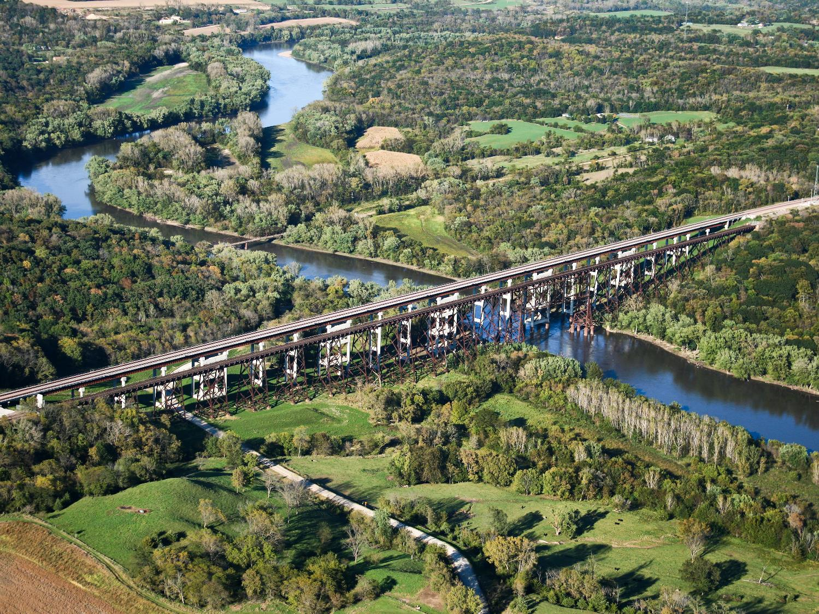
State Transportation Plan
Implementation Update
3/2/2023
Sam Hiscocks
Planning Team Leader
January 21, 2025

Slide 2
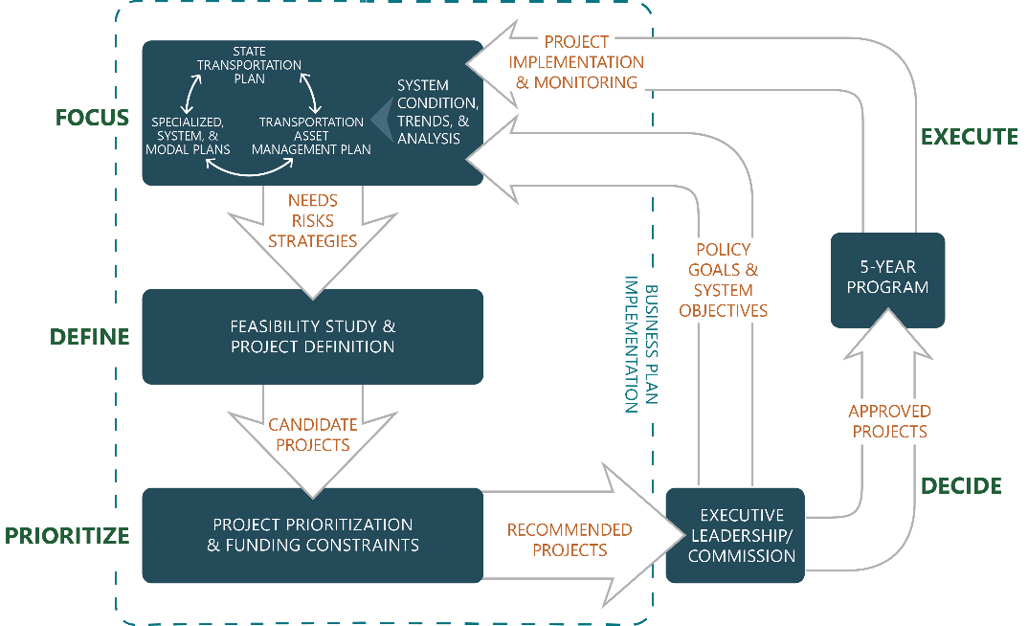

Slide 3
State Transportation Plan
Federally required per Title 23 of United States Code
Also required per Iowa Code chapter 307A as a function of the Commission
Current plan adopted by the Commission on May 10, 2022
Administrative modification completed in April 2024
Next update is due in May 2027
Notes:
January.

Slide 4
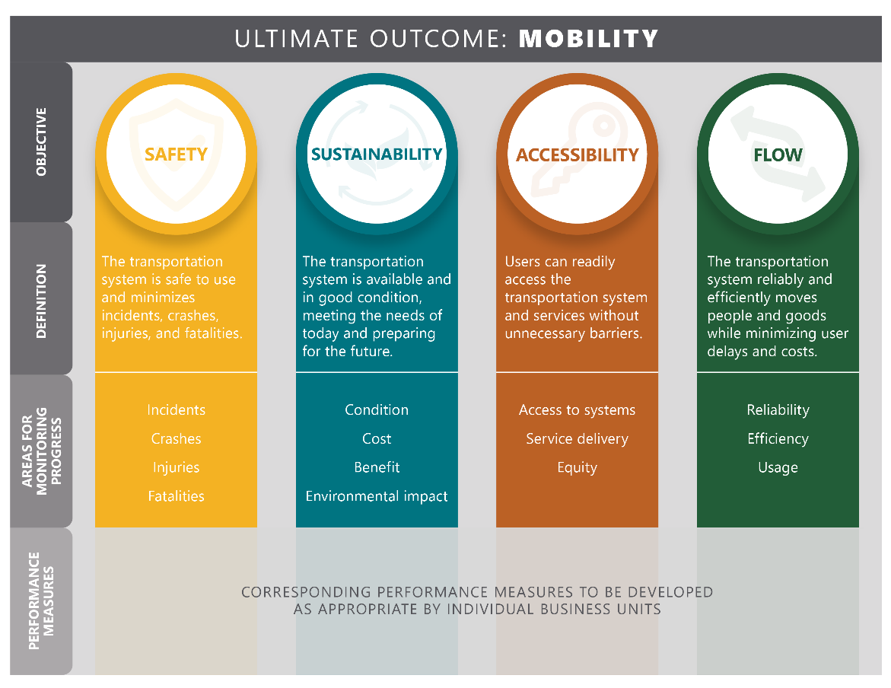
System objectives

Slide 5
Specialized, System, and Modal Plans
2024
2025
2026
Q1
Q2
Q3
Q4
Q1
Q2
Q3
Q4
Q1
Q2
Q3
Q4
Resilience Improvement Plan
Carbon Reduction Strategy
Public Transit Plan
Freight Plan
Bicycle and Pedestrian Plan
Rail Plan
State Transportation Plan
Kick off, due 5/2027
Transportation Asset Management Plan
Kick off, due 3/2027

Slide 6
System Condition, Trends, and Analysis
Policy implementation (Complete Streets, Rightsizing)
Planning corridors
Needs and risks analysis updates
Recently updated
Soon to be updated
Bicyclists
Bridge Condition
Bottlenecks
Capacity
Flood Resiliency
Operations
Pavement Condition
Pedestrians
Safety

Slide 8
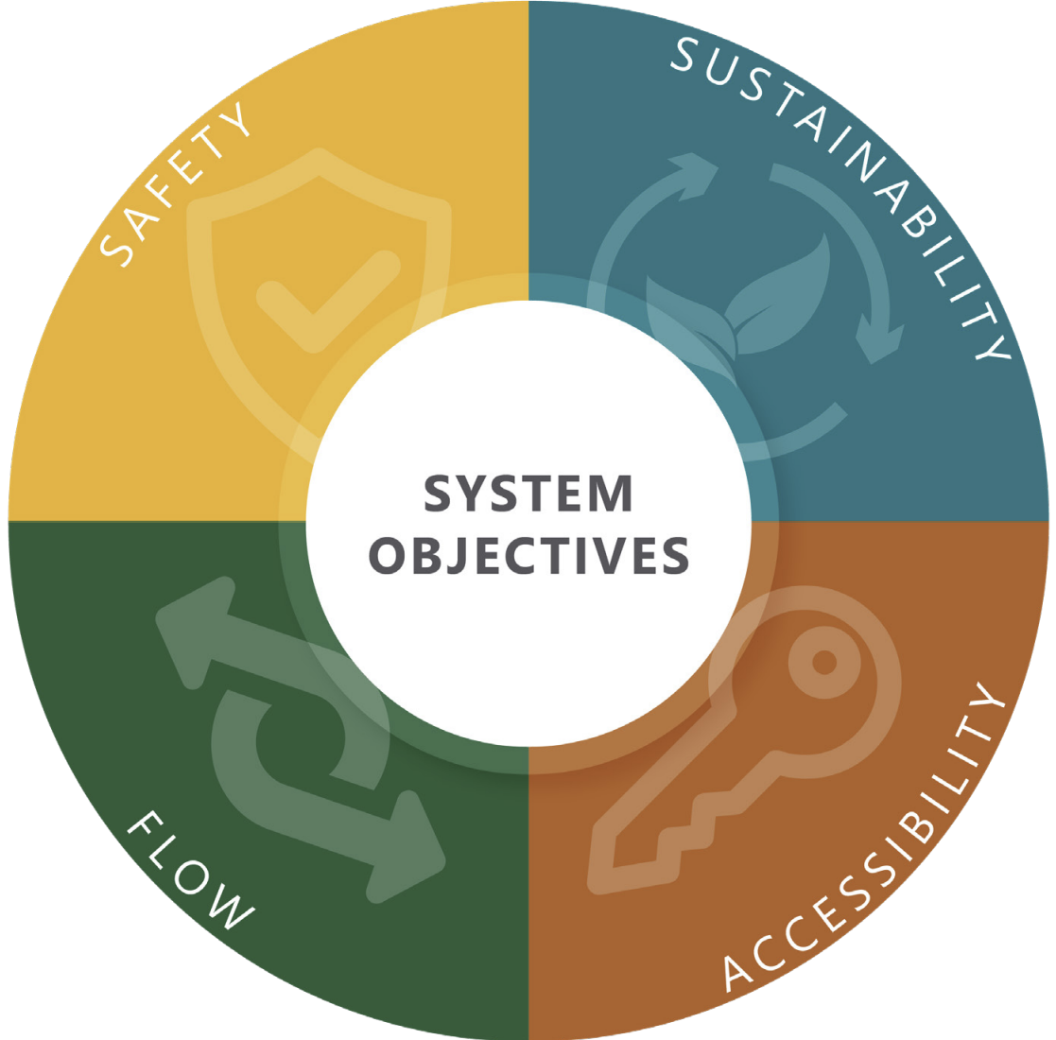
Project Prioritization
Project Prioritization/Scoping Tool
Update scoring criteria to better align with system objectives
Five Year Program Business Cases
Needs and risks analysis resources
Resilience improvement projects
Participation on Review Team

Slide 9
Questions?
SAM HISCOCKS
515-239-1520
samuel.hiscocks@iowadot.us​
iowadot.gov

