Slide 1
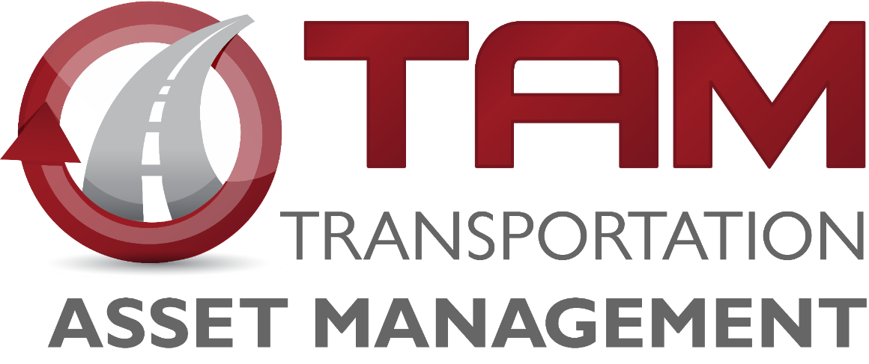
Pavement Management
Iowa Transportation Commission Workshop – January 21, 2025
3/2/2023

Slide 2
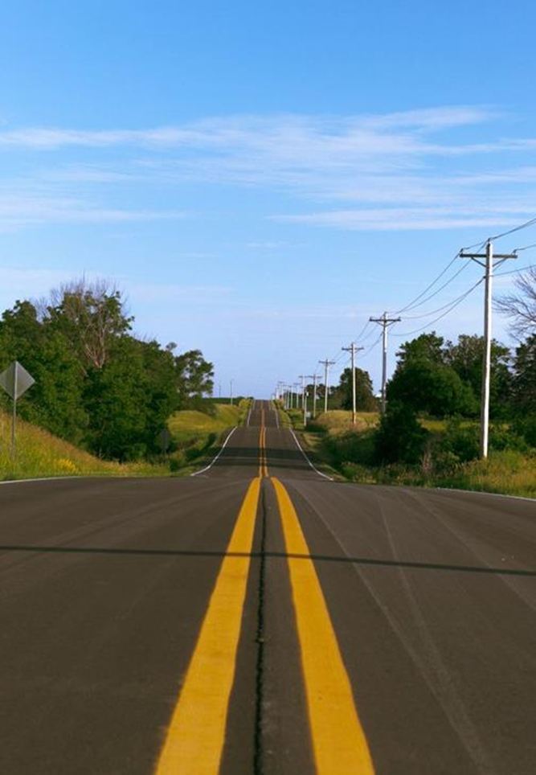
Agenda
Pavement Management Team
Pavement Inventory
Pavement Distress and Treatments
Pavement Performance Trends and Budget Scenarios
Strategic Project Selection

Slide 3
Pavement Management Team Introduction
Ashley Buss, Ph.D., P.E.
Pavement Management Leader
Jason Omundson, P.E.
Pavement Preservation Engineer
Currently hiring
Pavement Modeler and Analyst
Notes:
Our team works closely with all the districts, construction and materials, program management, project management, design, research and analytics, and systems planning.

Slide 4
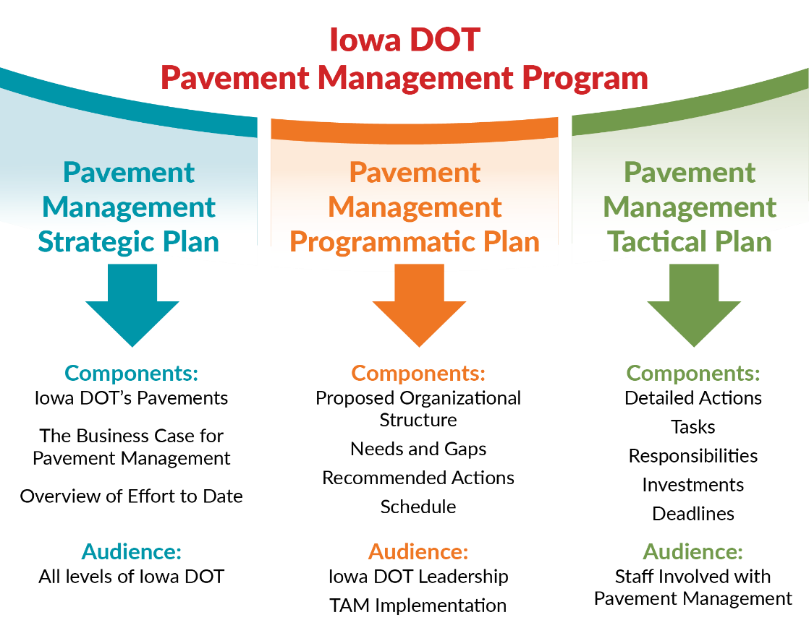
Guiding Documents
Notes:
The Pavement management strategic plan and the programmatic plan are our guiding documents that shaped the vision for creating the team.

Slide 5
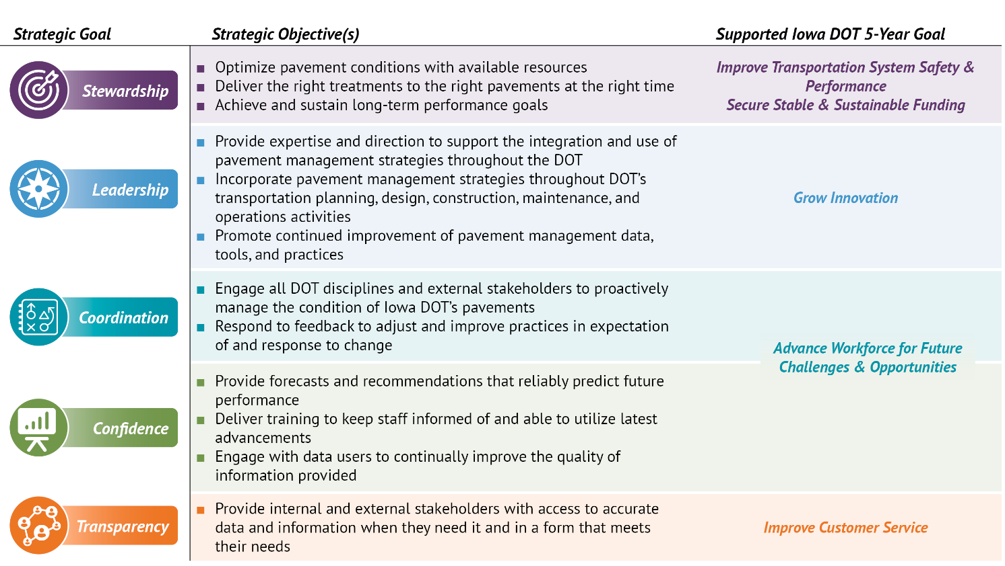
5-year Goals and Objectives
Notes:
These goals and objectives link to the Transportation Commission’s State Long-Range Transportation Plan. – particularly the emphasis on stewardship.

Slide 6
Pavement Inventory
The Primary system includes 24,636 lane miles of pavement.
3,899 or about 16% on the Interstate
799 lane miles of ramps
Our Investment
If we had to replace the pavement on all of these roads today, the cost would exceed $31 billion.
Notes:
One mile of four-lane roadway is four lane-miles.
These mileages are based on the LRS data, not PMIS.
(Documentation: Research & Analytics Bureau report generated 9/26/2024. Provided to me via email on 11/22/2024.)

Slide 7
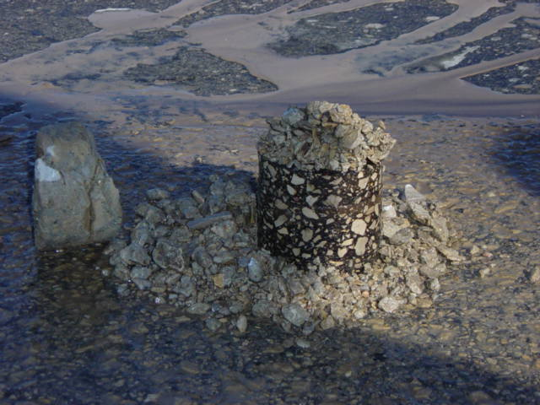
Pavement Inventory

Slide 8
Pavement Inventory
Lane Miles by Surface Type and Age
Notes:
Age is the age since resurfacing or age since construction. HMA is hot mix asphalt – and PCC is Portland cement concrete.

Slide 9
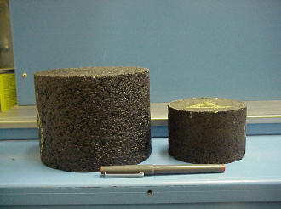
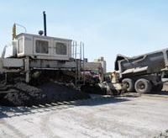
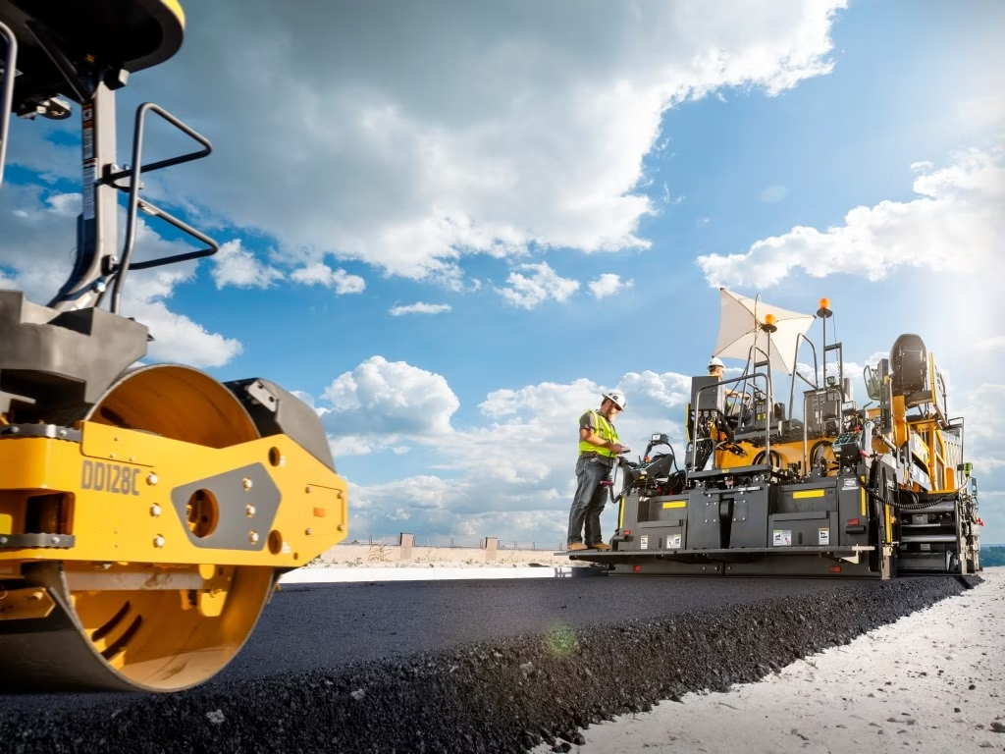
Causes of Pavement Distresses
Load (Trucks)
Material
Climate
Construction

Slide 10
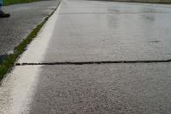
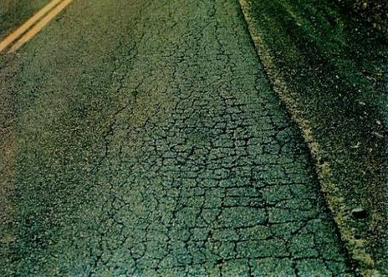
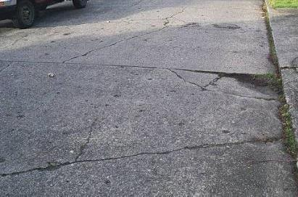
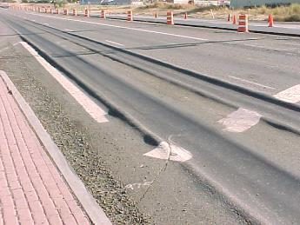
Pavement Distresses and Causes
Load (Trucks)
Fatigue Cracking
Material
Stripping
Climate
Rutting
Construction
Roller marks
Bleeding
Durability Cracking
Oxidation
Blowups
Thermal Cracks
Pot holes (freeze thaw)
Longitudinal Joint
Polishing
Mat Tearing
Segregation
Corner Breaks
Faulting
Rutting

Slide 11
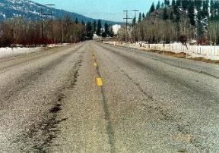
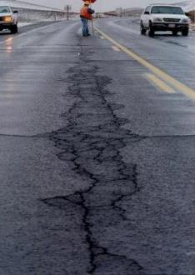
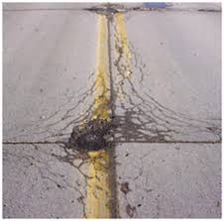
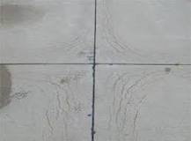
Pavement Distresses and Causes
Load (Trucks)
Fatigue Cracking
Material
Stripping
Climate
Rutting
Construction
Roller marks
Bleeding
Durability Cracking/Joint deterioration
Oxidation
Blowups
Thermal Cracks
Pot holes (freeze thaw)
Longitudinal Joint
Polishing
Mat Tearing
Segregation
Corner Breaks
Faulting
Rutting

Slide 12
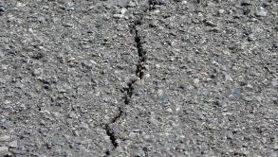
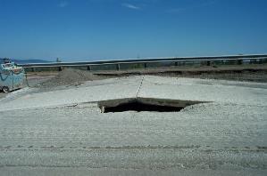
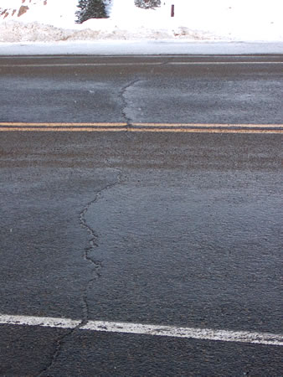
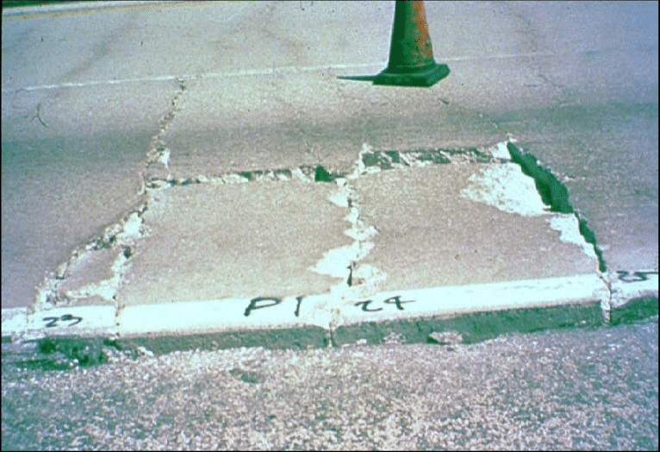
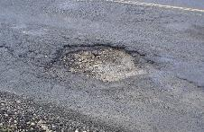
Pavement Distresses and Causes
Load (Trucks)
Material
Climate
Construction
Notes:
Blow-up in rigid pavement
Thermal cracking in flexible pavement
Erosion of the base leading to punch out in CRC rigid pavement
Potholes every spring

Slide 13
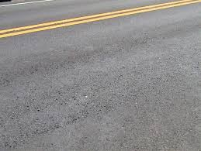
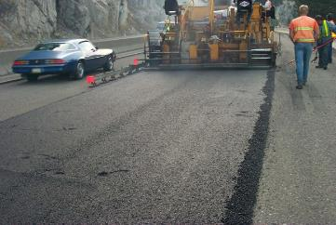
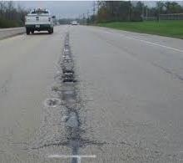
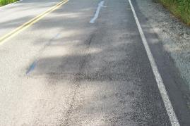
Pavement Distresses and Causes
Load (Trucks)
Fatigue Cracking
Material
Stripping
Climate
Rutting
Construction
Roller marks
Bleeding
Durability Cracking
Oxidation
Blowups
Thermal Cracks
Pot holes (freeze thaw)
Longitudinal Joint
Polishing
Mat Tearing
Segregation
Corner Breaks
Faulting
Rutting

Slide 14
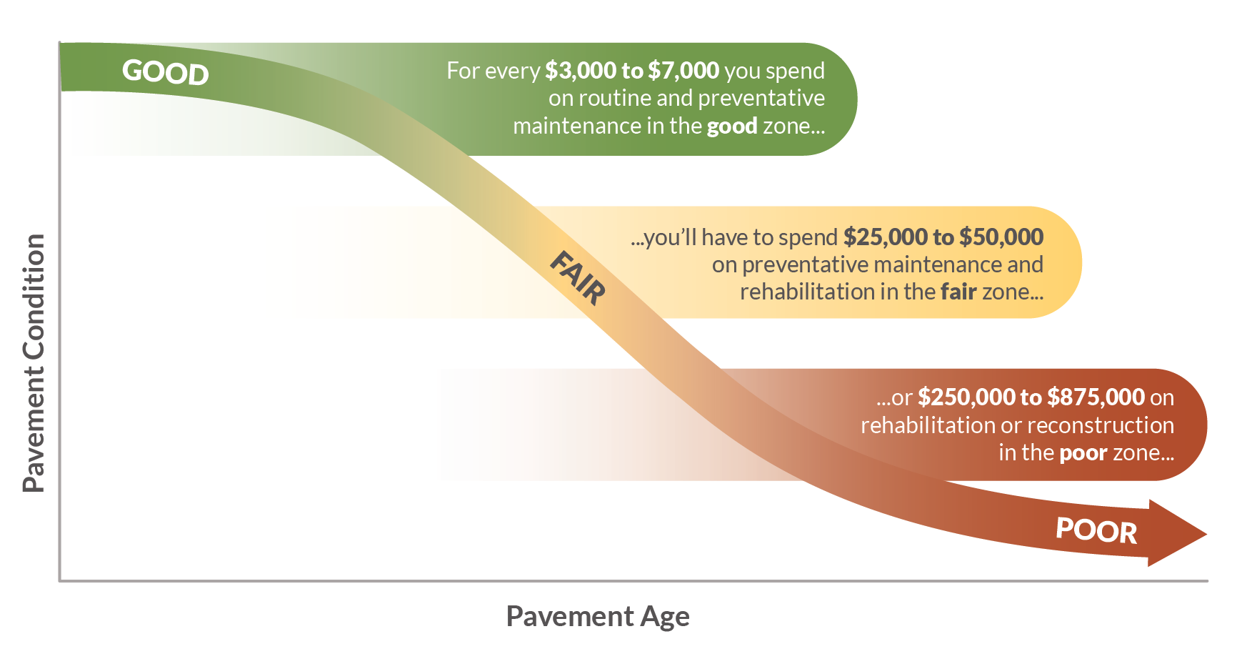
Pavement
Notes:
The Pavement management strategic plan and the programmatic plan are our guiding documents that shaped the vision for creating the team.
Link investment decisions to this slide – Investing when we are still in the “good” condition
Slowing down the deterioration
Preventive Maintenance/Preservation
Treatments applied to pavements in relatively good condition to extend pavement life and/or improve performance.
Begin early in pavement life
Very cost effective
Treatments may be repeated on a schedule
Maintaining Good Condition Costs Less
Just like your car or home, routine and preventative maintenance can help extend the life.
Eventually things wear out and more extensive rehabilitation or replacement is required.
Over the life of a pavement, preservation treatments are like sealing the deck on your house – it can help extend the life, but eventually it will need rehabilitation or replacement.
We use pavement management data and tools to help us determine the optimal mix of treatments to get the most life at the least cost.

Slide 15
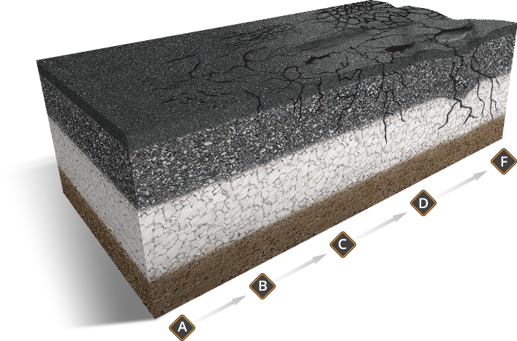
Pavement
Notes:
The Pavement management strategic plan and the programmatic plan are our guiding documents that shaped the vision for creating the team.
Link investment decisions to this slide – Investing when we are still in the “good” condition
Slowing down the deterioration
Preventive Maintenance/Preservation
Treatments applied to pavements in relatively good condition to extend pavement life and/or improve performance.
Begin early in pavement life
Very cost effective
Treatments may be repeated on a schedule
Maintaining Good Condition Costs Less
Just like your car or home, routine and preventative maintenance can help extend the life.
Eventually things wear out and more extensive rehabilitation or replacement is required.
Over the life of a pavement, preservation treatments are like sealing the deck on your house – it can help extend the life, but eventually it will need rehabilitation or replacement.
We use pavement management data and tools to help us determine the optimal mix of treatments to get the most life at the least cost.

Slide 16
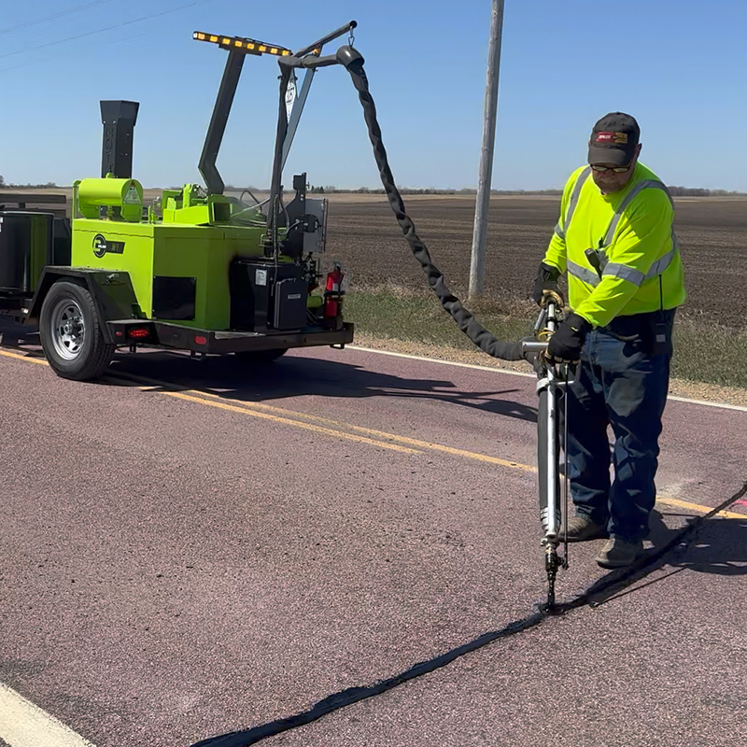
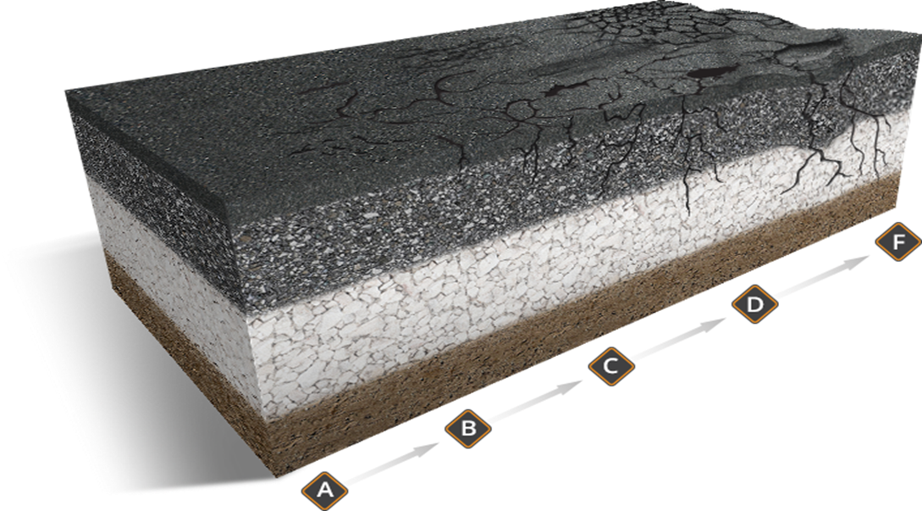
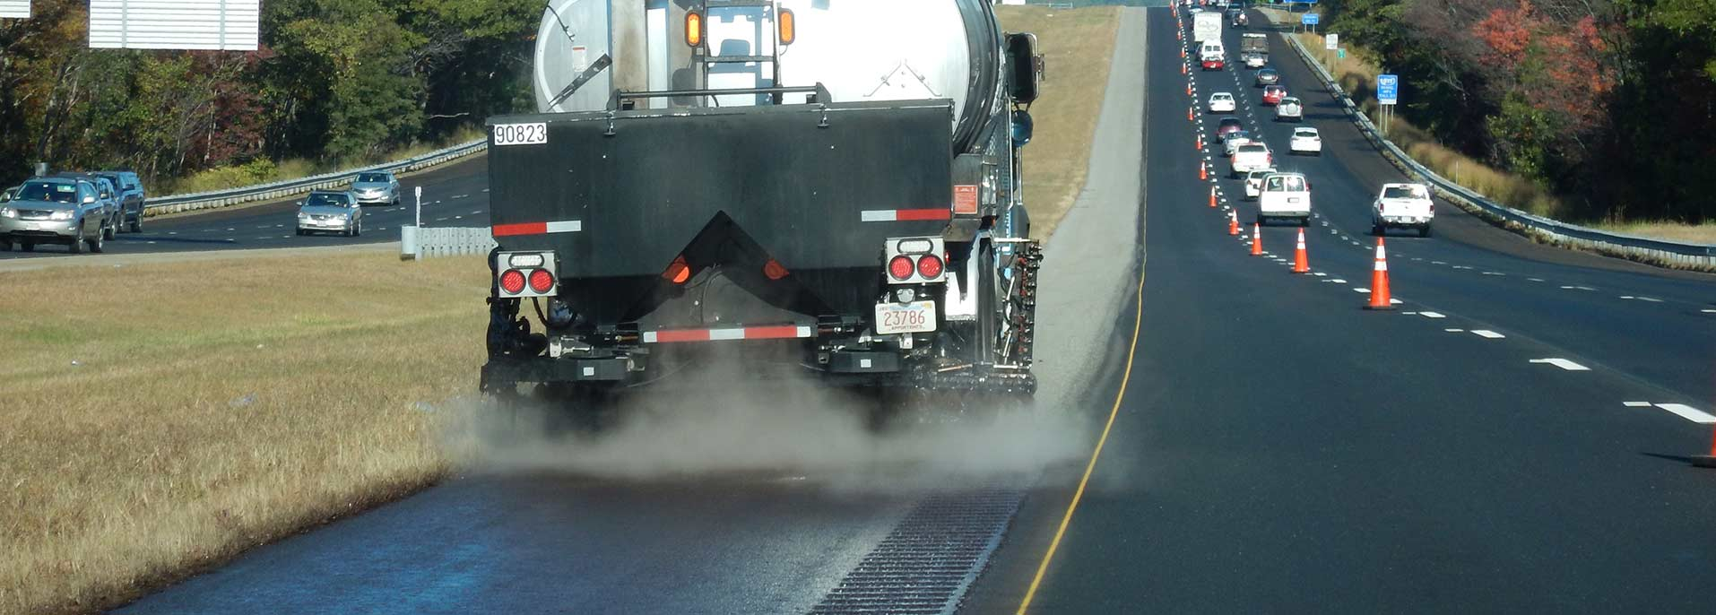
Pavement Treatments
Maintenance and Preventative
Crack & joint sealing/filling
$3,000/mile/year of life
Fog Sealing Shoulders
Diamond Grinding
Notes:
The treatment costs are in the unit $/mile/year of life. The $/mile refers to the cost of the treatment per lane mile and the “per year of life”
Preventive Maintenance/Preservation
Treatments applied to pavements in relatively good condition to extend pavement life and/or improve performance.
Begin early in pavement life
Very cost effective
Treatments may be repeated on a schedule

Slide 17
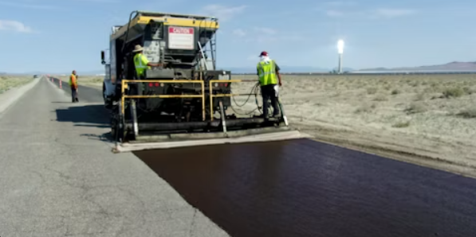
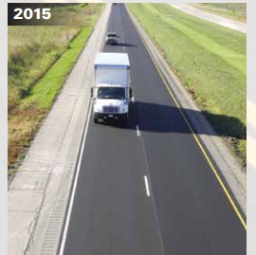
Pavement Treatments
Maintenance and Preventative
$5,000 – $9,000/mile/year of life
Microsurfacing
$12,000
/mile/year of life
1” Thin Overlay

Slide 18
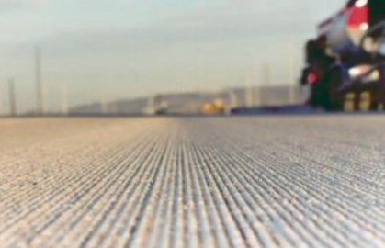
Pavement Treatments
Maintenance and Preventative
$5,000 – $9,000/mile/year of life
Microsurfacing
$9,000/mile/year of life
1” Thin Overlay
Diamond Grinding

Slide 19
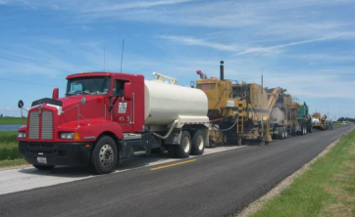
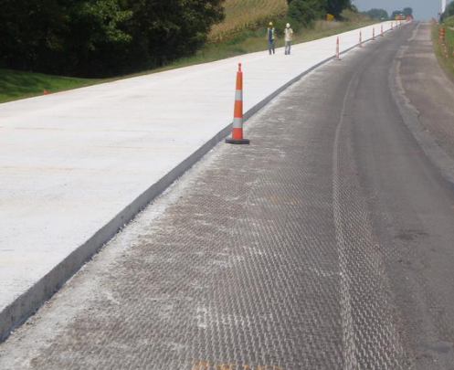
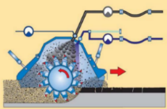
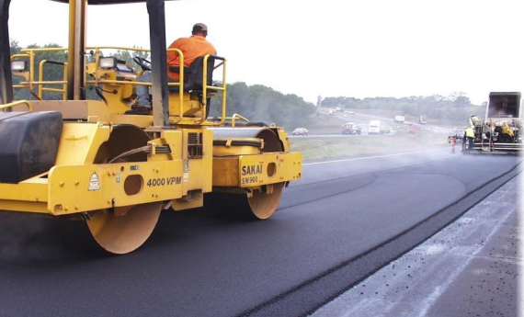
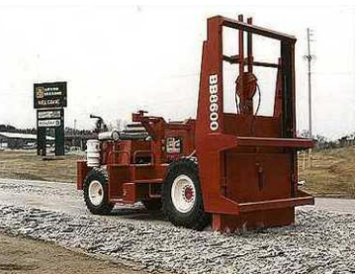
Pavement Rehabilitation Treatments
~$40,000/mile/year of life
PCC Overlay
Cold In-Place Recycling
PCC Rubblization
PCC Crack and Seat
HMA Milling & Resurfacing

Slide 20
Pavement Treatments
Increasing Annualized Cost
Maintenance/Preservation treatments
Crack & joint sealing/filling
Diamond grinding
Thin surface treatments
Chip seals
Slurry seals
Microsurfacing
Thin lift asphalt overlays
Rehabilitations (20 year life)
Functional overlays (to address ride)
Cold-in-Place recycling
Structural overlays (asphalt and concrete)
Rubblization/crack & seat
Reconstruction (40 year life)
Completely replacing the pavement and sometimes the subgrade
$3,000/mile/year of life
$9,000/mile/year
$12,000/mile/year
$40,000/mile/year
$80,000/mile/year
Notes:
Costs (from TAMP): Maint/Pres Tx $20k - $50k per lane mile; Rehab Tx $220k - $500k per LM; Recon Tx $600k - $750k per LM

Slide 21
Interstate Pavement Condition and Future Performance Estimates

Slide 22
Non-Interstate Pavement Condition and Future Performance Estimates

Slide 23
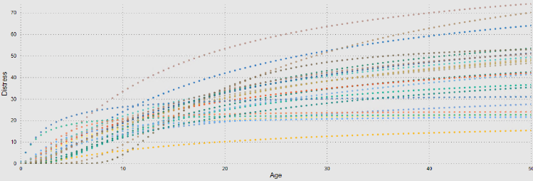
Pavement Modeling
Pavement Performance Models
Network Structural Testing
~20% Annually
Friction Data Collection
20% Annually
Pavement Performance Data
Special Investigations Team
Vendor Collected Data

Slide 24
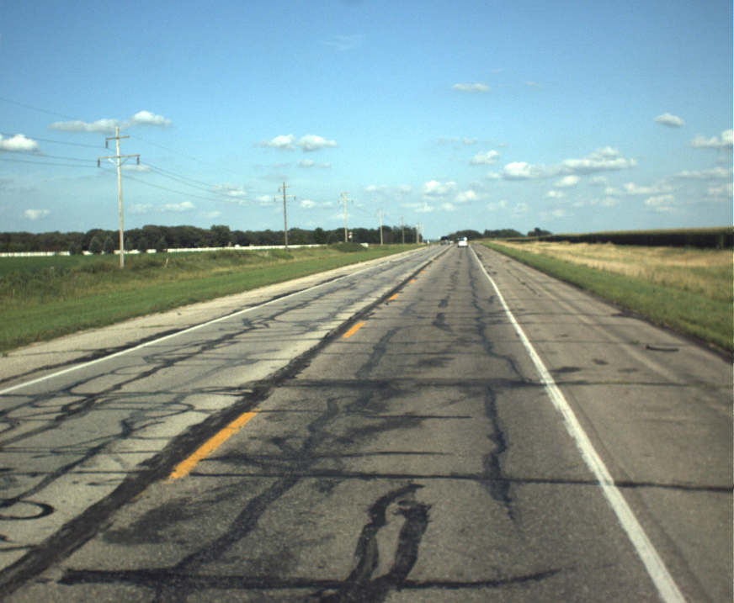
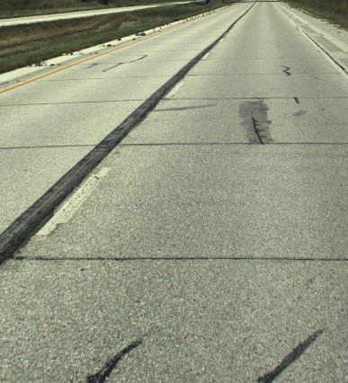
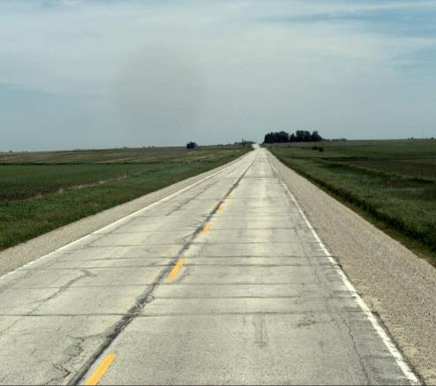
PCI = 33
PCI = 50
PCI = 75
Notes:
PCI stands for pavement condition index. Iowa DOT uses a numerical scale to assess the condition of a roadway’s surface, ranging from 0 to 100 (excellent). It is based on the severity and extent of cracking, roughness, and rutting for HMA) or faulting for PCC. The condition index is used to guide maintenance and repair decisions. Over time, PCI is not generally a steady decline. Cracking in the roadway causes significant increases in roughness and the combination of issues leads to an accelerated decrease in the condition index.

Slide 25
Non-Interstate Budget Scenarios with Pavement Condition
Notes:
Budget scenarios help illustrate how pavement condition will change with time and investment levels.

Slide 26
Non-Interstate Budget Scenarios with Pavement Condition
Target Condition Index
Funding level needed to reach desired condition target

Slide 27
Interstate Budget Scenarios with Pavement Condition
Target Condition Index
Funding level needed to reach desired condition target

Slide 28
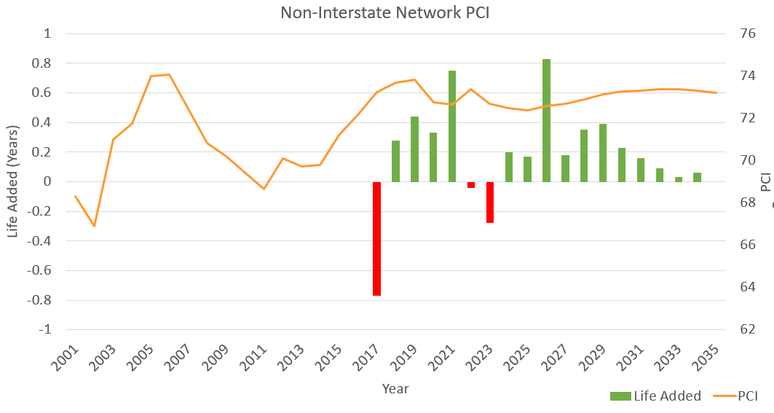
Historical PCI and Added Life Each Year
Notes:
The orange line is pavement condition index over the years. PCI values are shown on the right y-axis. The increase from 2002 to 2007 included transfer of jurisdiction lane miles. In 2012, the pavement condition increased reflecting higher expenditures in years 2009 and 2012-2015. The bar charts show how the pavement life added or reduced from that year’s investment. Life added to the network is predicted for future years based on the status-quo budget. The predicted life is based on an optimized project selection. The year of 2017 saw a low in expenditures resulting. Expenditures were high in 2020. The reduction in purchasing power over time is reflected in the reduced life added shown for future years.

Slide 29
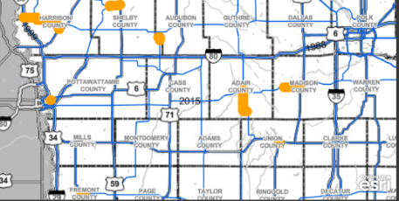
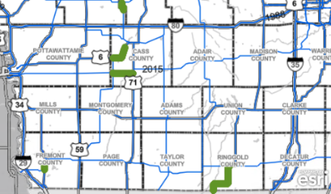
Project Selection Optimization (Non-Interstate)
Optimization Software Makes Recommendations
Engineers Make Adjustments
Traffic
Field Staff Reviews
Drainage/Safety
Compare and Finalize
Life Added vs Life Lost
Lane Miles Treated
PCI Impact
Notes:
We have tools that tell us the most economical way to invest. Engineers take these recommendations and make adjustments based on local feedback and other non-pavement considerations (ie safety). We quantify the impacts of the Engineer’s decisions compared to the optimization tools so we can balance the trade-offs. We make sure we put as much life back as we take out each year through normal deterioration. We make sure our selections offer a similar impact to PCI as the optimization’s recommendations do.

Slide 30
Pavement Management Key Takeaways
Pavement management team increases our ability to:
Use models and analytics to direct additional funding
Enhance strategic project selection
There are competing goals for pavement funding
Achieve the target 75 PCI condition
Replace pavements on a reasonable cycle to limit risk of our aging system
Decrease in buying power reduced the ability to add pavement life back to the system.
To achieve pavement performance targets, estimated funding levels needed are:
$70M for Interstate
$325M for Non-Interstate

Slide 31
Questions?

