Slide 1
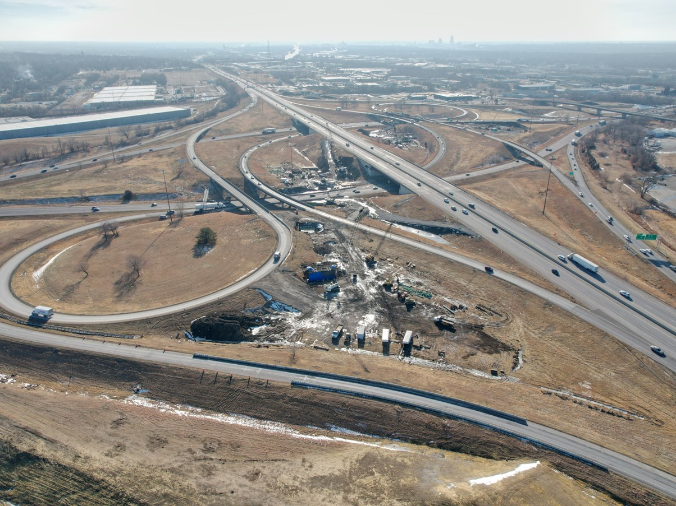


2026-2030 Highway Program Development
January 21, 2025
3/2/2023

Slide 2


Agenda
TOPIC 1
Highway Program Development Process
TOPIC 2
2026-2030 Highway Program Development Schedule
TOPIC 3
2025-2029 Highway Program Recap
TOPIC 4
Funding Categories
TOPIC 5
Federal Funding Status
TOPIC 6
Program Development Considerations
TOPIC 7
Next Steps

Slide 3
Topic 1
Highway Program Development Process

Slide 4

Highway Program Development Process
Public Policy and Input
What direction do we have?
Transportation Plans
What type of system do we need?
Performance Monitoring
Are we successful?
Five-Year Program
What projects will be done and when?

Slide 5
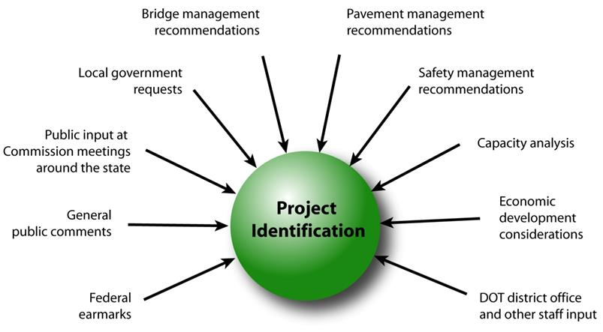
Step 1: Project Identification

Slide 6
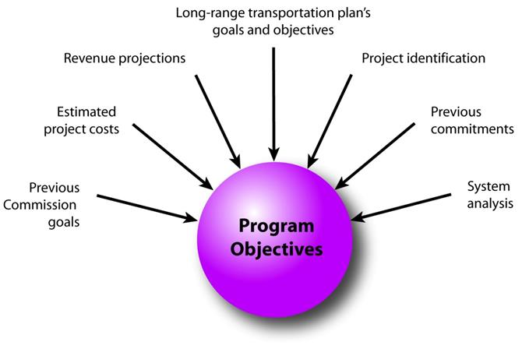
Step 2: Establishing the Transportation Commission’s Annual Programming Objectives

Slide 7
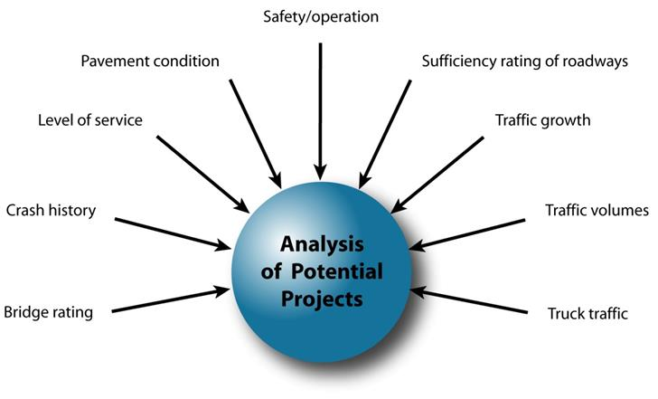
Step 3: Evaluating Potential Project Candidates

Slide 8
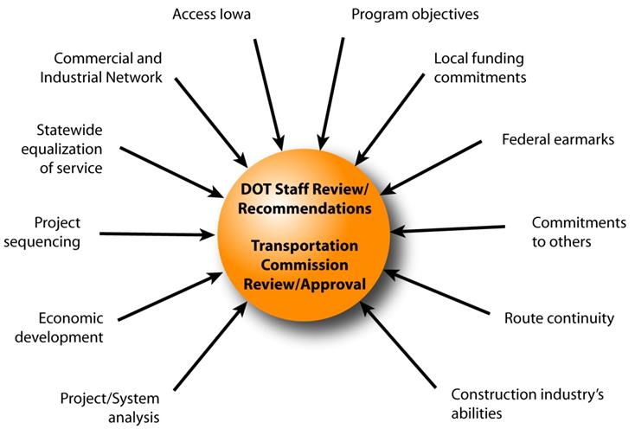
Step 4: Developing The Final Program

Slide 9
Topic 2
2026-2030 Highway Program Development Schedule

Slide 10
Highway Program Development Schedule (2026-2030)
January 2025
Discuss Highway Program Development Process
Discuss 2026-2030 Highway Program Development Schedule
February 2025
Discuss Extended Highway Program Analysis
Discuss Statewide Line Items
At what levels should the line-item targets be programmed?
March 2025
Discuss 2026-2030 available Highway Program funding
Discuss 2026-2030 Highway Program options
Determine 2026-2030 Highway Program Objectives
Action Item: Line-Item Targets for Programming
April 2025
Develop the Draft 2026-2030 Highway Program
Action Item: 2026-2030 Highway Program Objectives
May 2025
Present the Draft 2026-2030 Iowa Transportation Improvement Program to the public (including all previous program approvals and Draft 2026-2030 Highway Program)
June 2025
Action Item: Approve the 2026-2030 Iowa Transportation improvement Program

Slide 11
Topic 3
2025-2029 Highway Program Recap

Slide 12
2025-2029 Highway Program Recap
Challenges
No additional funding
FY 2024 negative program balance adjustment
Actions
Prioritized stewardship
Project underfunding
Program balancing adjustment to Interstate Stewardship

Slide 14
Topic 4
Program Funding Categories

Slide 15
Stewardship Funding Categories
Category
Interstate Stewardship
Non-Interstate Pavement Modernization
Non-Interstate Bridge Modernization
Safety Specific
Commission defines targets for these categories for a ten-year period
Commission has focused on increasing these targets
Asset Management presentations are intended to support this process

Slide 16
Interstate Stewardship (4R)
Funds available based on stewardship target.
Off-the-top allocations for rest areas, lighting, guardrail repair, signing, and pavement maintenance.
Remaining funds generally targeted to pavements (2/3) and bridges (1/3).
Requires coordination with multiple bureaus and Districts.

Slide 17
Non-Interstate Pavement Modernization (3R)
Funding available based on stewardship target.
Allocation to each District based on formula.
Starting in 2027 an additional $35 m in 3R funding is available for reconstruction projects.

Slide 18
Non-Interstate Bridge Modernization (BR)
Funding available based on stewardship target.
Significant increase in target over past several years.
Recommended projects determined by Bridges and Structures Bureau.

Slide 19
Safety Specific (SR)
Funds available based on stewardship targets.
Recommended projects selected by Traffic and Safety Bureau.
Some funding used on 3R projects (paved shoulders).

Slide 20
Non-Interstate Capacity/System Enhancement (NR)
Non-stewardship funding category.
Capacity to add projects based on overall funding available after deduction for stewardship targets and consideration of Major Interstate project additions.
Recommended projects selected from Highway Candidates list.

Slide 21
Major Interstate Capacity/System Enhancement (MI)
Non-stewardship funding category.
While not a stewardship category, projects do include stewardship benefits.
Primarily driven by Interstate Plan (I3P).

Slide 22
Topic 5
Federal Funding Status

Slide 23
Federal Funding Status
FFY 2025 Appropriation: Second continuing resolution expires March 14.
Infrastructure Bill authorizes federal funding through September 30, 2026, leaving some funding uncertainty for the last four years of this Program.
Infrastructure Bill funding allocations based on Commission action in June 2022.
The next Highway Trust Fund cliff is in 2028.
Legislation to address a portion of the large August Redistribution amounts has been passed.

Slide 24
Topic 6
Program Development Considerations

Slide 25
Program Development Considerations
Construction costs have declined this fiscal year.
State road funding continues to come in higher than forecast.
The last four years of federal funding in this Program are not part of an authorization.
Continue to prioritize bridge and pavement stewardship investments on existing highway system.
Pursue grant funding opportunities.
Assess balance of pavement and bridge stewardship investments.
Balance capacity improvements with stewardship needs.
Address major river crossing needs.

Slide 26
Topic 7
Next Steps

Slide 27
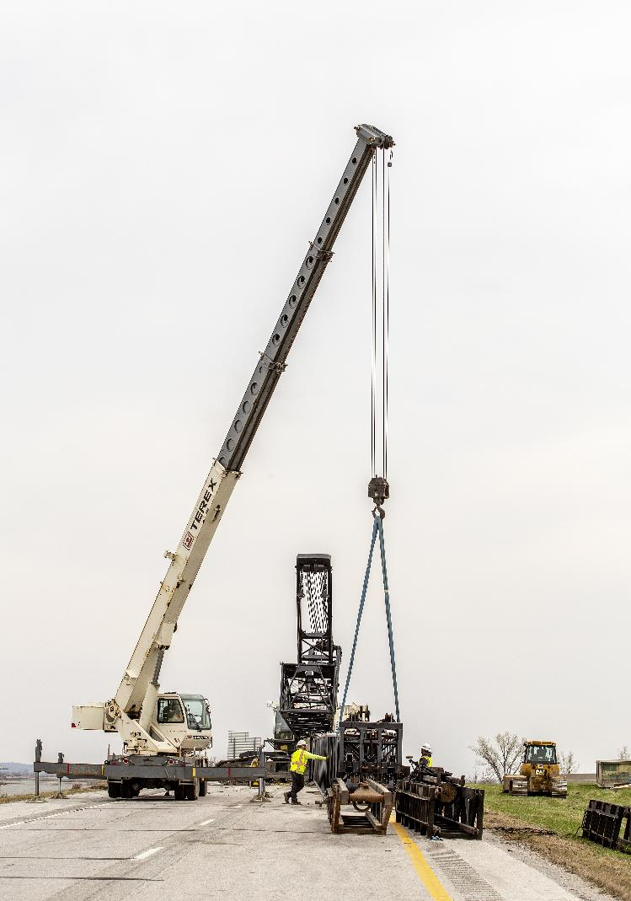
Next Steps
Discuss Extended Highway Program Analysis
Discuss Statewide Line Items
At what levels should the line-item targets be programmed?

Slide 28
Questions?

