Slide 1
Statewide Operations & Intelligent Transportation Systems
Tim Simodynes
Traffic Operations Bureau
January 21, 2025

Slide 2
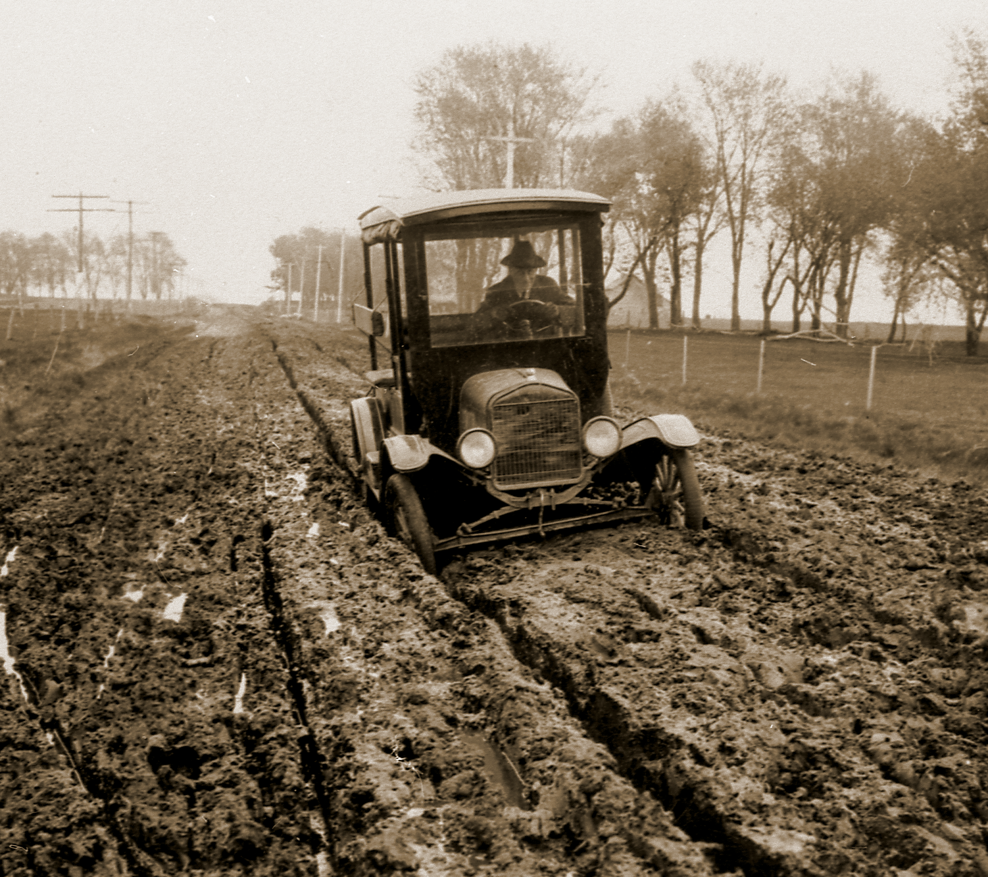
110+ Years of Experience
“Get Iowa Out of the Mud”
“On-Time and On-Budget”
“Can Do”
“TSMO”?
Notes:
Our history started with Engineering & Infrastructure and that can be seen in our past Slogans/Mantras.
“TSMO” is not our CORE FOCUS: “Making Lives Better Through Transportation,” but it is a National Emphasis.
So what is TSMO?...

Slide 3
What is TSMO?
Transportation Systems Management & Operations
System-wide approach to get people and goods to their destinations safely and efficiently
More holistic
Less emphasis on new infrastructure
Notes:
TSMO is the recognition the even if we could have the very best roads and bridges, that is not the end of our Core Focus “Making Lives Better Through Transportation”
There is still a lot we need to do to make sure people get where they are going safely and efficiently.
Still, it isn’t ground-breaking or controversial; Aren’t we already doing this?
Yes, but this emphasis has helped us collaborate and focus on key areas that can have a big impact…
https://commons.wikimedia.org/wiki/File:Apple_pie_182161_02.JPG
https://commons.wikimedia.org/wiki/File:Golde33443.jpg

Slide 4
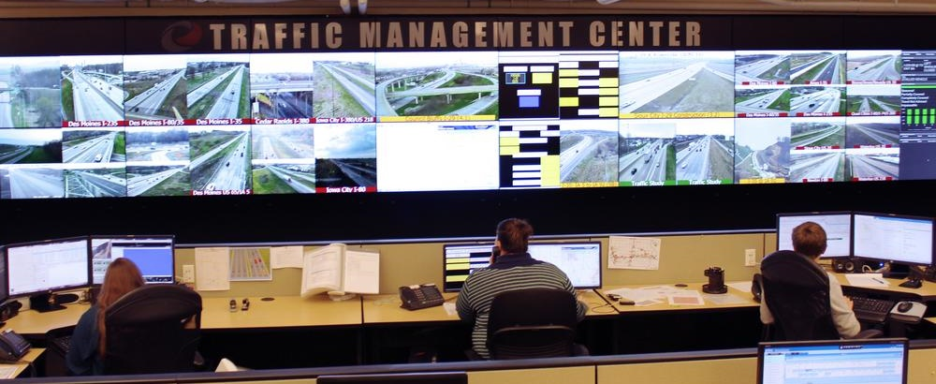
Traffic Management Center “TMC”
Incidents Managed in 2024
Motor Vehicle Building, Ankeny
Notes:
24/7 operation; Motor Vehicle Building in Ankeny; You may get to tour it later this year!
Manage 3000-4000 Incidents per month; Post messages to DMS; Dispatch Highway Helper motorist assist; Coordinate DOT responses with other agencies; populate 511; generate data feeds

Slide 5
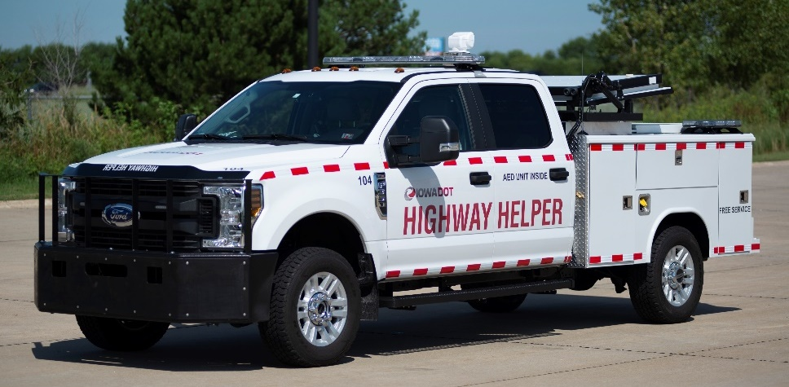
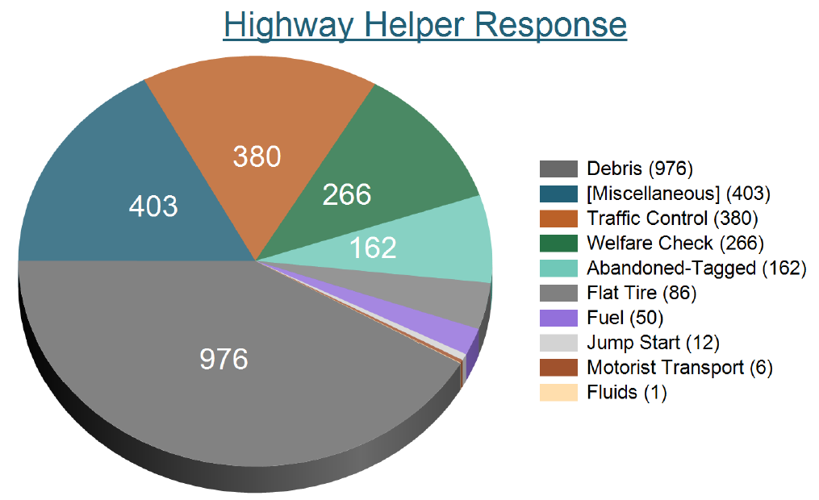
Highway Helper Responses
1700-2400 Responses/month
October 2024
Notes:
Dispatched by TMC.
1700-2400 Incidents managed per month. (2-3% fuel)
~100% Satisfaction rate among motorists and Law Enforcement

Slide 6
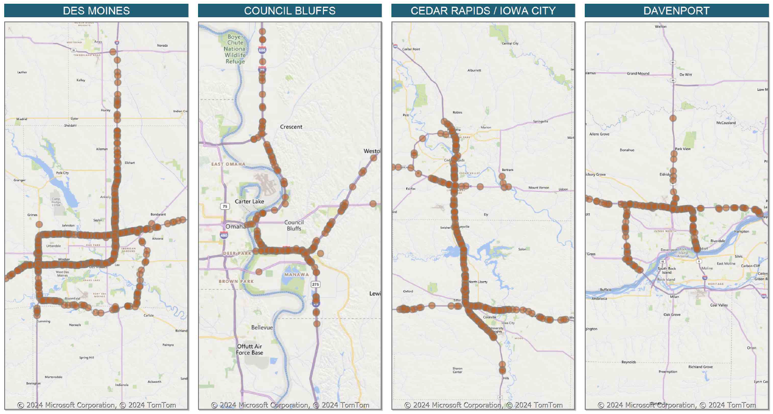
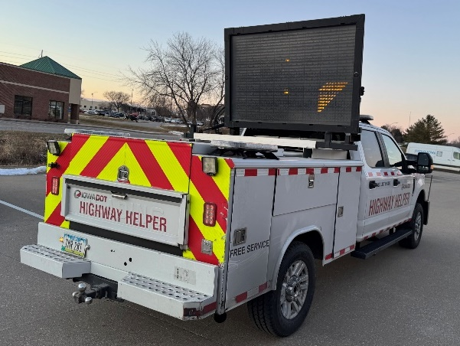
Highway Helper Response Locations
October 2024
Notes:
Plan to add Sioux City in 2025 when we start a new contract.

Slide 7
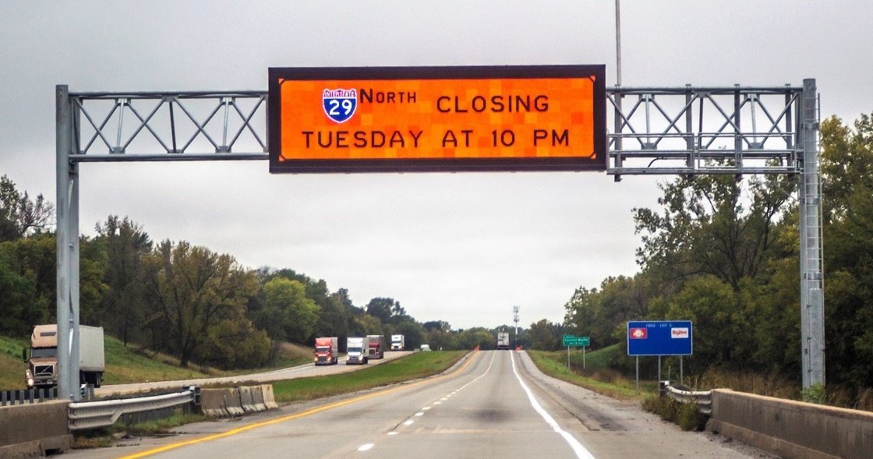
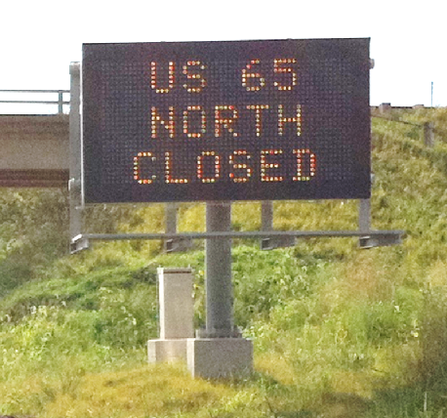
Intelligent Transportation System (ITS) Deployments
Pan-Tilt-Zoom Cameras
(~650)
Dynamic Message Signs
(~150)
Speed/ Volume Sensors
(~430)
Notes:
The TMC uses many resources, but the most common are these, and are still great tools for managing operations.

Slide 8
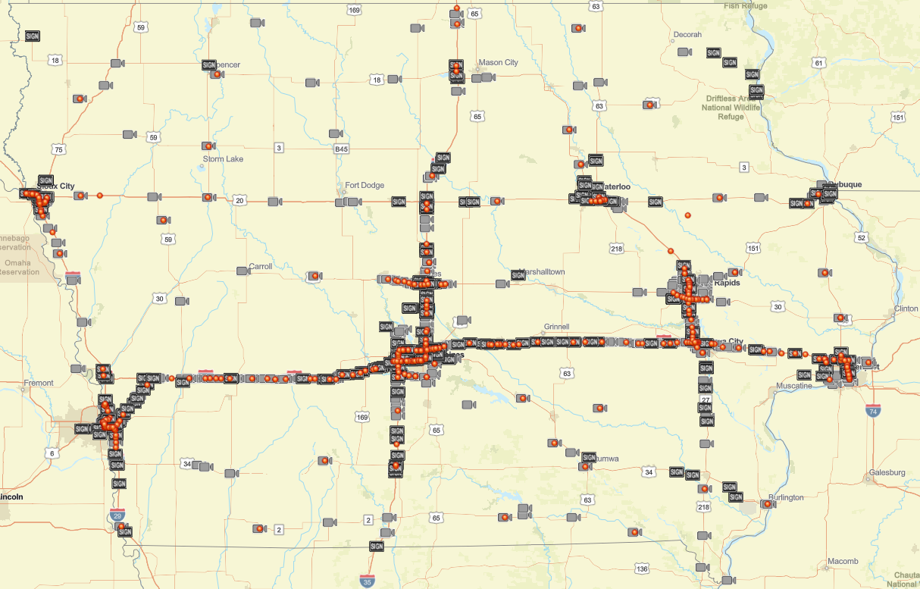
Cameras, Sensors & DMS
Notes:
Primarily focused on where we have the most traffic, but also Road Weather Information Systems and Rural Work Zones or Safety Concerns.

Slide 9
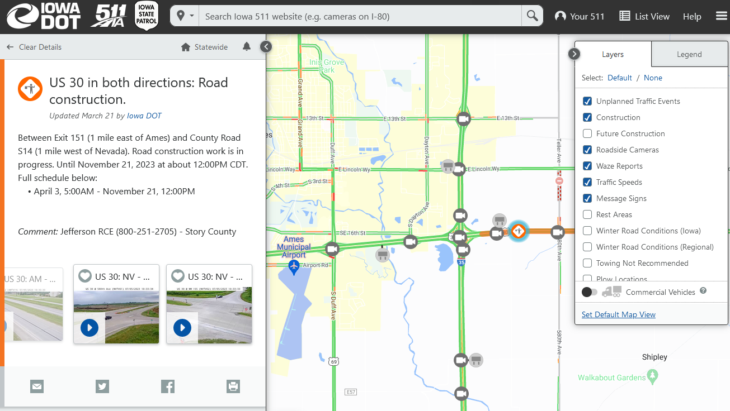
Traveler Information
511ia.org & Mobile app
Notes:
Most people are used to checking winter road conditions and camera images (permanent cameras and snowplow cameras).
Incredible amount of information, display layers, and options: Traffic speeds, construction, future construction, incidents, message signs, rest area amenities; ALSO includes subscription/alert services, data feeds for 3rd parties and Connected Vehicles, recorded video requests, etc.
We recognize that not everyone will use our web site or app, so we also provide our information to other navigation systems via data feeds.

Slide 10
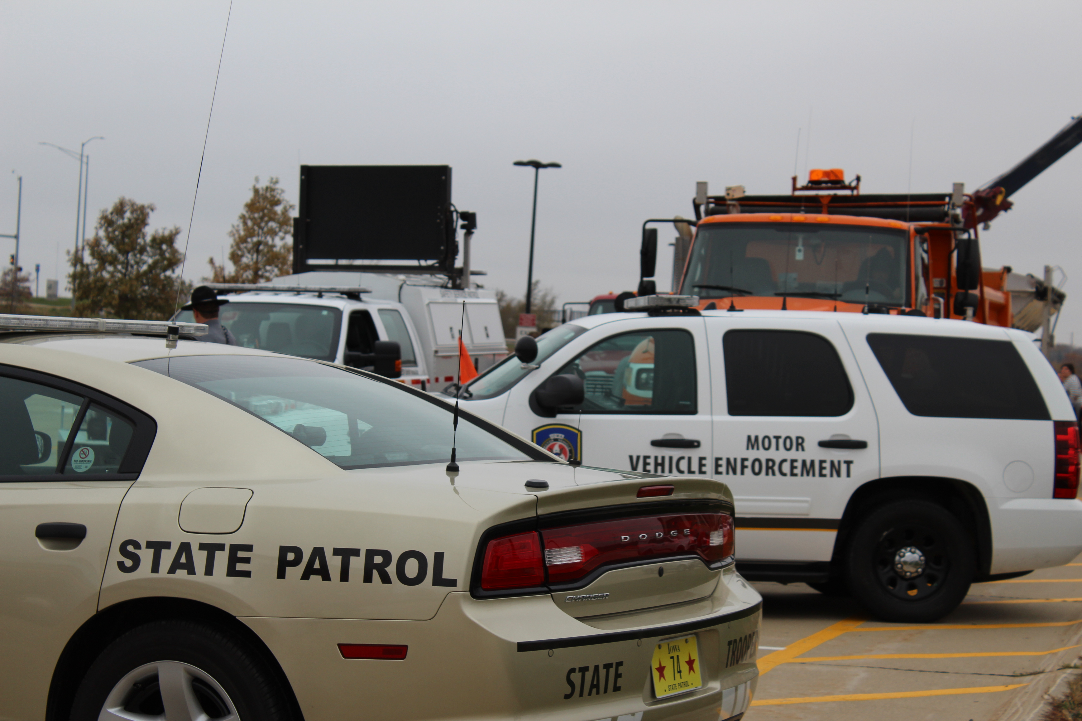
Traffic Incident Management
Notes:
Collaboration with emergency responders; paradigm shift away from using bright lights and big trucks to “Secure the Scene,” toward quick-clearance.
Statewide TIM Committee; TIM Training; TIM Plans;
Photo: Iowa DOT Canto

Slide 11
Towing Recovery Incentive Program (TRIP)
Quick clearance of commercial vehicles
Iowa City I-80 & I-380 interchange project
Now also in Des Moines
Notes:
Pre-qualified towing companies;
Eastbound I-80 crash near 38th Street, east of NE MM, 12/18/2024.

Slide 12
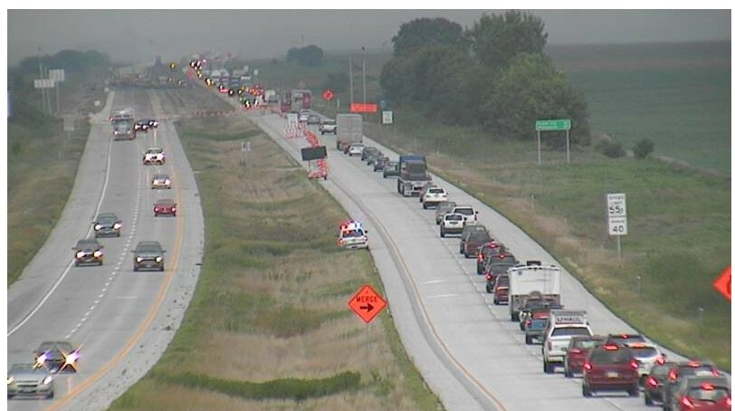
Work Zone Management
Notes:
Sources of Congestion: Bottlenecks, Weather, Special Events, Incidents, Work Zones
Work Zones are unique because we are also the cause. We have ultimate control over them.
Our efforts with Work Zones have been our best example of improving “System Management and Operation.” The key is good DOT staff across many bureaus and the Districts, who knew their own areas very well when it comes to work zones. And they are empowered to work together:
Work Zone Council & Work Zone Info Sharing Workshop (internal/external); Innovative Contracting; Lane Closure Planning; Traffic Critical Projects & Intelligent Work Zones & queue detection; Extra Enforcement; etc.

Slide 13
Active Transportation & Demand Management Sample Strategies
Ramp Metering
Dynamic Shoulder Lanes
Transit Signal Priority
Adaptive Traffic Signal Control
Active Parking Management
Dynamic Speed Advisories
Notes:
Looking to the Future, What are some next steps in TSMO? We are fortunate NOT to need these yet in Iowa, but we are learning from more populous states and are considering ATDM strategies where appropriate…
Sample of strategies, not exhaustive, FROM US DOT:
Ramp Metering—With an ATDM approach, real-time and anticipated traffic volumes on the freeway facility and ramps, and possibly the parallel arterial streets, are used to dynamically control the rate of vehicles entering the freeway facility
Dynamic Shoulder Lanes—With an ATDM approach, real-time and anticipated congestion levels are used to determine the need for using a shoulder lane as a regular or special purpose travel lane, instead of a fixed time-of-day schedule for using the shoulder for a travel lane
Transit Signal Priority—With an ATDM approach, current and predicted traffic congestion, multiagency bus schedule adherence information, and number of passengers affected may all be considered to determine conditionally if, where, and when TSP may be applied.
Adaptive Traffic Signal Control— This strategy continuously monitors arterial traffic conditions and the queuing at intersections and dynamically adjusts the signal timing to smooth the flow of traffic along coordinated routes and to optimize one or more operational objectives (such as minimize overall stops and delays or maximize green bands). ATSC approaches typically monitor traffic flows and modifies specific timing parameters to achieve operational objectives.
Active Parking Management - strategies and concepts (e.g., dynamic parking pricing and real-time parking availability information) to affect the demand, distribution, availability, and management of parking.
Dynamic Speed Limits—With an ATDM approach, real-time and predicted traffic conditions are used to adjust the speed limits dynamically to meet an agency's goals and objectives for safety, mobility, and environmental impacts.

Slide 14
Key Takeaway…
Making Lives Better Through Transportation relies on both Infrastructure and how we Operate the System
“…and the next solutions will come from within the DOT!”
-Scott Marler, Director
Notes:
Here at the DOT we are all not just employees, but we are also users of our Transportation System. We see things that frustrate us as drivers AND we have the opportunity to do something about it.
One of the great things about Iowa DOT is that from our Director on down we are all encouraged to contribute to “Making Lives Better Through Transportation”
(quote from Director, Scott Marler, “The next solutions to our problems are already here in the room.”)

