Slide 1
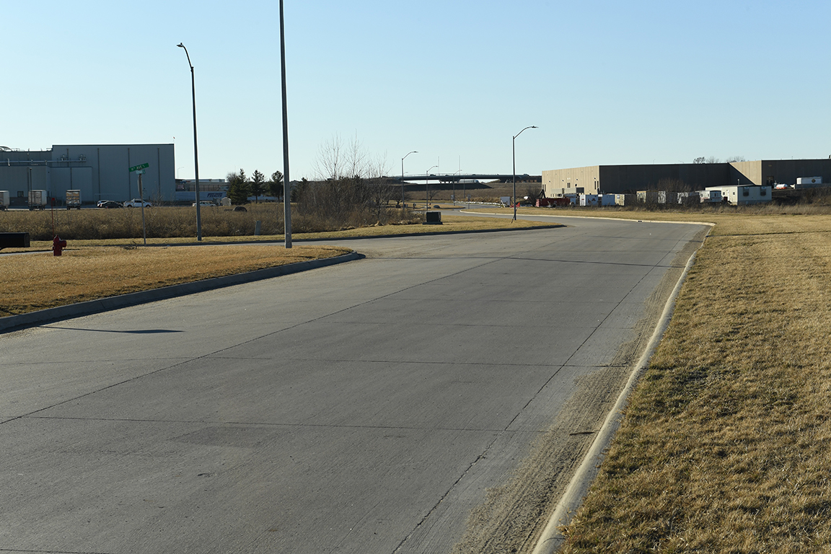

Revitalize Iowa’s Sound Economy Program

Slide 2
Revitalize Iowa’s Sound Economy Program
Created in 1985
Purpose: To promote economic development through roadway improvements.
Eligible development shall have value-adding activities that feed new dollars into the economy
Available to cities and counties through an application program

Slide 3
Available Funding and Application Summary
Available Funding
  Funded annually with dedicated state motor fuel and special fuel tax revenues
Application Summary for SFY2020
  Total number of projects awarded: 0
  Total project costs: $0
  Total amount awarded: $0
 | CITY | COUNTY
Average funding generated monthly | $997,556 | $498,778
SFY 2020 estimated Road Use Tax Revenue for July 2019 | $997,556 | $498,778
Estimated Unobligated Balance | $17,114,238.71 | $0

Slide 4
Local Development Project Evaluation Criteria
Development Potential (35 points)
Economic impact and Cost Effectiveness (20 points)
Local Commitment and Initiative (33 points)
Transportation Need and Justification (4 points)
Local Economic Need (6 points)

Slide 5
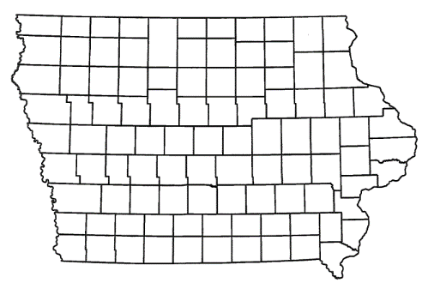
List of Local Development Applications Recommended
PROJECT NAME
SPONSOR
SCORE
TOTAL PROJECT COST
PERCENT PARTICIPATION
RECOMMENDED AMOUNT
Roadway improvements to Newell Street, including a left-turn lane. | Waterloo | 52 | $937,500 | 50% | $468,750

Slide 6
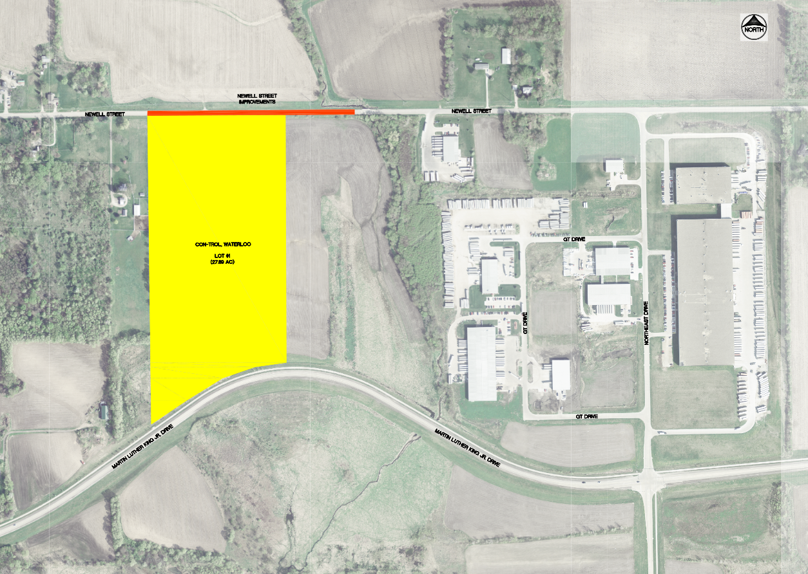
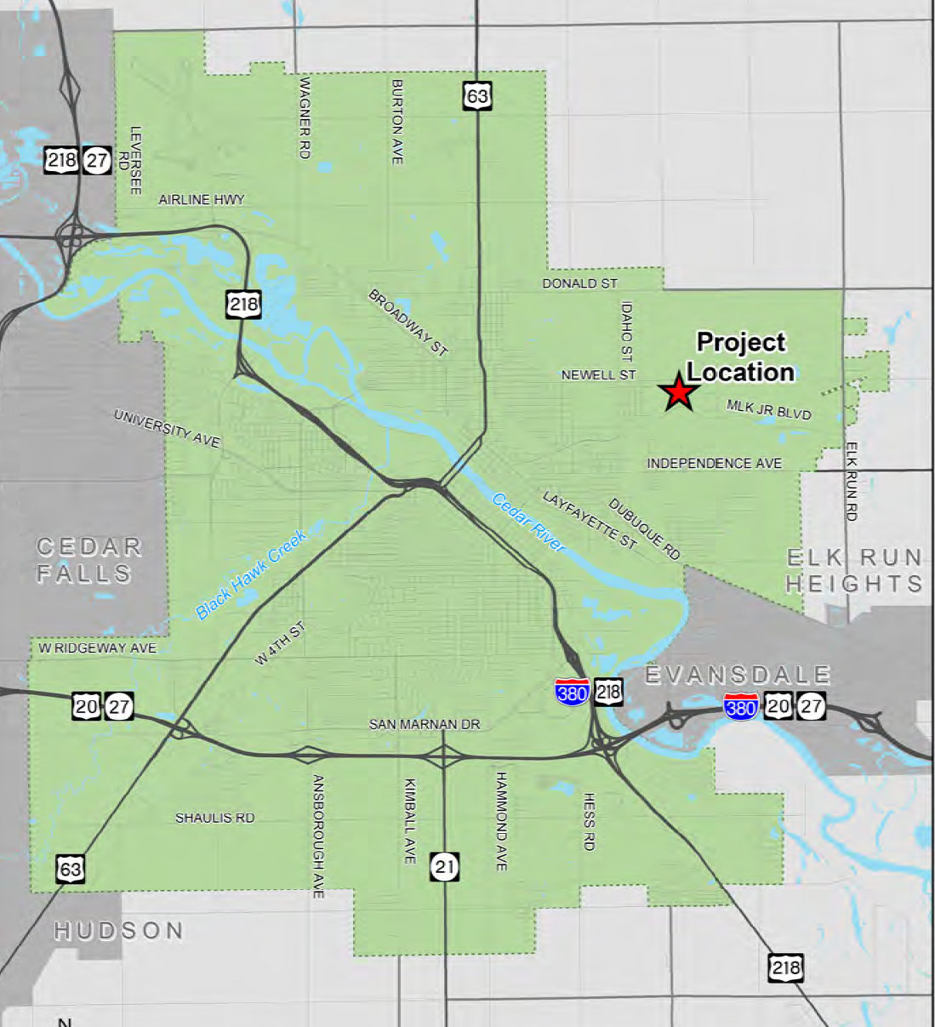
Waterloo
(Local Development)
Roadway improvements to Newell Street, including a left-turn lane, located on the northeast side of town. This project is necessary to provide improved access to more than 27 acres for industrial purposes.
Total Cost: $937,500
Requested: $468,750 (50%)

Slide 7
Immediate Opportunity Project Evaluation Criteria
Growth Potential
Average wages meet at least 100% laborshed wage
Quality of Jobs
No pattern of violations
In-state suppliers
Impact on import substitution
Few Iowa competitors
Operating expenditures spent in Iowa
Out-of-state sales
Hiring preferences to Iowa residents

Slide 8
List of Immediate Opportunity Applications Recommended
PROJECT NAME
SPONSOR
JOBS
TOTAL PROJECT COST
PERCENT PARTICIPATION
RECOMMENDED AMOUNT
Paving of approximately 5,280 feet of Union Avenue. | Butler County | 78 | $1,157,500 | 80% | $926,000
Paving of approximately 2,733 feet of 300th Street, 5,286 feet of Kiwi Avenue and 7,557 feet of 290th Street. | Washington County | 25 | $2,250,480 | 80% | $250,000

Slide 9
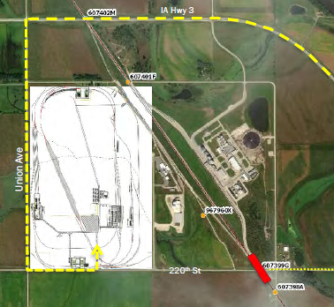
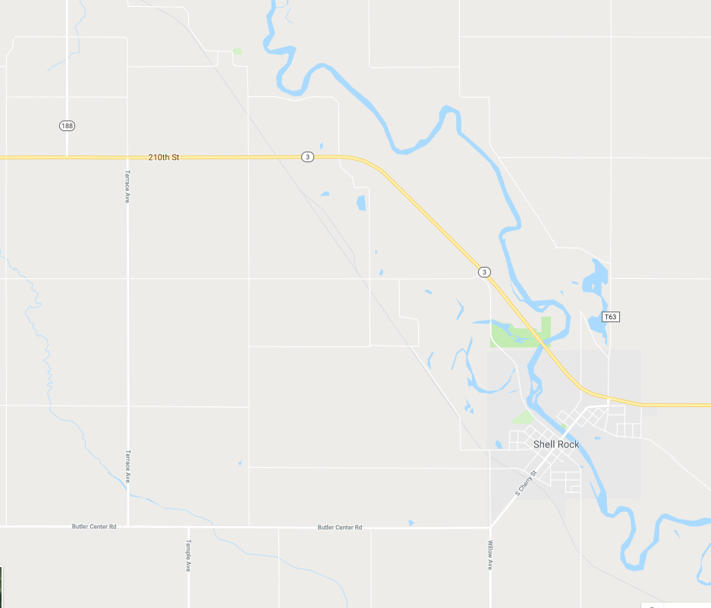
Butler County
(Immediate Opportunity)
Paving of approximately 5,280 feet of Union Avenue located northwest of Shell Rock. This improvement is necessary to provide improved access to the proposed site of TrinityRail Maintenance Services Inc., a railcar manufacturing and maintenance facility.
Total Cost: $1,157,500
Requested: $926,000 (80%)
Jobs Created: 78
RISE Cost/Job Assisted: $11,871.79
Capital Investment/RISE $: $71.27
Company Average Wages: $20.00
(112% of laborshed)

Slide 10
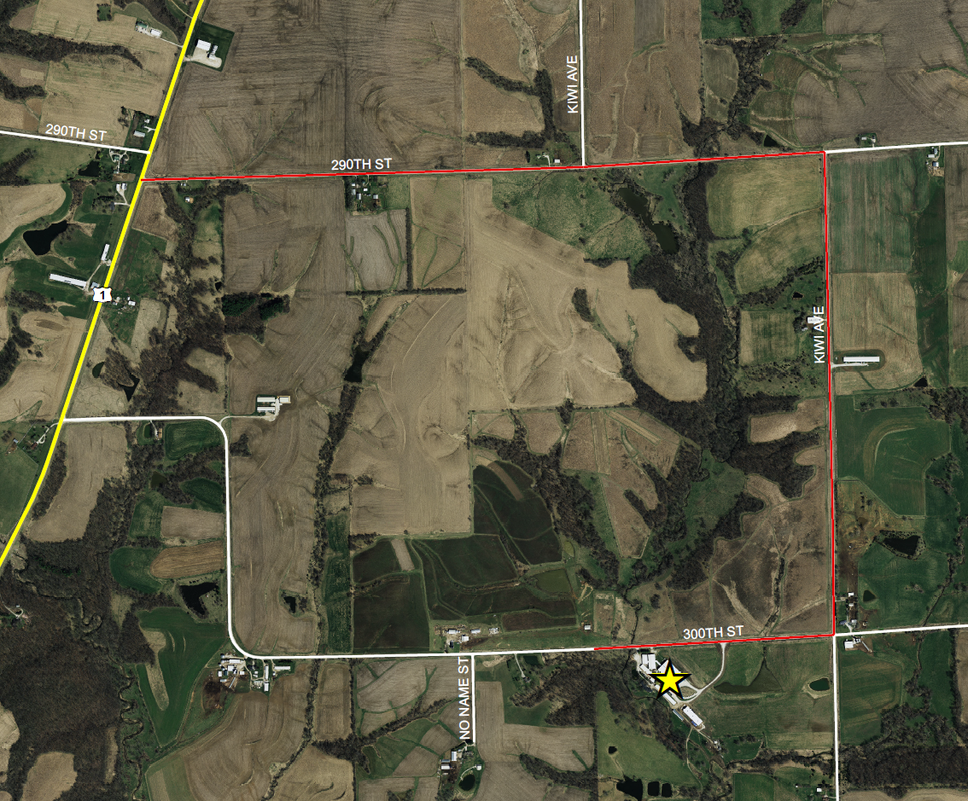
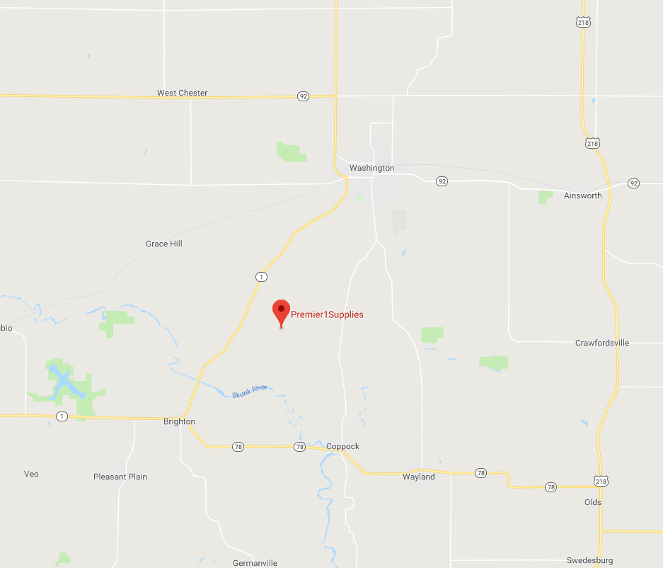
Washington County
(Immediate Opportunity)
Paving of approximately 2,733 feet of 300th Street, 5,286 feet of Kiwi Avenue and 7,557 feet of 290th Street located southwest of Washington. This improvement is necessary to provide improved access to the proposed expansion of Premier 1 Supplies, an importer and distributor of high-end supplies and equipment for farms.
Total Cost: $2,250,480
Requested: $250,000 (11%)
Jobs Created: 25
RISE Cost/Job Assisted: $10,000.00
Capital Investment/RISE $: $26.00
Company Average Wages: $18.41
(106% of laborshed)

Slide 11

QUESTIONS?
Craig Markley, Systems Planning Bureau
craig.markley@iowadot.us
515-239-1027

