Slide 1
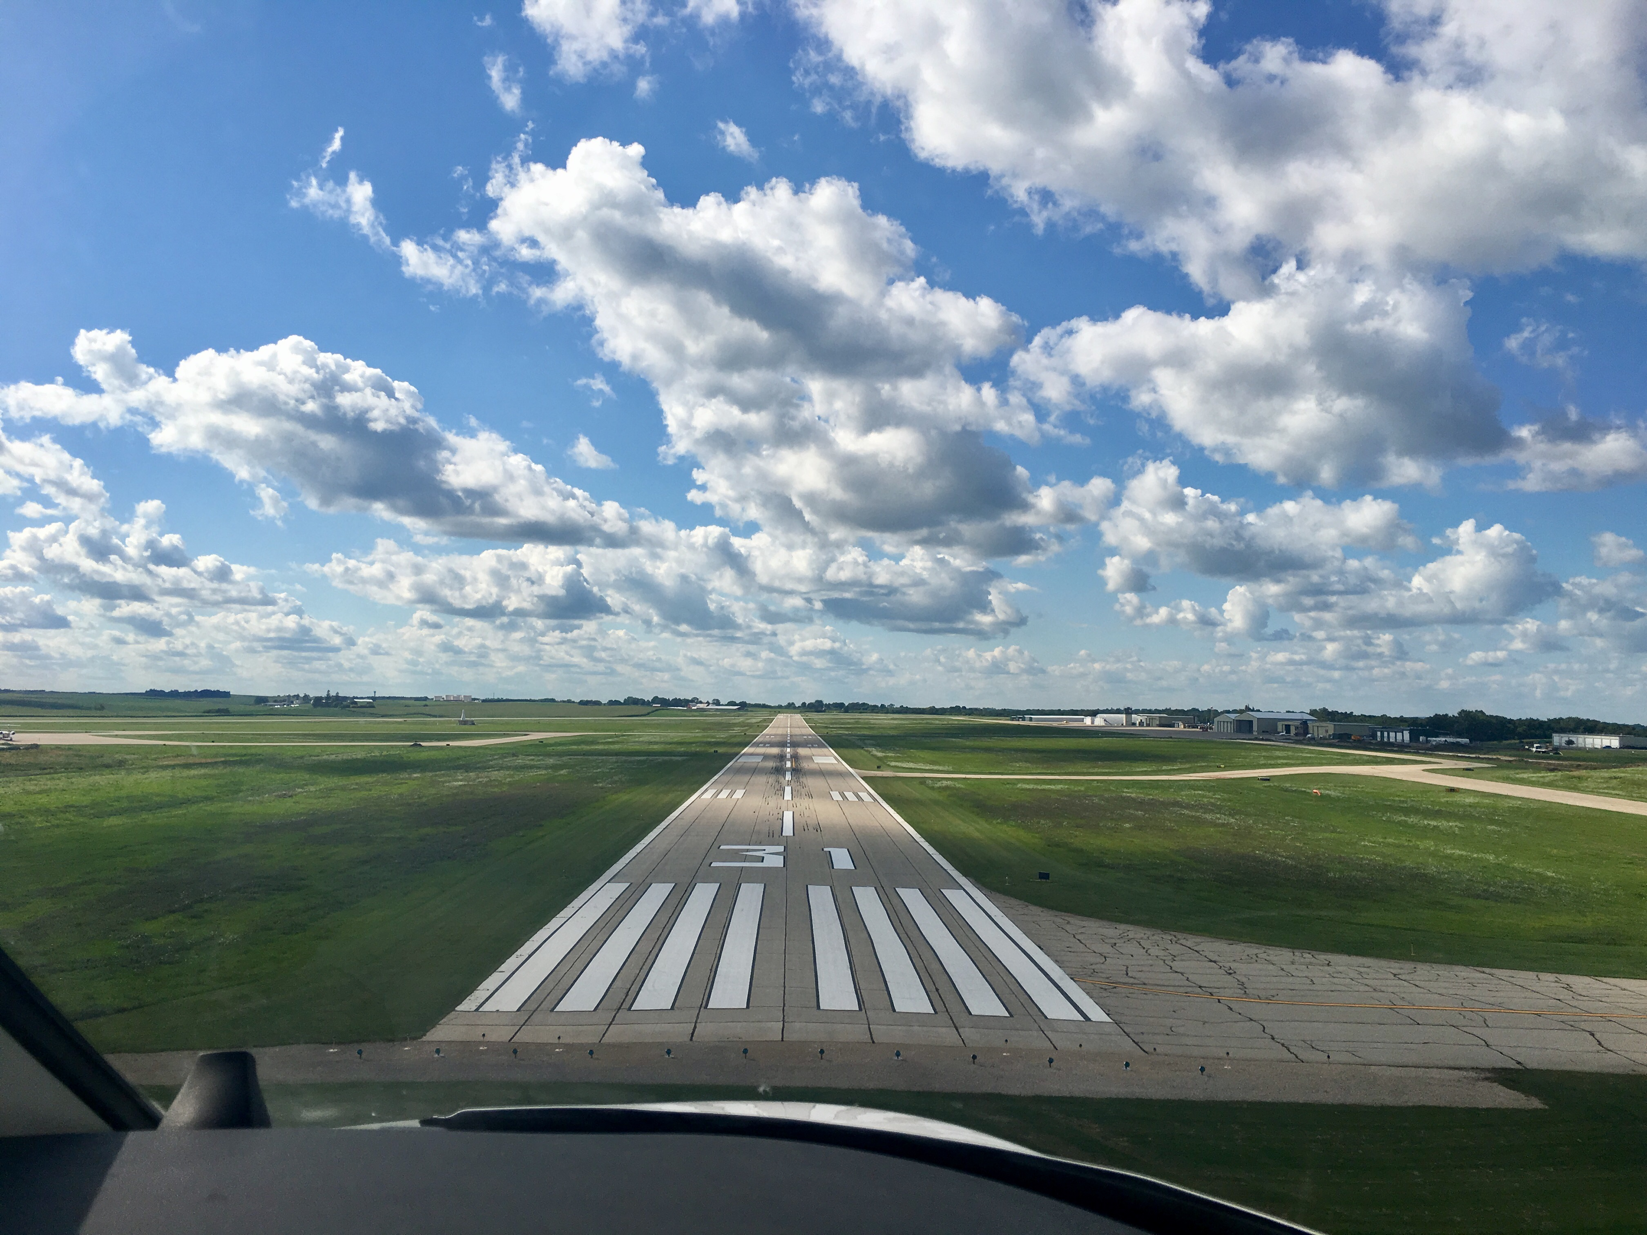

FY20 State Aviation Program
Funding Recommendation

Slide 2
State Aviation Program - AIP
Includes Airport Improvement Program (AIP)
Public-owned airport sponsors may apply for grants to assist in the preservation and development of the airfield and related infrastructure.
Eligible projects are funded up to 85% and generally include planning and improvements related to enhancing airport safety, capacity, security and environmental concerns.

Slide 3
Project Evaluation Criteria
Airport Role (5-20 Points)
Local participation (5-30 Points)
Multi-jurisdictional support (0-10 Points)
Type of project (5-30 Points)
Justification (5-20 Points)

Slide 4
Available Funding and Application Summary
Available Funding:
  FY20 Funds Available: $4,503,536
  Aviation Safety Programs: $ 546,040
  Aviation Development Programs: $ 523,000
  Funds awarded: $3,434,496
Application Summary:
  Total number of projects: 35
  Total project costs: $10,323,712
  Total amount requested: $5,818,430

Slide 5
List of Applications Recommended
PROJECT NAME | SPONSOR | SCORE | TOTAL PROJECT COST | REQUESTED AMOUNT (% of Total Project Cost) | RECOMMENDED AMOUNT (% of Total Project Cost)
Rehabilitate Taxiway A | Sioux Gateway Airport | 90 | 3,294,000 | 425,000 (13%) | 425,000 (13%)
Install Airport Beacon | Des Moines International Airport | 90 | 138,500 | 55,400 (40%) | 55,400 (40%)
Reconstruct Taxilane | Southeast Iowa Regional Airport | 90 | 125,080 | 28,318 (23%) | 28,318 (23%)
Update Zoning Ordinance | Southeast Iowa Regional Airport | 80 | 30,000 | 25,000 (83%) | 25,000 (83%)
Construct Hangar Taxilane Grading | Mason City Municipal Airport | 75 | 240,000 | 168,000 (70%) | 168,000 (70%)
Terminal and Hangar Site Improvements | Marshalltown Municipal Airport | 70 | 400,000 | 320,000 (80%) | 320,000 (80%)
Widen Taxiway | Fort Dodge Regional Airport | 70 | 251,500 | 196,000 (78%) | 196,000 (78%)
Fuel System Upgrade | Red Oak Municipal Airport | 70 | 172,500 | 129,375 (75%) | 129,375 (75%)
Hangar Site Improvements | Forest City Municipal Airport | 70 | 95,000 | 71,250 (75%) | 71,250 (75%)
Prepare Airport Layout Plan | Mount Ayr Municipal Airport | 70 | 30,000 | 21,000 (70%) | 9,000 (70%)
3 Stall hangar Approach Paving | Algona Municipal Airport | 70 | 65,000 | 48,750 (75%) | 48,750 (75%)
Construct Support Pavement at air cargo racility | The Eastern Iowa Airport | 65 | 433,670 | 368,619 (85%) | 368,619 (85%)
Reconstruct North Apron | Clinton Municipal Airport | 65 | 420,500 | 357,425 (85%) | 357,425 (85%)
Reconstruct Apron and Taxiway | Iowa City Municipal Airport | 65 | 370,700 | 315,095 (85%) | 315,095 (85%)
Apron Improvements | Ottumwa Regional Airport | 65 | 350,000 | 297,500 (85%) | 297,500 (85%)
Fuel Facility Improvements | Iowa Falls Municipal Airport | 65 | 130,000 | 104,000 (80%) | 104,000 (80%)
Construct 6 Unit T-Hangar Taxilanes | Shenandoah Regional Airport | 65 | 120,000 | 90,000 (75%) | 90,000 (75%)
Runway Overlay | Milford Municipal Airport | 60 | 285,862 | 230,862 (81%) | 230,862 (81%)
Obstruction Removal | Waverly Municipal Airport | 60 | 174,150 | 148,027 (85%) | 148,027 (85%)
Reconstruct Apron | Waukon Municipal Airport | 60 | 46,500 | 34,875 (75%) | 34,875 (75%)
Jump to applications not recommended for funding

Slide 6
State Aviation Program - GAVI
General Aviation Vertical Infrastructure(GAVI)
Public owned general aviation airport sponsors may apply for projects that include landside development and renovation of airport terminals, hangars, maintenance buildings, and fuel facilities.
Eligible projects are funded up to 85%
Funds are subject to annual appropriation

Slide 7
Project Evaluation Criteria
Airport Role (5-20 Points)
Local participation (5-30 Points)
Multi-jurisdictional support (0-10 Points)
Type of project (10-30 Points)
Justification (5-20 Points)

Slide 8
Available Funding and Application Summary
Available Funding:
  FY20 Funds Appropriated: $1,000,000
  Underrun: $ 185,110
  Funds awarded: $1,185,110
Application Summary:
  Total number of projects: 19
  Total project costs: $4,397,190
  Total amount requested: $2,060,030

Slide 9
List of GAVI Applications Recommended
PROJECT NAME | SPONSOR | SCORE | TOTAL PROJECT COST | REQUESTED AMOUNT (% of Total Project Cost) | RECOMMENDED AMOUNT (% of Total Project Cost)
Construct New Hangar | Carroll - Arthur N Neu | 95 | 600,000 | 150,000 (25%) | 150,000 (25%)
Terminal Building Improvements | Marshalltown Municipal Airport | 90 | 1,050,000 | 150,000 (14%) | 150,000 (14%)
3 Stall Hangar Extension | Algona Municipal Airport | 85 | 360,000 | 150,000 (42%) | 150,000 (42%)
Hangar Rehabilitation | Atlantic Municipal Airport | 85 | 168,750 | 75,000 (44%) | 75,000 (44%)
Construct T-Hangar | Knoxville Municipal Airport | 80 | 300,000 | 150,000 (50%) | 150,000 (50%)
Hangar Building | Forest City Municipal Airport | 80 | 55,000 | 30,250 (55%) | 30,250 (55%)
Construct 6 Unit T-Hangar | Shenandoah Regional Airport | 75 | 250,000 | 150,000 (60%) | 150,000 (60%)
Fuel Facility Expansion | Iowa City Municipal Airport | 75 | 177,900 | 150,000 (84%) | 150,000 (84%)
New Fuel Facility | Perry Municipal Airport | 75 | 149,800 | 104,860 (70%) | 104,860 (70%)
Install Hangar Doors | Harlan Municipal Airport | 75 | 101,140 | 75,000 (74%) | 75,000 (74%)
Jump to applications not recommended for funding

Slide 10
State Aviation Program - CSVI
The Commercial Service Vertical Infrastructure (CSVI) program provides funding for landside development and renovation of terminals, hangars, maintenance buildings, and fuel facilities at commercial service airports.
Appropriated funds are distributed to the commercial service airports by a 50/40/10 formula with no local match required.

Slide 11
Available Funding and Application Summary
Available Funding:
  FY20 Funds Appropriated: $1,900,000
  Funds awarded: $1,900,000
Application Summary:
  Total number of projects: 8
  Total project costs: $28,444,390
  Total amount requested: $1,900,000

Slide 12
List of CSVI Applications Recommended
PROJECT NAME | SPONSOR | SCORE | TOTAL PROJECT COST | REQUESTED AMOUNT (% of Total Project Cost) | RECOMMENDED AMOUNT (% of Total Project Cost)
South Quadrant FBO Site Development | Des Moines International Airport* |  | 11,312,438 | 727,692 | 727,692
Equipment Wash Facility | Dubuque Regional Airport* |  | 500,000 | 134,372 | 134,372
Renovate Hangars and AFSS Building, Construct Hangar A and IT Room | Fort Dodge Regional Airport |  | 125,000 | 121,513 | 121,513
Terminal Upgrades and Roadway Lighting | Mason City Municipal Airport* |  | 231,000 | 121,653 | 121,653
Terminal and Hangar Repair | Sioux Gateway Airport |  | 155,000 | 134,923 | 134,923
Terminal Upgrades | Southeast Iowa Regional Airport |  | 121,752 | 121,752 | 121,752
Air Cargo Logistics Facility | The Eastern Iowa Airport |  | 15,866,250 | 408,752 | 408,752
Hangar and Terminal Improvements | Waterloo Regional Airport |  | 132,950 | 129,342 | 129,342
* Airports requesting to use funds from previous years on FY20 projects

Slide 14

QUESTIONS?
Shane Wright
Aviation Program Manager
Shane.Wright@iowadot.us

Slide 15
List of AIP Applications Not Recommended
PROJECT NAME | SPONSOR | SCORE | TOTAL PROJECT COST | REQUESTED AMOUNT (% of Total Project Cost) | RECOMMENDED AMOUNT (% of Total Project Cost)
Taxiway C Shoulder | Sioux Gateway Airport | 70 | 385,000 | 308,000 (80%) | 0
Develop Instrument Approach Procedure | Marion Municipal Airport | 65 | 128,750 | 90,125 (70%) | 0
Underground Fuel Storage Tank Removal | Davenport Municipal Airport | 60 | 350,000 | 150,000 (43%) | 0
Jet A Fueling Facility | Forest City Municipal Airport | 60 | 254,000 | 215,900 (85%) | 0
Security Gate Improvements | Northeast Iowa Regional Airport | 60 | 130,000 | 104,000 (80%) | 0
Replace Airport Lighting | Mount Ayr Municipal Airport | 60 | 90,200 | 63,140 (70%) | 0
Jet A Fuel System Replacement | Oelwein Municipal Airport | 60 | 193,400 | 164,390 (85%) | 0
Regrade and Improve Drainage to Runway 18/36 | Pocahontas Municipal Airport | 60 | 179,520 | 152,592 (85%) | 0
Hangar 802 Refurbishment | Sioux Gateway Airport | 55 | 510,000 | 408,000 (80%) | 0
Replace Beacon Pole And Terminal Area Lighting | Pocahontas Municipal Airport | 55 | 181,575 | 154,338 (85%) | 0
Drainage Improvements | Le Mars Municipal Airport | 50 | 61,130 | 51,960 (85%) | 0
SRE Building Design and Site Improvements | Sioux Gateway Airport | 50 | 275,000 | 220,000 (80%) | 0
Automated Weather Observation System | Marion Municipal Airport | 45 | 325,725 | 228,007 (70%) | 0
Parking Lot Expansion | Iowa City Municipal Airport | 45 | 74,050 | 62,942 (85%) | 0
Jump to applications recommended for funding

Slide 16
List of GAVI Applications Not Recommended
PROJECT NAME | SPONSOR | SCORE | TOTAL PROJECT COST | REQUESTED AMOUNT (% of Total Project Cost) | RECOMMENDED AMOUNT (% of Total Project Cost)
Construct New Hangar | Sibley Municipal Airport | 70 | 233,500 | 150,000 (64%) | 0.00
Rehabilitate Hangar Doors | Vinton Veterans Municipal Airport | 70 | 85,000 | 68,000 (80%) | 0.00
Terminal Building Exterior Rehabilitation | Spencer Municipal Airport | 70 | 80,000 | 64,000 (80%) | 0.00
Upgrage Fuel System | Emmetsburg Municipal Airport | 70 | 80,000 | 60,000 (75%) | 0.00
Fuel System Improvement | Washington Municipal Airport | 65 | 176,000 | 149,000 (85%) | 0.00
Hangar Repairs | Mount Ayr Municipal Airport | 65 | 74,600 | 52,220 (70%) | 0.00
Exterior Maintenance Building Renovation | Davenport Municipal Airport | 65 | 96,500 | 48,250 (50%) | 0.00
Modify Bulk Hangar Building | Waverly Municipal Airport | 50 | 184,000 | 150,000 (82%) | 0.00
SRE Building Addition | Sioux County Regional Airport | 50 | 157,000 | 133,450 (85%) | 0.00
Jump to applications recommended for funding

