Slide 1
Revitalize Iowa’s Sound Economy Program

Slide 2
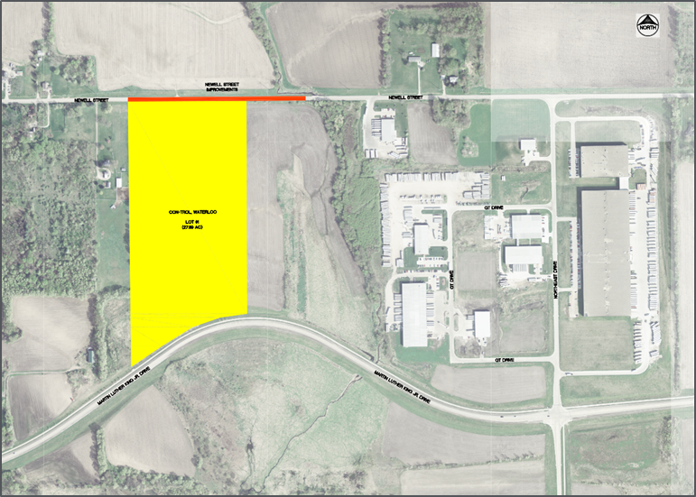
Local Development Application Recommended for Award
PROJECT NAME
SPONSOR
SCORE
TOTAL PROJECT COST
PERCENT PARTICIPATION
RECOMMENDED AMOUNT
Roadway improvements to Newell Street, including a left-turn lane. | Waterloo | 52 | $937,500 | 50% | $468,750

Slide 3
Immediate Opportunity Application Recommended for Award
PROJECT NAME
SPONSOR
JOBS
TOTAL PROJECT COST
PERCENT PARTICIPATION
RECOMMENDED AMOUNT
Paving of approximately 5,280 feet of Union Avenue. | Butler County | 78 | $1,157,500 | 80% | $926,000
RISE Cost/Job Assisted: $11,871.79
Capital Investment/RISE $: $71.27
Company Average Wages: $20.00
Percent Laborshed Wage: 112%

Slide 4
Immediate Opportunity Application Recommended for Award
PROJECT NAME
SPONSOR
JOBS
TOTAL PROJECT COST
PERCENT PARTICIPATION
RECOMMENDED AMOUNT
Paving of approximately 2,733 feet of 300th Street, 5,286 feet of Kiwi Avenue and 7,557 feet of 290th Street . | Washington County | 25 | $2,250,480 | 80% | $250,000
RISE Cost/Job Assisted: $10,000.00
Capital Investment/RISE $: $26.00
Company Average Wages: $18.41
Percent Laborshed Wage: 106%

